Slide 1
Outlook for the global energy sector and energy transitions
Oil and Gas in the context of energy security and transition – Joint TCP Workshop
Carl Greenfield, International Energy Agency
24 November 2022

Slide 2
An energy shock of unprecedented breadth and complexity
Percentage of countries with annual inflation greater than 6%
1973
oil crisis
1979
oil crisis
2022
energy crisis
100%
80%
60%
40%
20%
1970
1975
1980
1985
1990
1995
2000
2005
2010
2015
2020
Advanced economies
Emerging and developing economies
Exacerbating already tight energy markets, the Russian invasion of Ukraine has tipped the world into a global energy crisis of unprecedented breadth and complexity, affecting all countries and the vulnerable in particular

Slide 3
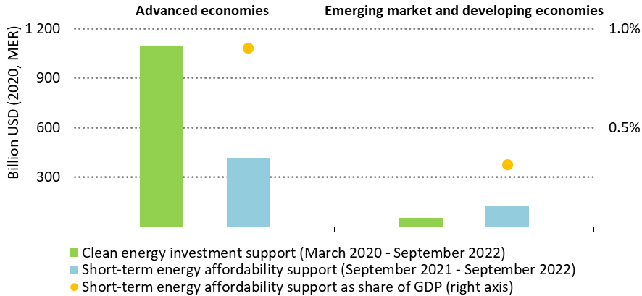
Total government outlays on sustainable recovery spending and
energy affordability support
Emergency government spending to help keep energy affordable is growing and already
half the total allocated to support clean energy investment since the pandemic

Slide 4
Government responses are fast-tracking the clean energy economy
Clean energy investment in the Stated Policies Scenario
2
Trillion
USD
(2021)
1
2015
2016
2017
2018
2019
2020
2021
2030
The US Inflation Reduction Act, the EU’s Fit for 55 package, Japan’s GX, China’s new clean energy targets and India’s solar revolution propel clean energy investment to new highs, but $4 trillion is needed by 2030 to be on track for 1.5 °C

Slide 5
Peak fossil fuel demand is coming this decade
Fossil fuel demand in the Stated Policies Scenario, 1900-2050
600
EJ
Historical
Projected
450
Oil
Oil
300
Coal
Coal
150
Natural gas
Natural gas
1900
1950
2000
2050
Today’s policy settings are now sufficiently strong that they produce a distinct peak in fossil fuel use before 2030

Slide 6
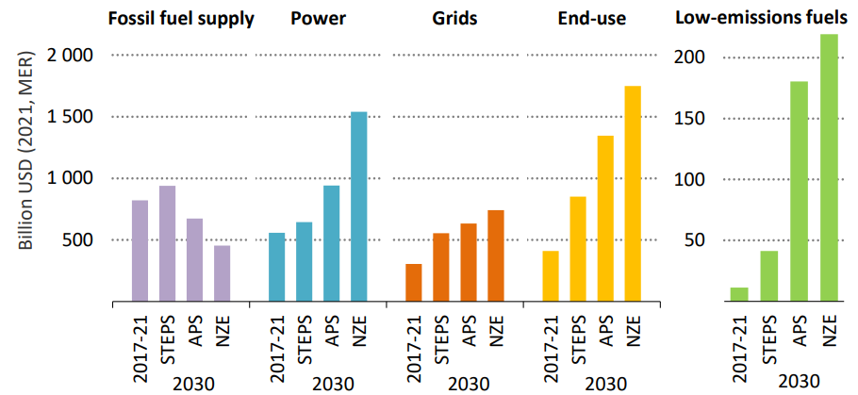
Synchronise scale-up of clean technologies with scale-down of fossil fuels
Annual average investment in fossil fuel supply, clean power, infrastructure, end-uses and low-emissions fuels by scenario
The world is not investing enough in energy. Fossil fuel investment is geared to stagnant or falling demand, while clean energy investment is not rising fast enough.

Slide 7
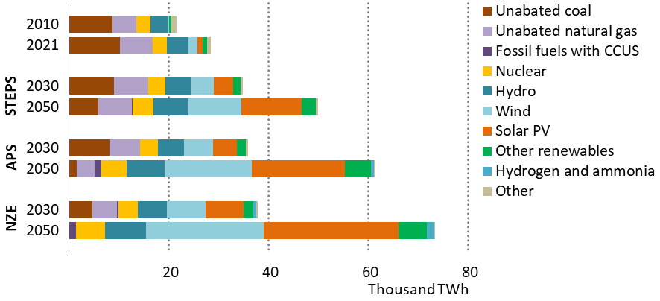
Global electricity generation by source and scenario,
2010-2050
Electricity generation from unabated fossil fuels peak by 2030, as low-emissions sources
ramp up and renewables dominate electricity supply in all scenarios by 2050

Slide 8
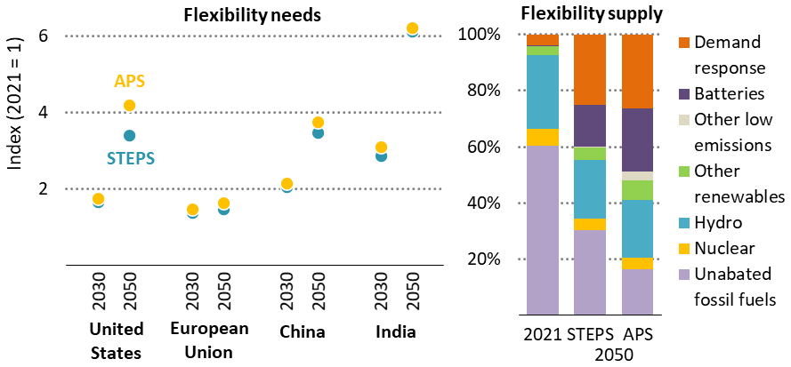
Flexibility needs and supply by region and scenario
Flexibility needs rise in all scenarios and vary substantially by country; a broad range of
technologies and approaches is required to ensure electricity security

Slide 9
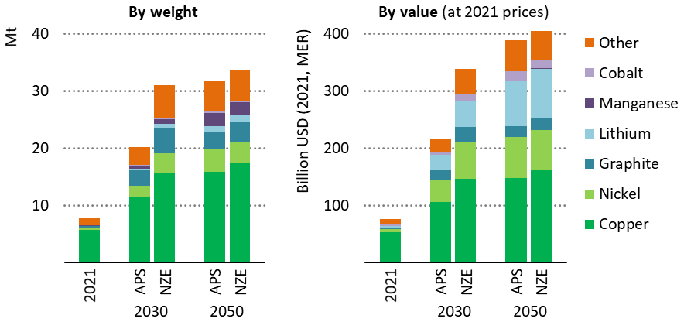
Critical mineral demand by weight and value for clean energy
technologies by scenario
Critical mineral demand for clean energy technologies quadruples already by 2050
in the NZE Scenario, with particularly high growth for EV-related minerals

Slide 10
Conclusions
Russia’s invasion of Ukraine has sparked a global energy crisis
With energy markets remaining extremely vulnerable, today’s energy shock is a reminder of the fragility and unsustainability of our current energy system.
Policy responses are fast-tracking the emergence of a clean energy economy and today’s stronger policy settings bring a fossil fuel peak into view
Led by clean electricity, some sectors are poised for a faster transformation
There needs to be a focus on affordable, secure transitions based on resilient supply chains
The energy crisis promises to be a historic turning point towards a cleaner and more secure energy system

Slide 12
Keeping the door to 1.5 °C open
Global energy related CO₂ emissions
50
Gt CO₂
Pre-Paris
baseline
40
Stated
Policies
Scenario
30
20
Announced
Pledges
Scenario
10
Net Zero
Emissions by
2050 Scenario
1990
2000
2010
2021
2030
2050
Policy and technology progress since 2015 has shaved 1 °C off projected warming, a step in the right direction;
but much more needs to be done in order to avoid severe climate disruptions

