Slide 1



Cake & Discuss
My model, your model, OUR model
Organization Committee
Sonja Kuhlmann
Marine Seignole
Oslo facilitator
Camilla Oftebro

Slide 2
Welcome to “Cake & Discuss”
TODAY:
24 March 25
My model, your model, OUR model
Past sessions:
Future sessions:
13 April 23
The Structural Framework
22 August 23
The Grid
XXX
7 November 23
The Property Model – Part1
23 April 24
The Property Model – Part2
27 August 24
The Uncertainty Study – Part1
7 November 24
The Uncertainty Study – Part2
https://www.sodir.no/en/force/archive/

Slide 3
Impulse talk topics
Working together
Ormen Lange static-dynamic handover
Maria Phase 2 Projects: How We Use Ensembles Before and During Drilling

Slide 4
Impulse talk 1

Slide 5
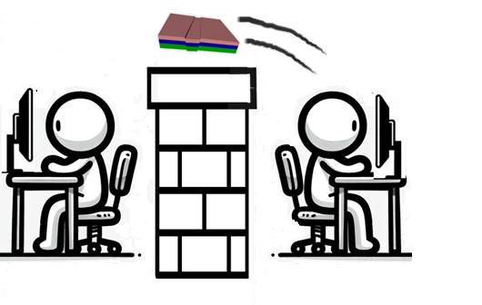


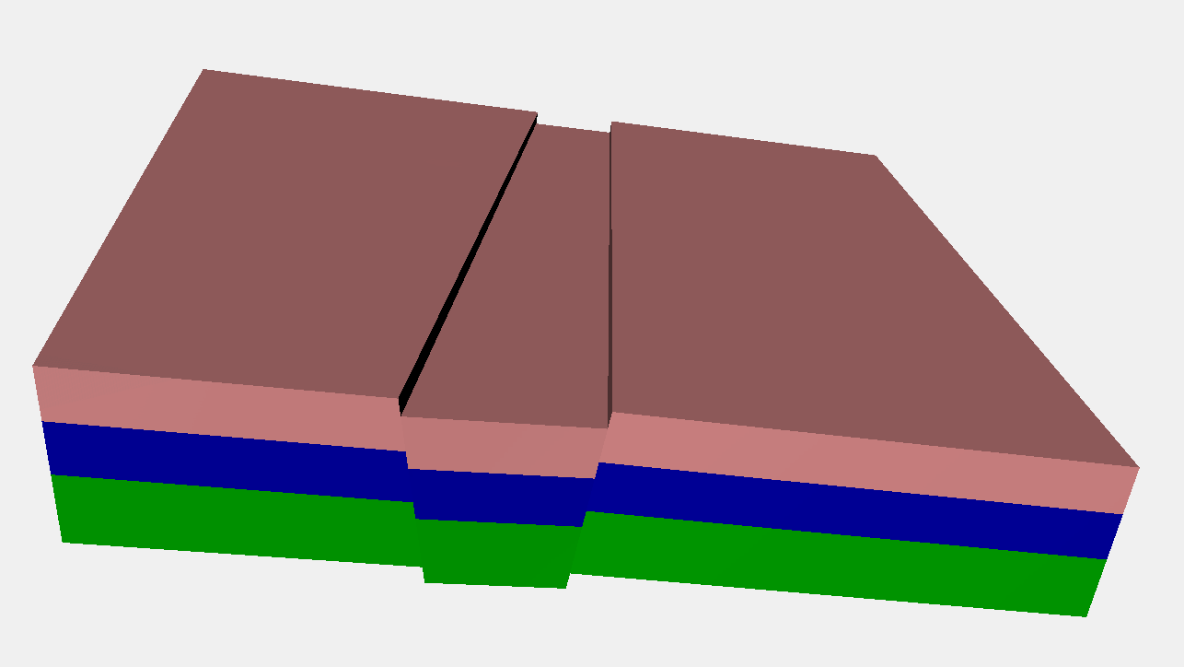
How do we work together?

Slide 6
How do we work together?
Do you think the way we work together influences the final product?
  How are you organized? E.g. multidisciplinary asset teams, groups by discipline, …
  Do you share an office, do you need to go over to each other? Do you have collaboration spaces?
  Do you work more sequential, more in feedback loops?
  What background has you manager?
  What is your ideal set-up?

Slide 7
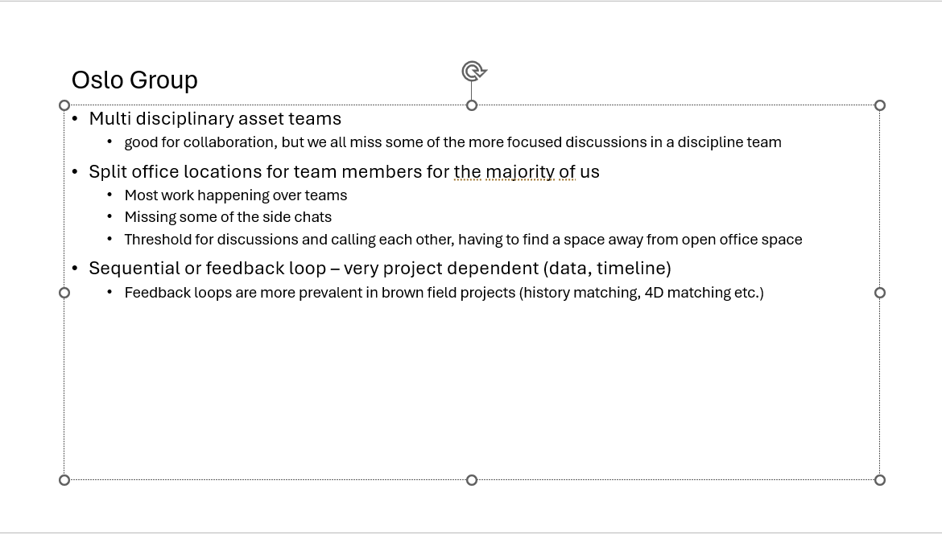

Slide 8
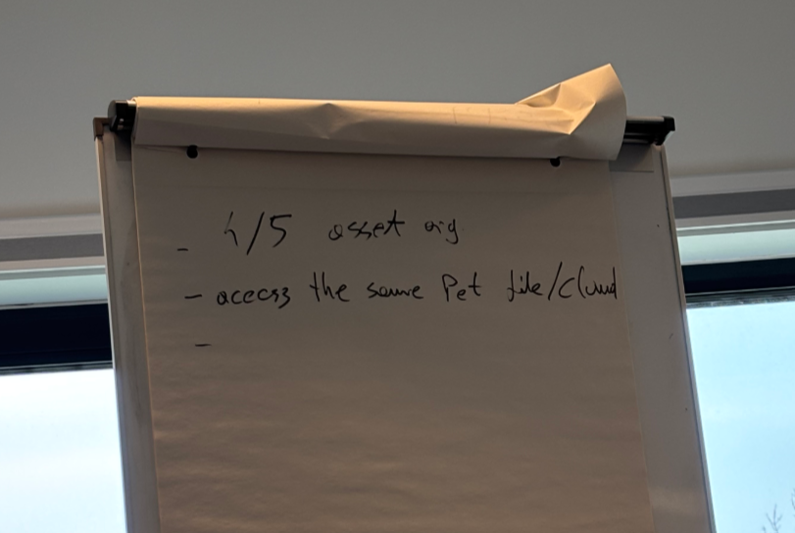

Slide 9
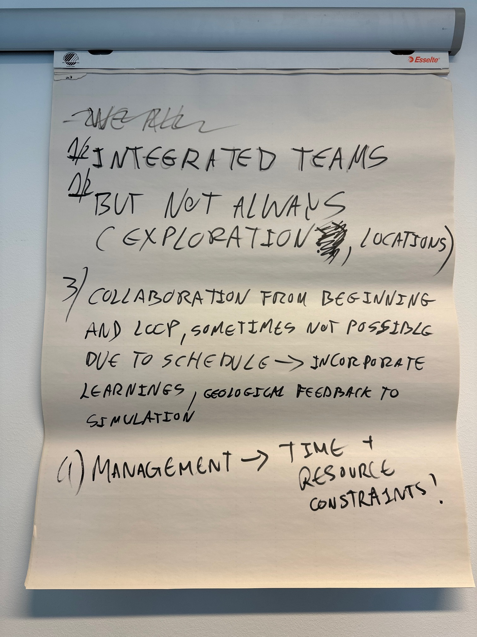

Slide 10
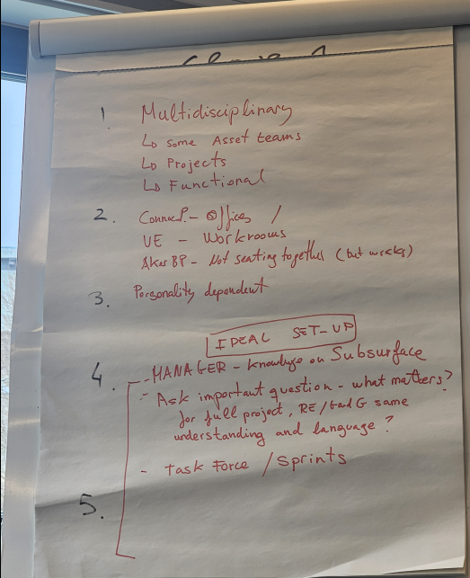

Slide 11
Impulse talk 2

Slide 12
Questions to mull over
Topic | Questions
4D FWL | How to update understanding or model based on this uncertain information? Should the range be widened?
Faults vs flexure | How to implement this update in our models? How to communicate understanding of fault behavior (e.g. baffling)?
HM learnings | When might a dynamic output be rejected as being “too different”? (does this differ in brownfield vs greenfield?) - Do we request the REs to “try again”?! ☺ Should we update anything in the static model? When do you revisit input data?
Questions
How best to upscale? (Advantages vs disadvantages)
When do you start the process of dynamic modelling?
Is there such a thing as “handover”?
What inputs does each discipline have to the other?
What is the best way to maintain an integrated “joint understanding”?
CONFIDENTIAL

Slide 13
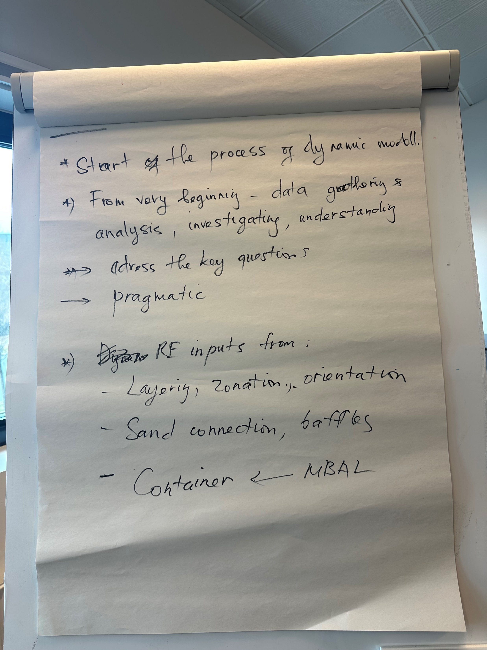

Slide 14
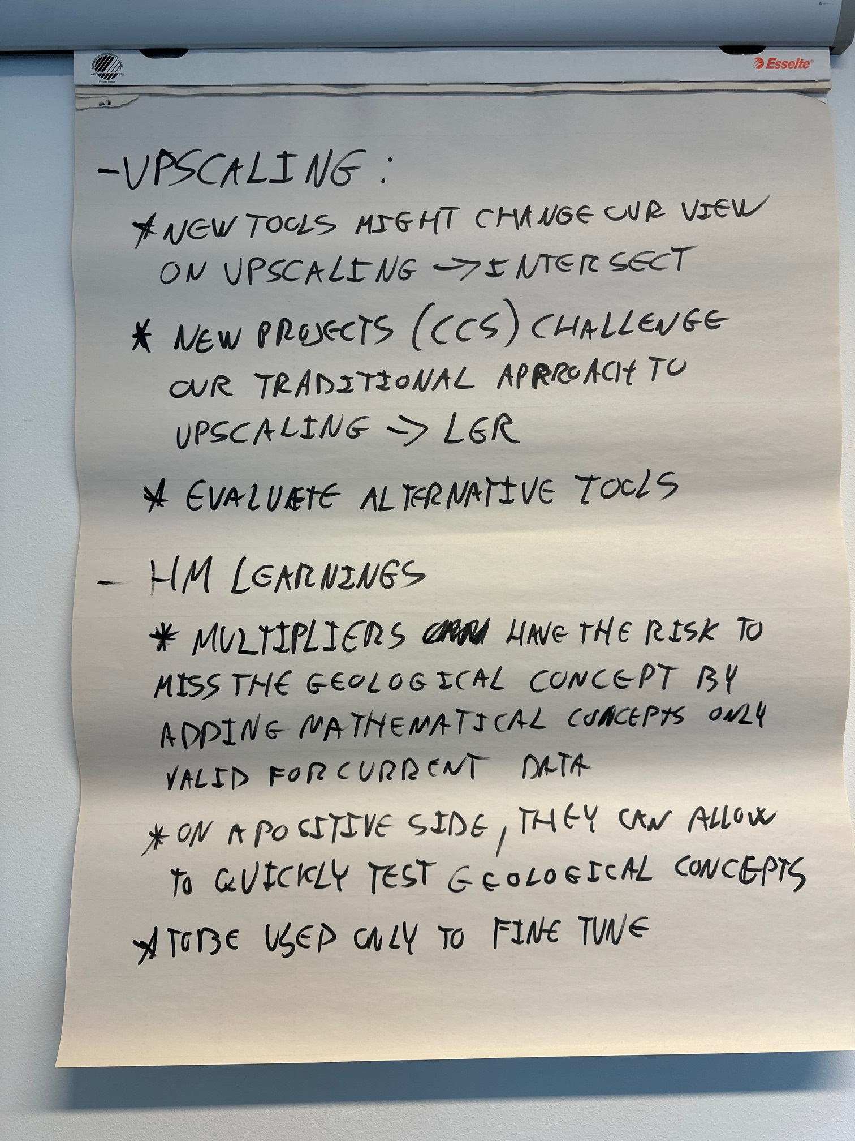

Slide 15
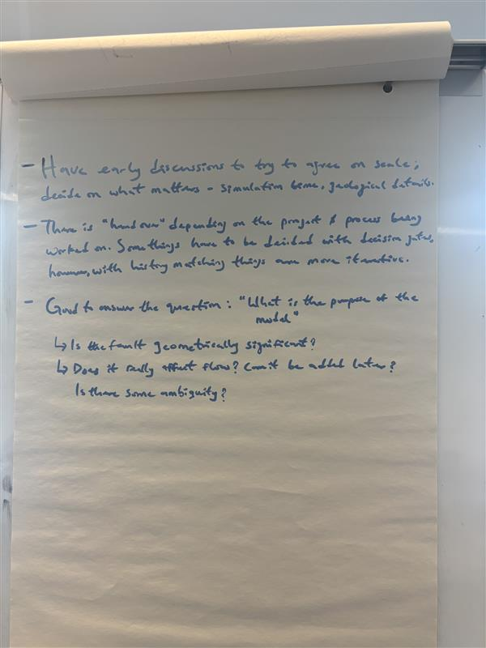

Slide 16
