Slide 1
DISKOS 2.0
The value of data – especially when it is shared
FORCE April 11 2024
Louis Vos, Assistant Director Data Management (NOD)
John Norman, Industry Solution Advisor-IMPT (Halliburton-Landmark)

Slide 2
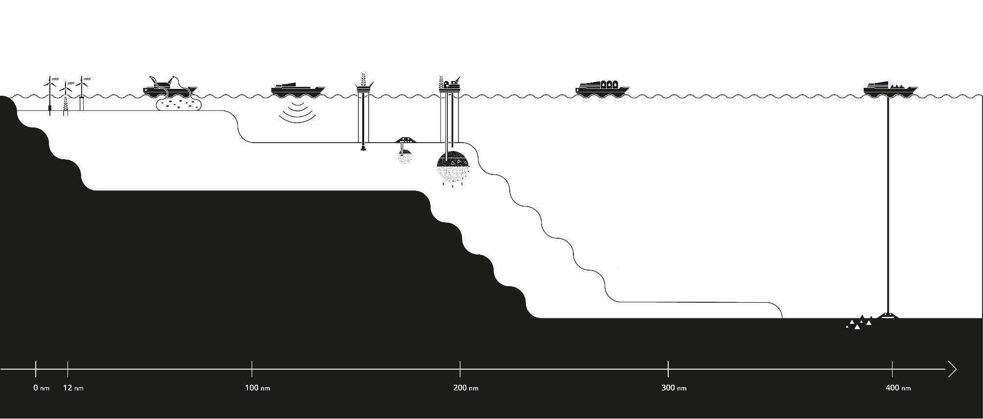
Norwegian Offshore Directorate (NOD)
SOKKELDIREKTORATET
CO-EXISTENCE
The Norwegian Continental Shelf
OFFSHORE WIND
GEOPHYISCAL SURVEYS
TRANSPORT OF PETROLEUM
SURVEYS
FISHING INDUSTRY
CO₂-STORAGE
PETROLEUM
EXPLORATION DRILLING
JORDSKORPE
The NODs primary objective: «contribute to maximizing value to society through efficient and responsible resource management»
DEEPSEA
MINERALS
Notes:
We have gotten a new name, but our main responsibility: maximizing value to society through efficient and responsible resource management” has not changed.
What has changed is our mandate, that in addition to petroleum includes CO2-storage and Deepsea mining, and one of the big topics for the future for us as an authority is co-existence and value creation on the shelf.

Slide 3

Collecting, storing and sharing data
SOKKELDIREKTORATET
The value of NOD’s data
For licensees and operators estimated annual economic return of 1.5 billion NOK in saved time, resources, innovation (Menon, 2023)
Notes:
The NPO has 4 main functions:
professional adviser to the Ministry ,
follow-up the petroleum activities
Strategic driving force and
National responsibility for the NCS data – collecting, storing and sharing data
In 2023, Menon carried out a study on our behalf, to develop a method for evaluating the effect of data sharing. One of the conclusions was that is is actually not an easy task, setting a value to data / data sharing. But through interviews and analysis concluded Menon that Licensees and operators achieve estimated annual economic return of 1.5 billion NOK in saved time, resource savings and innovation through the use of the NODs data.

Slide 4
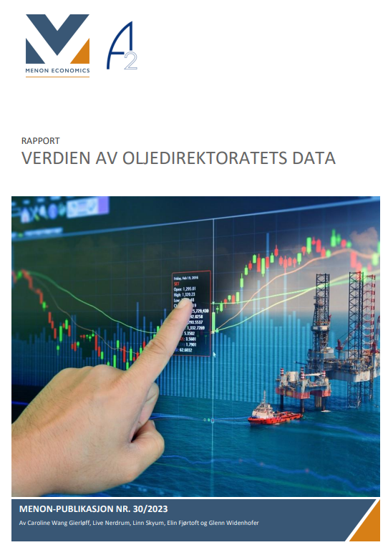
The value of the NOD’s data (Menon, 2023)
SOKKELDIREKTORATET
«NOD data: advantageous for the Norwegian petroleum Industry.»
«NOD’s data management: described by the industry as key factor to further development of the Norwegian Petroleum Industry.»
«NOD is expected to play a significant role in facilitating and contributing to a more speedy development of new industries on the continental shelf.»
Notes:
More qualitative results of the report includ that
data quality is a significant factor in discovering and developing new resources
NODs data is therefore seen as advantageous to the entire Norwegian petroleum industry
NODs datamanagement is a key factor to further development of the sector
NOD is expected to play a significant rile in facilitating a speedy development of new industries

Slide 5
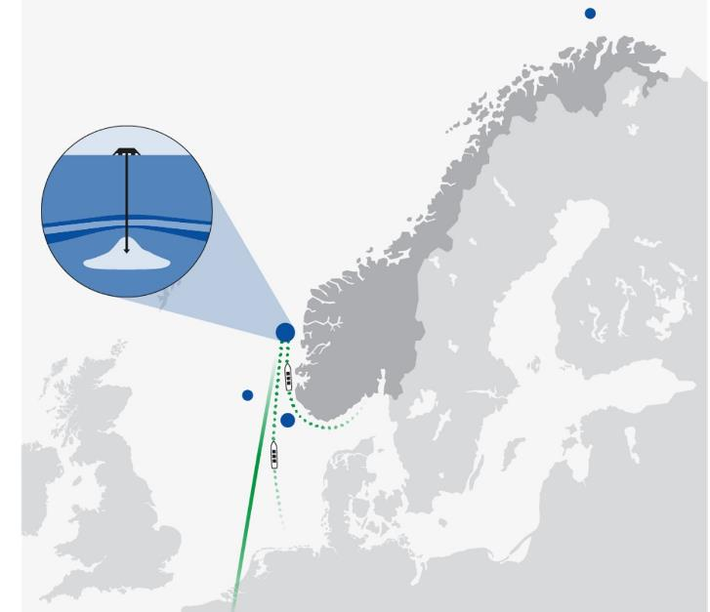
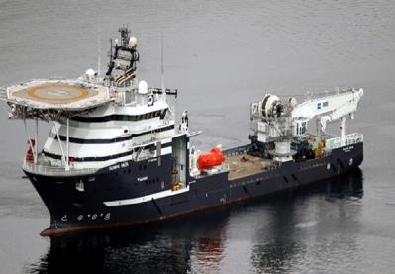
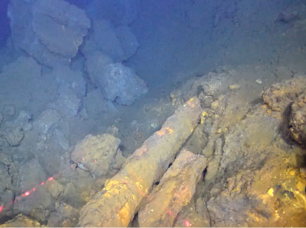
Opening the Norwegian shelf for mineral activities
SOKKELDIREKTORATET
S5
Developing a regulatory framework for new data
Growing interest in storing CO₂ on the Norwegian shelf
Mapping
Resource assessment
Impact assessment
Notes:
Just like the petroleum industry in the 60s
Considerable efforts are invested in understanding the resource potential on the Norwegian shelf
Collections /expeditions – create new data and there will be a continued need for more data collection in the years ahead
Data that will need to managed.

Slide 6

SOKKELDIREKTORATET
Value
Data quality
Structured data
Data
accessibility
Standardisation
Data completeness
Notes:
Feedback on data / data management we have collected from the industry over the past 2 years through workshops, the Menon study and a recent customer survey highlights that the dataattributes that drive value creation most are:
Standardisation
Data quality
Availability of structured data
Data completness (volume)
And, last but not least data accessibility.
I realise that the seamingly strict rules we set to reporting of the data to us can be a right pain in the backside. But since I am talking to a room full of data nerds, I think it is save to say that we all agree on that good data is the prerequisite for any good model or analysis. I won’t og into the imporantance of each of these topics, that is a presentation in itself, but I have to more slides about data accessibility and in particular DISKOS.
Standardization – make the reported data more comparable, ensure that data collected reaches the same high standard. Implement new standards in reporting to encourage industry adoption, contribute to ensuring the OSDU platform and standards will serve the needs of the NCS
Data quality – Focus on quality of reported data before adding more datasets are reported. Ensure the completeness of reportings, make sure they have sufficient resolution.
Structured data – Data reported as data, and not in report form. The ,ore structured datasets are, the easier it will be to get value out of them. Work on getting value of unstructured legcy datasets – looking forward to seeing what willl be presented here…
Data accessiblity – Make sure data is discoverable, easily accisible. Cloud solutions, OSDU enable new ways of working. Make certain datasets more available.
Data competeleness, volume

Slide 7

DISKOS a collaborative initiative
SOKKELDIREKTORATET
DISKOS NDR
NOD’s National Data Repository (NDR) for exploration and production-related information from the NCS since 1995
NOD’s external archive
System for sharing data for all DISKOS members
Data is available through secure access 24/7
Diskos is currently operated by Landmark while Kadme operates the Trade module
Companies
Authority
Vendors
DISKOS operator
NOD
Administrator
Regulator
Legal responsibility
DISKOS members
DB operation
Technology
Implementation
Use of data
Value creation
Contributers
Notes:
DISKOS is a truly collaborative initiative. It’s a consortium between
the DISKOS members/companies who use the data,
a DISKOS operator/ vendor who is responsible for the opeartion and technology
and us, the regulator or administrator who also has legal responsibility for DISKOS.
It’s worth mentioning that DISKOS is NODs external national data repository for exploration and production-related infromation from the NCS (and has been since 1995).
But the most important part is that it is build on trust between the industry and the authorities

Slide 8

DISKOS 2.0 – a digital step forward
Enable data analysis and processing
High degree of automatisation
Open API technology
Industry recognised standards
Notes:
It goes with out saying that the technology advances of recent years are exponential, and the DISKOS consortium decided therefor to take a digital step forward.
The VISION for DISKOS 2.0 was:
More data available
More time for interpretation
Increase the competiveness
Reduce the cost data storage
Reduce the cost of reporting
Reduce cost of doing QC
This was going to be achieved through
Open API technology
Virtual data rooms
OSDU compliant
Public cloud platform
Self-service data loading
Business verification rules
The realisation and implementation of that vision is an exponential learning curve in itself, and where we are at, some of the teething problems we experienced and more insights on teh technology will be presented by John form Landmark/Halliburton who are The current vendor for DISKOS.

Slide 9
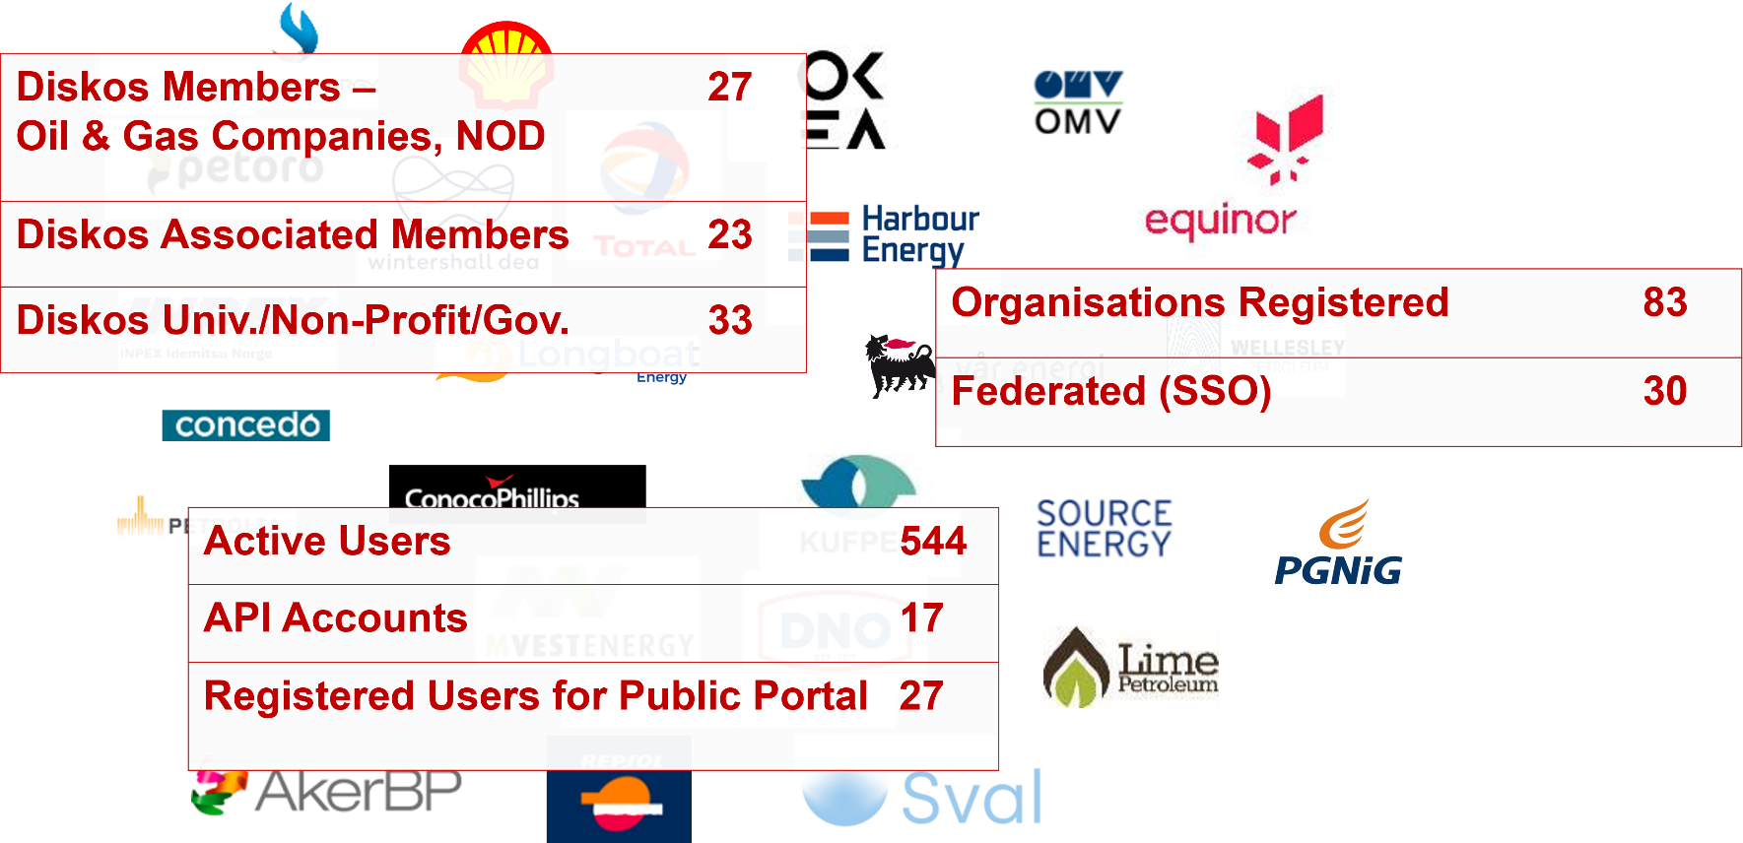
Diskos Community

Slide 10
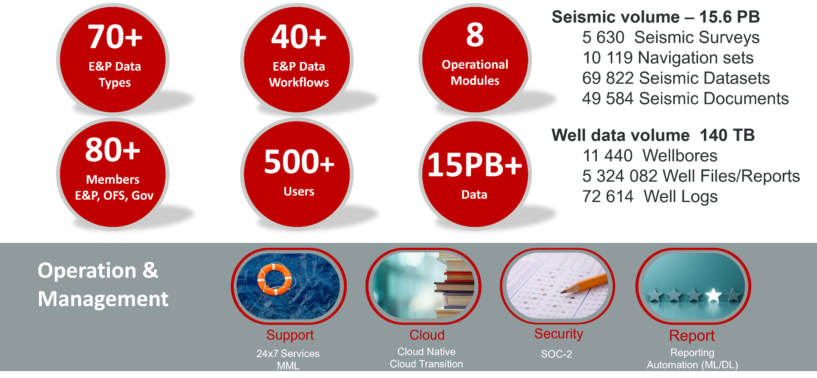
Diskos at a Glance

Slide 11
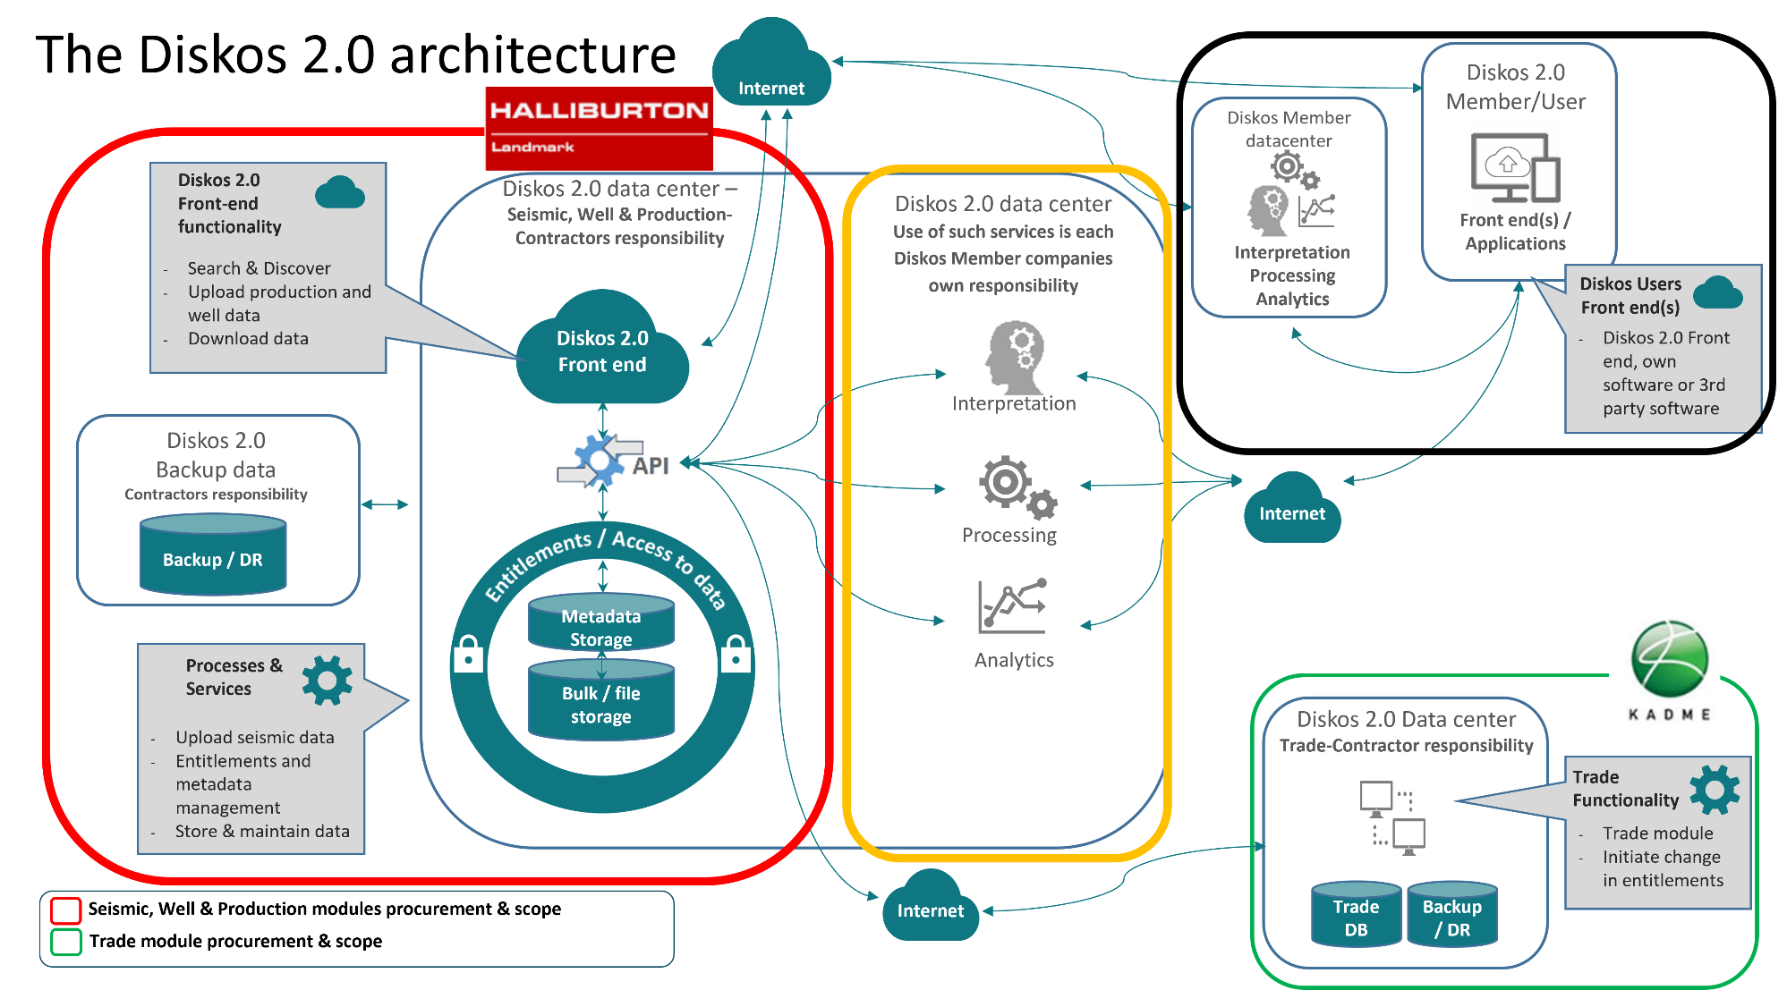

Slide 12

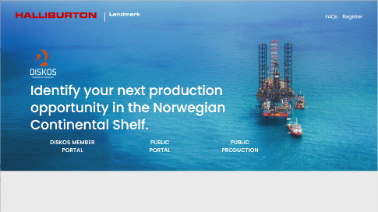
Diskos 2.0 on iEnergy®
Cloud-native solution running on Public Cloud Infrastructure
Scalable & Elastic
    Evolves and adapts changing needs
Storage with multiple tiers
Safe & Secure
    Multi-layer security
    Identity Federation
    Encryption during transport, storage and processing
    Multi-region with replication, data backups and DR
Advanced automated workflows for data ingestion, enrichment and retrieval
    Heightened focus on Data Quality and Quality Control
Open & Extensible
    Bring the data in the NDR closer to the user through advanced API's
https://www.diskos.com

Slide 13
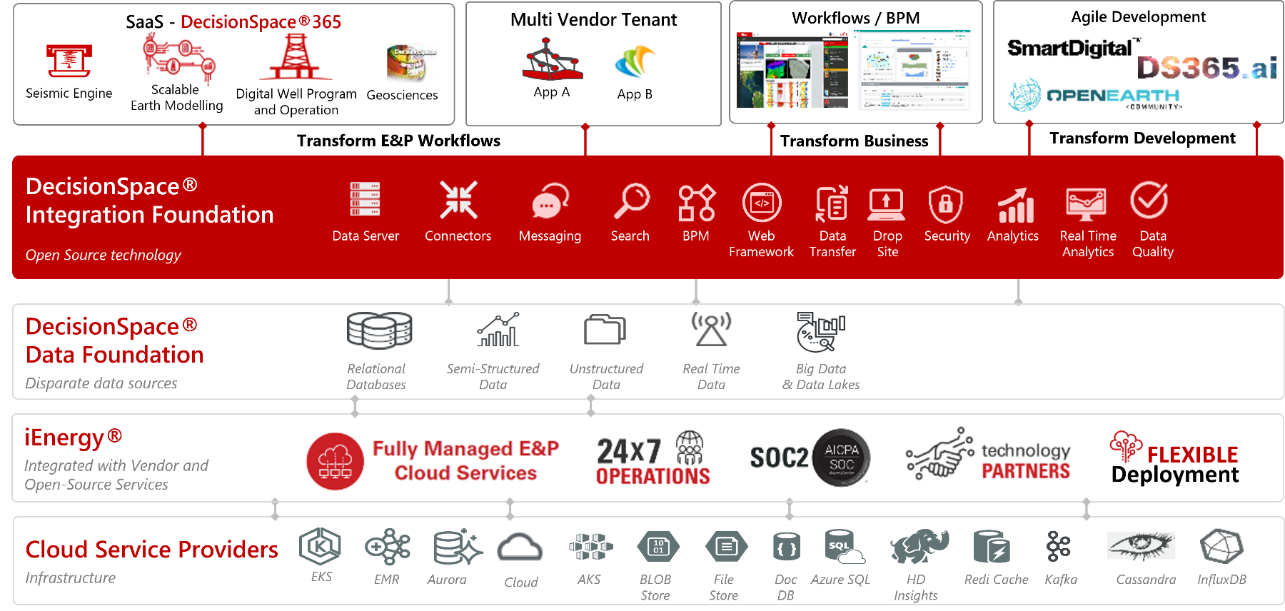
E&P Digital Platform

Slide 14
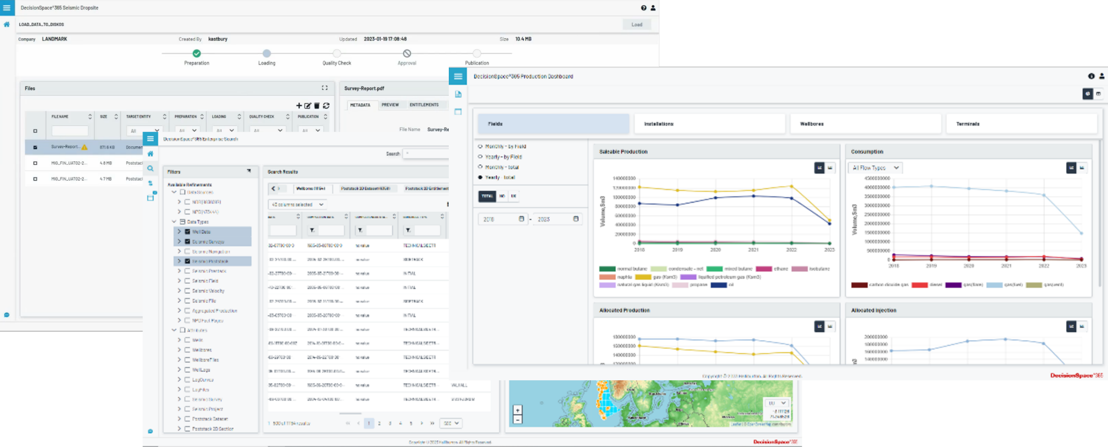
Diskos 2.0

Slide 16
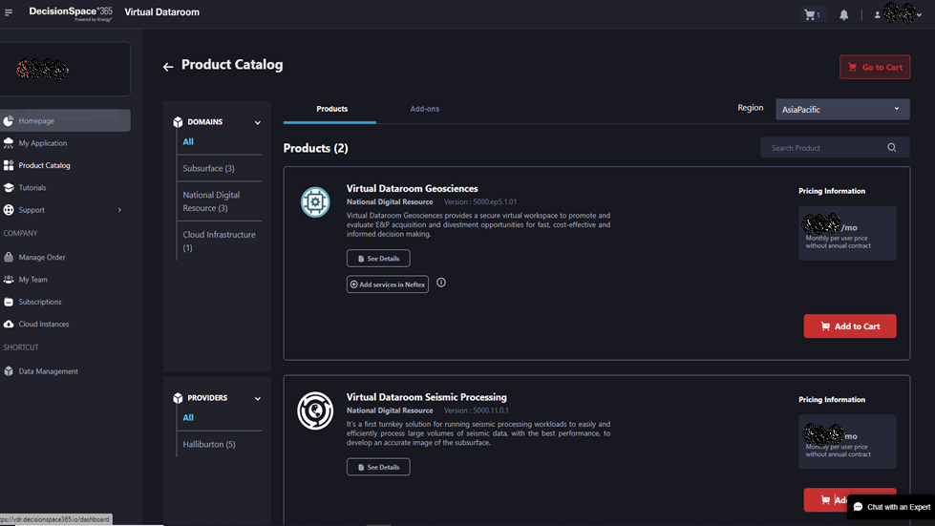
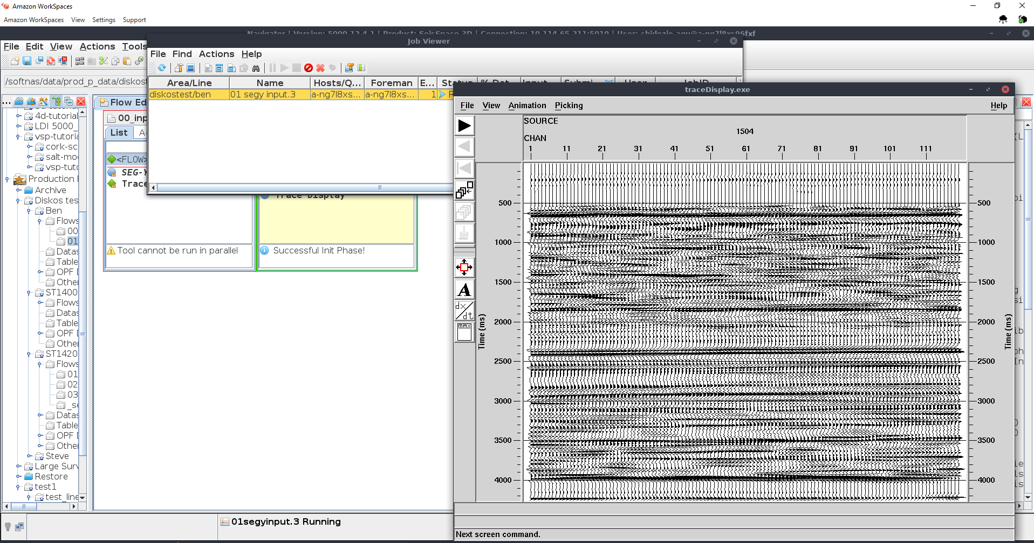




DecisionSpace®365 Essentials/VDR
Data Security
  Data is hosted in iEnergy® Cloud, which is guided by several industry-standard guidelines and best practices including ISO 27001, the NIST (National Institute of Standards and Technology) Cyber Security Framework (CSF), and SOC2
Rapid Provisioning & Configuration
  Open cloud-technology enables approved users to be onboarded in a matter of hours.
DecisionSpace® 365 SaaS
  Access to intelligent DecisionSpace® 365 cloud applications and solutions to conduct complete and comprehensive evaluations.
Dedicated Support Services.
  Access to additional services for data migration, data loading and data room workflows are available.
          Secure On-Demand,
          Multi-User Database Technology
          Industry-Leading Technology
          in the Cloud
          Resource
          Optimization
          24/7 Access
          from Anywhere

Slide 17
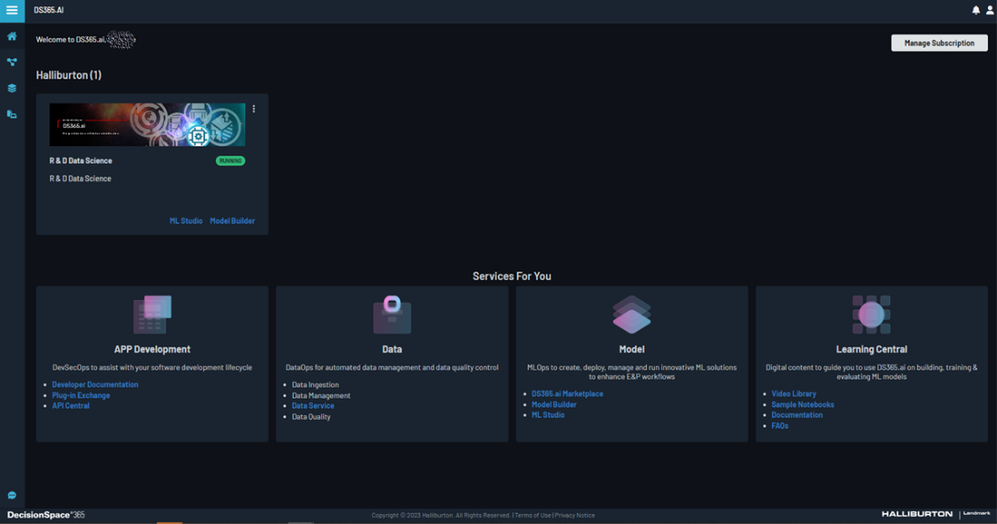
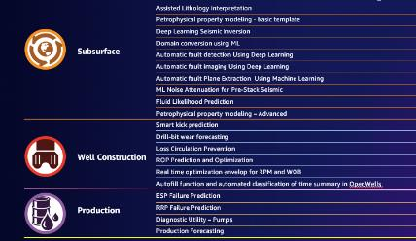




DS365.ai
DS365.ai
Unlock your data’s potential with DataOps, ModelOps and DevSecOps. Build and maintain assets’ digital twins. Manage data, develop robust applications and develop or deploy powerful AI/ML models effortlessly. Elevate subsurface interpretation, boost drilling efficiency, and achieve cost effective production.
DataOps: Streamline data management with high quality data ingestion, QC, visualization and search
ModelOps: Powerful insights from your own data
DevSecOps: Robust, faster app development
© 2024 Halliburton. All rights reserved.

Slide 18
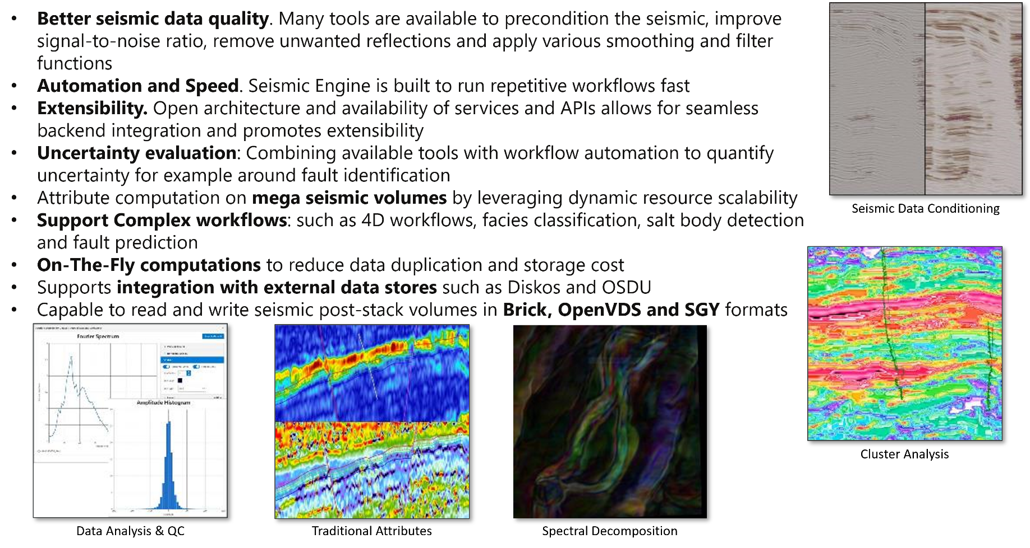
DecisionSpace®365 Seismic Engine

Slide 19
Driving value from the power of cloud technology using E&P cloud native applications. We will show the value and integration of fast & robust ways of executing E&P workflows like seismic reprocessing within minutes, AI insight in granular fault interpretations, lithology dash boards and much more.
Date: Tuesday, 30th April 2024
Time: 09:00 - 16:00
Venue: Clarion Hotel Energy.
Ishockeyveien 2, 4021 Stavanger
Seismic Processing
Seismic Engine
Dashboards
AI/ML
Seismic Interpretation
Assisted Lithology Interpretation

