Slide 1
Segy Rev 2.1 and other topics

Slide 2

Segy Rev 2.1
Initial workshop in nov 2021, survey of companies by Troika international completed in 2023
Letter sent to industry in March – deadline for response 1/5-24
Planned implementation by 8/2025

Slide 3
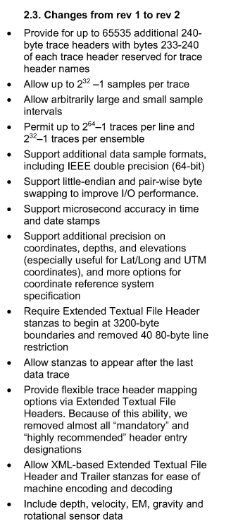
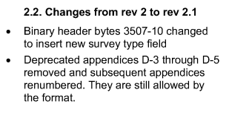
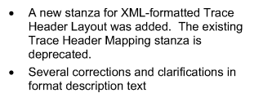
Enables better positioning through OGP P2/11 or P6/11
64 bit support – more traces per line, more precision
XML trailers will enable automatic read-in of seg-y files

Slide 4
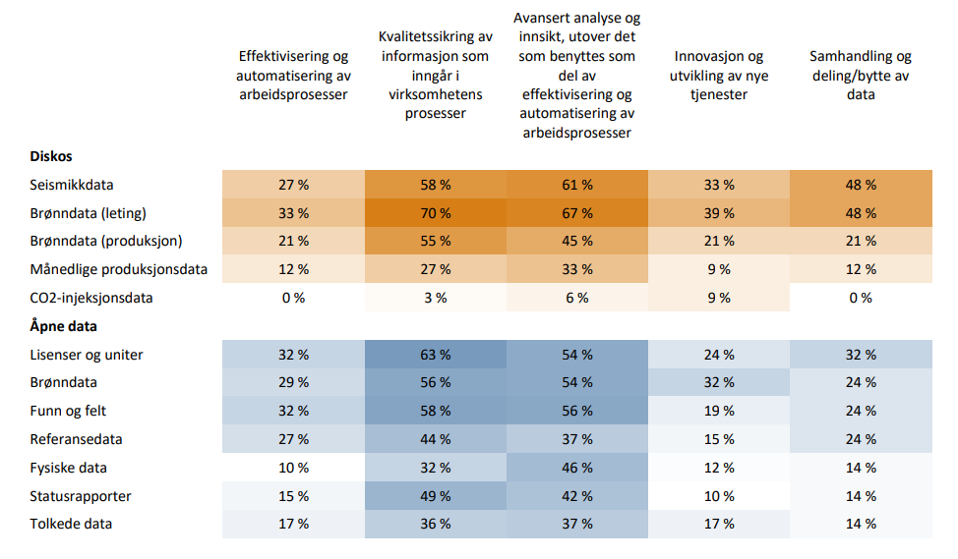
Data management and reporting for innovation
How can we facilitate the necessary technological development to create the most value on the NCS?

