Slide 1
Monthly Production from NCS 2021 compared with prognosis and 2020
Updated to March

Slide 2
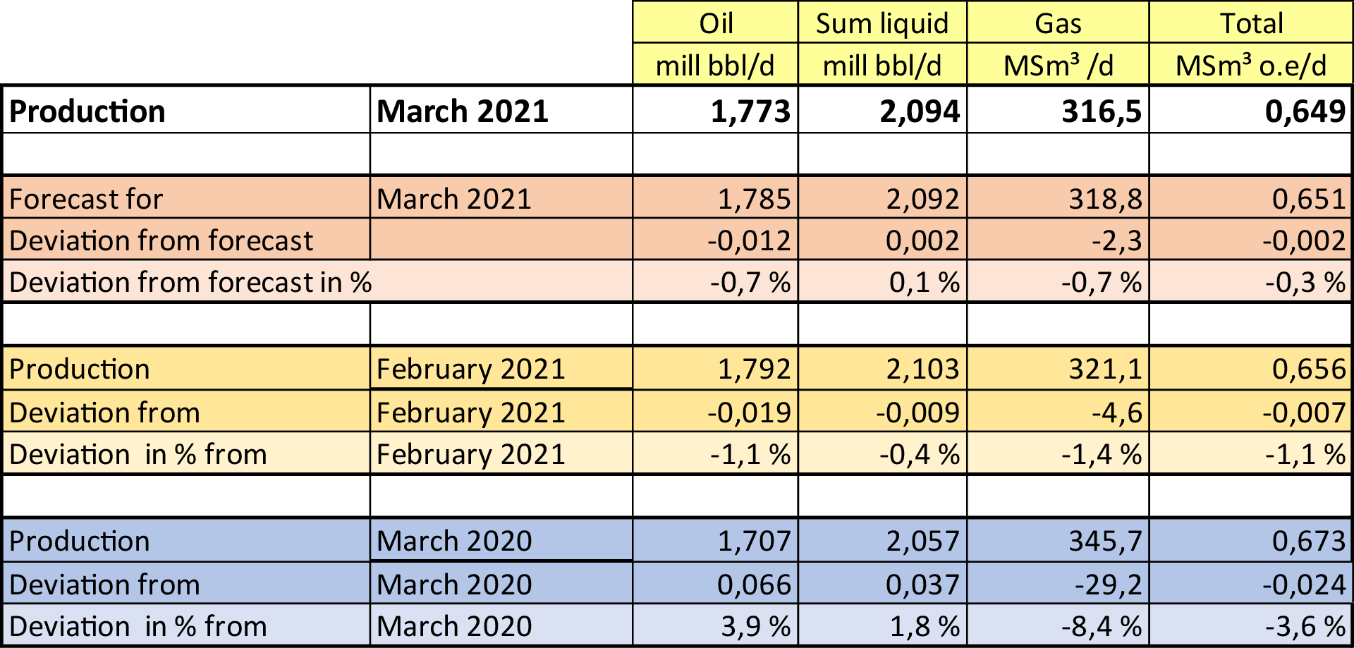
Production March 2021

Slide 3
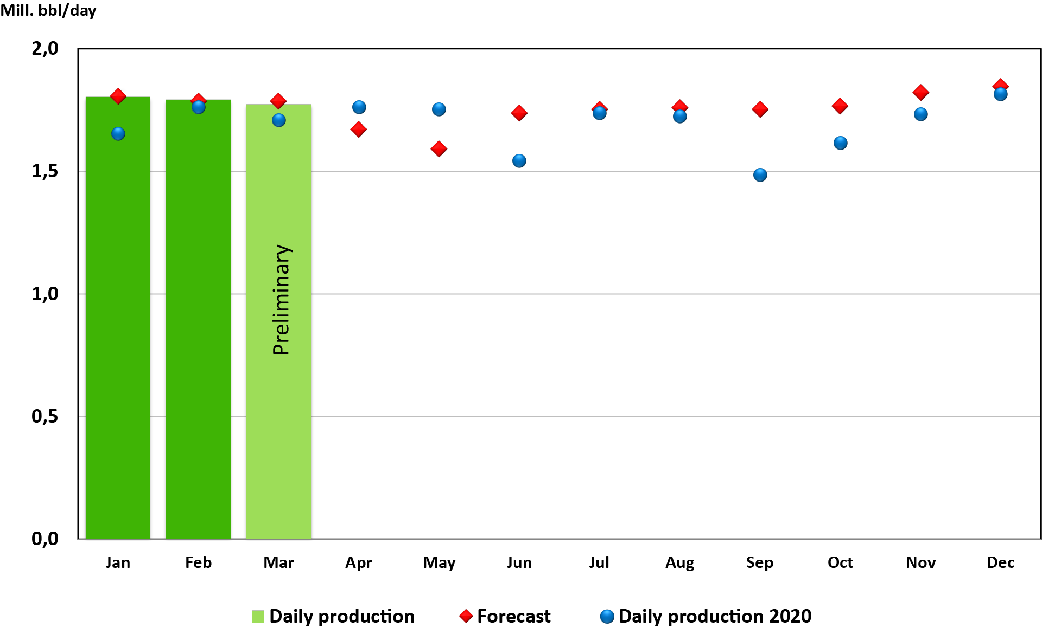
Oil production 2021

Slide 4
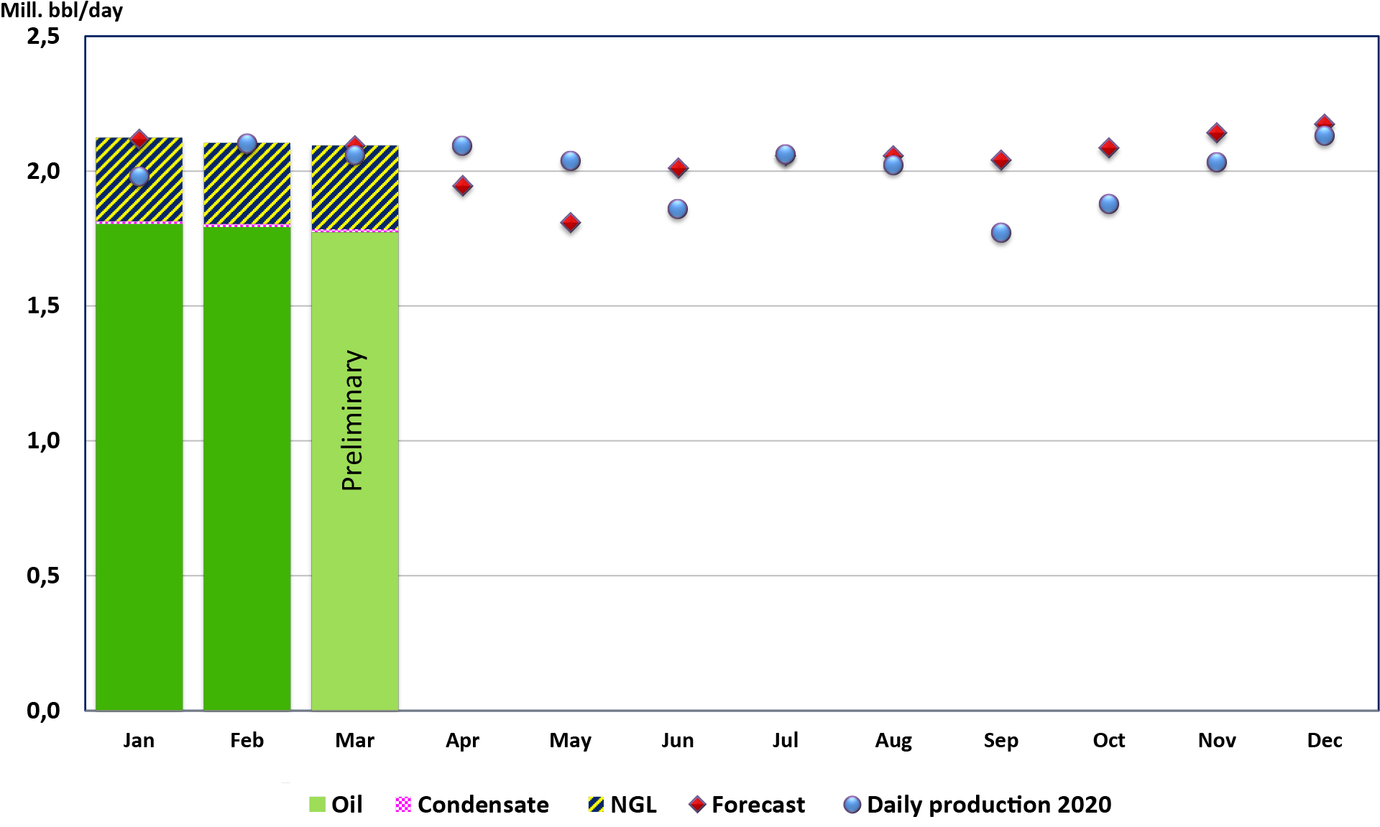
Liquid production 2021

Slide 5
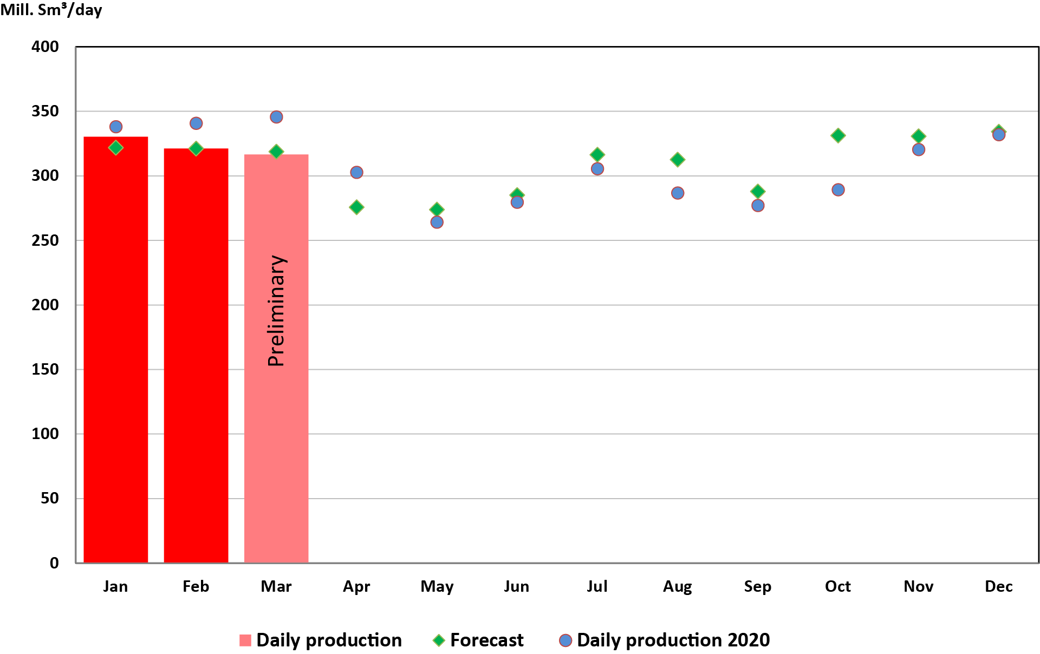
Gas production 2021

