Slide 1
Resource Report for Discoveries and Fields 2019
27 September

Slide 2
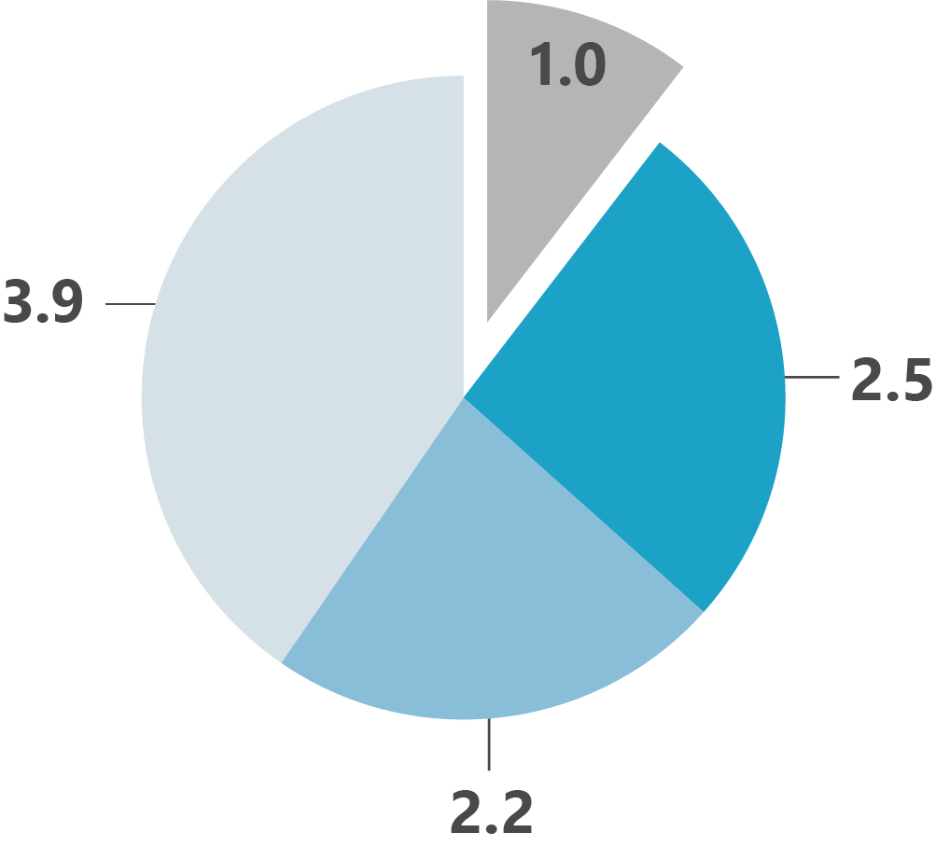
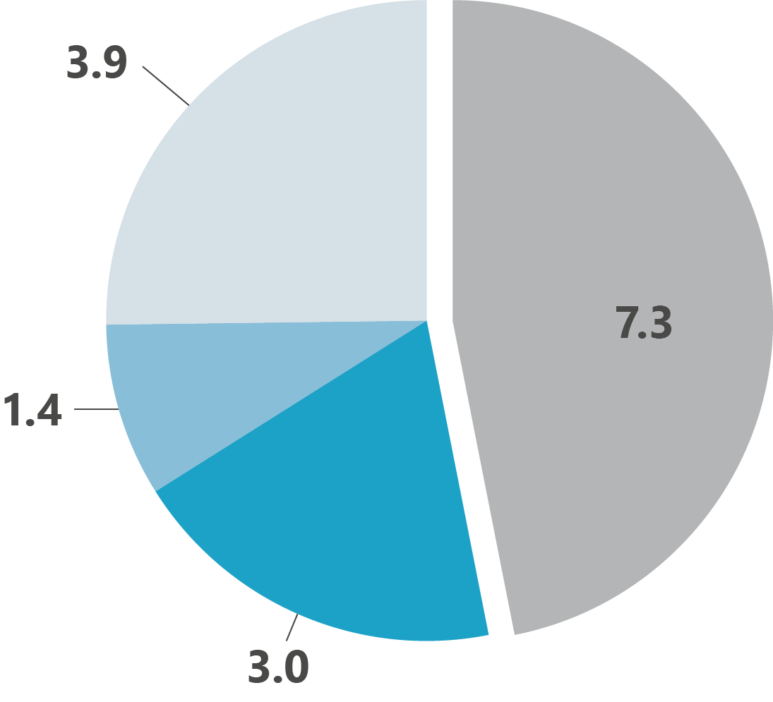
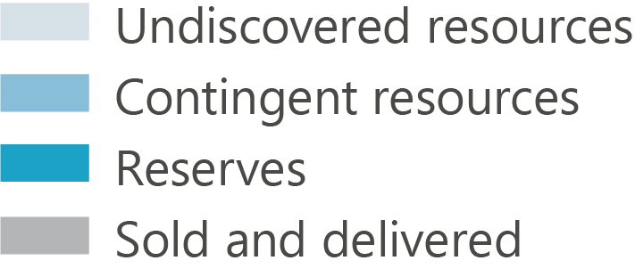
More than half left
1990
(billion scm oe)
Resource
Report 2019
2018
(billion scm oe)

Slide 3
Significant resources in fields
Resource
Report 2019

Slide 4
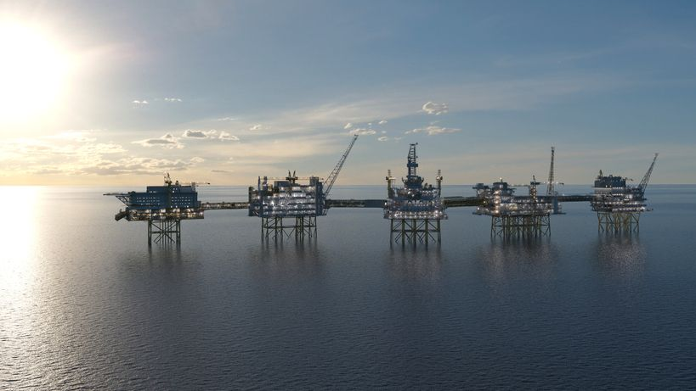
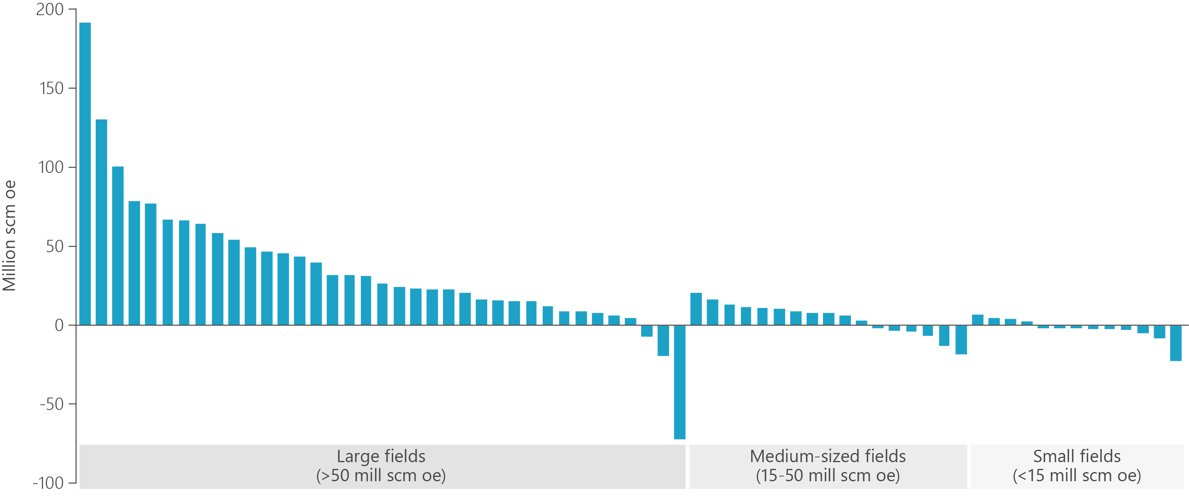
Increasing reserves – Johan Sverdrup x 3
Resource
Report 2019

Slide 5
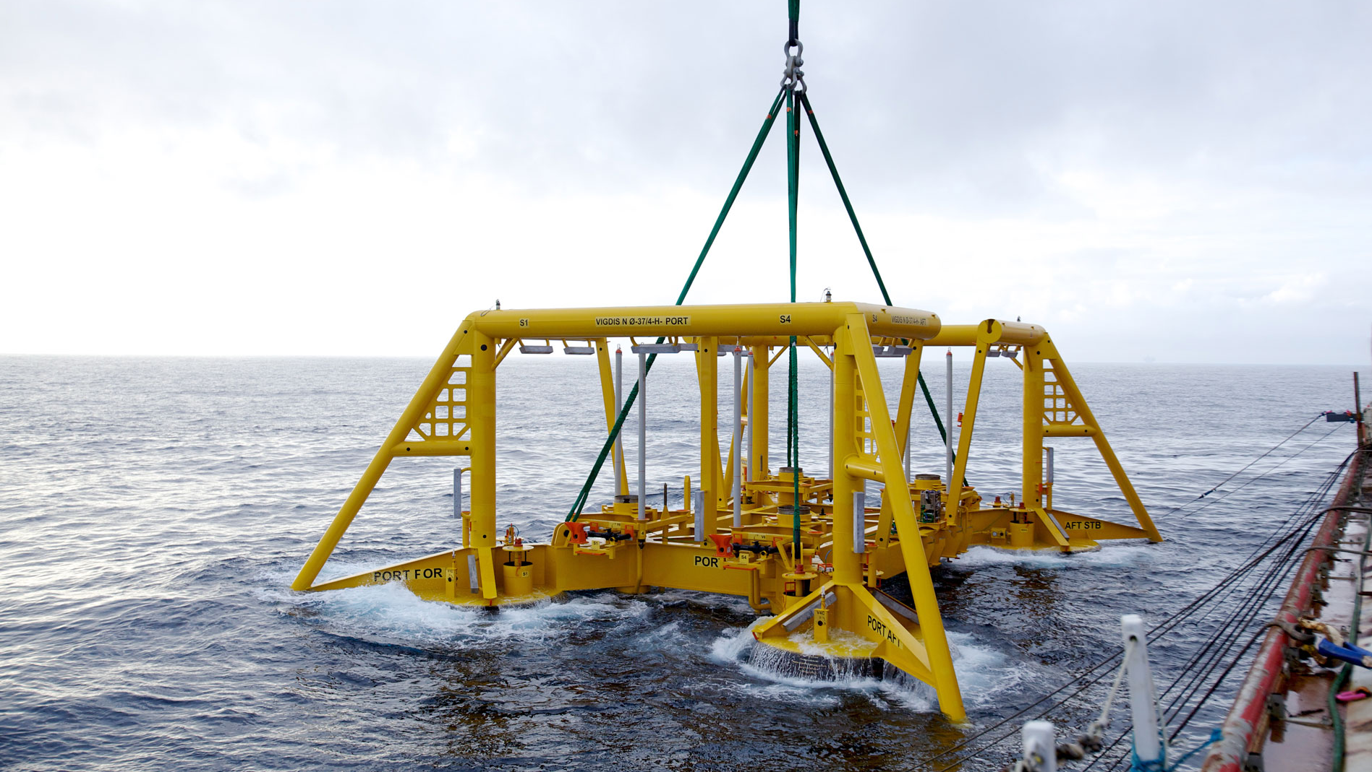
New reserves in old fields
Resource
Report 2019

Slide 6
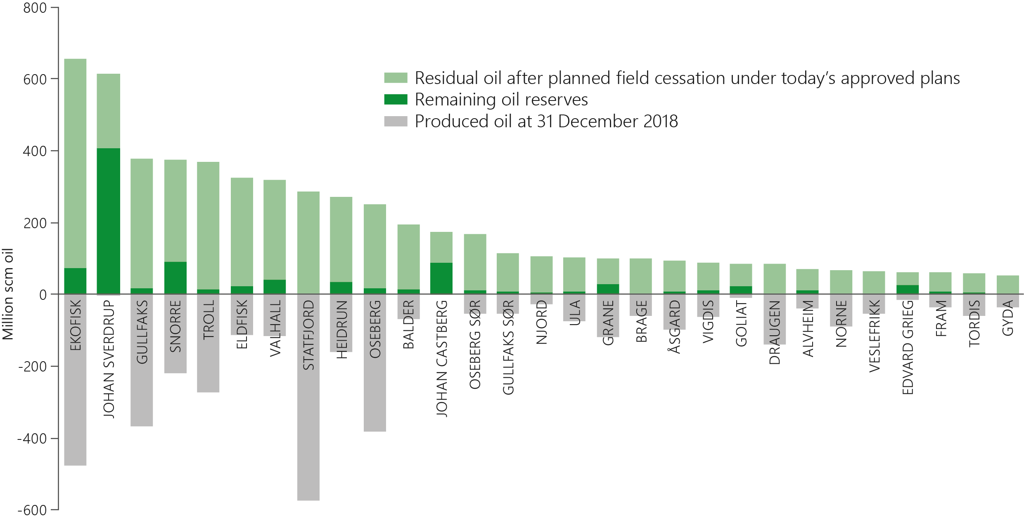
All socio-economically profitable resources should be produced
Resource
Report 2019

Slide 7
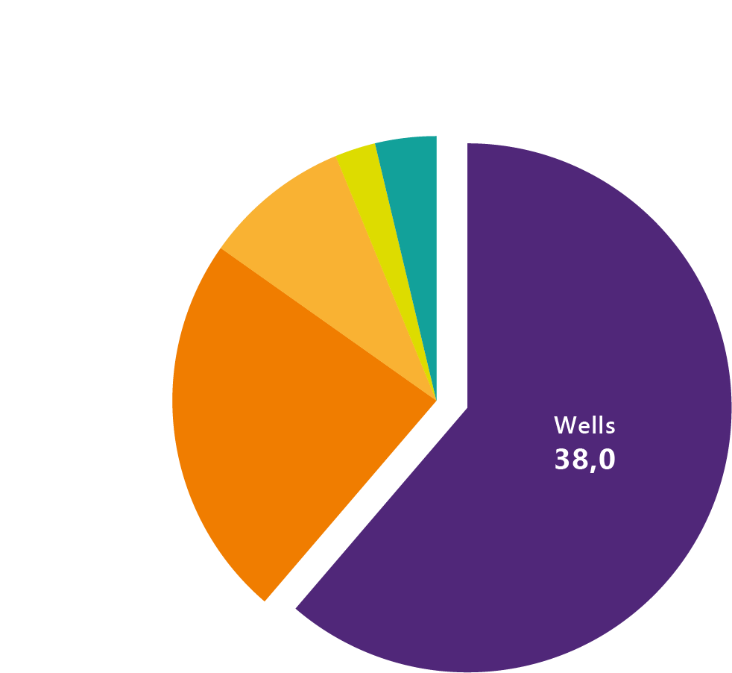
Wells are the most important measure for improved recovery
Resource
Report 2019
Figures are in billion 2018-kroner

Slide 8
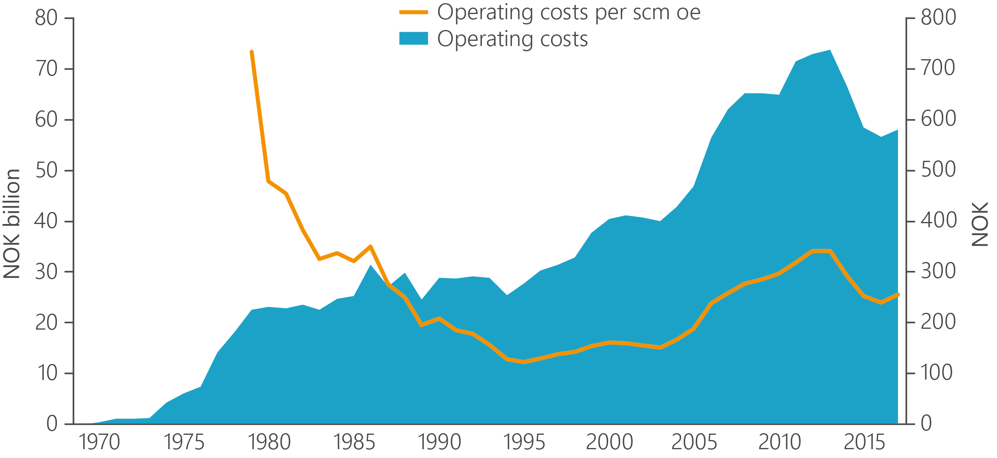
Operating costs are down
Resource
Report 2019

Slide 9
Data provides new opportunities
Resource
Report 2019

Slide 10
Significant opportunities in the discovery portfolio
Resource
Report 2019

Slide 11
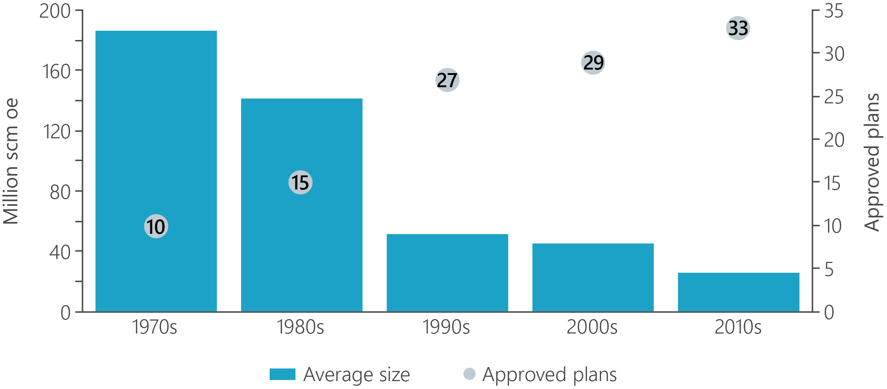
Profitable development of smaller discoveries
Resource
Report 2019

Slide 12
Many discoveries – many possibilities
Resource
Report 2019

Slide 13
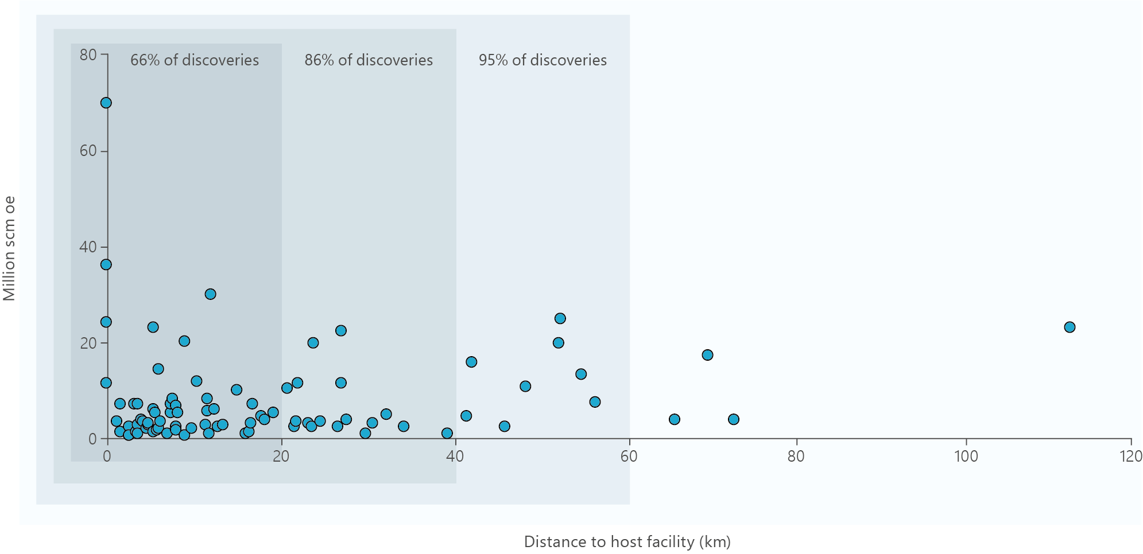
Phase-ins are the future – use of existing infrastructure is key
Resource
Report 2019

Slide 14
The challenging barrels
Resource
Report 2019

Slide 15
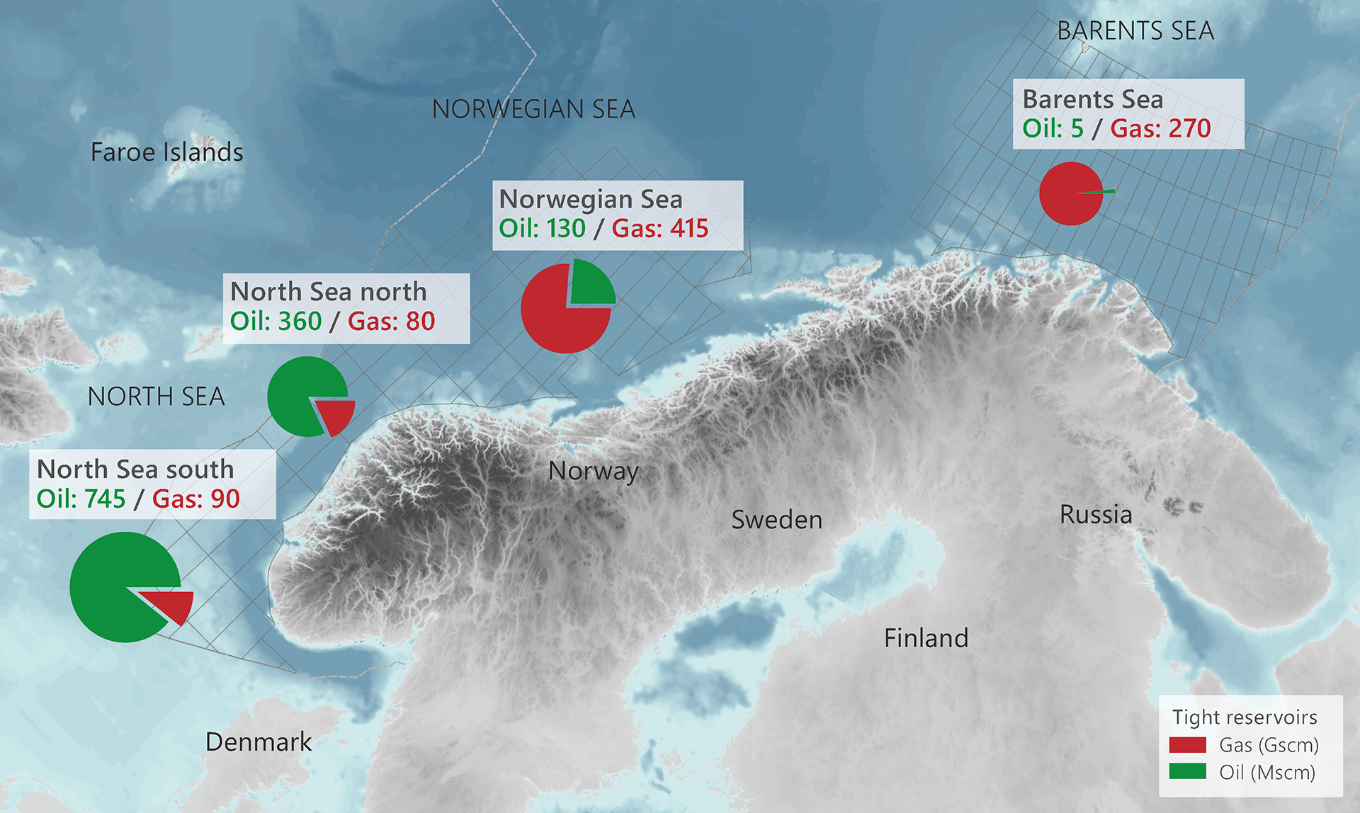
A lot of oil and gas in tight reservoirs
Resource
Report 2019

Slide 16
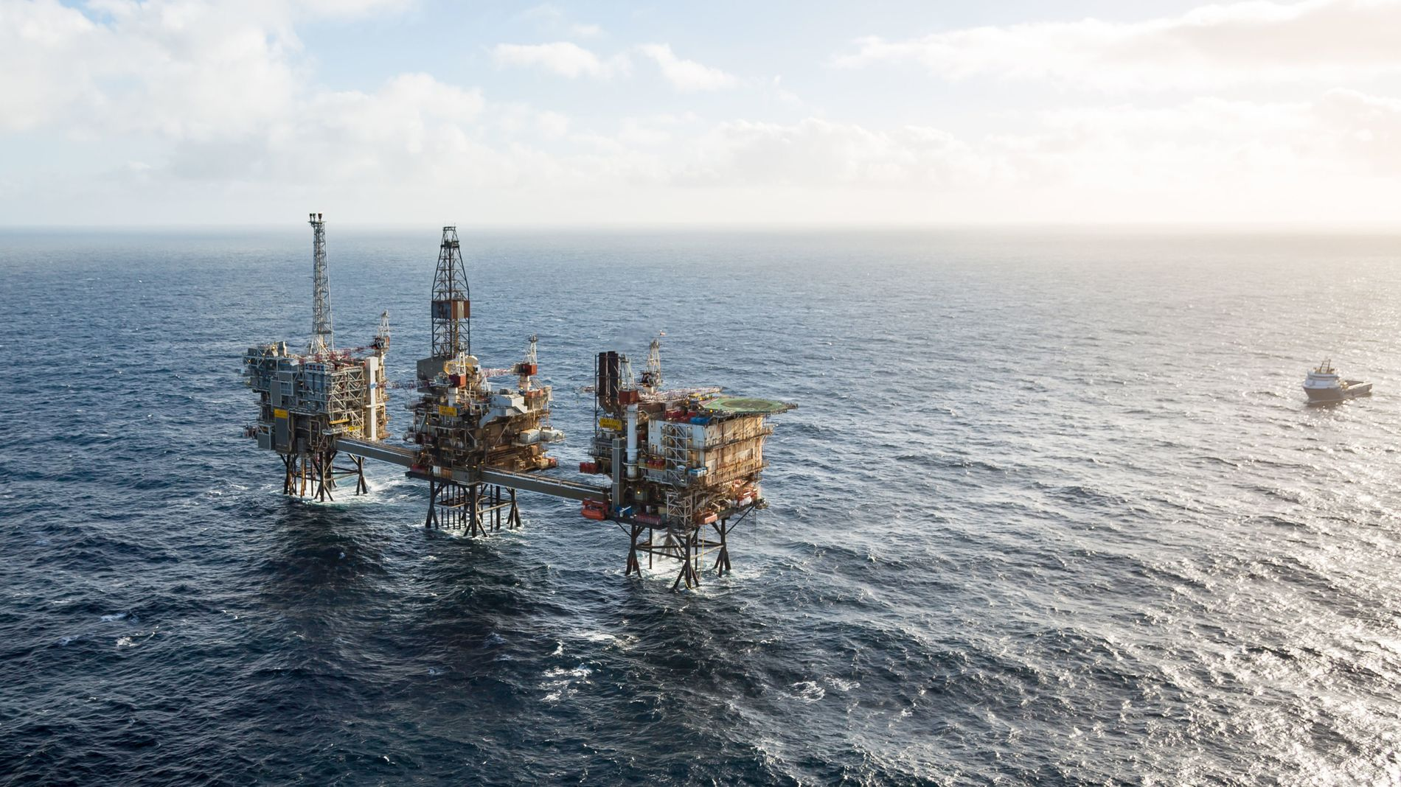
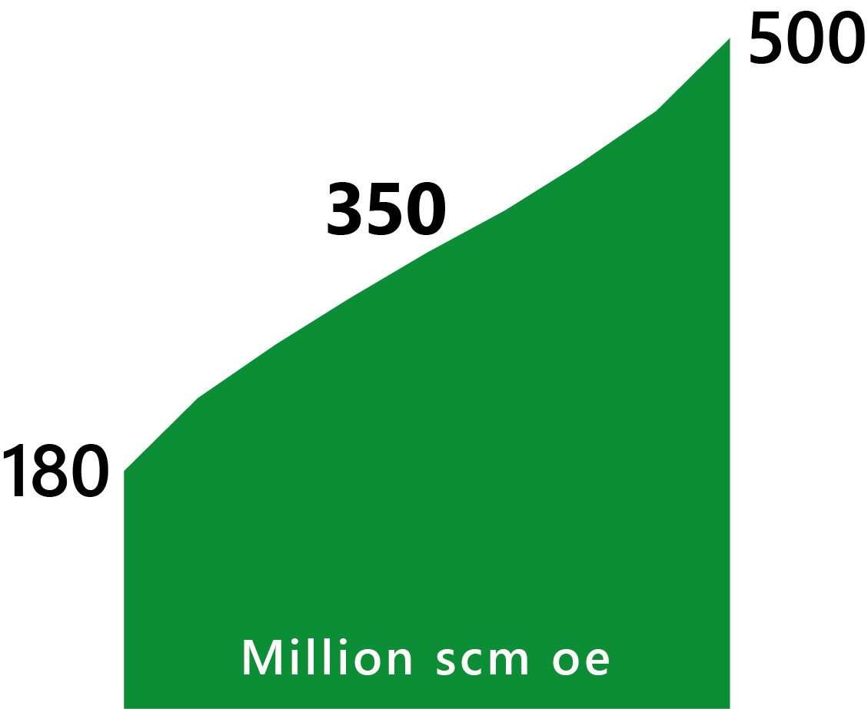
A significant EOR potential
Resource
Report 2019

Slide 17
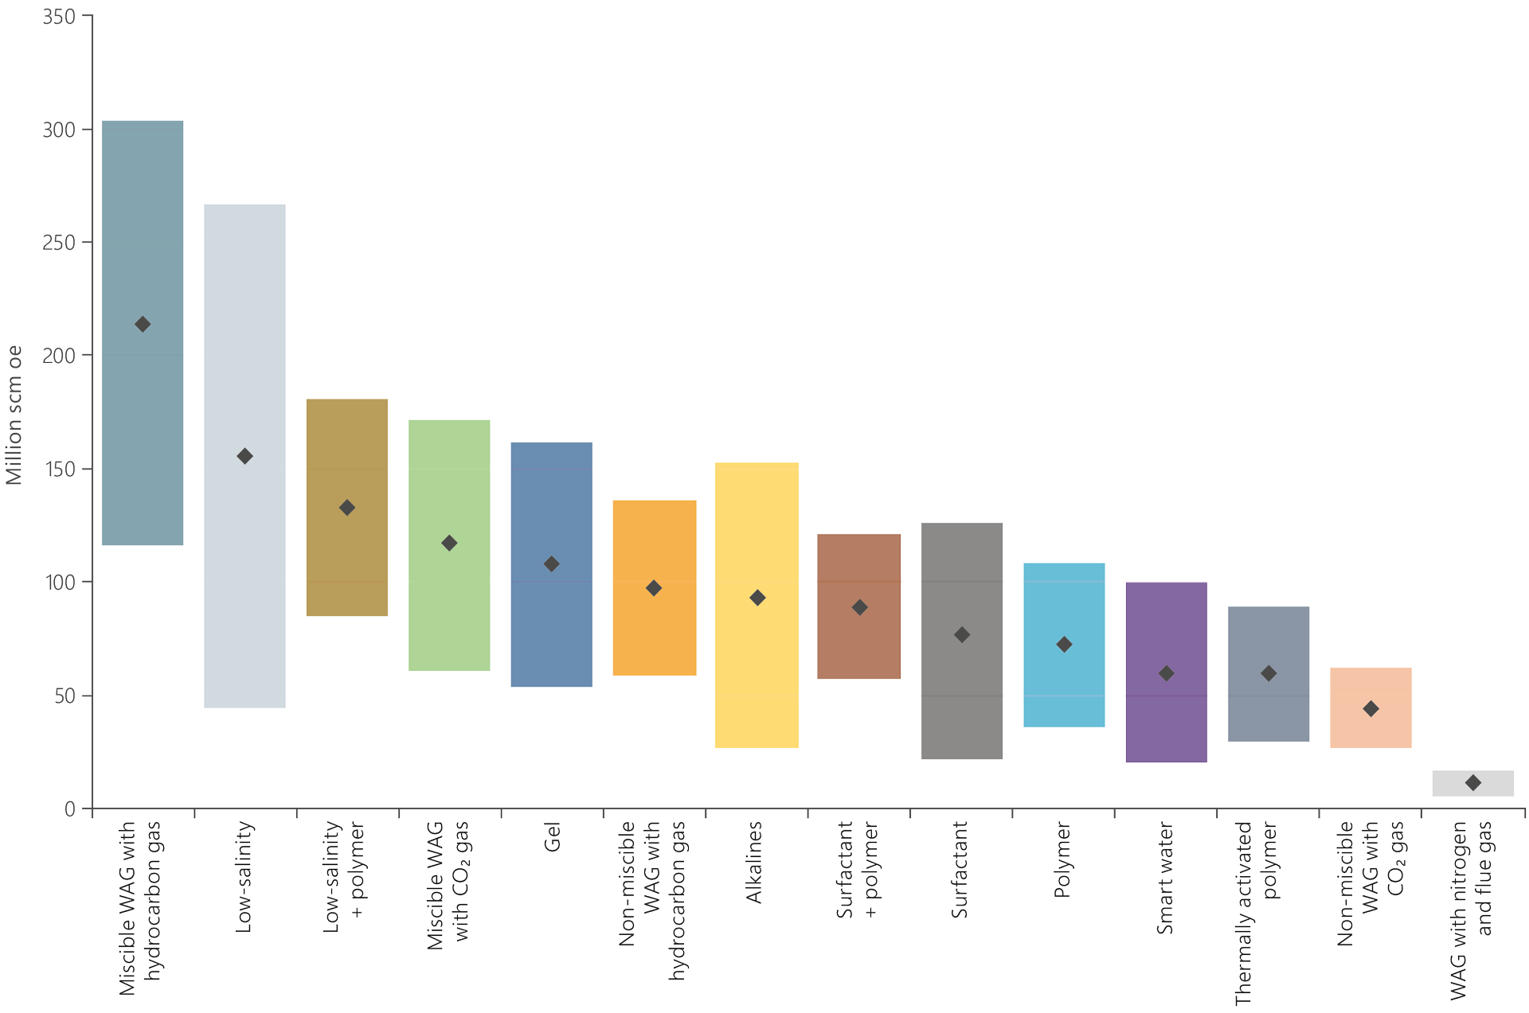
Now is the time for field pilot tests
Resource
Report 2019

Slide 18
Emissions and environment
Resource
Report 2019

Slide 19
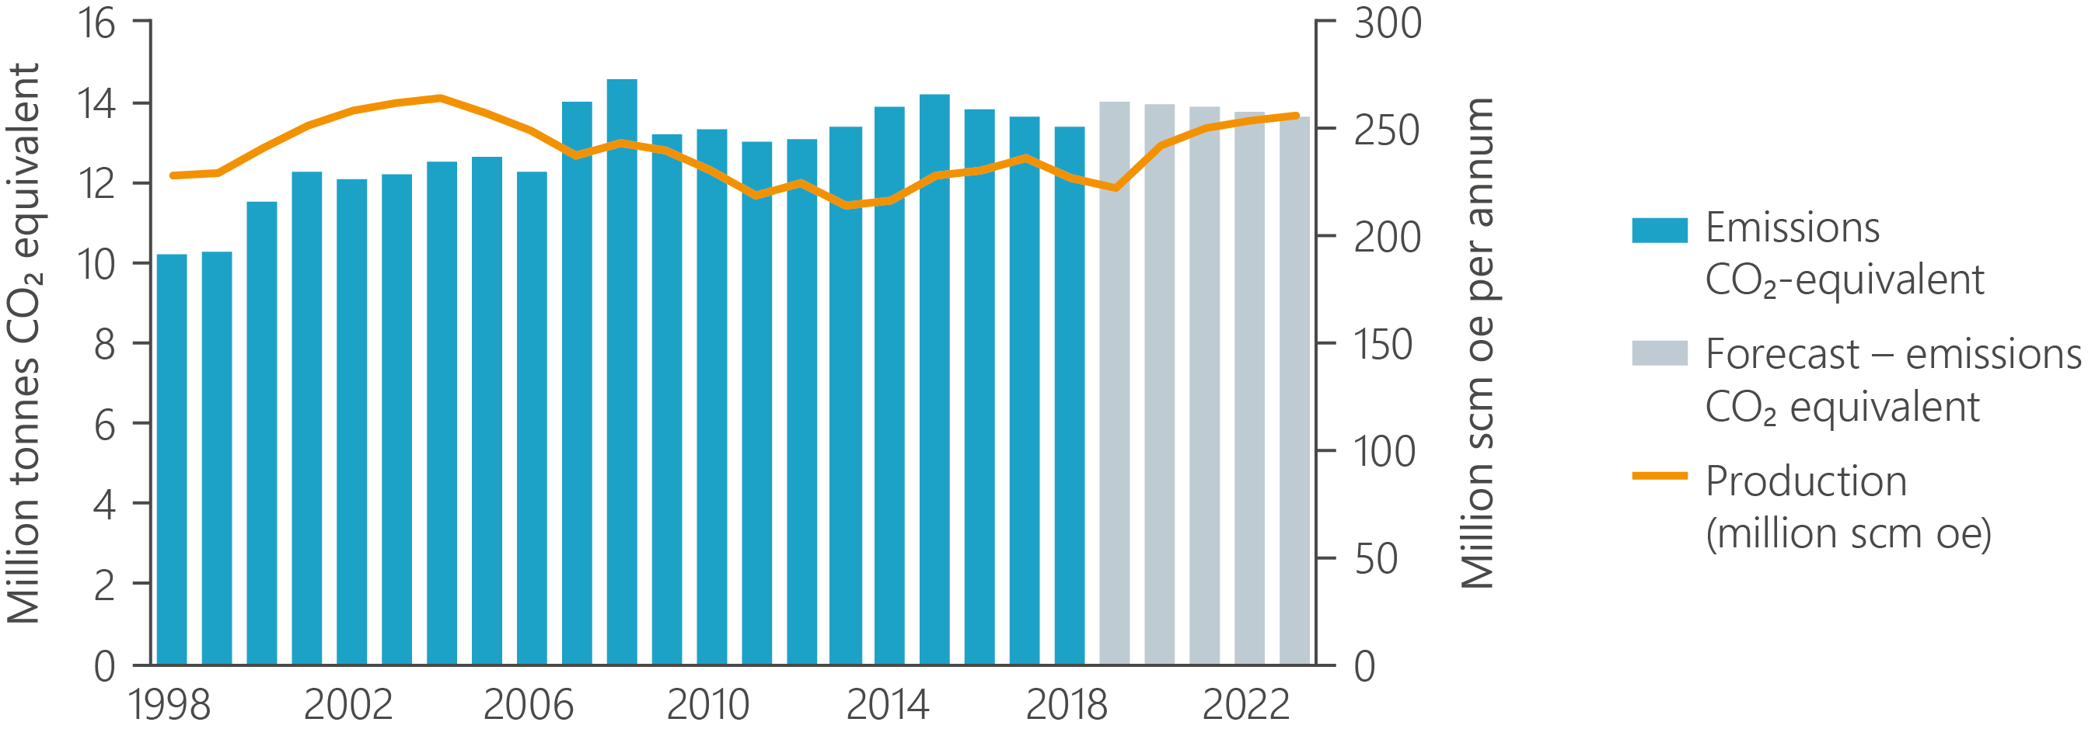
Production is increasing, emissions are holding steady
Resource
Report 2019

Slide 20
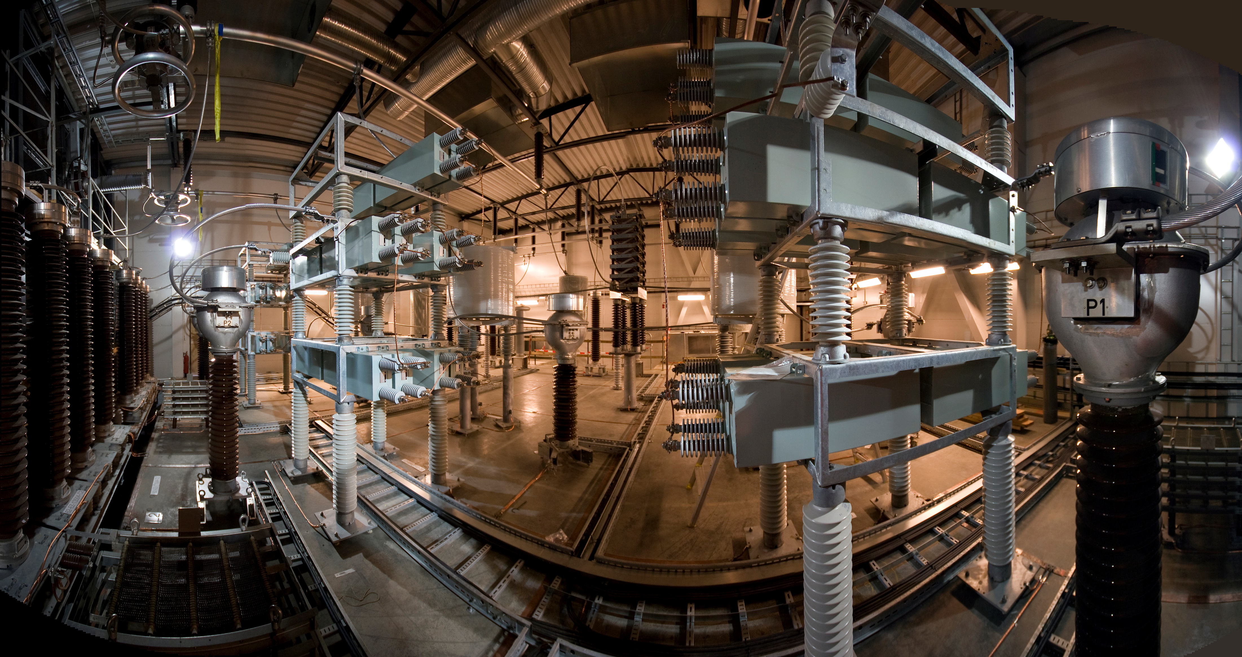
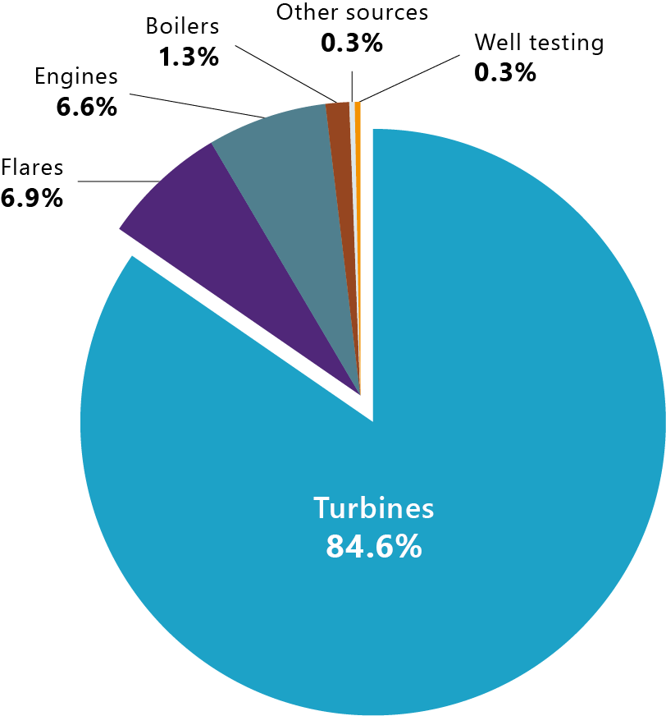
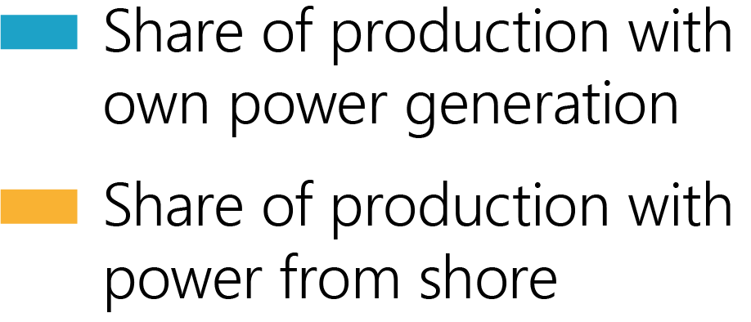
Turbine operation is the
largest emission source
Resource
Report 2019
Notes:
Syns at det som er gulet ut bør
tas ut.

Slide 21
Resource
Report 2019

