Slide 1
OPM Flow an overview

Slide 2
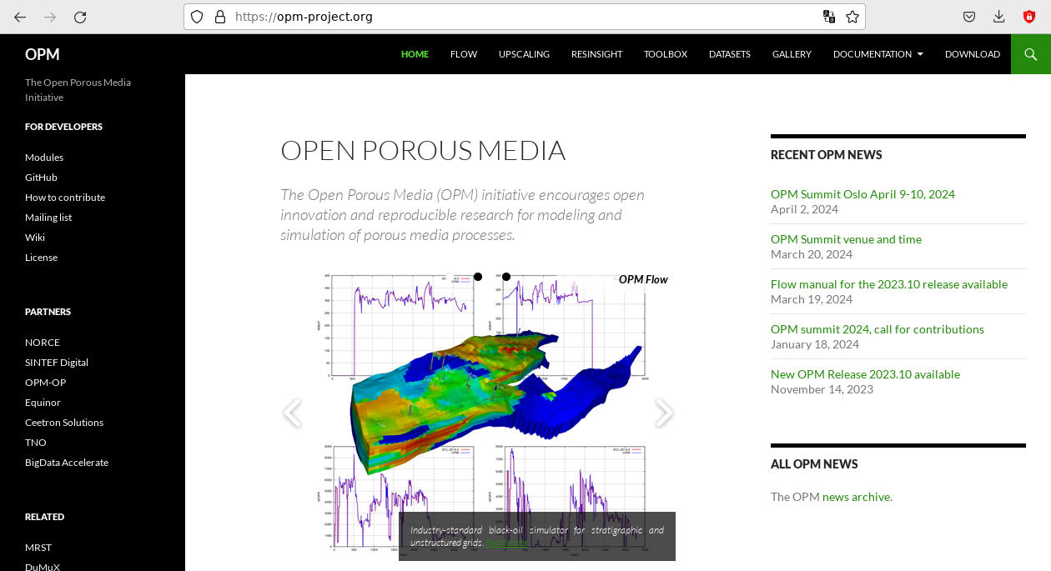
Open source works!

Slide 3
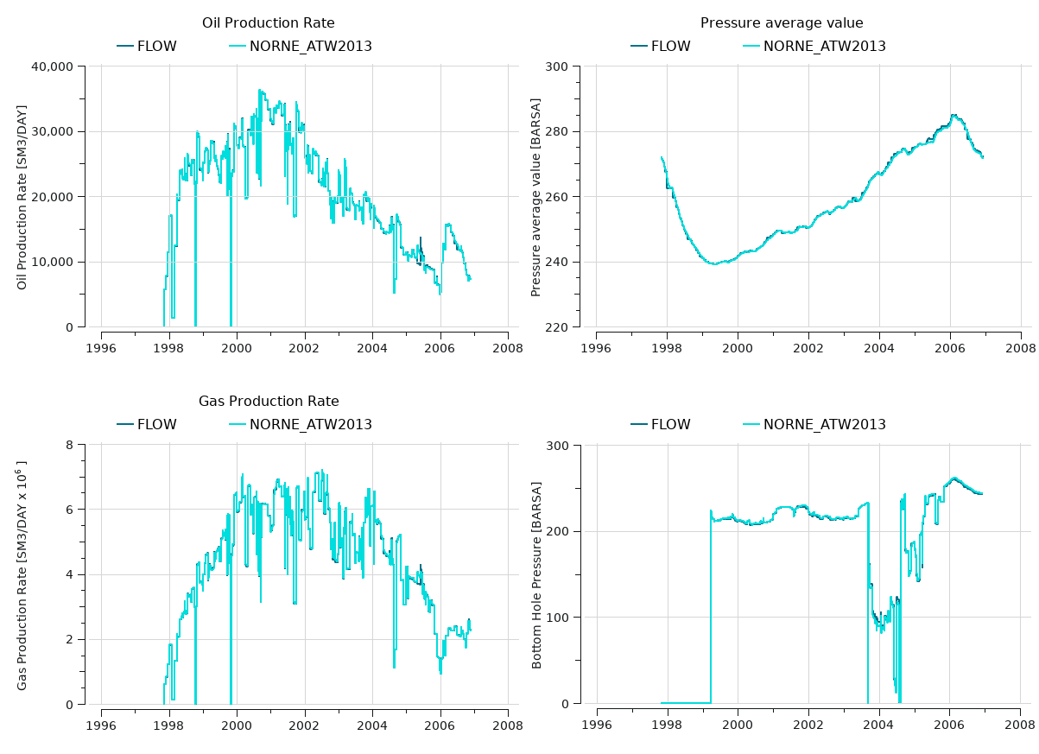
Correctness is necessary

Slide 4
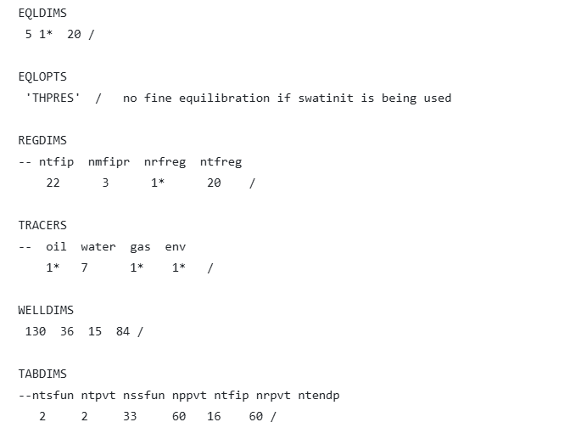
File formats enables compatibility
Eclipse is the industry standard
Support on input and binary output
LOG- and PRT-file differs
Even restart compatible

Slide 5
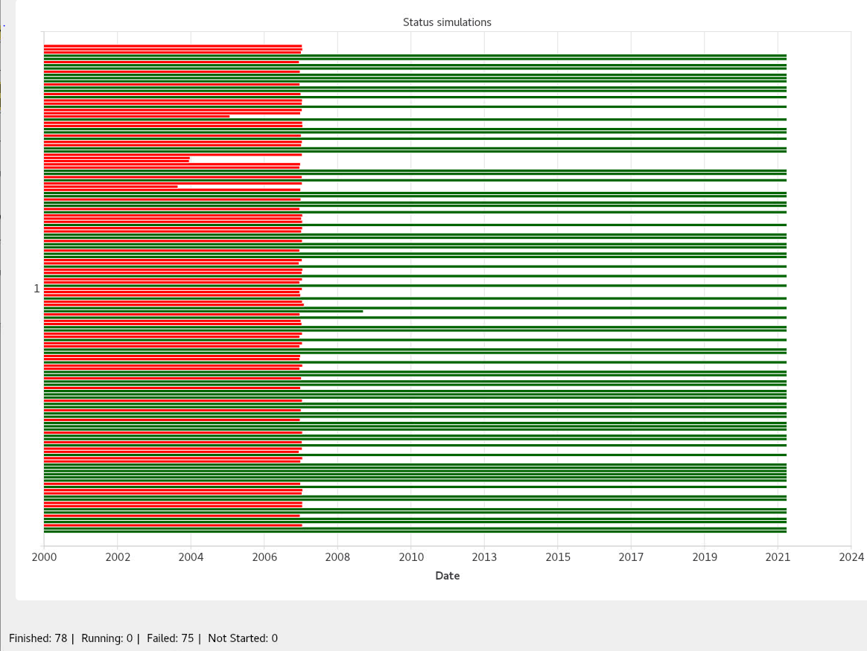
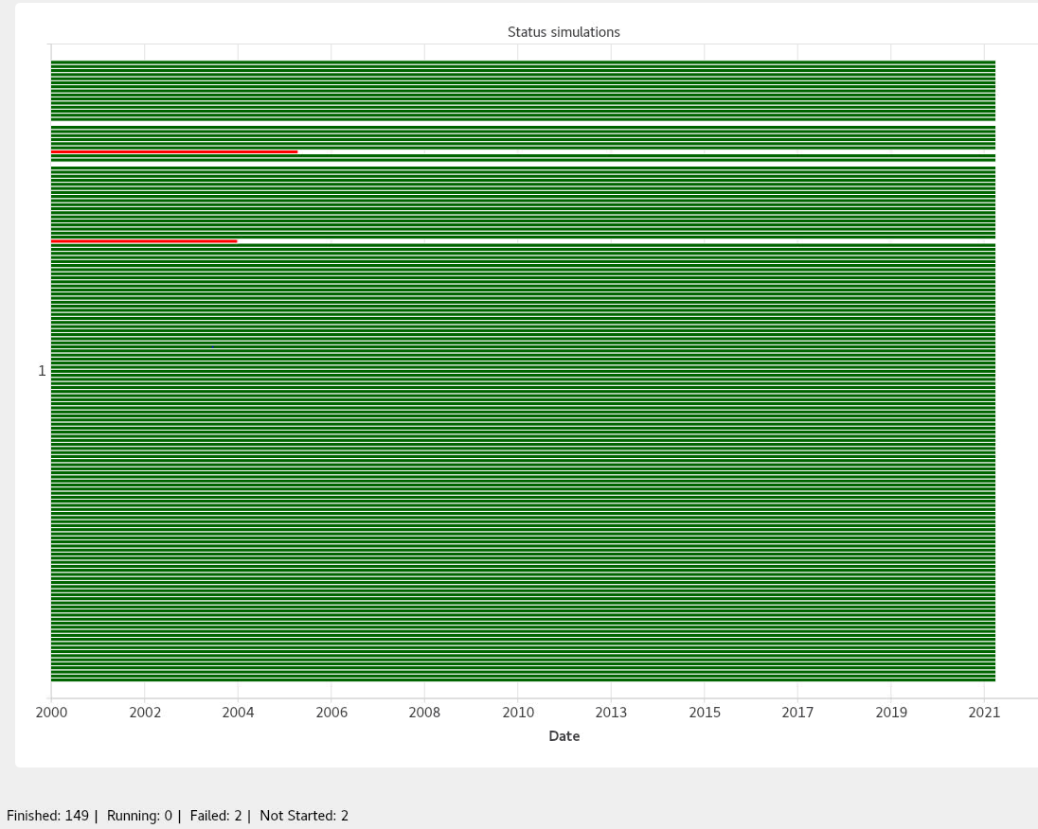
Ensemble modelling – robustness important for FMU

Slide 6
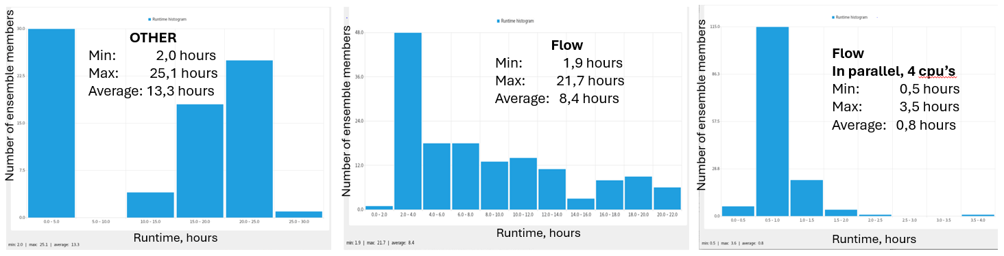
Run time also matters of course

Slide 7
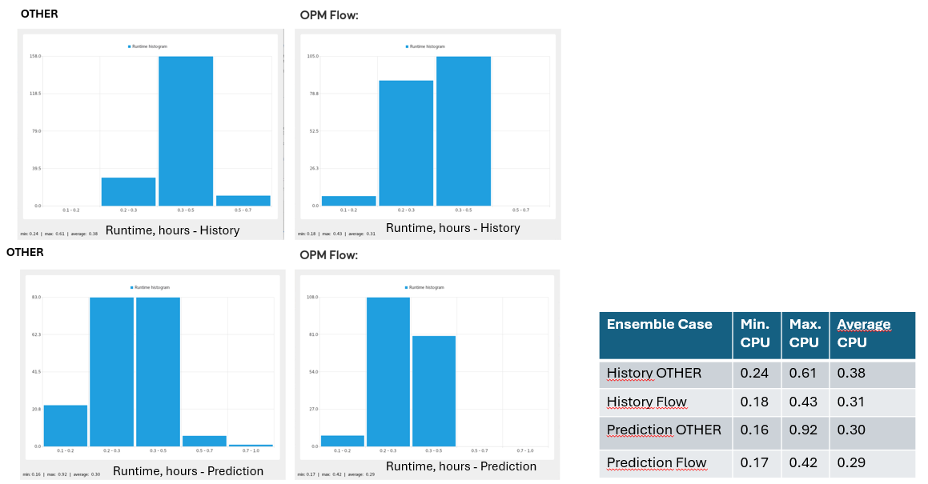
Another reservoir - when convergence is easy

Slide 8
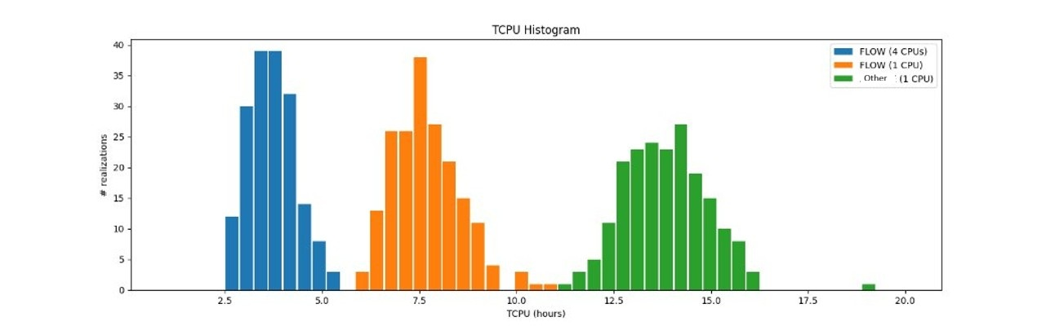
When parallel excel

Slide 9
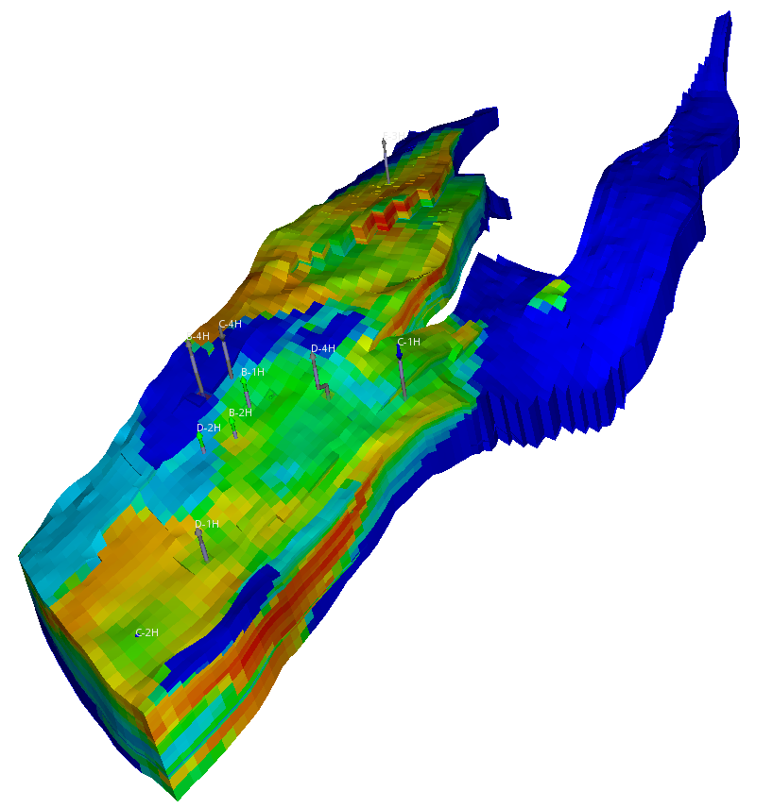
What is already done
General black oil simulator functionality
Multi-Segment Well option and advanced completions
Aquifer
Group control functionality
Network functionality
Hysteresis
ACTIONX and UDA/UDQ functionality
Tracer
Gas lift optimization
Thermal simulations
Salt precipitation
CCS in saline aquifers

Slide 10
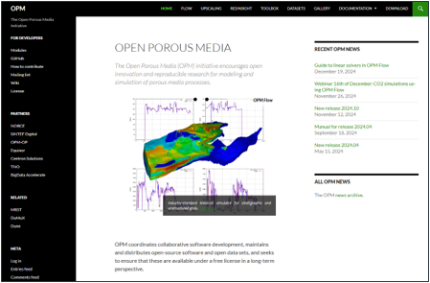
Notable things that are not done
Satellites​
Reservoir coupling​
LGR or radial grids​
Dual porosity​
Compositional simulation or API-tracking​
CCS in depleted reservoirs​
Polymer and solvent options​
Pyaction​
Directional relative permeability​
Flux boundary conditions​

Slide 11
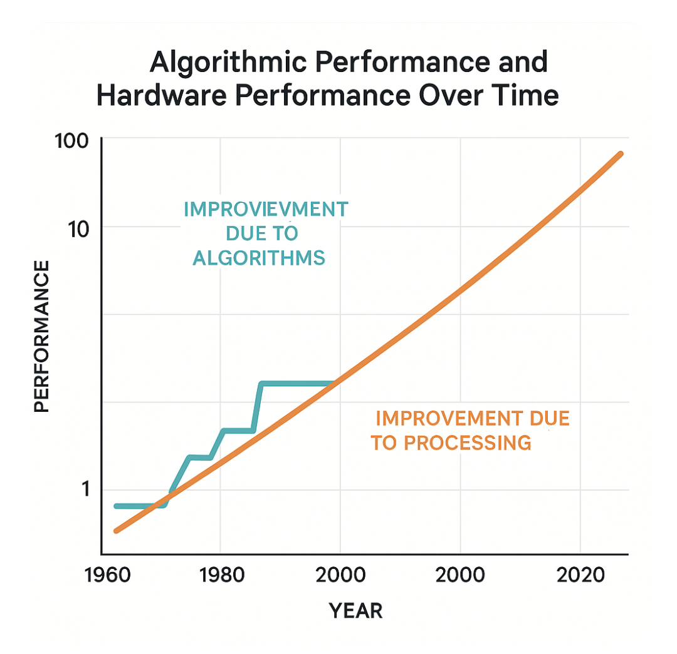
Primary objective
Numerical performance
Numerical robustness

Slide 12
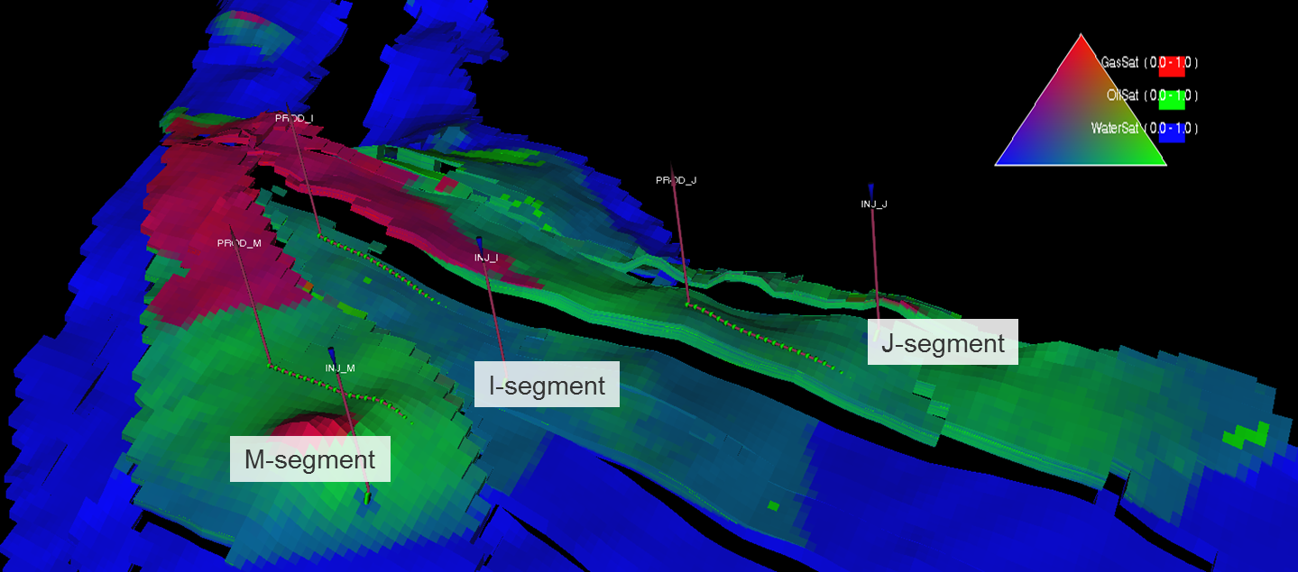
Secondary objectives
Interactive simulations on current typical reservoir models, enabling new workflows
Complex fluid physics, including fully compositional formulations
Innovative solutions providing flexibility beyond todays technology. For instance, python interfaces and wrappers, flexible reservoir coupling, dynamic grid refinement.

Slide 13
Thank you!

