Slide 1
Oil vs. Gas - Acceleration of Gas Blowdown on Skarv
FORCE seminar 29. november 2022
Victoria Daae

Slide 2
Notes:
DN 28.march 2022
On behalf of the oil – a bit of an exaggeration

Slide 3
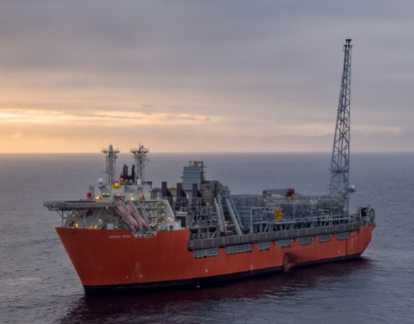
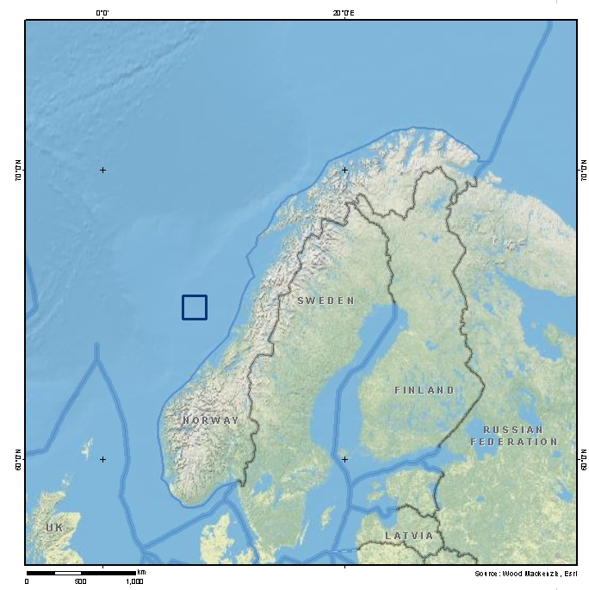
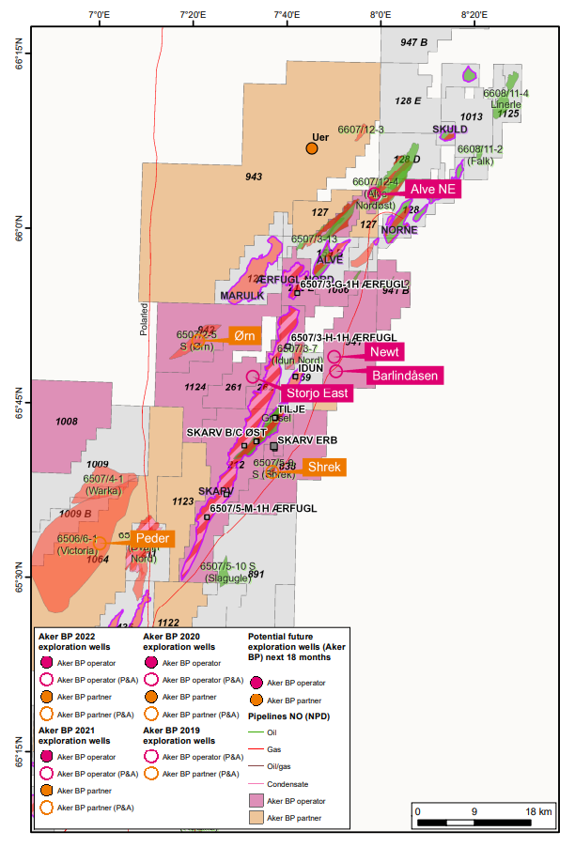
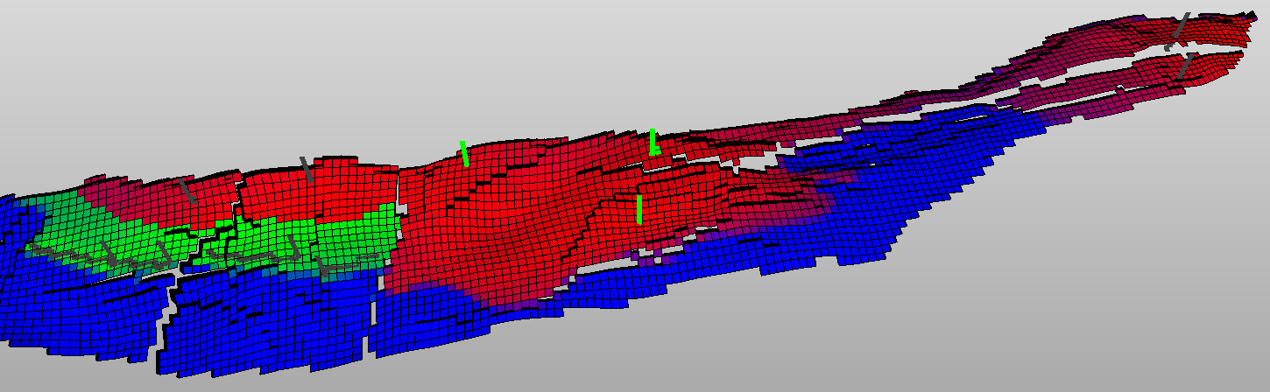
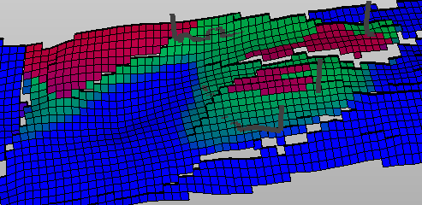
Skarv overview
FPSO=Floating Production Storage and Offloading vessel
Discovery: 1998 and unitized with Idun and Ærfugl in 2007.
Start production 31.12.2012.
Located in the northern part of the Norwegian Sea
Skarv FPSO also hosts production from the Gråsel and Ærfugl fields, planned nearby satelite fields and provides capacity for exploration tie backs.
Skarv reservoir: Lower to Middle Jurassic shallow marine sandstones (Garn, Ile, Tilje) at 3500 mTVDSS
North
D02
Skarv
D03
A
Idun Tunge
C
B
A03
Idun
B03
B02
A06
A04
Skarv-Idun
Saddle
B10
B06
B09
B08
Gas injectors
Gas producers
Oil producers
Skarv A –Tilje Reservoir
Bounding
Faults
J02
J01
J03
Companies (names and numbers): | Aker BP ASA (Op 23.835%) Equinor Energy AS (36.165%), Wintershall DEA Norge AS (28.0825%) PGNiGUpstream Norway AS (11.9175%)
J04
Notes:
The Skarv field is located in the northern part of the Norwegian Sea. The field has been developed with a floating production, storage and offloading vessel (FPSO) and has one of the world’s largest offshore gas processing plants on this type of facility.
Deposition environment: Shallow marine
Depth: 3500 mTVDSS
Porosity: Garn 19%, Ile 13%, Tilje 15%
Avg permeability: Garn 1000 mD, Ile 15 mD, Tilje 20 m
Describe the different segments and depletion strategy

Slide 4
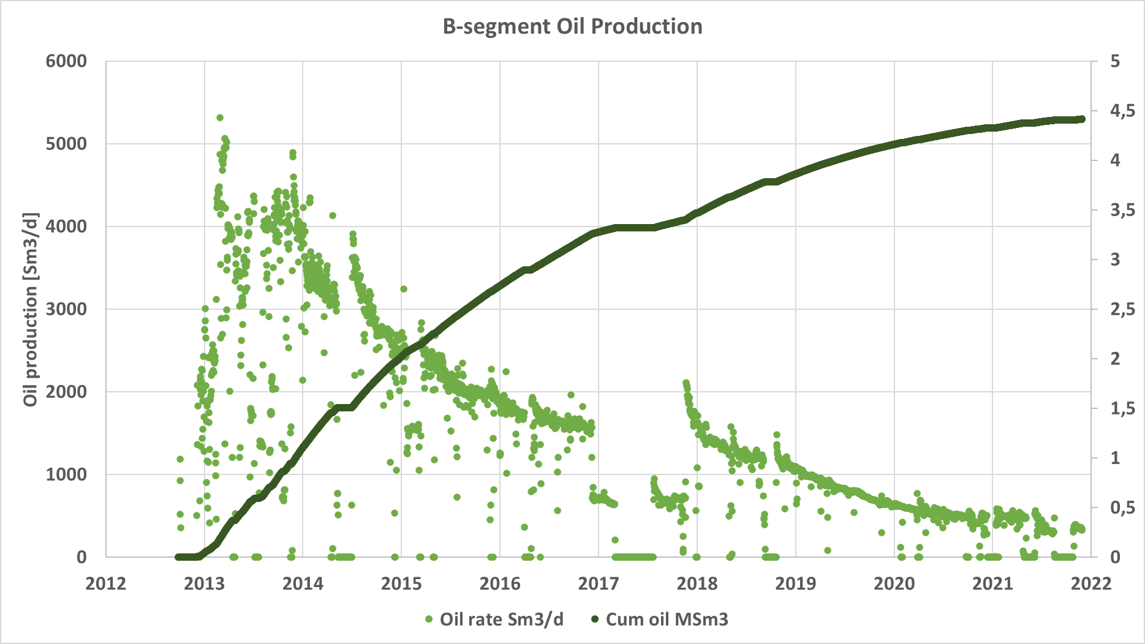
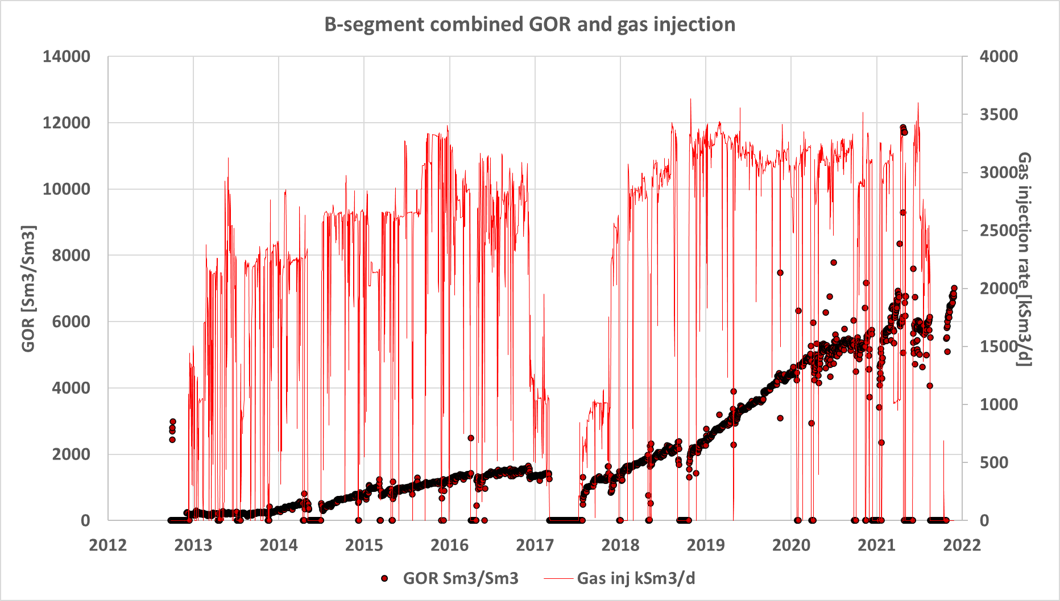
B- and C-segments
Key facts
*
Two oil producers supported by one updip gas injector in each segment
Producers placed deep in oil leg, gas injectors in gas cap
Blowdown was part of PDO production strategy: Stop injection, produce downdip wells before converting injectors to producers.
Oil recovery factor as per March 2022 >50%
Total of 13 GSm3 of gas injected.
Plan to produce down dip oil during pressure depletion ahead of water break through
Notes:
Oil producers placed horisonatlly deep in oil leg, injectors place high on structure in gas caps
Over the past 10 years of a total of 13 GSm3 of gas has been injected, causing the gas cap to expand and move towards the producers, mobilizing and partly displacing oil.
High initial oil rates, decline to low rates especially after gas breakthrough. Late year GOR has increased rapidly, indicating that injection gas is becoming less and less efficient when it comes to oil recovery.
Ref first slide, oil production rates at time of blowdown start had already declined significantly from inital rates while injected gas rates was still high.

Slide 5
Evaluate optimal blowdown timing
Sequence of activities
Production performance
GOR development
Gas injection efficiency
Remaining oil
Uncertainity of oil left behind
IOR potential
Value of accelerated gas production exceed value of IOR potential
Economic analysis
Near-term high gas prices
Optimized capacity utilization
Notes:
Look at oil rates vs. gas injection, recent years’ GOR increase, how efficient is the gas we inject wrt oil production
Concern about remaining oil, important to not start too soon.
Economic analysis clearly showed that the optimal time for blowdown was as early as possible, mainly driven by the two-year near-term high gas prices, and optimized capacity utilization at Skarv FPSO and in Åsgard Transport (ÅTS).

Slide 6
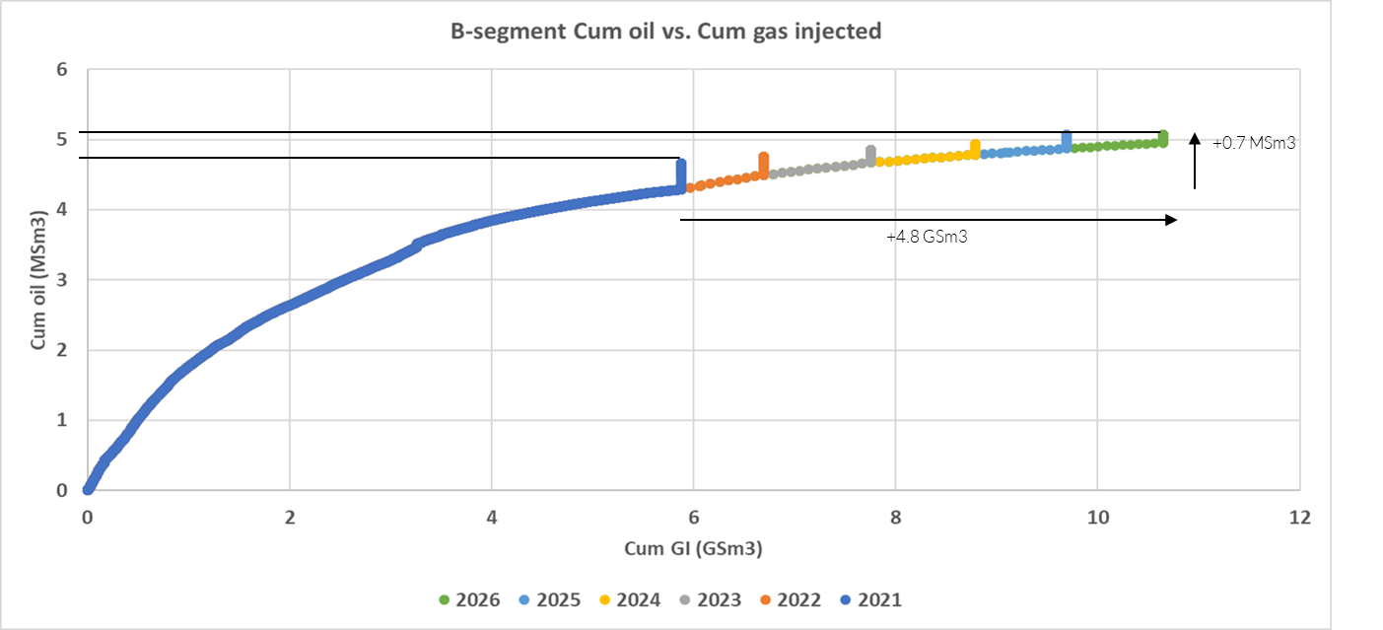
Production performance
RF for oil will keep increasing with more injected gas
Production data indicates that the segments are reaching optimal time for gas blowdown
+ 0.3 MSm3
60%
61%
62%
63%
RF 58%
59%
+ 4 GSm3
Notes:
Large recycling of gas to achieve only small volumes of oil.
Requires significant amounts of fuel to inject gas, inefficient wrt power usage
Oil recovery factor continues to increase with later gas blowdown
Relatively small oil volumes compared to volumes of gas injected

Slide 7
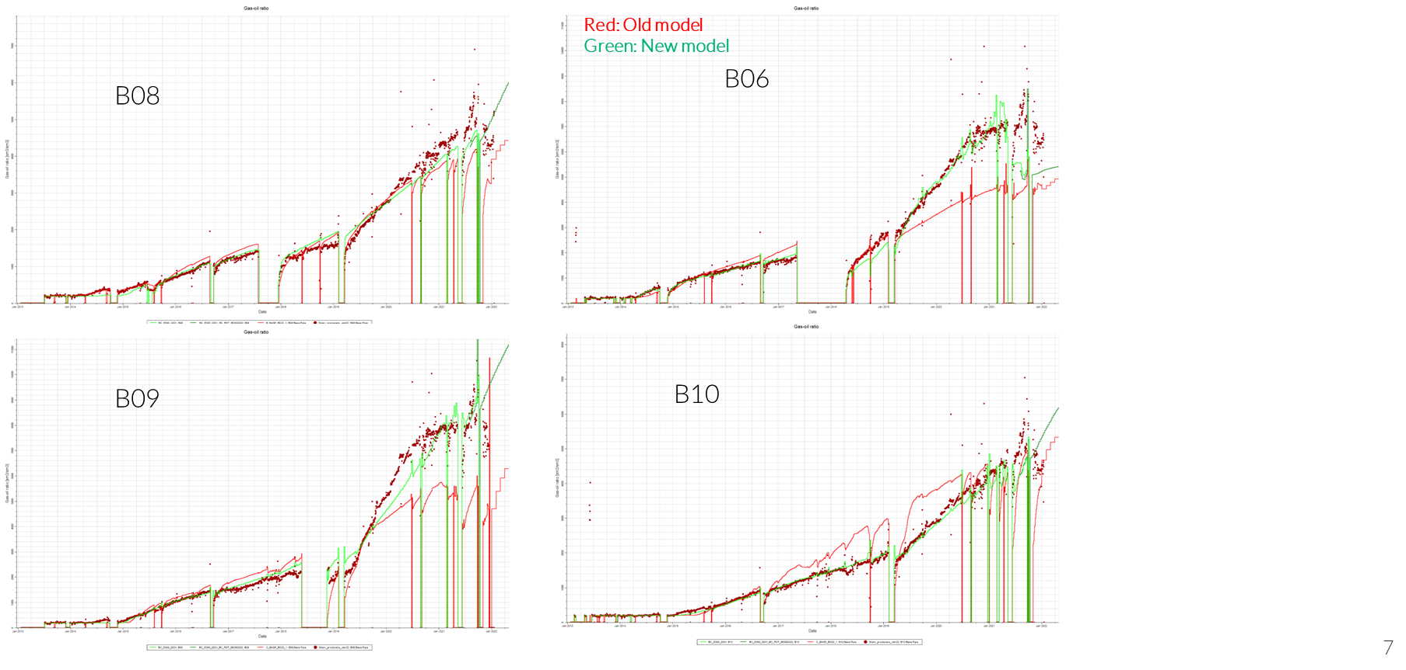
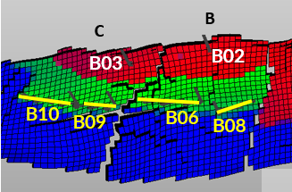
New model to evaluate remaining oil and IOR potential
Objectives
Improve history match
Better understanding of remaining oil
Evaluate potential IOR opportunities and value against accelerated gas export
Observation and results
Compositional modelling improved history match quality
Remaining oil left behind ranged from 3 to 7 mmboe, equivalent to decreased oil recovery factor by 3% to 6%
Limited potential from infill wells and value was significantly overruled by value of starting blowdown in todays high gas price market
Infill wells targeting down dip oil
Infill C
Infill B
Notes:
The current reservoir model struggled to HM match late life performance, overpredicting oil
Compositional modelling value – importance of late life HM, increase understanding of remaining oil
Tested multiple scenarios with different models
Remaining oil identified down dip from the producers -> infill well targets

Slide 8
Skarv export gas BC blowdown 2024
Export gas production blowdown start 2024
Export capacity
Other Skarv Unit production and tie in satelite fields
Export gas production rate
Skarv main
Notes:
Blowdown placeholder in 2024 was suboptimal both wrt space capacity and other planned tie in fields.

Slide 9
Skarv export gas BC blowdown 2022
Export gas production blowdown start 2022
Export capacity
Other Skarv Unit production and tie in satelite fields
Export gas production rate
Skarv main
Notes:
By accelerating BD to 2022, able to fill gap
Much more effcient use of facilities

Slide 10
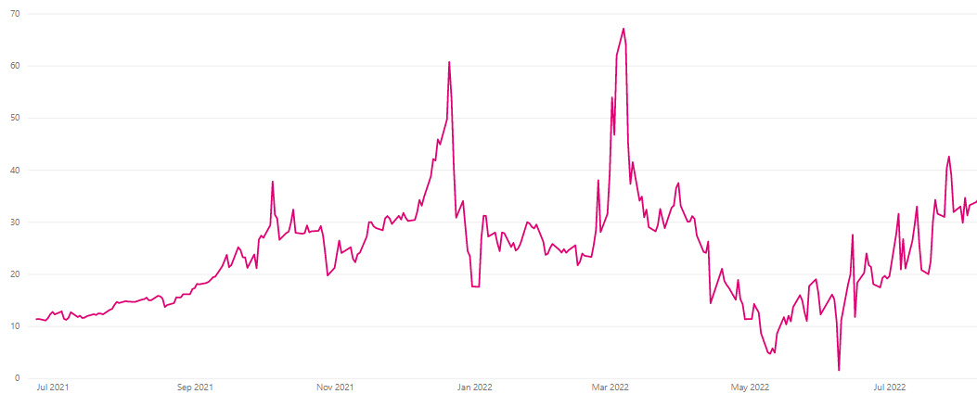
The decision to accelerate blowdown was taken based on the overall best value creation in all price scenarios
First step: Evaluate the timing of blowdown. The following criterias where evaluated:
mmboe (gas / oil)
CO2 emissions
NPV of increased gas export vs. oil production
Second step: Blowdown or infill well?
Blowdown wins by far
UK Natural Gas, USD/mmbtu
Net present value after tax for different timing
Jul 2021
Sept 2021
Nov 2021
Jan 2022
Mar 2022
May 2022
Jul 2022
+980%
Study concludes that blowdown in 2024 gives the overall best value
Decision to accelerate blowdown in 2022 taken in Skarv Unit license
0
BD 2027
BD 2024
BD 2022
Notes:
Economic analysis clearly showed that the optimal time for blowdown was as early as possible, mainly driven by the two-year near-term high gas prices, and optimized capacity utilization at Skarv FPSO and in Åsgard Transport (ÅTS).

Slide 11
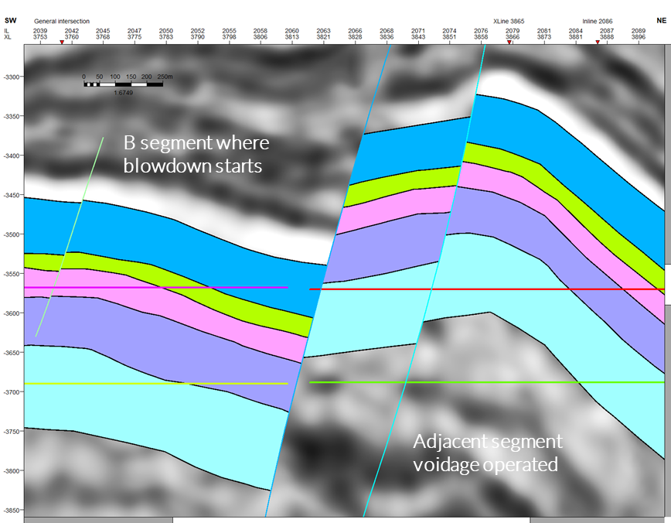
Opportunity: Skarv B/C blowdown acceleration – significant value creation
Rationale for 2022 Skarv B/C blowdown:
Overall best value creation
Significant NPV increase to accelerate
Available capacity on Skarv FPSO
Available capacity in Åsgard transport
Reduces CO2 in ÅTS during critical years
High European Energy demand
Abnormal forward gas prices
Early blowdown makes space for other projects
No identified economic IOR
Acceptable range of lost oil production
Risks with 2022 blowdown:
Potential lost IOR opportunity
Overall oil recovery from field reduced
Irreversible once started
Produced water handling bottleneck and scale
Communication to other segments
Total daily production volumes (mboepd)
Year 1: +20 %
BD2027
Year 2: +30 %
BD2024
BD2022
2022
2023
2024
2025
2026
2027
2028
2029
2030
2031
2032
Notes:
Risks were considered acceptable, within licens and NPD

Slide 12
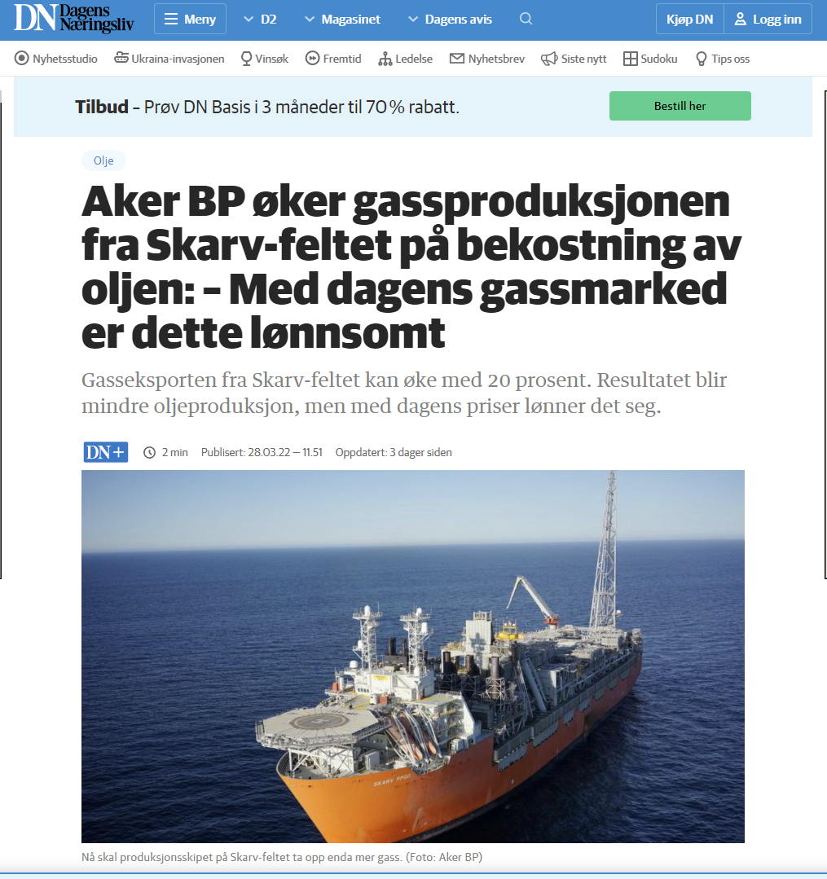
March 2022 – Injection stops
Approval from partners and NPD to stop injection
Injection stops in B and C segments on Skarv 26th of March 2022, immediately increasing gas export by 20%
Testing on the export riser allowed capacity to increase further, total gas export increased by almost 40%

Slide 13
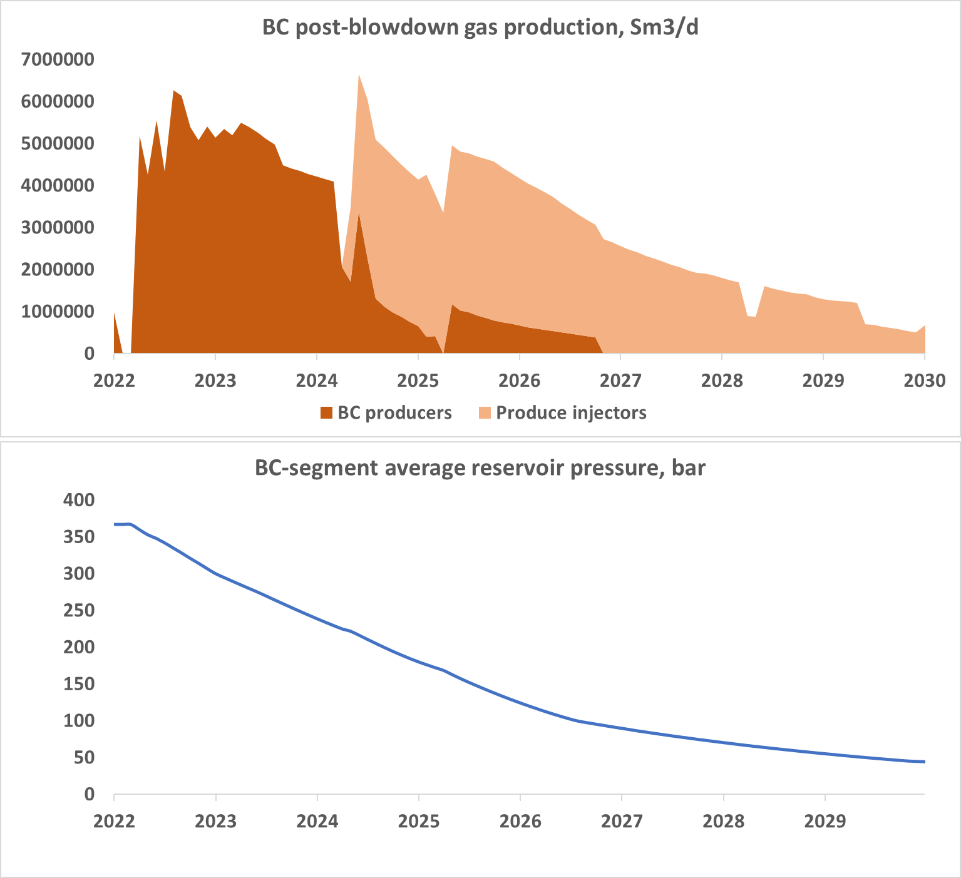
Observations and way forward
Observations 6 months after
Skarv still producing on gas export plateau
Pressure decline in reservoirs as expected
Need for scale squeeze in water expecting wells was identified, wells successfully treated with scale inhibitor
Down dip oil production from wells so far lower than prognosed, however water break through also delayed
Way forward
When total gas export production goes off plateau start planning for converting injectors to producers to drain gas cap
Evaluation ongoing for accelerating gas blowdown on other segments on Skarv to take advantage of demand and high gas prices

Slide 14
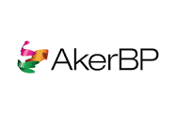
Acknowledgement
Skarv team at AkerBP, including AMT and finance
Partners on Skarv Unit
Equinor Energy AS
Wintershall DEA Norge AS
PGNiG Upstream Norway AS
NPD

