Slide 1
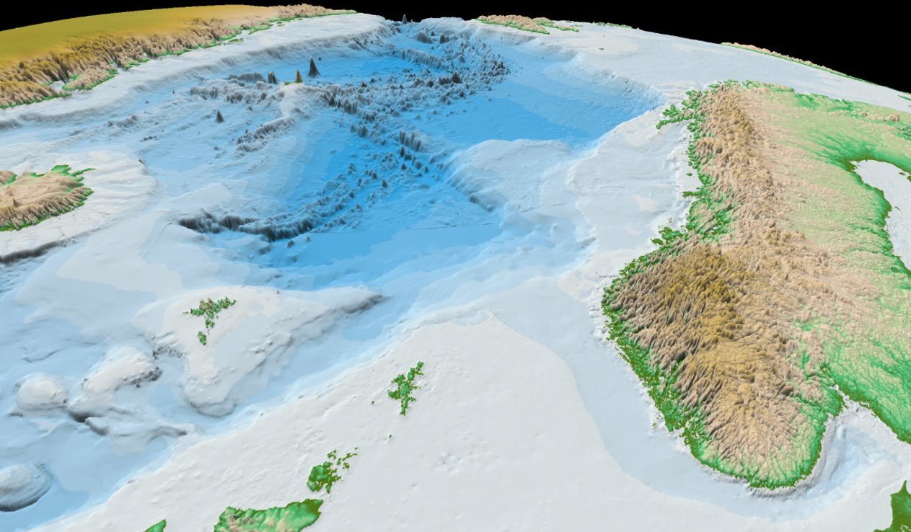
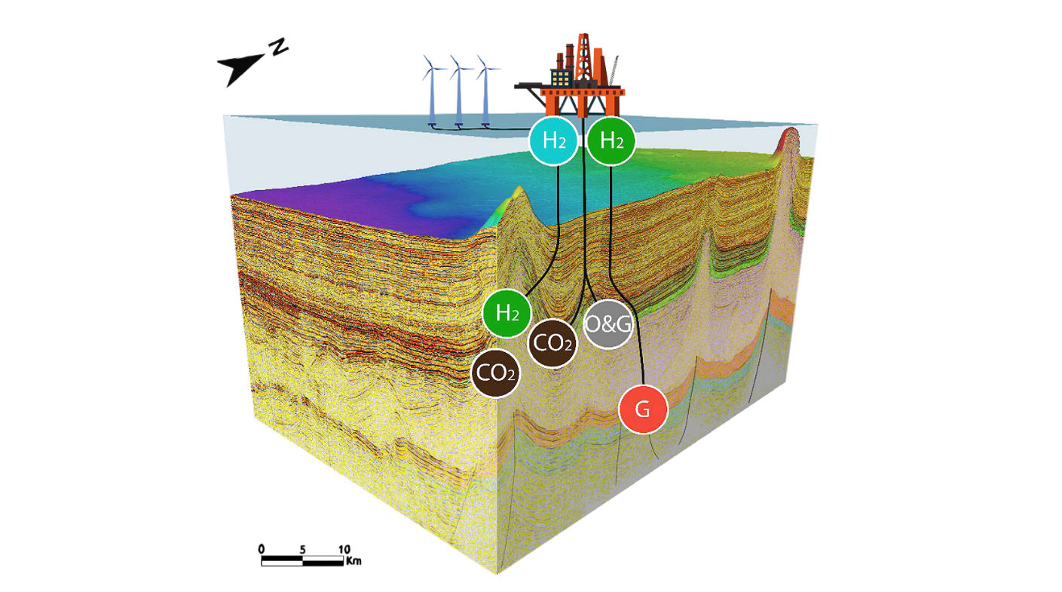
NCS2030 – a research centre for sustainable utilization of the Norwegian continental shelf
Tina Puntervold, Associate Professor, Department of Energy Resources, UiS
EOR/IOR FORCE-seminar 16th of November 2022

Slide 2
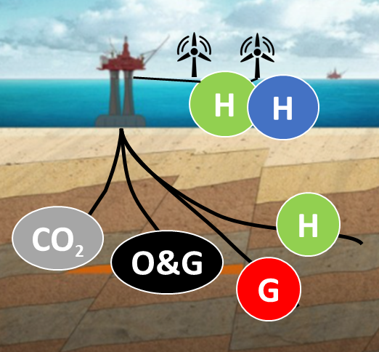
The vision of the NCS2030 centre is to facilitate an energy-efficient, multi-purpose utilization of the subsurface of the NCS into a “Sustainable Subsurface Value Chain”
Subsurface Energy Systems
Education
Outreach
Sustainable Subsurface
Value Chain
Net-zero emission production
Society
Collaboration
Innovation
Digitalization

Slide 3
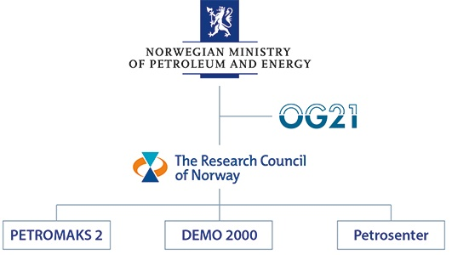
What is it the NCS2030 Petrosenter?
8 years research center (2022-2029)
Type of research project
Main objective ‘Sustainable management of the environment, resources, nature and areas’ and more specifically, the sub-goal ‘Responsible management of Norwegian petroleum resources in areas opened for petroleum activities’.
Long-term research, international level, and address specific challenges related to the exploitation of Norwegian petroleum resources. ​
Ca 120 MNOK
Vectorstock.com/2103253
80 MNOK
Ca 100 MNOK

Slide 4
NCS2030, research and user partners
User partners
Observers
Research partners

Slide 5
Initial academic and research collaborators
- National
UiO
UiT
Norwegian Petroleum Research School
- International
USA: The University of Texas at Austin, Stanford University, Virgina Tech
UK: University of Aberdeen, Imperial College
Italy: University of Basilicata
Denmark: Danish Technical University
Germany: RWTH Aachen University
Canada: Memorial University of New Foundland
Brazil: CEPETRO, Univ. Federal do Rio de Janeiro
Australia: Edith Cowan University; University of New South Wales
Initial collaborating organizations - clusters
Innovation companies
More?

Slide 6
Governance structure
General Assembly
Board
TC
Task force 3
Task force 2
Scientific Advisory Board (SAC)
Task force 1
Innovation Program
WP8
Centre Management
(CM)
Innovation Committee
WP7
Education
and outreach
Researchers, PhD / Postdocs
WP1
WP2
WP3
WP4
WP5
WP6

Slide 7
Industry challenges and opportunities for the next decades:
Energy security (energy mix) for accelerating the transition towards a sustainable society
50% emissions cut by 2030 and net-zero by 2050 (stop global warming; CO₂ taxation; Taxonomy)
Infrastructure reutilization, exploration and production life-time
Large scale storage of CO₂ and CO₂-EOR
Reduction of water production and energy consumption
Development of renewable and sustainable energy sources

Slide 8
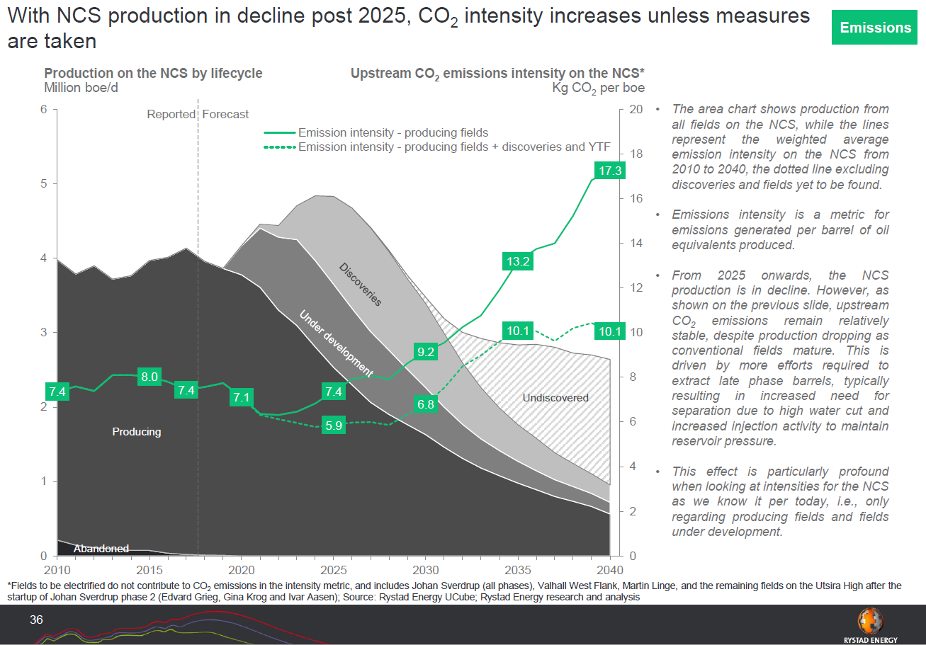
NCS – CO₂ intensity is increasing
Courtesy: Rystad supporting report, 2019, www.og21.no

Slide 9
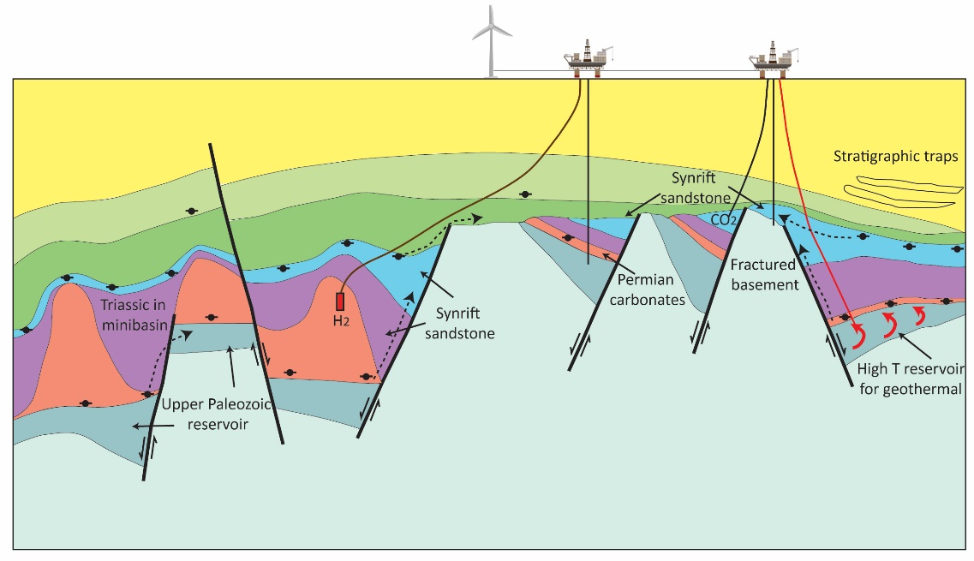
The energy transition requires large scale and multipurpose utilization of the subsurface
H2
H2
CO2
HC
HC
H2
H2
G
Sketch of the North Sea Subsurface
Notes:
In addition oil and gas, Subsurface reservoirs in the NCS can provide large capacity for storage of waste (e.g. CO2) and energy (e.g. H2), and heat extraction (e.g geothermal).
Education and research within subsurface competence are of most relevance

Slide 10
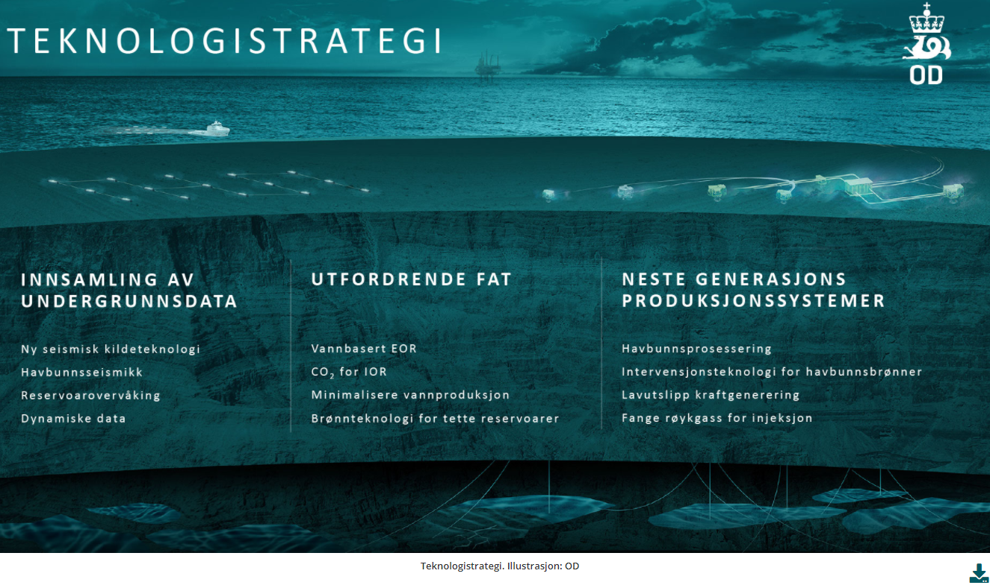
Link to OG21-NPD strategies – keywords summarizing centre activities

Slide 11
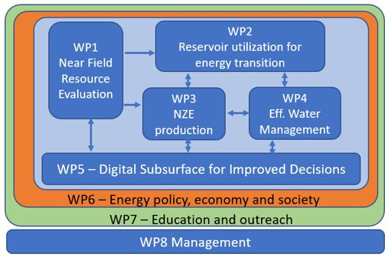
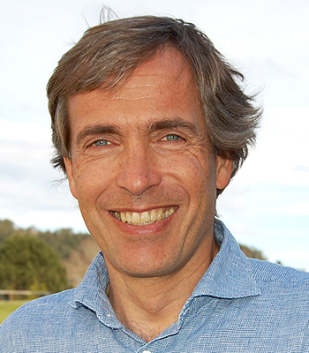
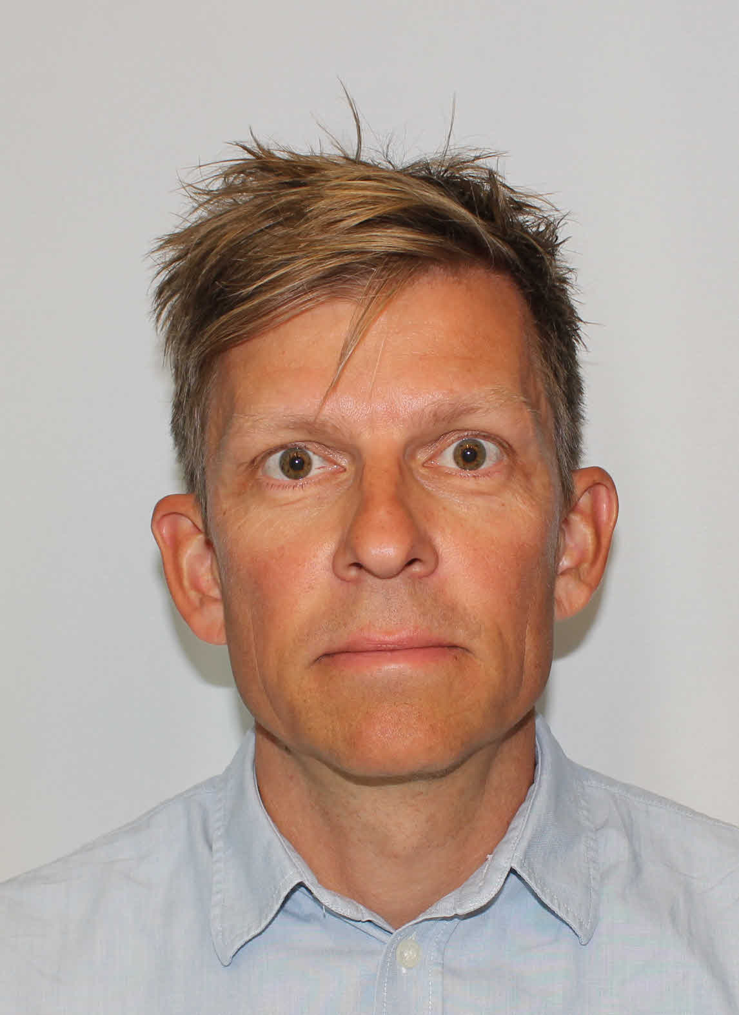
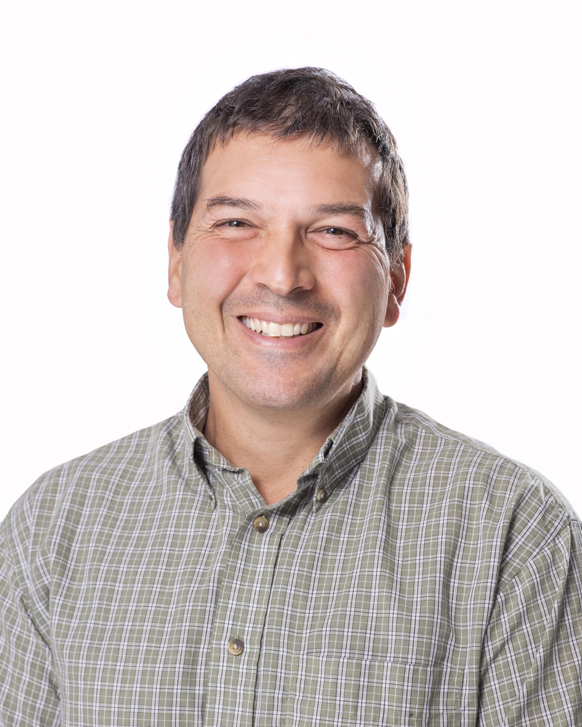
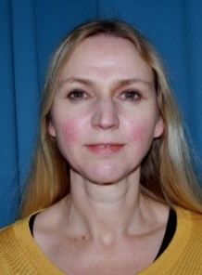
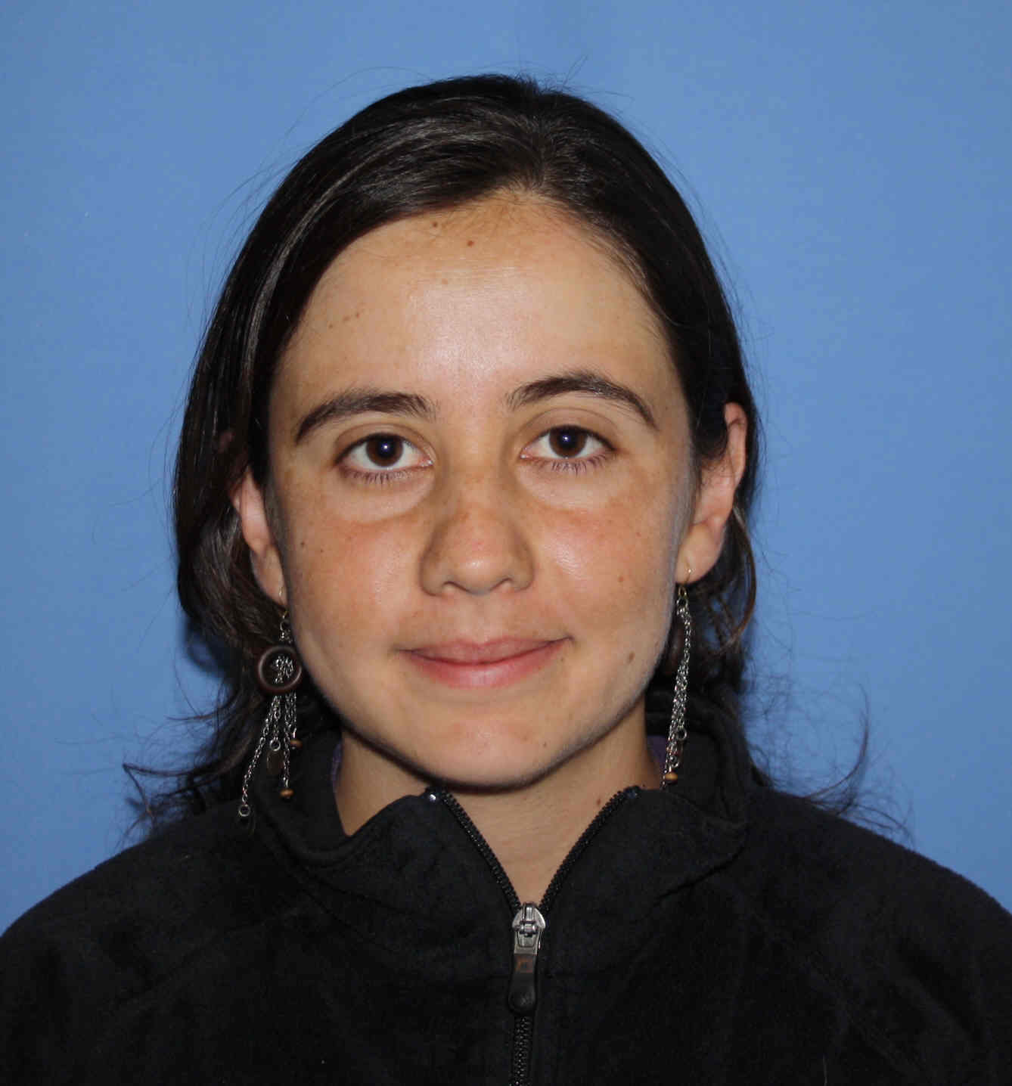
Stepháne Polteau
Viktoriya Yarushina
NCS2030 CM / WPL
Tina Puntervold
Torfinn Harding
Geir Evensen
Centre Director
Randi Valestrand
Dep. Centre Director
Innovation Director
R&D Director
Coordinator
Communications
Dora Marín
Alejandro Escalona
Ying Guo
Christian Dye
Zachary Alcorn
Siv Marie Åsen
Kjersti Riiber

Slide 12
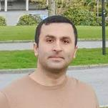
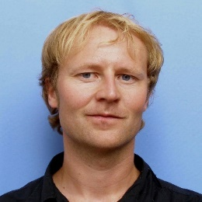
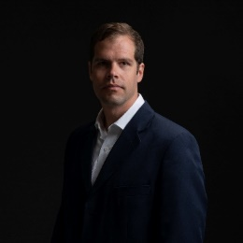
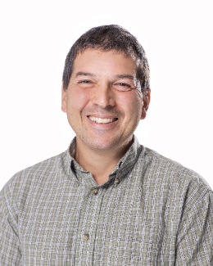
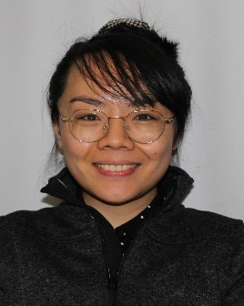
More than 40 experts with a wide range of expertise
Expect to educate at least 17 Phds and 5 Postdocs and more than 40 M.Sc

Slide 13
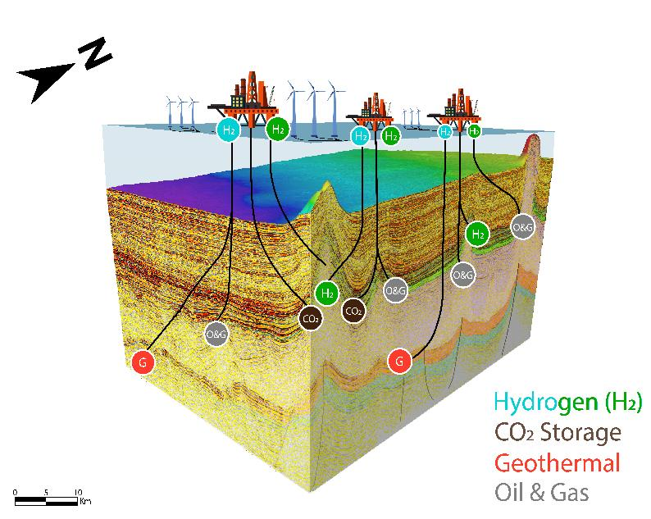
WP1 | Near field resource evaluation
Background
Large potential of yet-to-find resources near existing infrastructure. Large amounts of data. Many reservoir opportunities for storage of energy (e.g. H2) and waste (e.g. (CO2) that can extend the lifetime of the infrastructure and contribute to reduce drastically emissions
Aim
Provide a holistic representation and evaluation of the subsurface in near field areas, for energy production and storage in reservoirs in order to increase value creation and meet low carbon targets
Task 1.1 | Reservoir and seal integrity for net-zero energy production and storage
Quantitative models for reservoir prediction
Geophysical and geological scenario analyses utilizing outcrop analogues, stratigraphic forward modelling and machine learning methods
Potential to hold hydrocarbons
Suitability to store CO₂, H₂ or wastewater
As a source of geothermal energy
Characterize overburden seal integrity for
De-risking charge by correlating the signature of surface seeps to fluid sources
Quantify the fluid retention of CO₂, H₂ or wastewater of potential storage sites
Evaluate risk of leakage and fluid migration through seismic chimneys and fault structures
Task 1.2 | Source rocks and primary migration
Mapping of the distribution, type and maturation of source rocks
Understand processes of primary migration to trap within an oil-brine system
Assess basin scale fluid connectivity from basement to surface

Slide 14
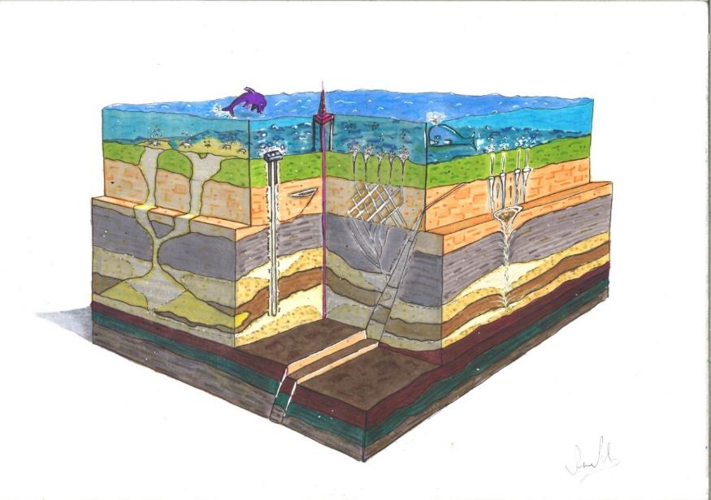
WP2 | Reservoir utilization for energy transition
Background
Renewable energy combined with H₂ production and geological CO₂ storage is a crucial part of the global energy transition and reduction of greenhouse-gas emissions. Geothermal energy can reduce GHG emissions from offshore operations
Aim
Develop methods and tools for evaluating and optimizing geological storage of CO₂ and H₂, and potential of geothermal energy production offshore
Task 2.1 | Reservoir CO2 Utilization and Storage Enhancement
Potential CO₂-EOR combined with field late life and CCS (optimize reservoir drainage strategy)
Fluid-rock interactions (trapping, impurities, storage capacity, injectivity and sweep efficiency)
Flow description, forecasting, and modeling
Subsurface tracer monitoring and mitigations
Task 2.2 | Underground H2 Storage Site Reliability Improvement
Potential storage in salt structures: geomechanical and geochemical challenges
Fluid-rock interactions for porous rocks (biological, impurities, storage capacity)
Leakage monitoring and mitigation strategies
Task 2.3 | Geothermal Heat Mining from HPHT Reservoirs
Converting HPHT reservoirs to heat extraction sites (combined with CO₂ utilization)
Characterising natural heat-flow and cooling operational conditions.
Closed loop geothermal systems, coaxial heat exchange with the reservoir

Slide 15
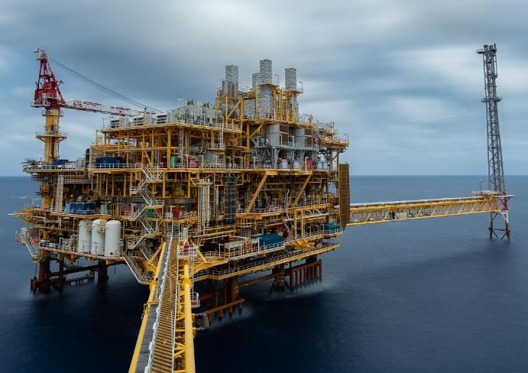
WP3 | Net Zero Emission production
Background
Approximately half the reserves on the Norwegian Continental Shelf are left behind by the end of the field lifetime due to unfavourable reservoir properties and conditions (challenging barrels).
Field production in the coming decades must comply with the Net-Zero ambition. At the same time, it is our obligation to maximise value creation from existing fields and invested infrastructure.
Aim
Contribute to carbon-neutral future on NCS by further developing cost- and energy-efficient HC recovery methods for improved and accelerated HC production at low environmental footprint.
Develop new technologies with focus on GHG emission reduction and to benefit from renewable energy sources offered by the upcoming sustainable offshore industries.
Build competence and new solutions integrating CCUS technologies for transitioning to CO2 storage for late life fields.
Task 3.1 | Maximizing value creation on NCS
Further mature EOR methods to reduce remaining oil and accelerate oil production at lower environmental footprint (smart water, green polymer, CO2 usage combined with storage)
IOR-solutions for tight reservoirs – The challenging barrels
Develop improved methods for in-situ determination and tracing of S_{or} and wettability
Develop improved near-well modelling capabilities (IORSim) for chemical reactions, hydrodynamics and injectivity issues
Task 3.2 | Real field applications for Net Zero emission production
Life cycle analysis methodology for Net Zero field improved production and emission quantification for existing and new solutions
Create net-zero emission field scenarios in collaboration with field operators
Implement new modelling capabilities for technical feasibility and economic analysis (OPM/IORSim)
Method development for improved reservoir modelling (e.g. time-lapse geophysical measurements and fibre optic data).

Slide 16
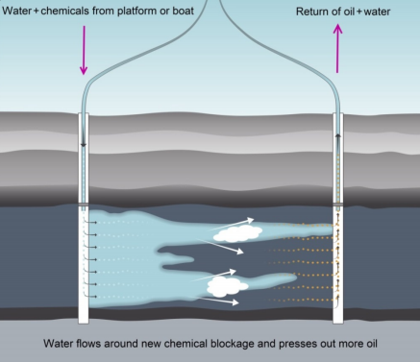
WP4 | Efficient water management
Background
Increasing amount of water is injected into and produced from aging fields. Water management is energy-consuming and costly. Large amount of injection water is recirculated and should be minimised by conformance control technologies. Reservoirs should be efficiently swept to minimize CO₂-emissions.
Aim
Deliver solutions for minimizing injection water recirculation with reduced energy needs, thus reducing the CO₂-emissions, by efficiently managing water injection and production through improved macroscopic sweep of the reservoir.
Task 4.1: Develop water-management solutions for energy-efficient production
Improved injection water conformance: Reduce back produced water and accelerated oil production at lower environmental impact.
Evaluate PWRI and water injection combined with CCS.
Task 4.2: Near-well modelling tools
Develop near-well modelling tools that incorporate the relevant injection, smart well completion and stimulation processes, including new tracer deployment methods.
Task 4.3: Real field applications for no water discharge to sea
Demonstration of methods/methodologies on field cases.
Testing/application of methods/methodologies in industry workflow with assistance from researchers.
Courtesy Equinor

Slide 17
WP5 | Digital Subsurface for Improved Decisions
Background
To increase the potential of data science, it must be aligned and used in the overall subsurface characterization, uncertainty quantification, HM and decision-making process.
Aim
Develop data-driven approaches to integrate ML into subsurface characterization, uncertainty quantification and management workflows for enhanced performance for better and faster decisions.
Task 5.1 | Data Assembly, Theory-guided Data science and Multi-Fidelity Modeling
Develop schemes for data selection, assembly and formatting.
Construct tools for automated labelling and quality checking.
Establish the Subsurface Knowledge Cloud digital platform.
Building proxy models through ML for fast modelling and optimization.
Characterizing errors of proxy models by combining physics-based models, empirical correlations and data science.
Couple state-of-the-art history-matching methods with ML-enhanced reservoir flow simulator.
Develop multi-fidelity data assimilation and optimization for flexibility and speed in reservoir management
Task 5.2 | Uncertainty quantification with multiple viable scenarios
Method development for uncertainty quantification with multiple scenarios
Method development for selecting a reduced number of scenarios (screening)
Develop multi-scenario data assimilation and optimization for more robust decisions and forecasting.
Task 5.3 | Improved Workflow for Decision Analysis
Use hybrid ML and ensemble-based inversion algorithms for improved reservoir management.
Develop new methods for dimensionality reduction to handle big models and field datasets.
Use ML for unbiased uncertainty quantification and decision support.
Use ML to inform sequential and multi-objective decision-making including the assessment of value-of-information and value-of-flexibility.

Slide 18
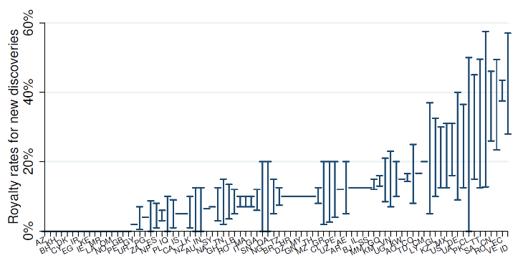
WP6 | Energy policy, economy and society
Enough fossil fuels already discovered – only those with low production costs will be extracted
Background
Climate change mitigation likely to decrease the oil price and make the business climate less supportive of the NCS
Increased international competition for delivering the last drop of oil
Pressure downwards on revenues, production and exploration on NCS
Focus on decision-making under risk and uncertainty, building on frameworks of risk, business principles and economics
Aim
Analyse the international and national business climate for energy production activities at the NCS throughout the value chain in the context of viable policies and societal aspects.
Task 6.1 Business climate (licenses, taxes, infrastructure, human capital)
Balancing investing in profitable projects and avoiding stranded assets
Increasing discrepancies in the interests of the oil sector, the state and the wider society
Increasing risk premiums, political scrutiny and competition in exploration and production
The roles of gas, CCS and Hydrogen for investments, production costs and profitability
What are the viable policy options that balance politics, economics and the environment?
What is the role of the oil sector in the energy transition?
Task 6.2 Emissions
Production vs. consumption emissions
Oil sector related measures to curb emissions, e.g., supply side measures and electrification
Leakage across countries and energy sources
Task 6.3 Acceptance evaluation
Risk and business principles and methods for evaluating quality of subsurface solutions
Use of multi-criteria decision-making approaches and prioritization of measures
Risk and uncertainty communication issues
Source: McGlade and Ekins (2015)
High potential of reducing distortive taxes across countries – will there be a race to the bottom?
Source: Ahlvik et al. (2021)

Slide 19
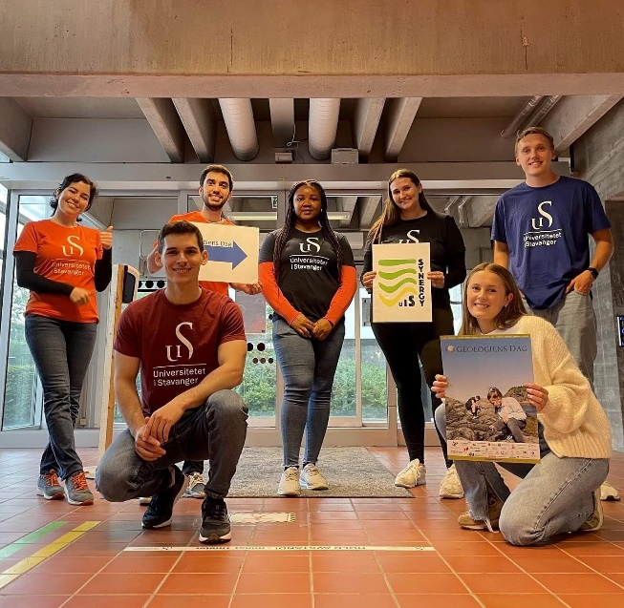
WP7 | – Education and outreach
>21 PhDs and Postdocs, ca 40 master students
Norway Energy conference on subsurface as an energy-sustainable system (March 2022)
School activities on subsurface utilization and sustainability
Research date - "Forskningsdagene"
Public discussions, white papers
Active research-based education / Subsurface Academy
Webinars
Forskerskole
19

Slide 20
26 research projects starting this year
WP | Project number | Project name | Project Manager | Partner
WP1 | 1 | WP1.1 Quantitative cross-disciplinary resource evaluation | Tuhin Bhakta | NORCE
WP1 | 2 | WP1.2 Salt characterization and modeling for the future energy mix​ (PhD) | Dora Marín | UiS
WP1 | 3 | WP1.3 Basin-scale fluid connectivity | Stéphane Polteau | IFE
WP1 | 4 | WP1.4 Next Generation of Petroleum/CO2 -Brine System Models | Stéphane Polteau | IFE
WP1 | 5 | WP1.5 Develop new workflows in the salt province of the Norwegian North Sea for evaluating the potential for CO2/H2 storage and geothermal energy | Rob Berendsen | Landmark
WP1 | 6 | WP1.6 Near field resource evalaution using solutions from the DELFI’s Petrotehcnical Suite | Pierre Le Guern | Schlumberger
WP2 | 1 | WP2.1 Physics of focused fluid flow in sedimentary basins​ | Viktoriya Yarushina | IFE
WP2 | 2 | WP2.2 Recommended practice for numerical modelling of geomechanical behavior of various fields on the NCS | Viktoriya Yarushina | IFE
WP2 | 3 | WP2.3 Tracers and tracing methods for utilization of the NCS in the energy transition | Mário Silva | IFE
WP2 | 4 | WP2.4 Hydrogen storage and back-production in porous media | Ingebret Fjelde | NORCE
WP3 | 1 | WP3.1 Tight reservoir solutions (PhD)​ | T. Puntervold/A. Omekeh | UiS/NORCE
WP3 | 2 | WP3.2 CO2 utilization (UiBPhD) | Z. Alcorn/I. Fjelde | UiB/NORCE
WP3 | 3 | WP3.3 Improved tracing​ | Sissel Viig | IFE
WP4 | 1 | WP4.1 Deep water diversion for minimizing CO2 footprint | R. Askarinezhad/P. Andersen | NORCE
WP4 | 2 | WP4.2 Optimization of injection water for IOR (PhD) | T. Puntervold/I. Fjelde | UiS/NORCE
WP4 | 3 | WP4.3 IORSim modeling for near wellbore geochemistry and geomechanics (NorcePhD) | B. Antonsen/A. Omekeh | IFE/NORCE
WP5 | 1 | WP5.1 ​Federated Knowledge Cloud for Subsurface Digitalization across Multiple Sites (UiSPhD) | Chunming Rong | UiS
WP5 | 2 | WP5.2 Multi-fidelity models, scenario evaluation and probabilistic forecasts for the digital subsurface (UiSPhD) | Kristian Fossum | NORCE
WP5 | 3 | WP5.3 Reservoir-management workflows for decision-making | Geir Evensen | NORCE
WP5 | 4 | WP5.4 Hybrid ensemble algorithms applied to CO2/H2 utilization and storage (UiSPhD) | Xiaodong Luo | NORCE
WP5 | 5 | WP5.5 Develop and support knowledge cloud for subsurface digitalization across multiple sites | Rob Berendsen | Landmark
WP5 | 6 | WP5.6 Explore, develop, test and deploy new automated workflows that utilize cloud storage data and cloud compute infrastructure | Pierre Le Guern | Schlumberger
WP6 | 1 | WP6.1 ​ NCS, the business climate, and market characteristics | Torfinn Harding | UiS
WP6 | 2 | WP6.2 Avoidance of stranded assets | Torfinn Harding | UiS
WP6 | 3 | WP6.3 Energy transition and the NCS | Mari Authen | IFE
WP6 | 4 | WP6.4 Acceptance evaluation | Torfinn Harding | UiS

Slide 21
Proposed NCS2030 master theses 2023 – opportunity for companies to suggest and co-supervise thesis projects!
New energy and storage opportunities:
Lithological heterogeneities in the Zechstein Group: Implications for hydrogen storage and drilling risk​
Geothermal energy opportunities in the Utsira High​
High-temperature storage systems opportunities in the North Sea
Lateral extension of the Rogaland sandstone in the southern North Sea: Implications for CO₂ storage
Efficient Water Management for NZE
Wellbore and reservoir leakage detection and monitoring with downhole gauges​
Net-Zero effect of selected conformance improvement techniques at NCS – a preliminary study
CO₂-based foams for conformance improvement at the NCS - Also to reduce CO₂ footprint?
Laboratory study of selected water diversion techniques
Preliminary study of the LCA for various suitable conformance improvement techniques at the NCS
Use of conformance control chemicals as CO₂ barrier for geological storage of CO₂
Reservoir Utilization for Energy Transition​
Deformation of unconsolidated sediments and its impact on CO₂ storage​
Modeling of induced seismicity during subsurface operations​
Net-Zero Emission (NZE) Production​
Well stimulation for tight North Sea reservoirs
Interactions of H₂-phase with rock/minerals and fluid phases during geological storage of H₂​
Alteration of rock properties during geological storage of H₂​
Injectivity of carbonated water with different CO₂ concentration into different rock types​
Rock integrity during injection of carbonated water into different rock types​
Improvement of volumetric sweep efficiency during oil production using ECO-clay​
Optimization of reinjection of produced water into different reservoir types​
Experimental work on multiphase flow and fluid production in core plugs
Reactive flow modelling with presence of a catalytic reaction in porous media – an insight into hydrogen production in a porous medium
Digital Subsurface for Improved Decisions
Core images and ML tools in the public and private repositories for rock property estimation​

Slide 22
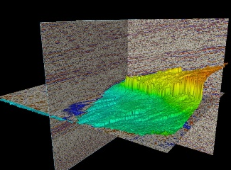
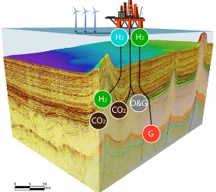
SURE
Subsurface utilization for
renewable energy
Regional Basin Studies
2 PhDs
2 Master
2 PhDs
1 Postdoc
1 Bachelor
Associated projects
Intpart
Brazil-Norway BN-REC
SUBSET
Subsurface courses for the
energy industry of the future
Twinning to sustainable
energy transition

Slide 23
A key to success: building collaboration and synergies with other centres for increased value and societal impact
Others
v

Slide 24
Innovation, a world of opportunities
NCS 2030
Innovation Forum
Idea/IP1
IP #, Contract #
SMBs
Scientists
Idea/IP2
NES
Idea/IP3
Valide/
TTOs
Funding
IPN/KPN/DEMO
IP ##, Contract ##
Idea/IP4
Innovation committee
Centre induced funding??
Idea/IP##
IP ###, Contract ###
Information flow

Slide 26
NCS2030 - Key figures
Goal
Facilitate to create sustainable subsurface value chains on NCS ​
Scope
4 main topics, 8 Work packages, 26 projects (2022-)
8 industrial end users, large number of national and international academic collaborators, innovation centres, clusters and SMBs
Collaboration
Budget
300 MNOK (30 M$) for 8 years (2022 – 2029)

Slide 27
NCS2030 – Preparing for the future
Sustainable reservoir utilization
Near field exploration and tie-ins for maximising value creation from existing infrastructure
Synergy with CCS and H2 storage
Maximising resource value creation
Emission reduction
IOR / EOR
Water Management
Digitalization
Efficient use of big data
Faster and better reservoir models
New digitalization solutions to improve cost efficiency
Social responsibility
Building frameworks of risk, business principles and economics
Integrate climate policy to increase competitiveness and public acceptant for delivering the last drop of oil

Slide 29
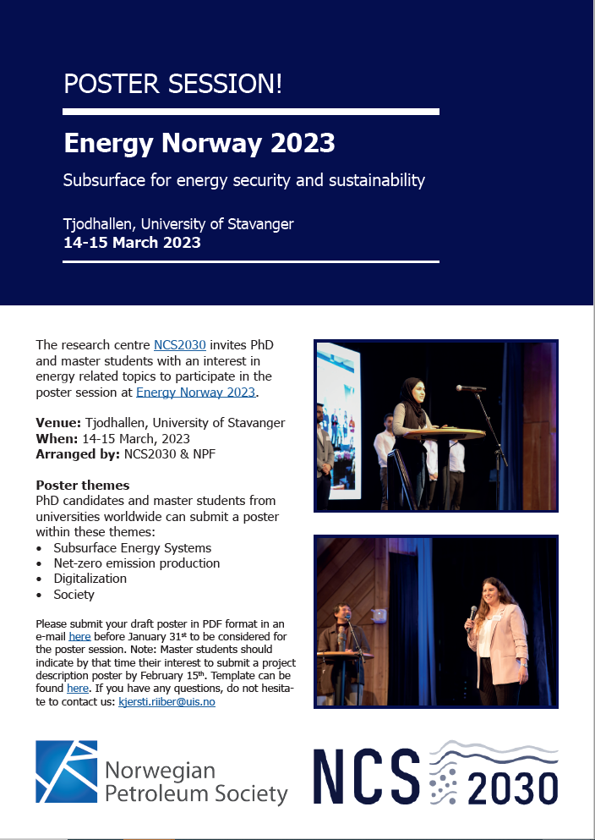
Energy Norway 2023:
Focus on the young and upcoming generation!
Read more about Energy Norway 2023 here:
https://www.uis.no/en/energy/energy-norway-2023

Slide 30
Acknowledgement
The author(s) acknowledge the Research Council of Norway and the industry partners of NCS2030 – RCN project number 331644 – for their support.

Slide 31
User partners & observers

