Slide 1
NCS2030 – IOR/EOR aspects
Tina Puntervold, Associate Professor, Department of Energy Resources, University of Stavanger
EOR/IOR FORCE-seminar 16th of November 2022

Slide 2

Challenge in the next decades:
Provide energy security (energy mix)
- while accelerating the transition towards a sustainable society
- and reach 50% emissions cut by 2030 and net-zero by 2050

Slide 3
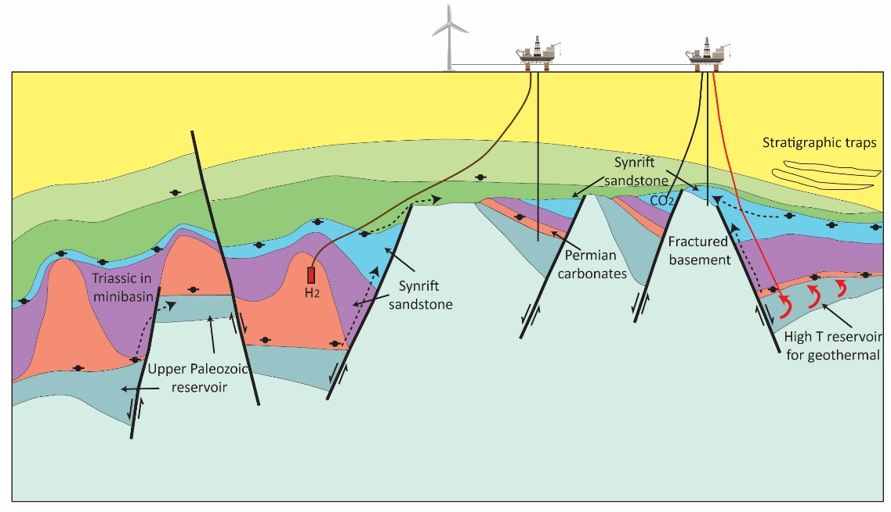
The energy transition requires large scale and multipurpose utilization of the subsurface
H2
H2
CO2
HC
HC
H2
H2
G
Sketch of the North Sea Subsurface
Notes:
In addition oil and gas, Subsurface reservoirs in the NCS can provide large capacity for storage of waste (e.g. CO2) and energy (e.g. H2), and heat extraction (e.g geothermal).
Education and research within subsurface competence are of most relevance

Slide 4
How can IOR/EOR contribute to reaching the ambitious emission reduction goals?

Slide 5
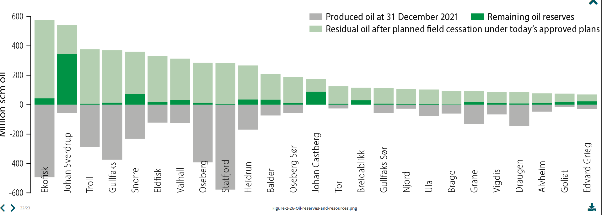
NCS – Large potential for the next decades
NPD Resource report 2022

Slide 6
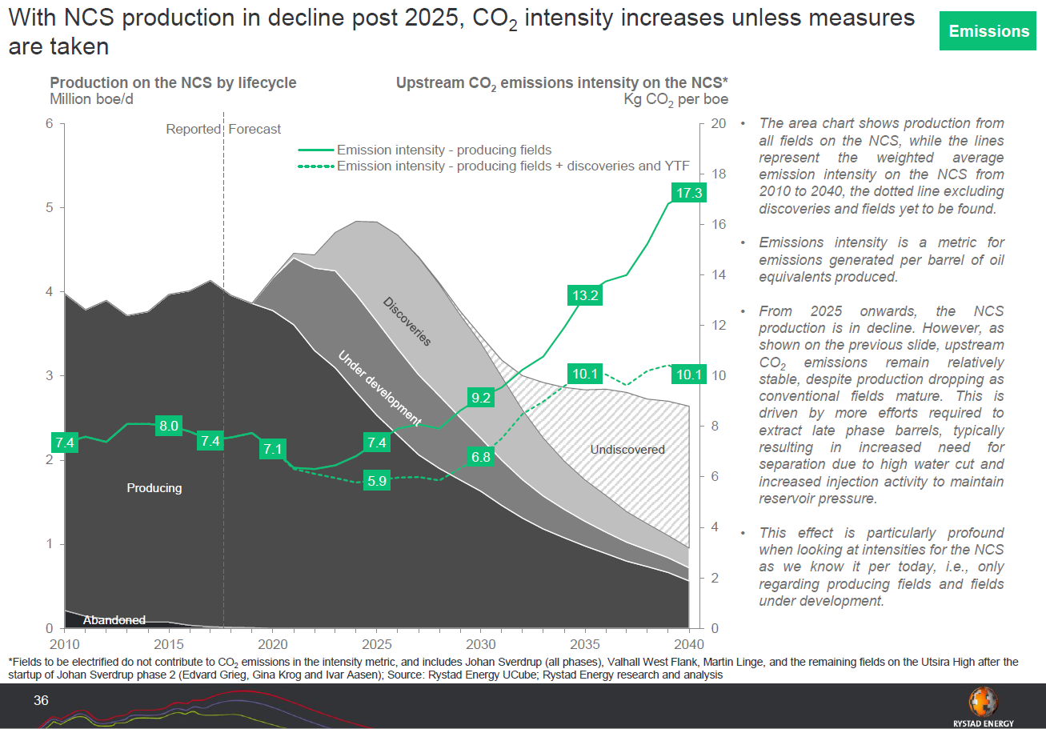
NCS – CO₂ intensity is increasing
Courtesy: Rystad supporting report, 2019, www.og21.no

Slide 7
NCS Fields are maturing
Courtesy: Ying Guo (NORCE), 2022.05

Slide 8
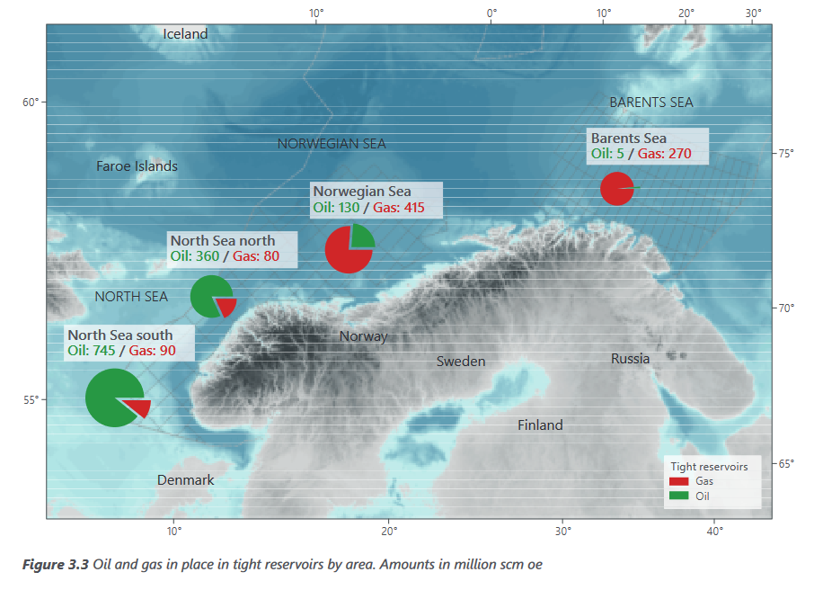
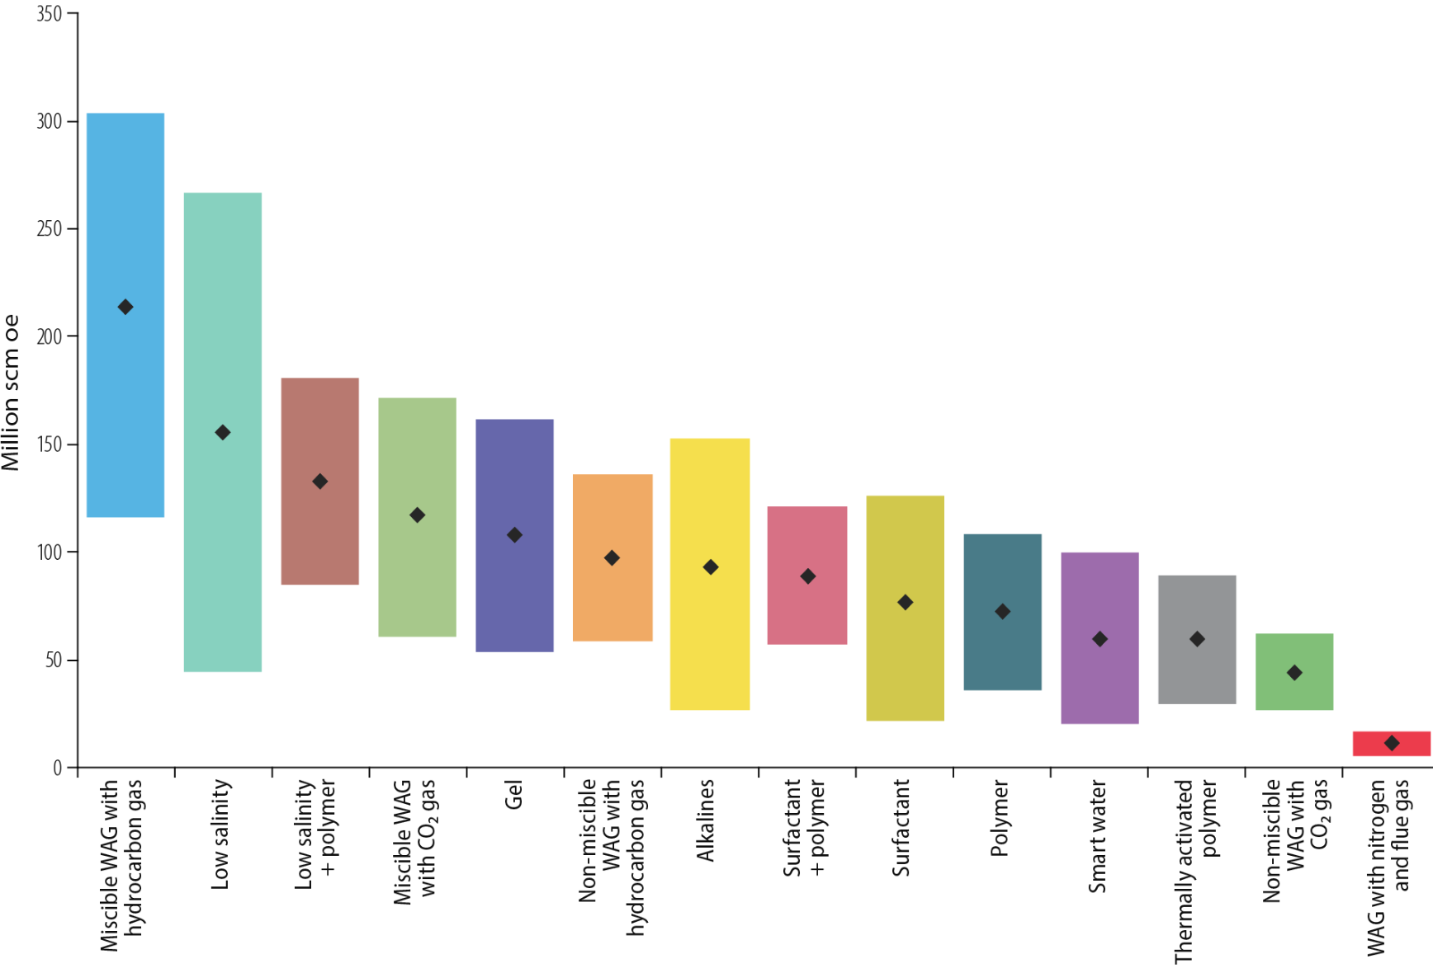
NCS - IOR / EOR are still very important for producing oil and decreasing water cut
Courtesy: NPD Resource Report, 2019 – Discovery and fields. www.npd.no
Courtesy: NPD Resource Report, 2022 – Discovery and fields. www.npd.no

Slide 9
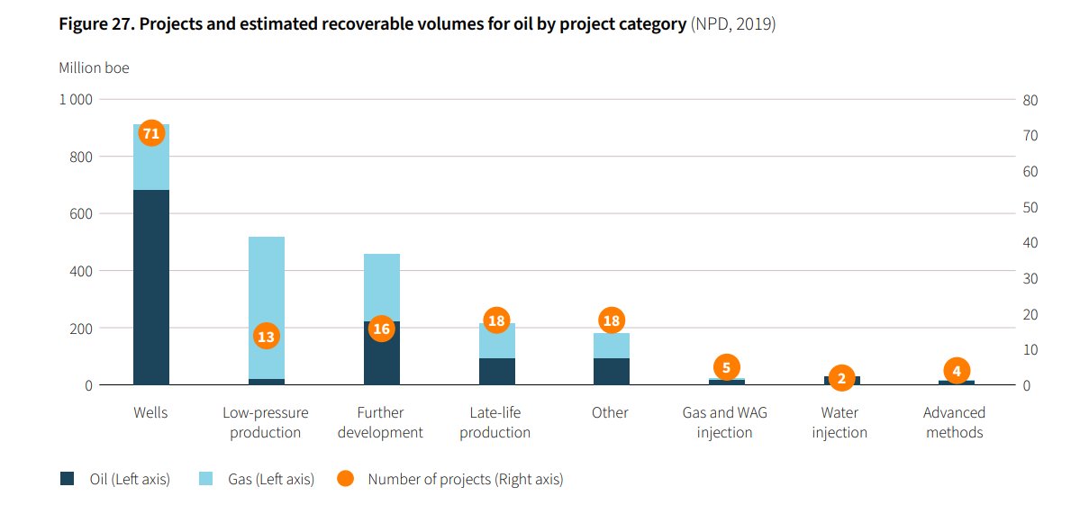
NCS – Competetive recovery rate, but…
… very few advanced IOR/EOR methods have been implemented to recover ‘left-behind’ HC
Ref: OG21 – Strategy 2021
Notes:
…but very few advanced methods to recover ‘left-behind’ HC.

Slide 10
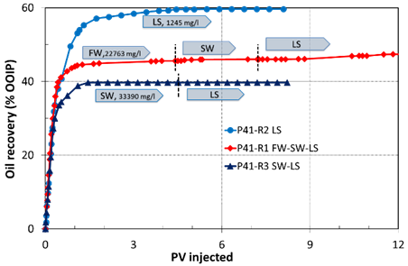
We need to start early! Example of low salinity waterflooding
Reservoir B at NCS T_{res}> 130 °C
Brines tested:
-LS (1 245 ppm) in secondary and tertiary
  0.3 mM Ca²⁺, 1.8 mM Mg²⁺
-FW (22 763 ppm) in secondary.
  3.5 mM Ca²⁺, 1.4 mM Mg²⁺
--SW (33 390 ppm) in secondary
  13 mM Ca²⁺ , 45 mM Mg²⁺
(Ref. Z. Aghaeifar PhD-thesis 2020)
LS injection most promising!
No LS EOR effect after seawater flooding in this case!

Slide 11
We should not wait to do EOR when we can use “EOR-methods” to do IOR instead.

Slide 12
IOR and EOR in NCS2030

Slide 13
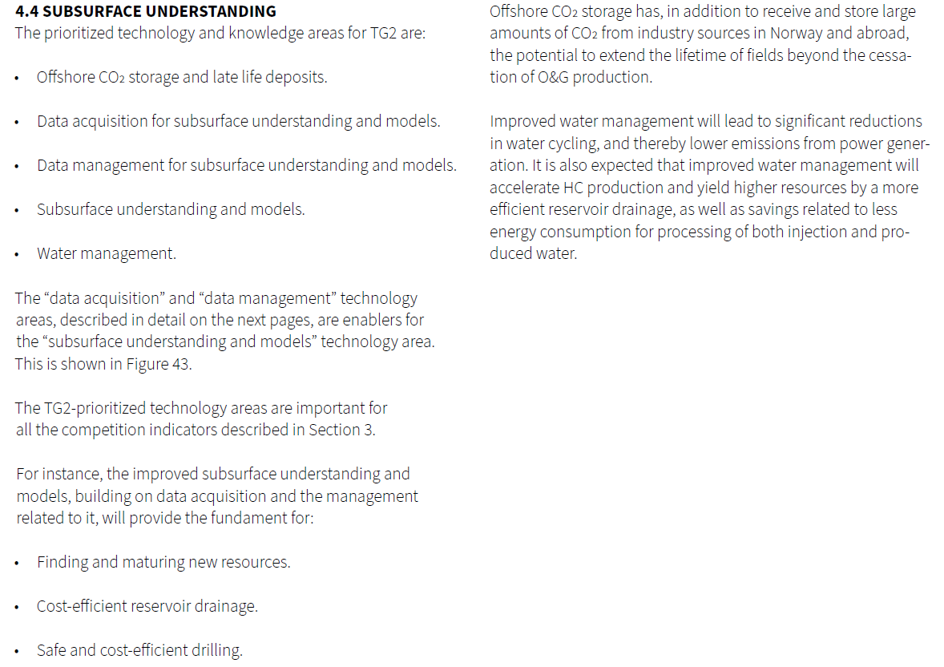
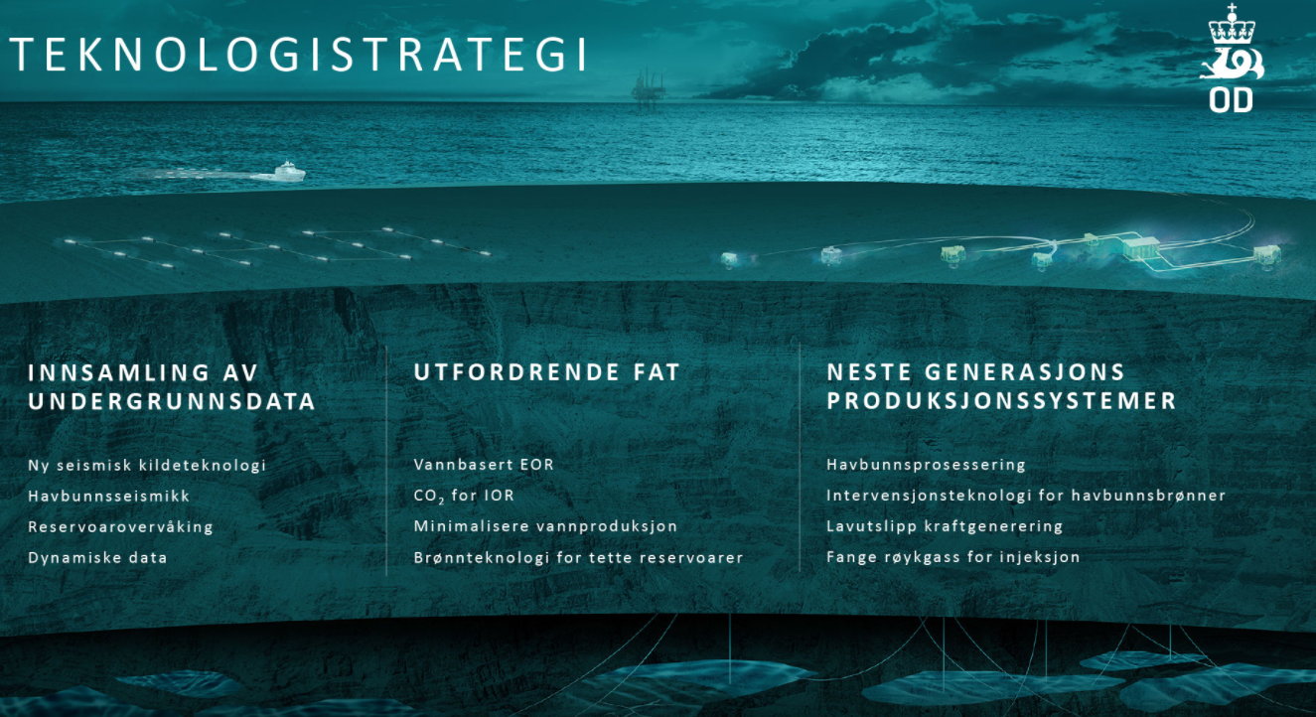
Inspired by OG21 and NPD strategies

Slide 14
6 projects linked to IOR starting this year
WP | Project number | Project name | Project Manager | Partner
WP1 | 1 | WP1.1 Quantitative cross-disciplinary resource evaluation | Tuhin Bhakta | NORCE
WP1 | 2 | WP1.2 Salt characterization and modeling for the future energy mix​ (PhD) | Dora Marín | UiS
WP1 | 3 | WP1.3 Basin-scale fluid connectivity | Stéphane Polteau | IFE
WP1 | 4 | WP1.4 Next Generation of Petroleum/CO2 -Brine System Models | Stéphane Polteau | IFE
WP1 | 5 | WP1.5 Develop new workflows in the salt province of the Norwegian North Sea for evaluating the potential for CO2/H2 storage and geothermal energy | Rob Berendsen | Landmark
WP1 | 6 | WP1.6 Near field resource evalaution using solutions from the DELFI’s Petrotehcnical Suite | Pierre Le Guern | Schlumberger
WP2 | 1 | WP2.1 Physics of focused fluid flow in sedimentary basins​ | Viktoriya Yarushina | IFE
WP2 | 2 | WP2.2 Recommended practice for numerical modelling of geomechanical behavior of various fields on the NCS | Viktoriya Yarushina | IFE
WP2 | 3 | WP2.3 Tracers and tracing methods for utilization of the NCS in the energy transition | Mário Silva | IFE
WP2 | 4 | WP2.4 Hydrogen storage and back-production in porous media | Ingebret Fjelde | NORCE
WP3 | 1 | WP3.1 Tight reservoir solutions (PhD)​ | T. Puntervold/A. Omekeh | UiS/NORCE
WP3 | 2 | WP3.2 CO2 utilization (UiBPhD) | Z. Alcorn/I. Fjelde | UiB/NORCE
WP3 | 3 | WP3.3 Improved tracing​ | Sissel Viig | IFE
WP4 | 1 | WP4.1 Deep water diversion for minimizing CO2 footprint | R. Askarinezhad/P. Andersen | NORCE
WP4 | 2 | WP4.2 Optimization of injection water for IOR (PhD) | T. Puntervold/I. Fjelde | UiS/NORCE
WP4 | 3 | WP4.3 IORSim modeling for near wellbore geochemistry and geomechanics (NorcePhD) | B. Antonsen/A. Omekeh | IFE/NORCE
WP5 | 1 | WP5.1 ​Federated Knowledge Cloud for Subsurface Digitalization across Multiple Sites (UiSPhD) | Chunming Rong | UiS
WP5 | 2 | WP5.2 Multi-fidelity models, scenario evaluation and probabilistic forecasts for the digital subsurface (UiSPhD) | Kristian Fossum | NORCE
WP5 | 3 | WP5.3 Reservoir-management workflows for decision-making | Geir Evensen | NORCE
WP5 | 4 | WP5.4 Hybrid ensemble algorithms applied to CO2/H2 utilization and storage (UiSPhD) | Xiaodong Luo | NORCE
WP5 | 5 | WP5.5 Develop and support knowledge cloud for subsurface digitalization across multiple sites | Rob Berendsen | Landmark
WP5 | 6 | WP5.6 Explore, develop, test and deploy new automated workflows that utilize cloud storage data and cloud compute infrastructure | Pierre Le Guern | Schlumberger
WP6 | 1 | WP6.1 ​ NCS, the business climate, and market characteristics | Torfinn Harding | UiS
WP6 | 2 | WP6.2 Avoidance of stranded assets | Torfinn Harding | UiS
WP6 | 3 | WP6.3 Energy transition and the NCS | Mari Authen | IFE
WP6 | 4 | WP6.4 Acceptance evaluation | Torfinn Harding | UiS

Slide 15
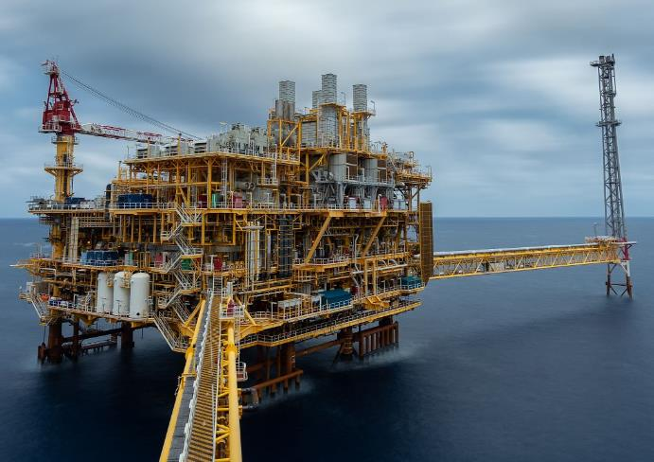
WP3 | Net Zero Emission production
Background
Approximately half the reserves on the Norwegian Continental Shelf are left behind by the end of the field lifetime due to unfavourable reservoir properties and conditions (challenging barrels).
Field production in the coming decades must comply with the Net-Zero ambition. At the same time, it is our obligation to maximise value creation from existing fields and invested infrastructure.
Aim
Contribute to carbon-neutral future on NCS by further developing cost- and energy-efficient HC recovery methods for improved and accelerated HC production at low environmental footprint.
Develop new technologies with focus on GHG emission reduction and to benefit from renewable energy sources offered by the upcoming sustainable offshore industries.
Build competence and new solutions integrating CCUS technologies for transitioning to CO2 storage for late life fields.
Task 3.1 | Maximizing value creation on NCS
Further mature EOR methods to reduce remaining oil and accelerate oil production at lower environmental footprint (smart water, green polymer, CO2 usage combined with storage)
IOR-solutions for tight reservoirs – The challenging barrels
Develop improved methods for in-situ determination and tracing of S_{or} and wettability
Develop improved near-well modelling capabilities (IORSim) for chemical reactions, hydrodynamics and injectivity issues
Task 3.2 | Real field applications for Net Zero emission production
Life cycle analysis methodology for Net Zero field improved production and emission quantification for existing and new solutions
Create net-zero emission field scenarios in collaboration with field operators
Implement new modelling capabilities for technical feasibility and economic analysis (OPM/IORSim)
Method development for improved reservoir modelling (e.g. time-lapse geophysical measurements and fibre optic data).

Slide 16
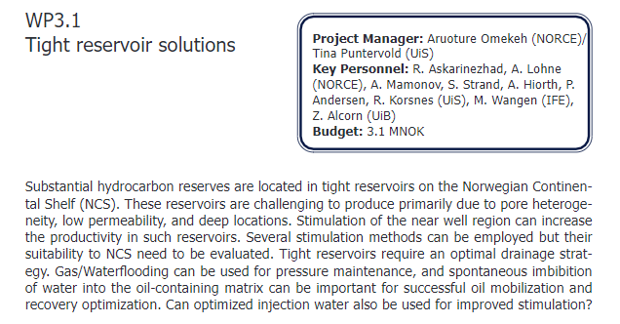
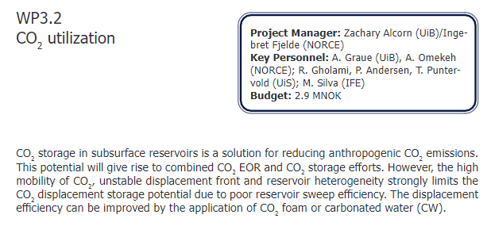
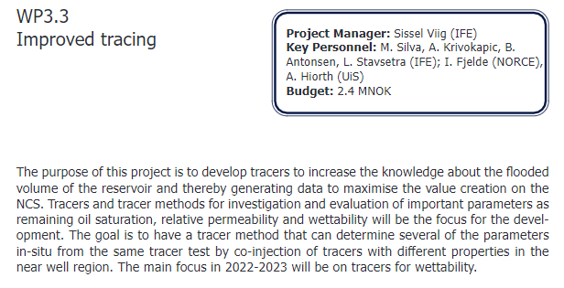
3 projects starting in 2022

Slide 17
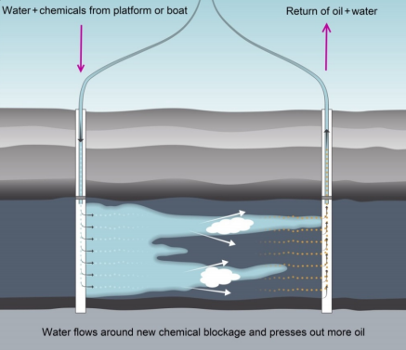
WP4 | Efficient water management
Background
Increasing amount of water is injected into and produced from aging fields. Water management is energy-consuming and costly. Large amount of injection water is recirculated and should be minimised by conformance control technologies. Reservoirs should be efficiently swept to minimize CO₂-emissions.
Aim
Deliver solutions for minimizing injection water recirculation with reduced energy needs, thus reducing the CO₂-emissions, by efficiently managing water injection and production through improved macroscopic sweep of the reservoir.
Task 4.1: Develop water-management solutions for energy-efficient production
Improved injection water conformance: Reduce back produced water and accelerated oil production at lower environmental impact.
Evaluate PWRI and water injection combined with CCS.
Task 4.2: Near-well modelling tools
Develop near-well modelling tools that incorporate the relevant injection, smart well completion and stimulation processes, including new tracer deployment methods.
Task 4.3: Real field applications for no water discharge to sea
Demonstration of methods/methodologies on field cases.
Testing/application of methods/methodologies in industry workflow with assistance from researchers.
Courtesy Equinor

Slide 18
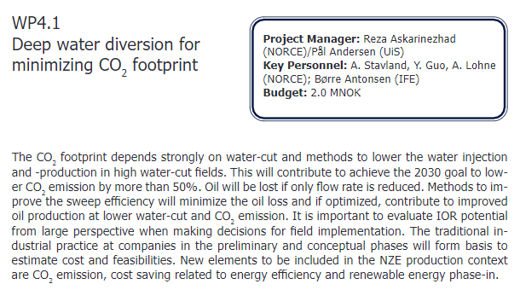
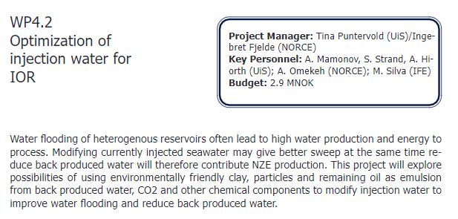
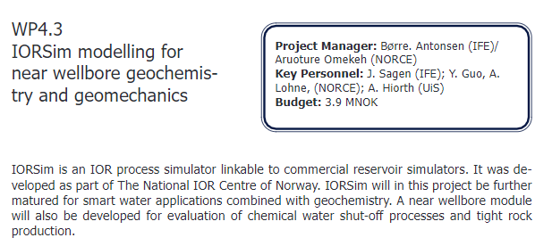
3 projects starting in 2022

Slide 19
Planned NCS2030 Master thesis topics 2023 related to the ongoing projects
New energy and storage opportunities:
Lithological heterogeneities in the Zechstein Group: Implications for hydrogen storage and drilling risk​
Geothermal energy opportunities in the Utsira High​
High-temperature storage systems opportunities in the North Sea
Lateral extension of the Rogaland sandstone in the southern North Sea: Implications for CO₂ storage
Efficient Water Management for NZE
Wellbore and reservoir leakage detection and monitoring with downhole gauges​
Net-Zero effect of selected conformance improvement techniques at NCS – a preliminary study
CO₂-based foams for conformance improvement at the NCS - Also to reduce CO₂ footprint?
Laboratory study of selected water diversion techniques
Preliminary study of the LCA for various suitable conformance improvement techniques at the NCS
Use of conformance control chemicals as CO₂ barrier for geological storage of CO₂
Reservoir Utilization for Energy Transition​
Deformation of unconsolidated sediments and its impact on CO₂ storage​
Modeling of induced seismicity during subsurface operations​
Net-Zero Emission (NZE) Production​
Well stimulation for tight North Sea reservoirs
Interactions of H₂-phase with rock/minerals and fluid phases during geological storage of H₂​
Alteration of rock properties during geological storage of H₂​
Injectivity of carbonated water with different CO₂ concentration into different rock types​
Rock integrity during injection of carbonated water into different rock types​
Improvement of volumetric sweep efficiency during oil production using ECO-clay​
Optimization of reinjection of produced water into different reservoir types​
Experimental work on multiphase flow and fluid production in core plugs
Reactive flow modelling with presence of a catalytic reaction in porous media – an insight into hydrogen production in a porous medium
Digital Subsurface for Improved Decisions
Core images and ML tools in the public and private repositories for rock property estimation​

Slide 20
The legacy from
The National IOR Centre of Norway
A petro centre hosted by UiS 2013-2021

Slide 21
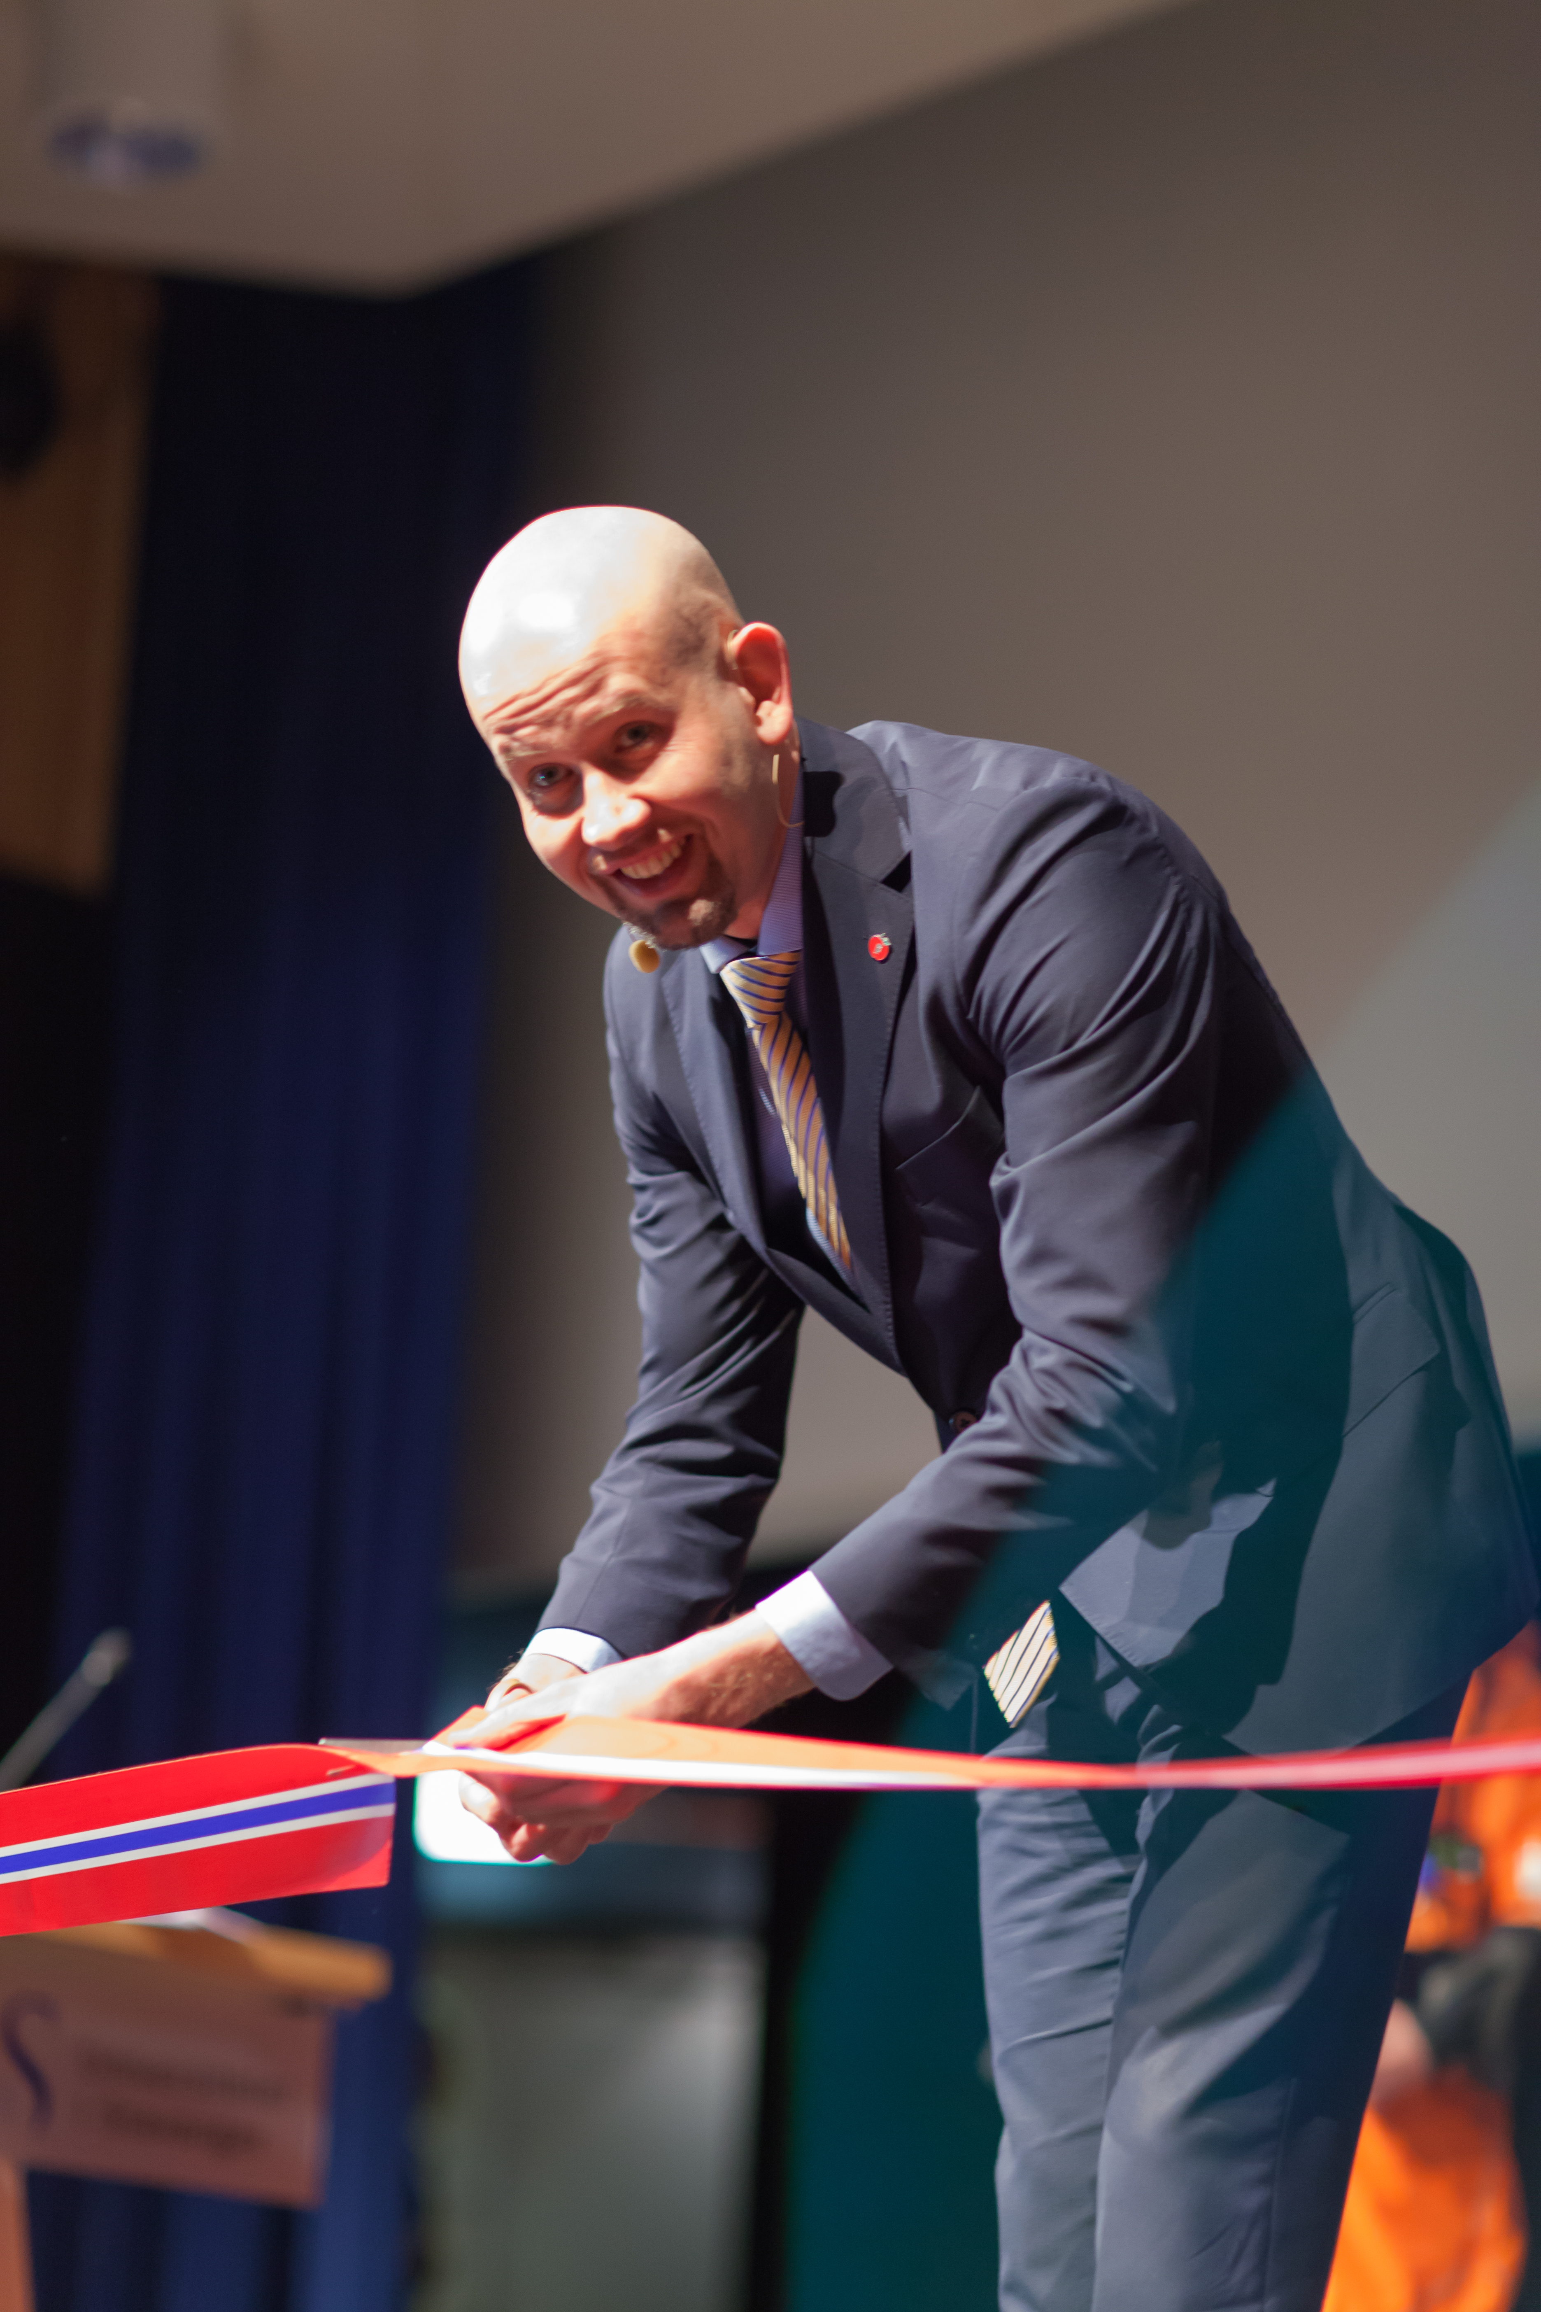
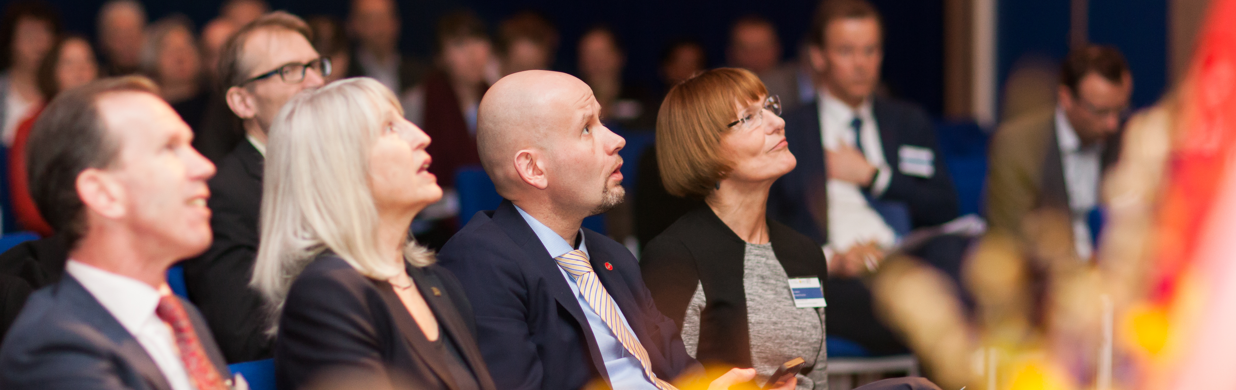
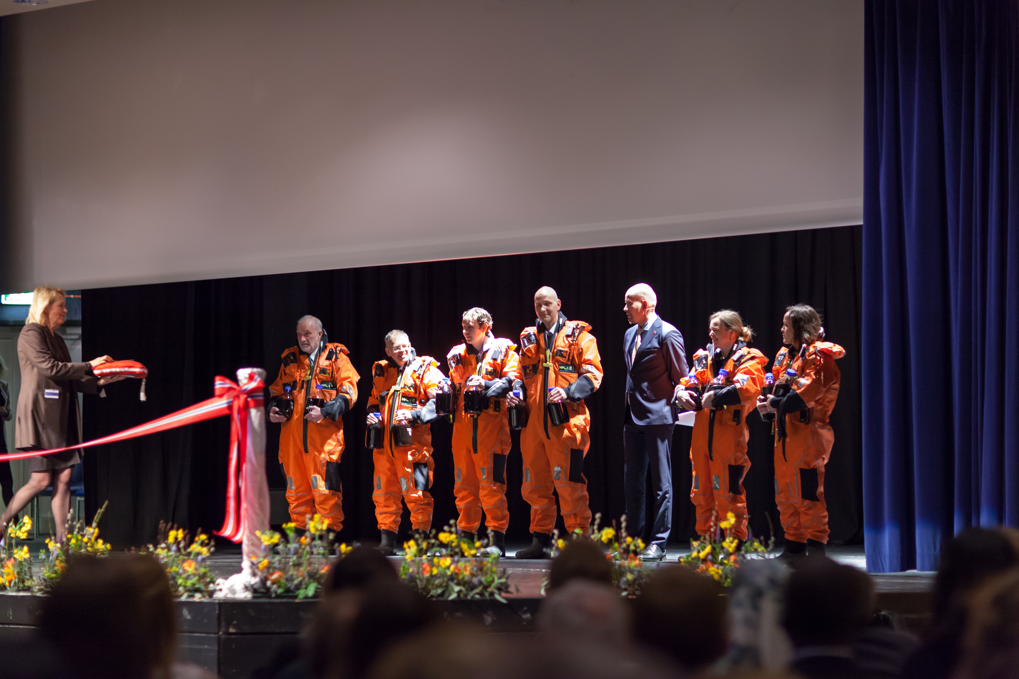
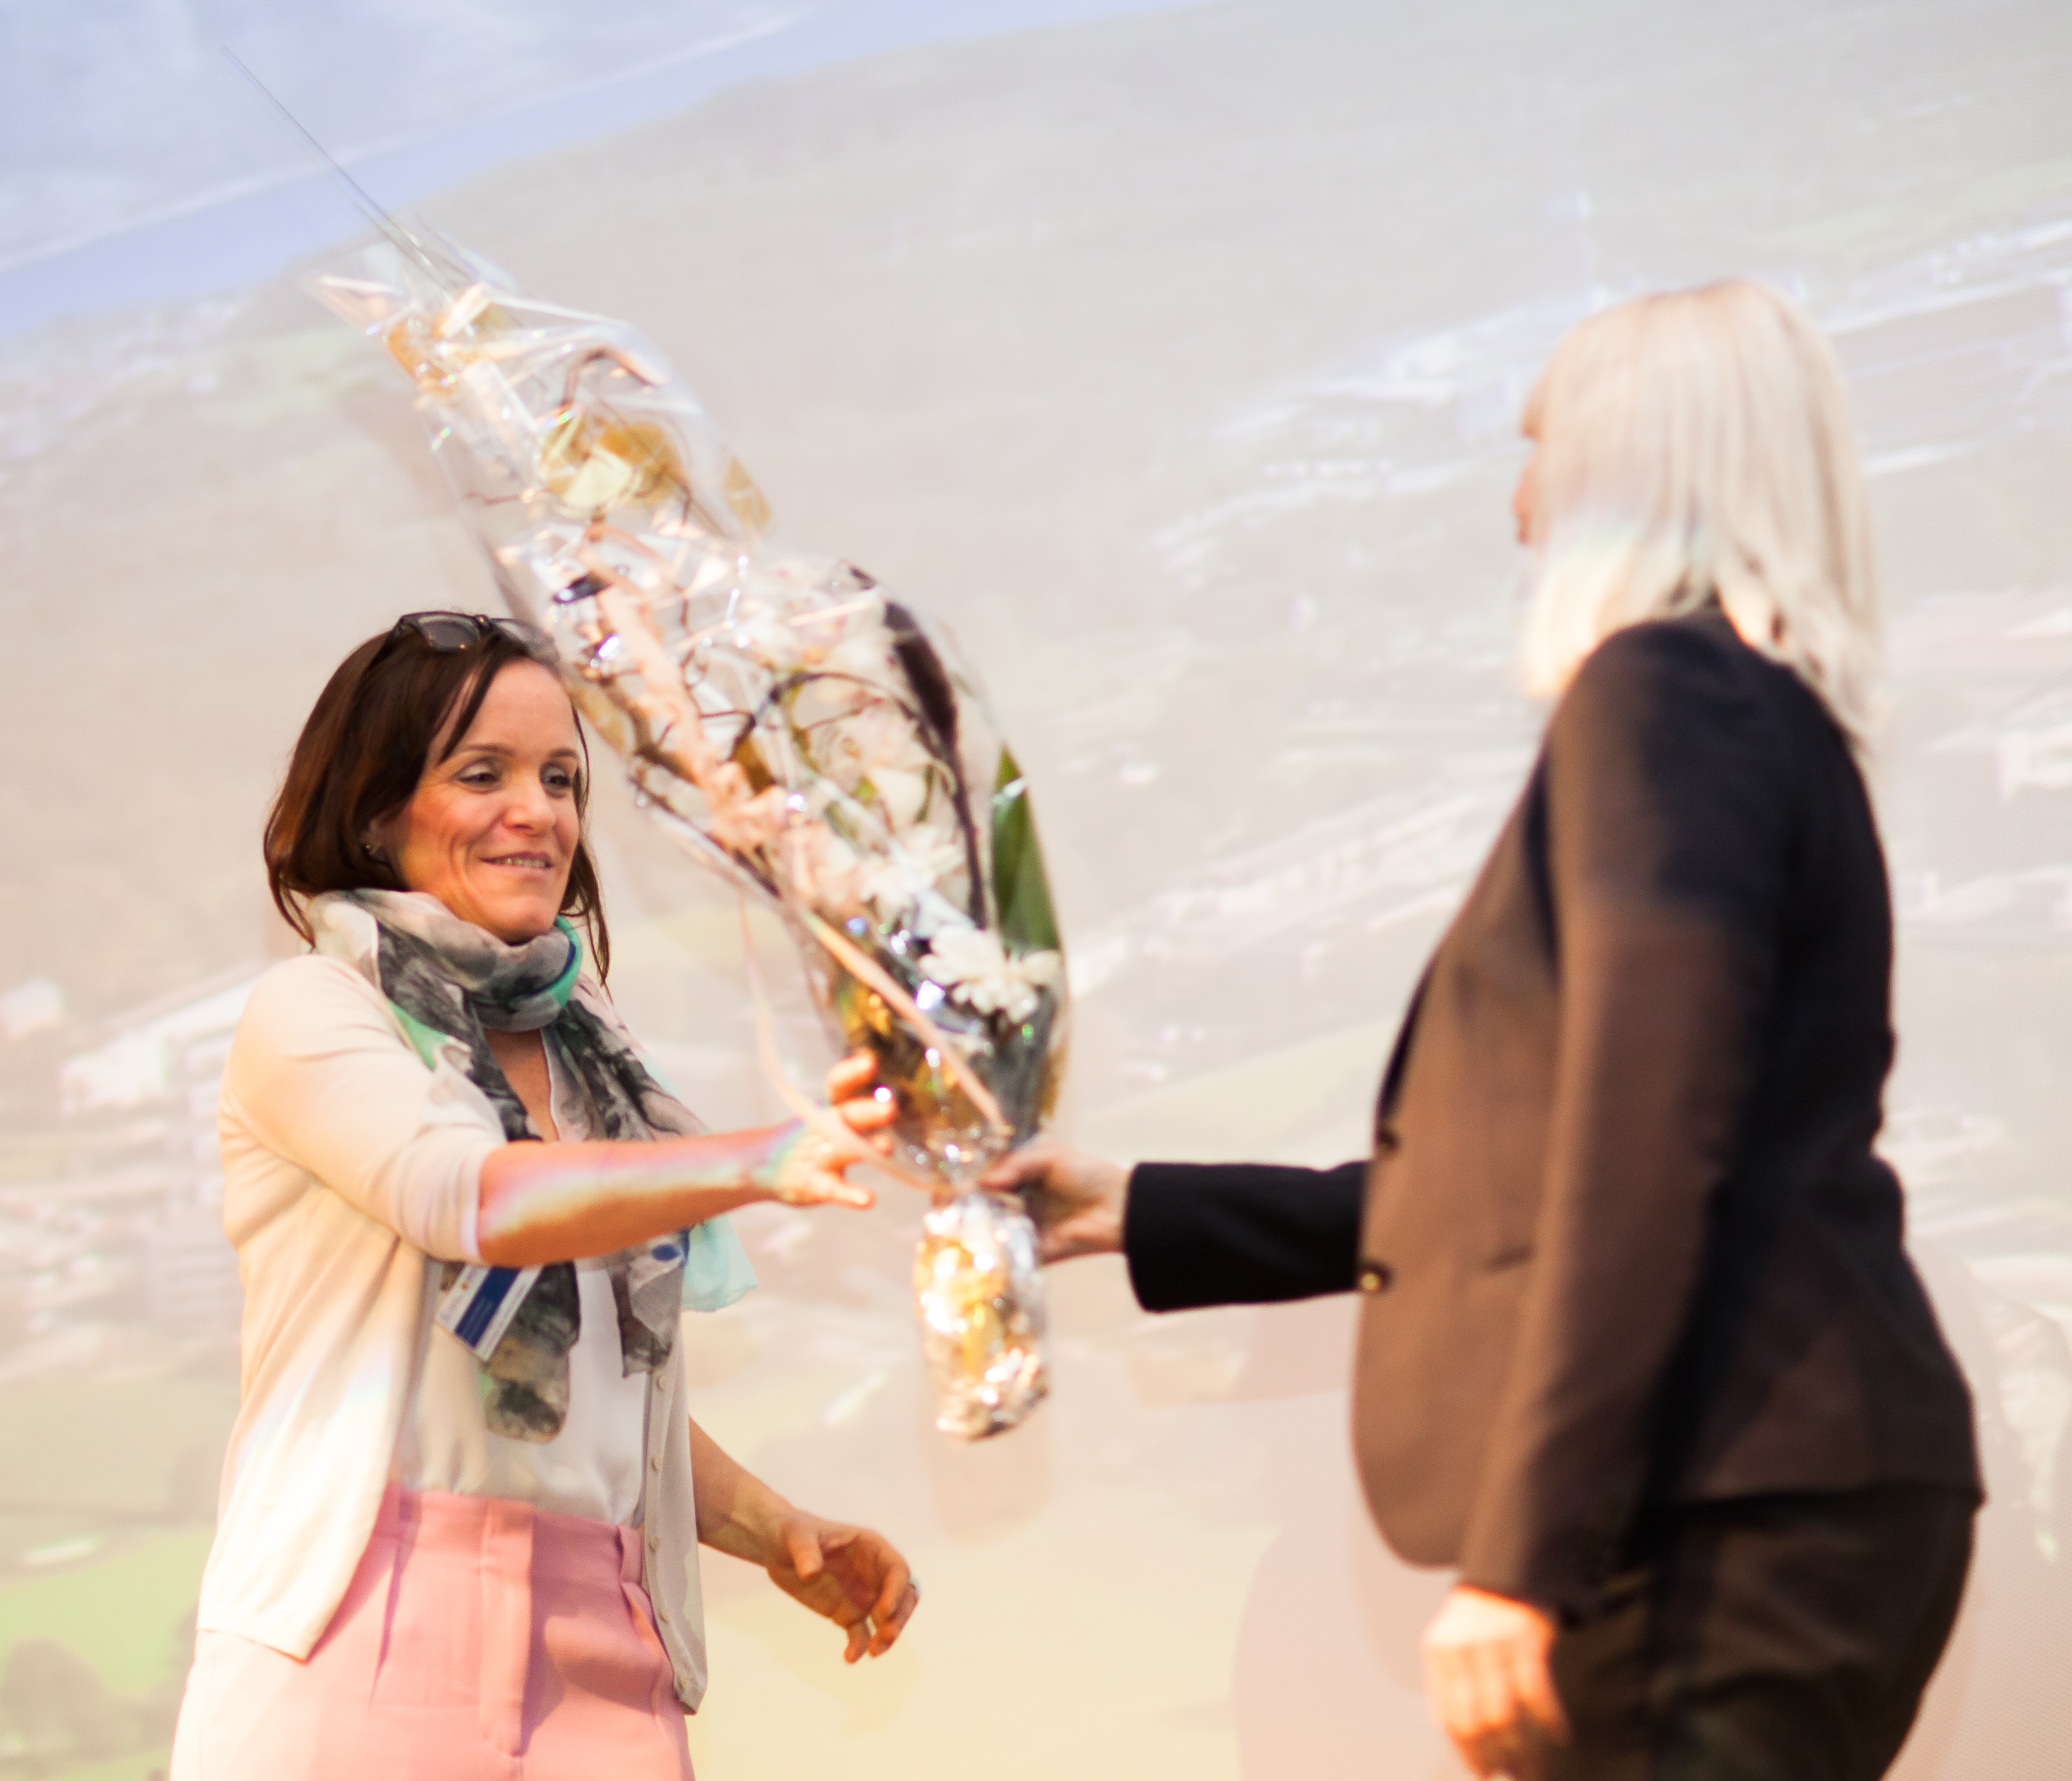
The National IOR Centre of Norway
- Opening of the centre, 2013-2021

Slide 22
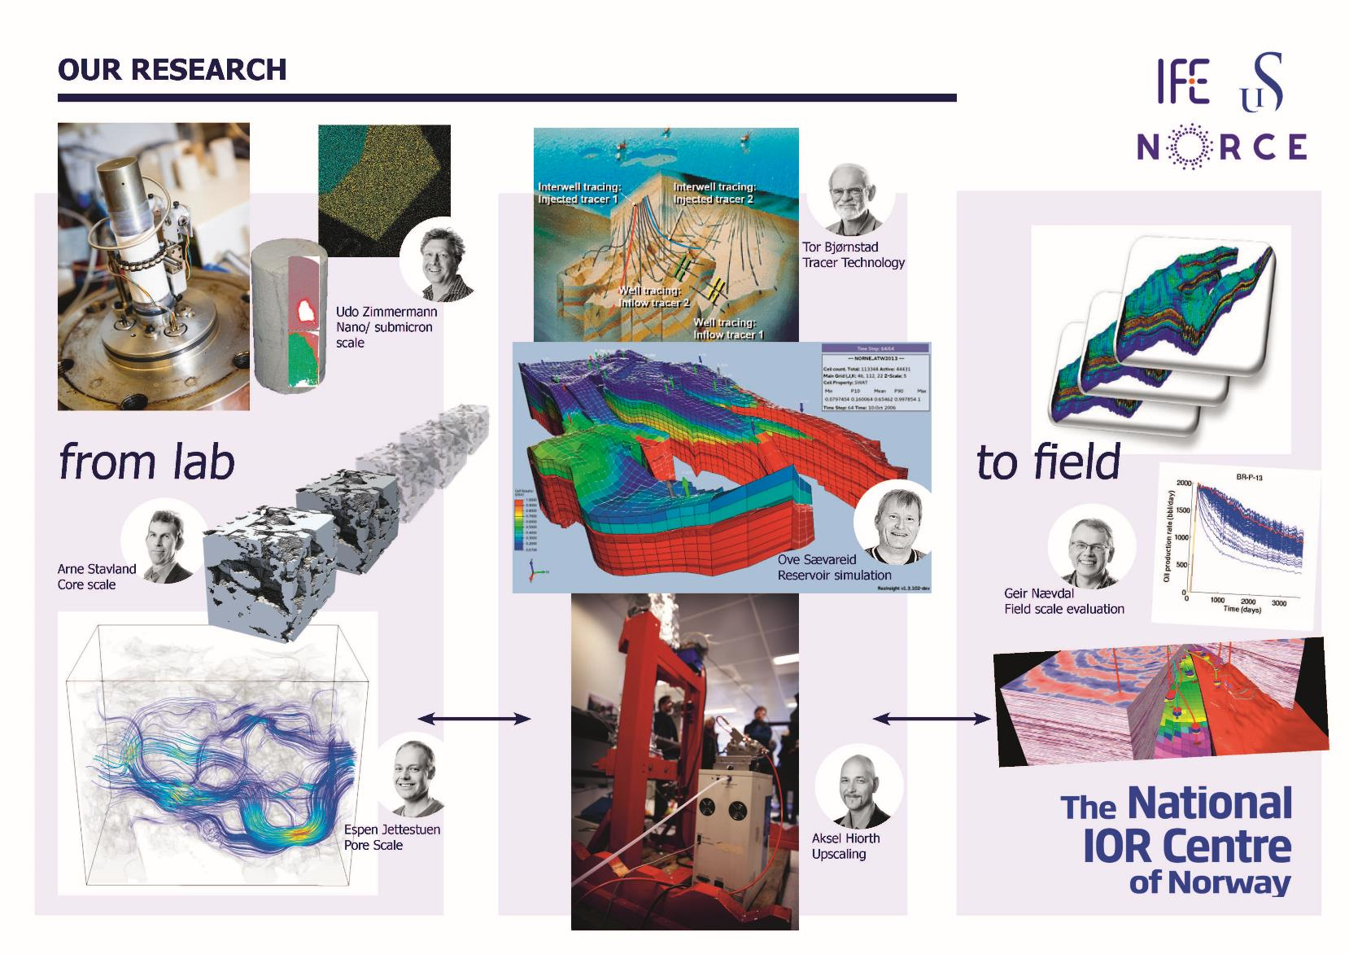

Slide 23
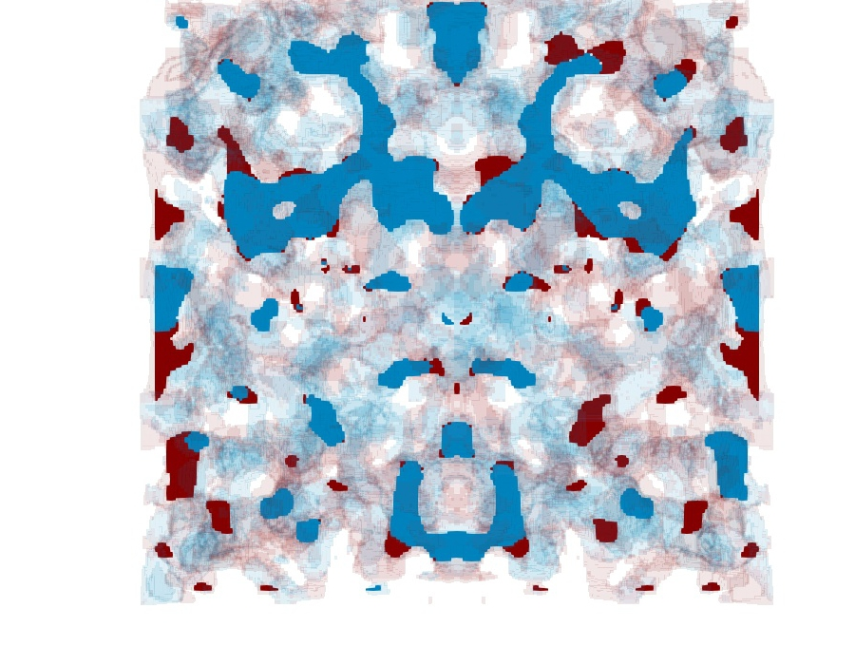
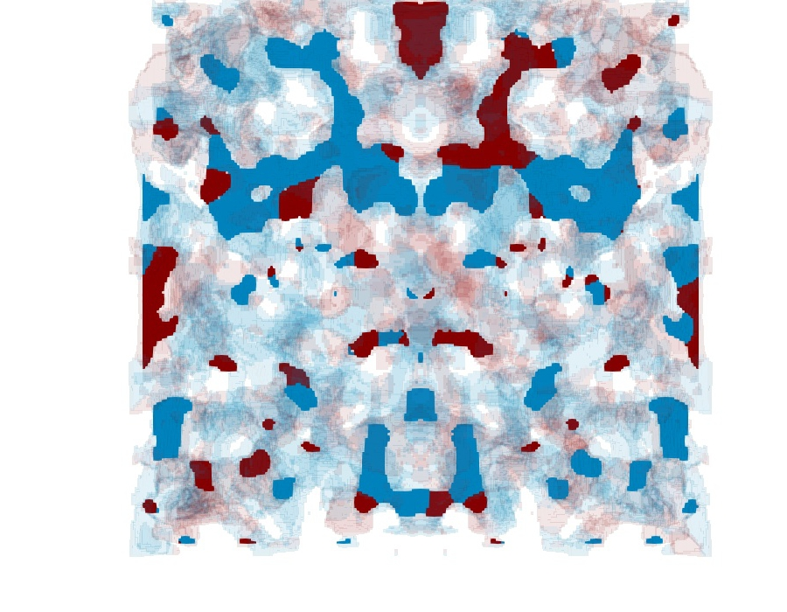
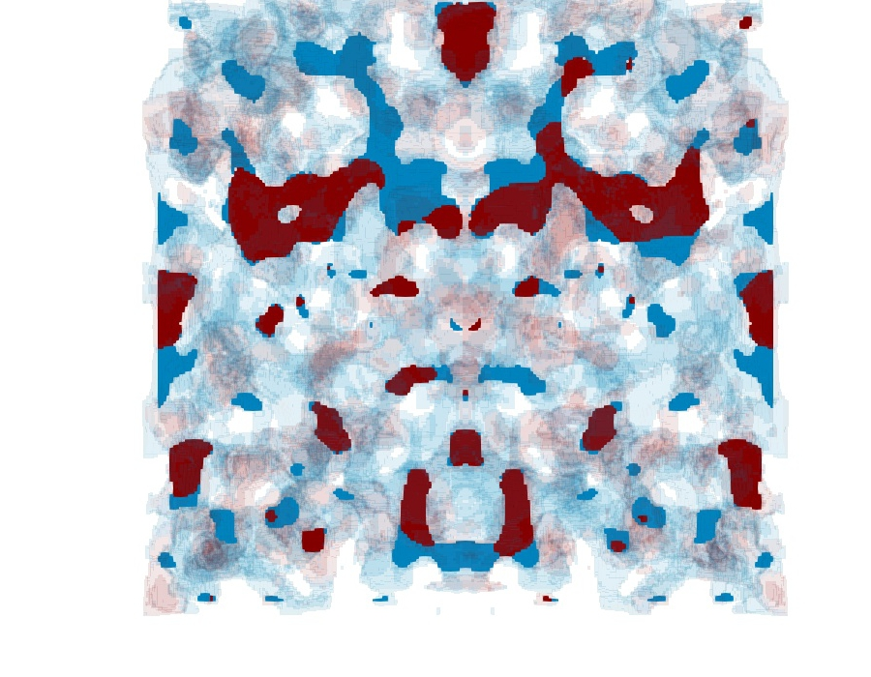
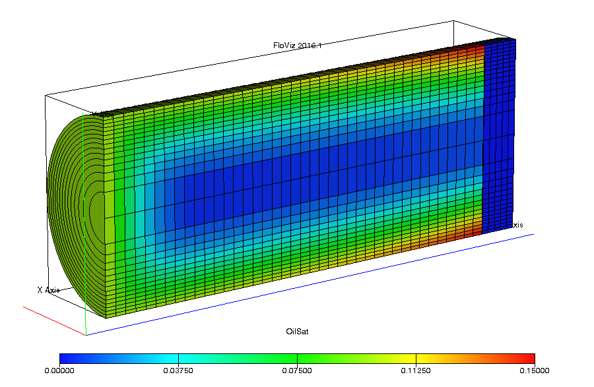
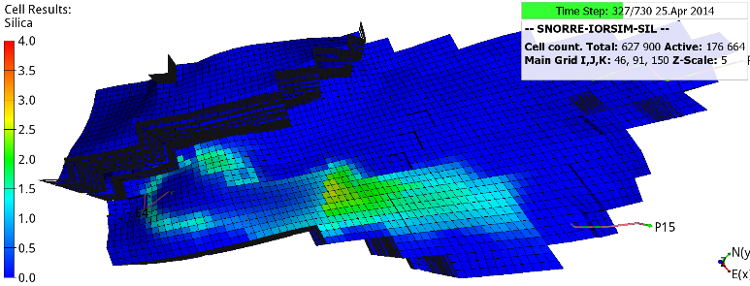
Software
BadChimp – pore scale
IORCoreSim – core scale
IORSim
OPM
Oil-wet
Neutral-wet
Water-wet
- field scale
So:
Water-wet disk
Silicate

Slide 24
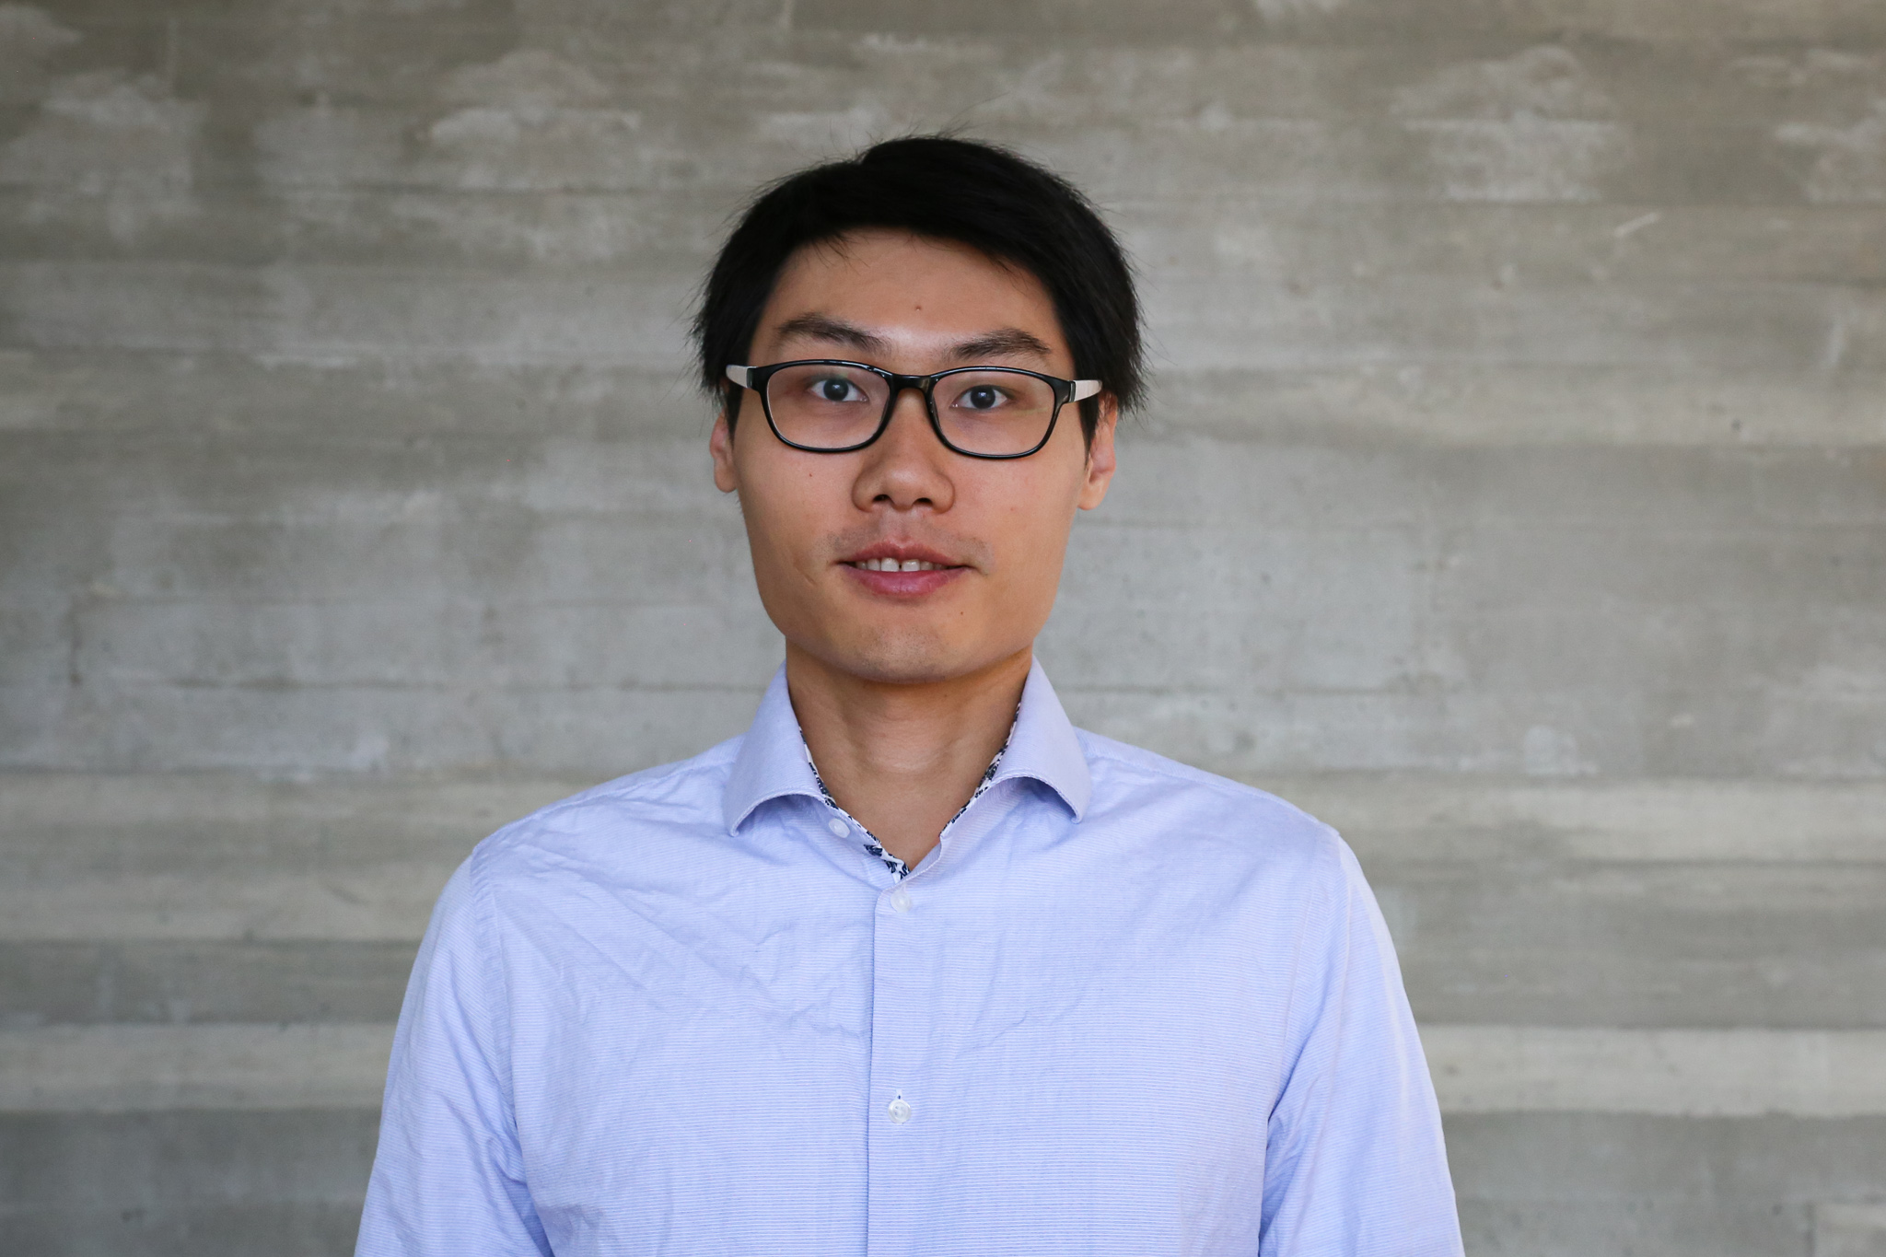
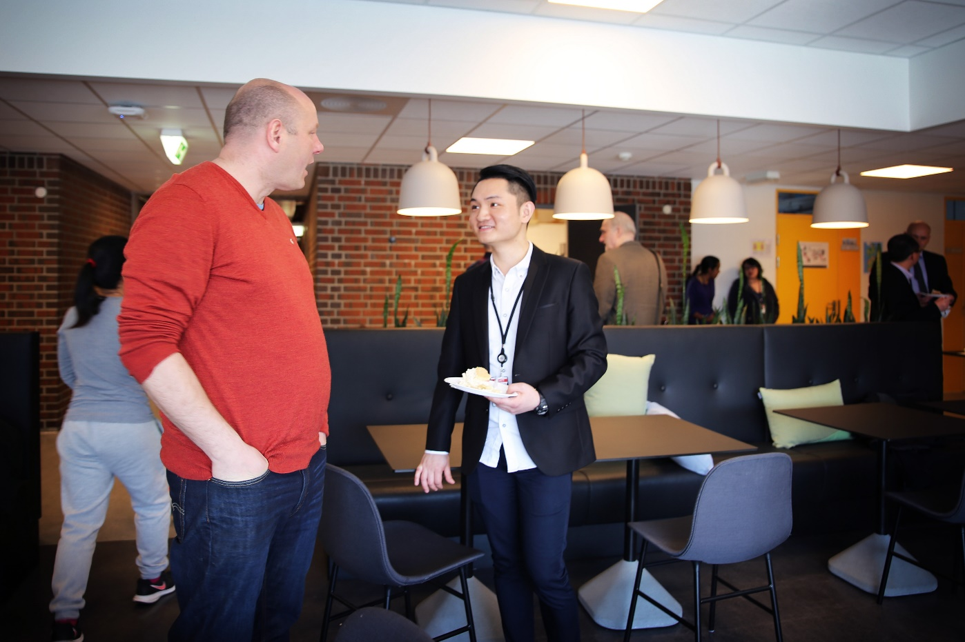
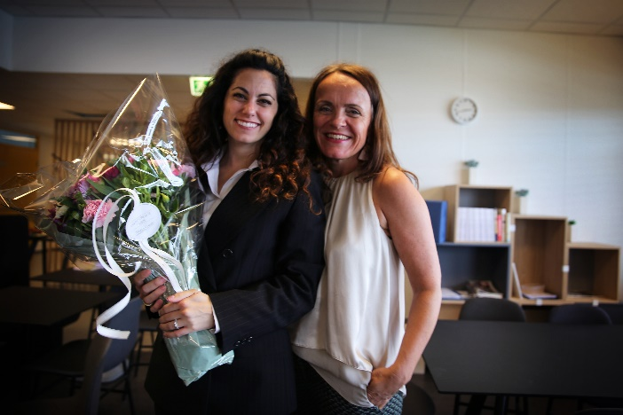
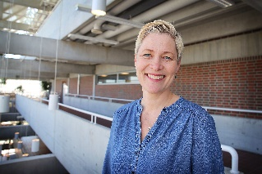
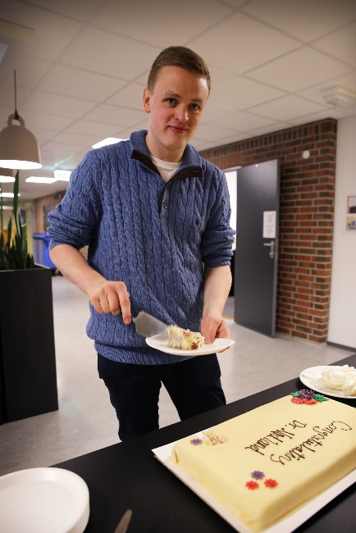
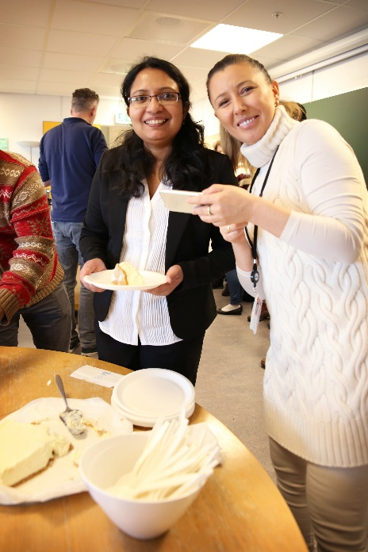
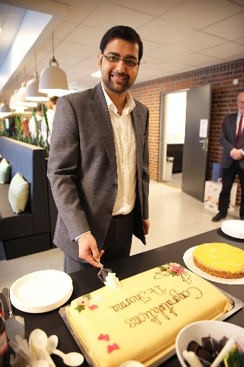
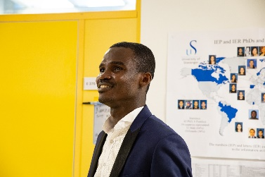
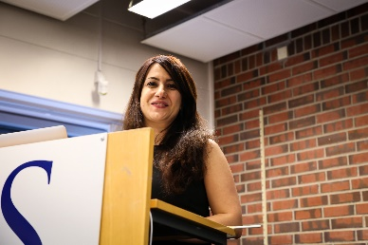
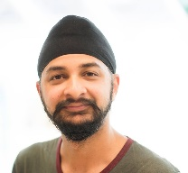
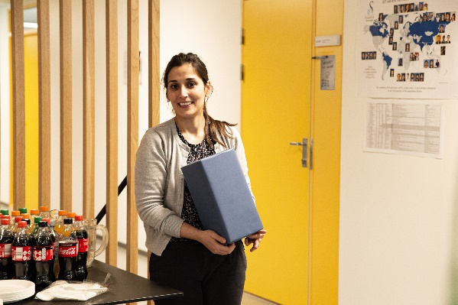
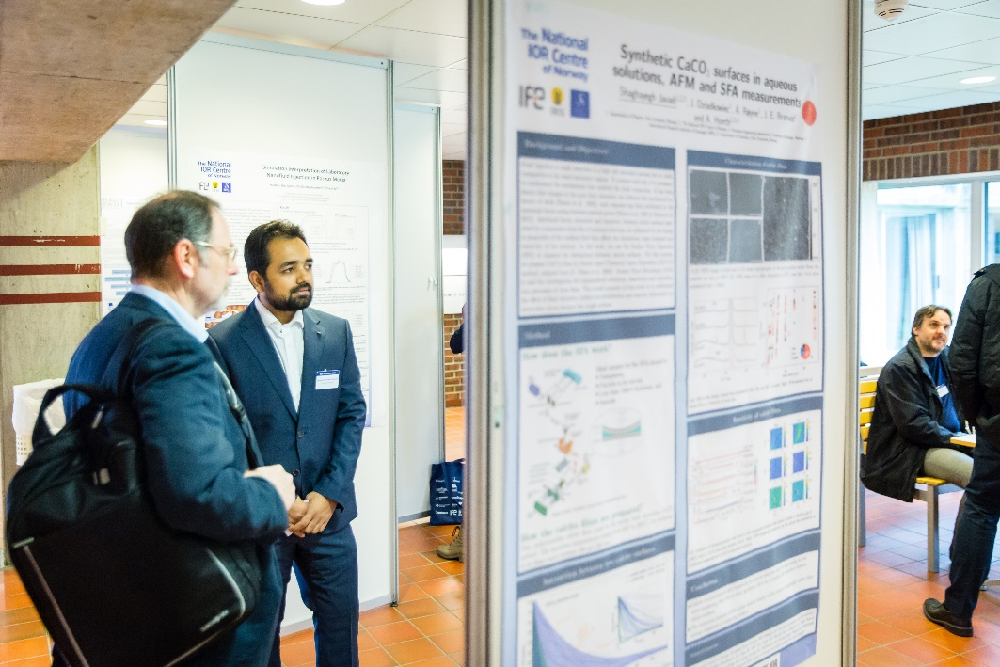
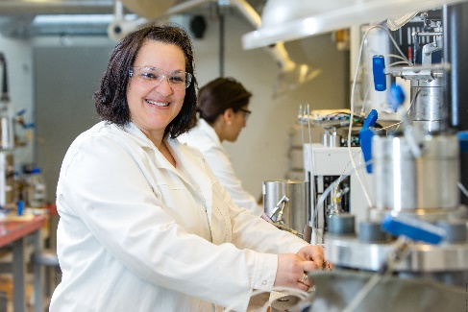
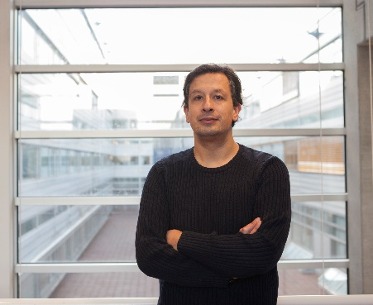
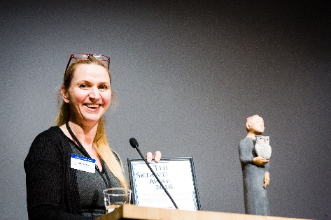

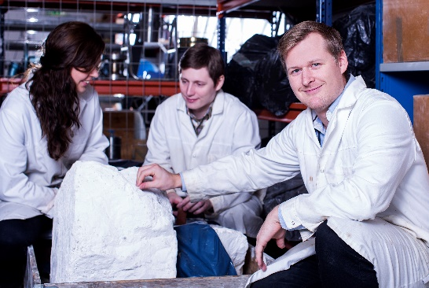
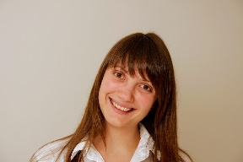
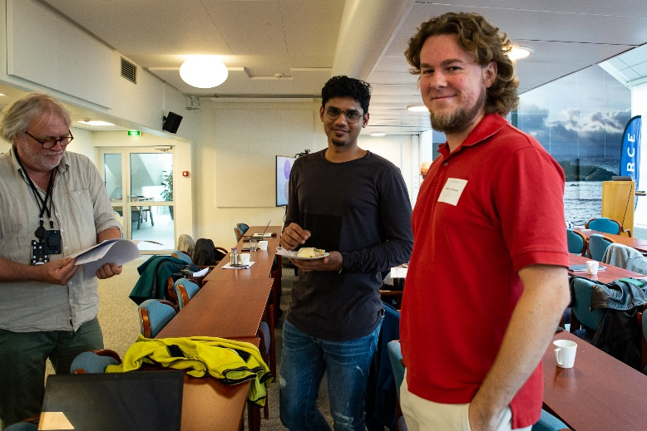
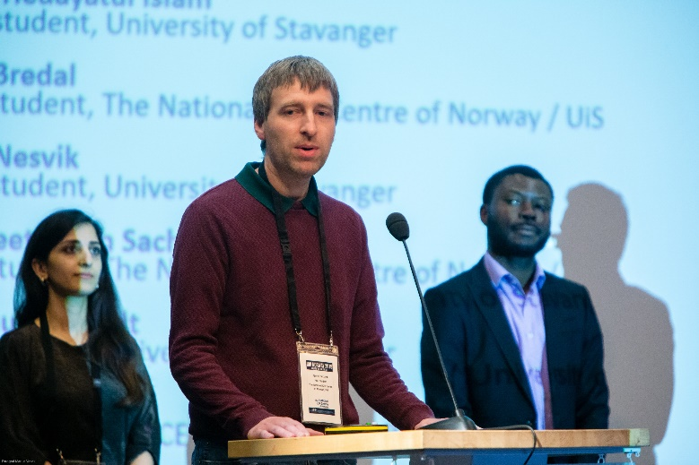
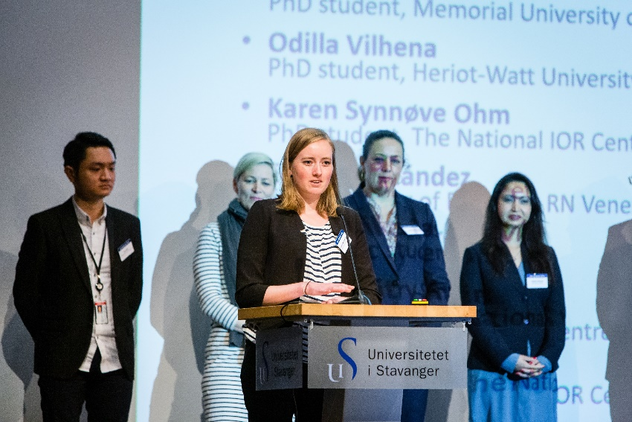
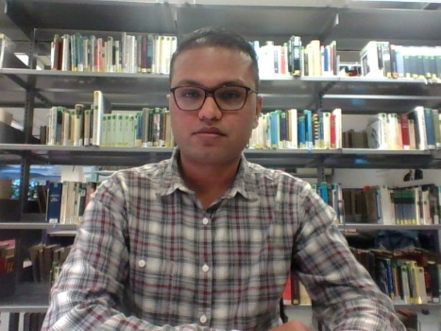
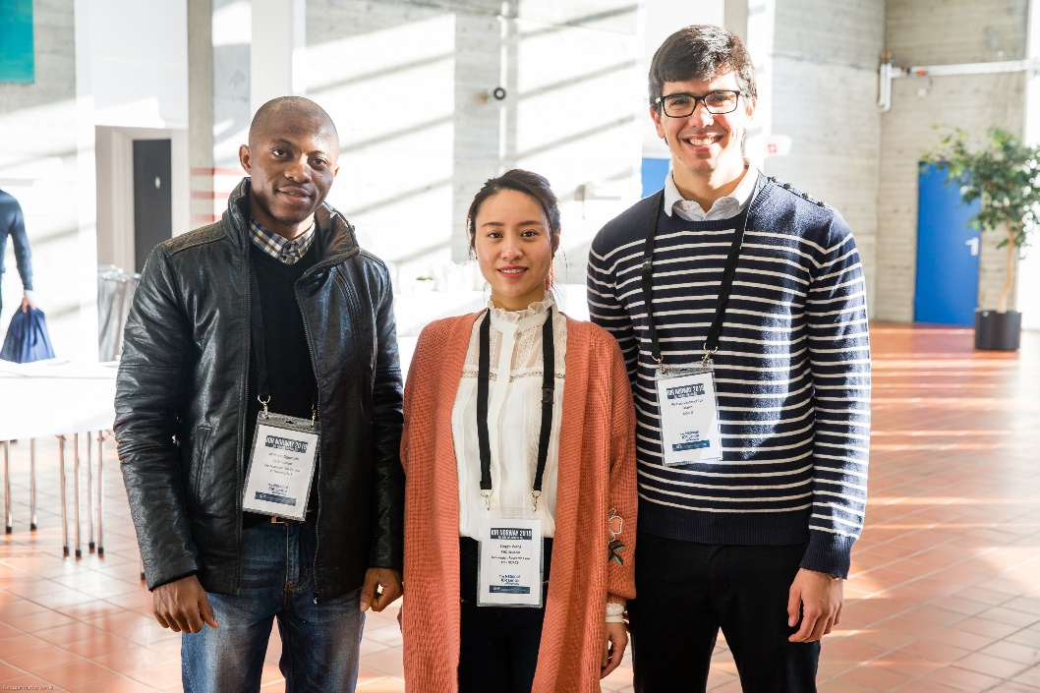
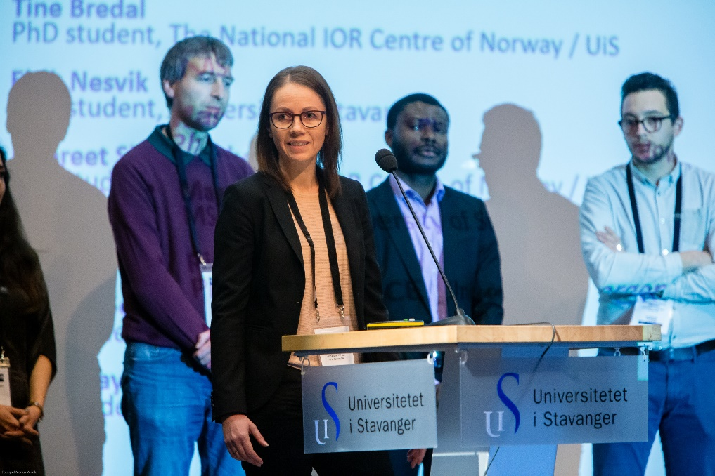





Educated and in-the-loop PhDs
Has defended
Industry jobs:
Remya – SEID AS
Mohan – Resoptima
Jaspreet – TechnipFMC
Tijana – Equinor
Dhruvit – Equinor
Yiteng – Shell
Anna – Equinor
Shaka – Zimmer and Peacock Ltd
Andre - Schlumberger
Aojie
Kun
Laura
Mona
Oddbjørn
Remya
Mohan
Samuel
Shaghayegh
Jaspreet
Tijana
Dhruvit
Emanuela
Mario
Siv
Defends thesis 2021/2022
Academic jobs:
Aojie – UiS
Kun – Shaoxing University
Laura – University of Milan
Mona – UiS
Oddbjørn – UiS
Samuel – KNUST
Mario – IFE
Siv – NORCE
Emanuela – UiS
Yiteng
Eystein
Anna
Andre
Bjarte
Karen
Mehul
Micheal
Tine
Arun
Panagiotis
William
Nisar
Hoang (2023)

Slide 25



















Educated postdoc-researchers
Finished
Industry jobs:
Thomas – MEXBRAIN/GLINCS
Mahmoud – SNF
Teresa – Independent consultant
Pål
Aruoture
Tuhin
Bergit
Thomas
Dimitri
Kjersti
Michael
Academic jobs:
Pål – UiS
Aruoture – NORCE
Tuhin – NORCE
Bergit – UiB
Dimitri – UiS
Kjersti – NORCE
Michael – DTU
Runar – Volda University College
Trine – NORCE
Ivan – UiS
Yanhui – KAUST
Runar
Trine
Mahmoud
Teresa
Ivan
Yanhui
Still working at the IOR Centre
Aleksandr
Rouholah
Felix
Oddbjørn
Birane

Slide 26
Journal papers
~200 scientific journal papers published and ~1800 citations

Slide 27




Workshops 2017-2021
2021 Workshop with Schlumberger Production optimization, value of information and decision-making Webinar series for PhDs and postdocs IOR NORWAY workshop: Symposium on Wettability 2020 IORSim Ensemble-based 4D seismic history matching Delivery Forum Webinar 2019 IORSim Interpore CO2-EOR Core Preparation PhD dissemination skills seminars IOR NORWAY workshop: Wettability 2018 Smart Water Polymer EOR IOR NORWAY workshop: Integrating the value-chain of IOR research in field development plans Integration of research activities Environmental Risk Assessment (ERA) 2017 Open Porous Media Seminar IOR NORWAY workshop: Offshore polymer EOR; how to make polymer work in the field PhD dissemination skills seminars

Slide 28
IOR NORWAY
2015
2016
2017 (EAGE)
2020 (webinar)
2021 (Wettability Symposium)
2019
2018
See all the presentations from IOR Norway 2021 here: https://www.uis.no/en/research/ior-norway-2021

Slide 29


11 Recommended practices
Core preparation
Smart Water part 1: Smart water workflow.
"Smart water flooding - Important input parameters for modeling and upscaling workflow".
Polymer part 1: Recommended workflow (including design of lab experiments and interpretation by IORCoreSim) to extract essential Polymer EOR parameters.
Polymer part 2: Identification and usage recommendation of important input parameters for modeling and upscaling of polymer processes, IORCoreSim, BADChIMP.
Polymer part 3: Polymer flooding - Simulation Upscaling Workflow.
Workflow on adding 4D seismic data in history matching
Methodological developments for ensemble-based optimization of EOR processes.
Recommended practices for tracer-based interwell SOR-monitoring and studies of various EOR-method efficiencies.
Recommended practices for tracer-based near-well SOR-monitoring and studies of various EOR-method efficiencies.
Environmental Risk Assessment for IOR on NCS.
https://www.uis.no/en/research/the-national-ior-centre-of-norway

Slide 30

Final report
Link to the report:
https://www.uis.no/sites/default/files/2022-07/Final_report_IOR_wo_appendix.pdf

Slide 31
Work from the most recently graduated PhD-candidate
Panagiotis Aslanidis

Slide 32

Experimental Reproduction of Wettability for Core Analysis
Doctorate thesis
by
Panagiotis Aslanidis
November 8, 2022
Scientific Advisors: Tina Puntervold, Associate Professor
Skule Strand, Associate Professor

Slide 33
Objectives
Obtain more representative reservoir wettability in cores used for laboratory wettability studies e.g. Smart Water EOR studies
  Aim to reproduce reservoir wettability
  Aim to replicate core wettability for reusing the same core in lab studies
  Find an optimal cleaning procedure
  Find an optimal fluid restoration procedure

Slide 34


Core material
7 sandstone cores retrieved from the Varg field of the NCS
  Two wells (9S and A5T2)
  High clay content (9%-15%)
  Low permeability (3mD-22mD)
  Large heterogeneity in pore size (0.001μm – 8μm)
6 chalk cores retrieved from the Stevns Klint quarry in Denmark
  CaCO₃ amount > 98%
  Low permeable (0.8mD-2.5mD)
  Large porosity (47%-50%)
Source: www.npd.no
Notes:
Drove there ourselves and handpicked the rock samples.

Slide 35
Core cleaning schemes
Mild cleaning (Kerosene/Heptane)
Low aromatic solvents
Avoid removal of material that are a part of the formation (bitumens, salt precipitates)
Goal is to preserve the initial wettability of a preserved core
  Does not remove a large fraction of the adsorbed POC (Hopkins et al., 2015)
  Multiple uses of the same core without altering the wetting properties
Harsh cleaning (Toluene/Methanol)
Toluene is aromatic
  Increased solvation power of adsorbed POC for Toluene and Methanol
  Observed that it creates a more water-wet rock surface
Representative rock wettability?

Slide 36


Effect of mild solvent cleaning on core wettability in sandstones
9S well
A5-T2 well
Reduced
water-wetness
Reduced
water-wetness
Mild solvents used (kerosene and heptane)
5 PV of crude oil in-between restorations
Spontaneous imbibition at 60º C
FW as the imbibing fluid
Decrease in %OOIP
Decrease in the rate of imbibition
Less water-wet system
Mild solvents in multiple restorations accumulate adsorbed crude oil components on the surface

Slide 37


Effect of harsh solvents on core wettability in sandstones
9S well
A5-T2 well
Increased water-wetness
Increased water-wetness
More aggressive solvents used (toluene and methanol)
5 PV of crude oil in-between restorations
Spontaneous imbibition at 60º C
FW as the imbibing fluid
Increase in %OOIP
Increase in the rate of imbibition
More water-wet system
Are harsh solvents removing more than adsorbed crude oil components?
How do we know how many pore volumes of crude oil is needed to recreate reservoir wettability?
Notes:
Closing quote: How we can improve the restoration process?

Slide 38


Wettability reproduction in sandstones
A5-T2 well
Mild cleaning
1 PV of crude oil in restorations
Spontaneous imbibition at 60º C
FW as the imbibing fluid
Core cleaning without interfering with the core’s natural wettability
Adequate amount of oil – 1 PV
Re-usable cores for multiple experiments

Slide 39




Wettability reproduction in carbonates
Mild cleaning
1 PV of crude oil in restorations
Spontaneous imbibition at 50º C
FW as the imbibing fluid
Wettability successfully reproduced in outcrop chalk

Slide 40
Summary
Multiple restorations using 5PV crude oil exposure after mild cleaning resulted in a less water-wet behaviour after each restoration operation in sandstone cores.
  Mild cleaning aims to preserve wettability, thus accumulating adsorbed crude oil components.
Multiple restorations using 5PV crude oil exposure after harsh cleaning resulted in a more water-wet behaviour after each restoration operation in sandstone cores.
  Strong solvents might harm the rock surface by dissolving/removing material that contributes to the rock’s initial wettability.
Optimized core preparation procedure: Core wettability was successfully reproduced on the preserved sandstone cores and outcrop carbonate cores after mild cleaning and 1 PV exposure of crude oil.
There is a need to standardize core preparation procedures for comparable studies of IOR/EOR methods with limited core material available.
Notes:
- What this work means as a bigger picture?

Slide 41


Slide 42
Acknowledgement
The author(s) acknowledge the Research Council of Norway and the industry partners of NCS2030 – RCN project number 331644 – for their support.

Slide 43











User partners & observers

