Slide 1
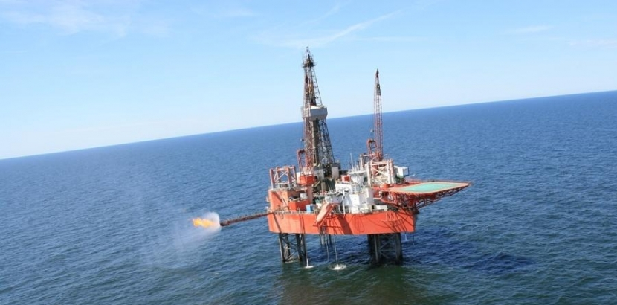
The Egersund Basin; the syn-rift structure and stratigraphy of a salt-influenced rift basin
Christopher A-L. Jackson, Matthew M. Lewis, Aruna S. Mannie,
Gary J. Hampson, Rob. L. Gawthorpe
Yme Field (source: http://lotosgeonafta.pl/en/)
Wednesday 9th December 2020

Slide 2
Introduction
Aruna Mannie
Matthew Lewis
Gary Hampson
Rob Gawthorpe
Me
PhD 2011-2014
Trinidadian Scholarship
(now Premier)
PhD 2011-2014
IC-funded
(now BP)

Slide 3
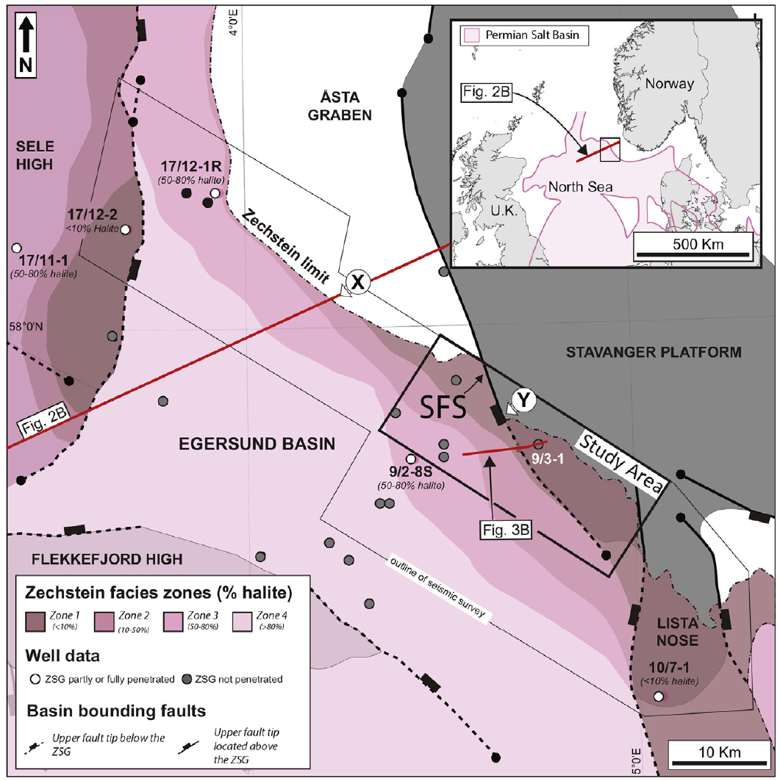
Regional geological setting
Egersund Basin, offshore SW Norway
Salt-influenced rift basin located along the north-eastern pinch-out of the salt-dominated Zechstein Supergroup (Upper Permian)
3D seismic reflection dataset (provided by PGS) and numerous wells located around the basin margin and in the basin centre

Slide 4
Regional geological setting
Regional cross-section (location shown on previous slide) illustrating the regional tectonic context of the Egersund Basin
Note the decreasing thickness of salt (and overall salt influence) north-eastwards towards the basin margin
Subsalt/basement-restricted faults active before (i.e. Carboniferous), during (i.e. Permian), and after salt deposition (i.e. Triassic-Cretaceous)
Suprasalt/cover-restricted faults active during the Triassic and Jurassic-Cretaceous

Slide 5
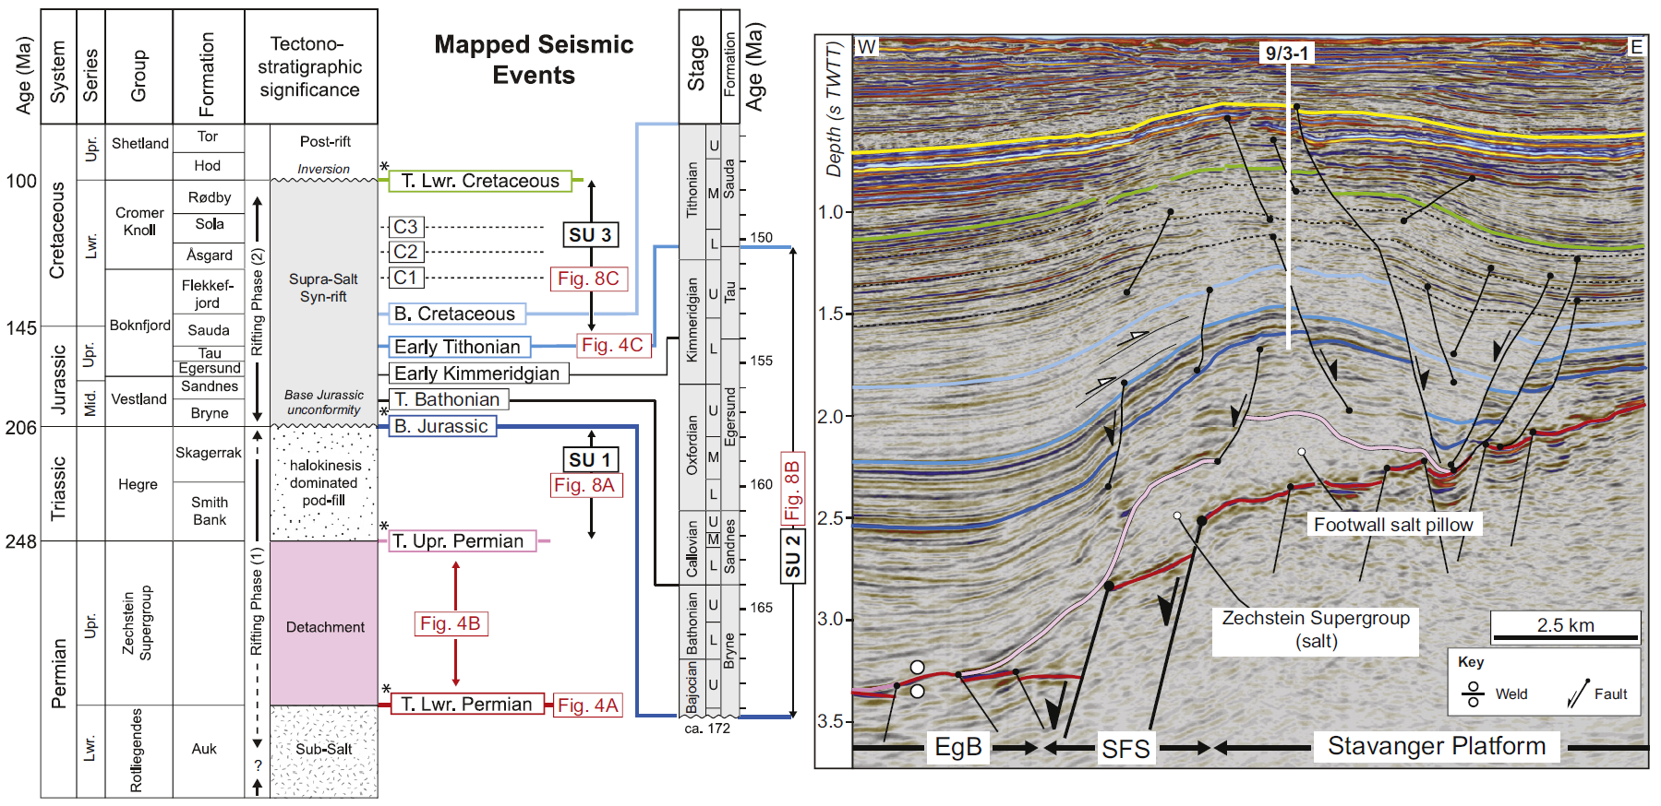
Tectono-stratigraphic framework

Slide 6
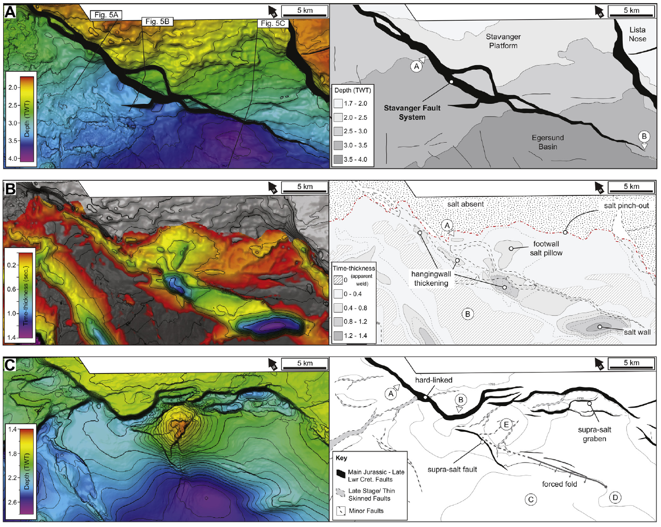
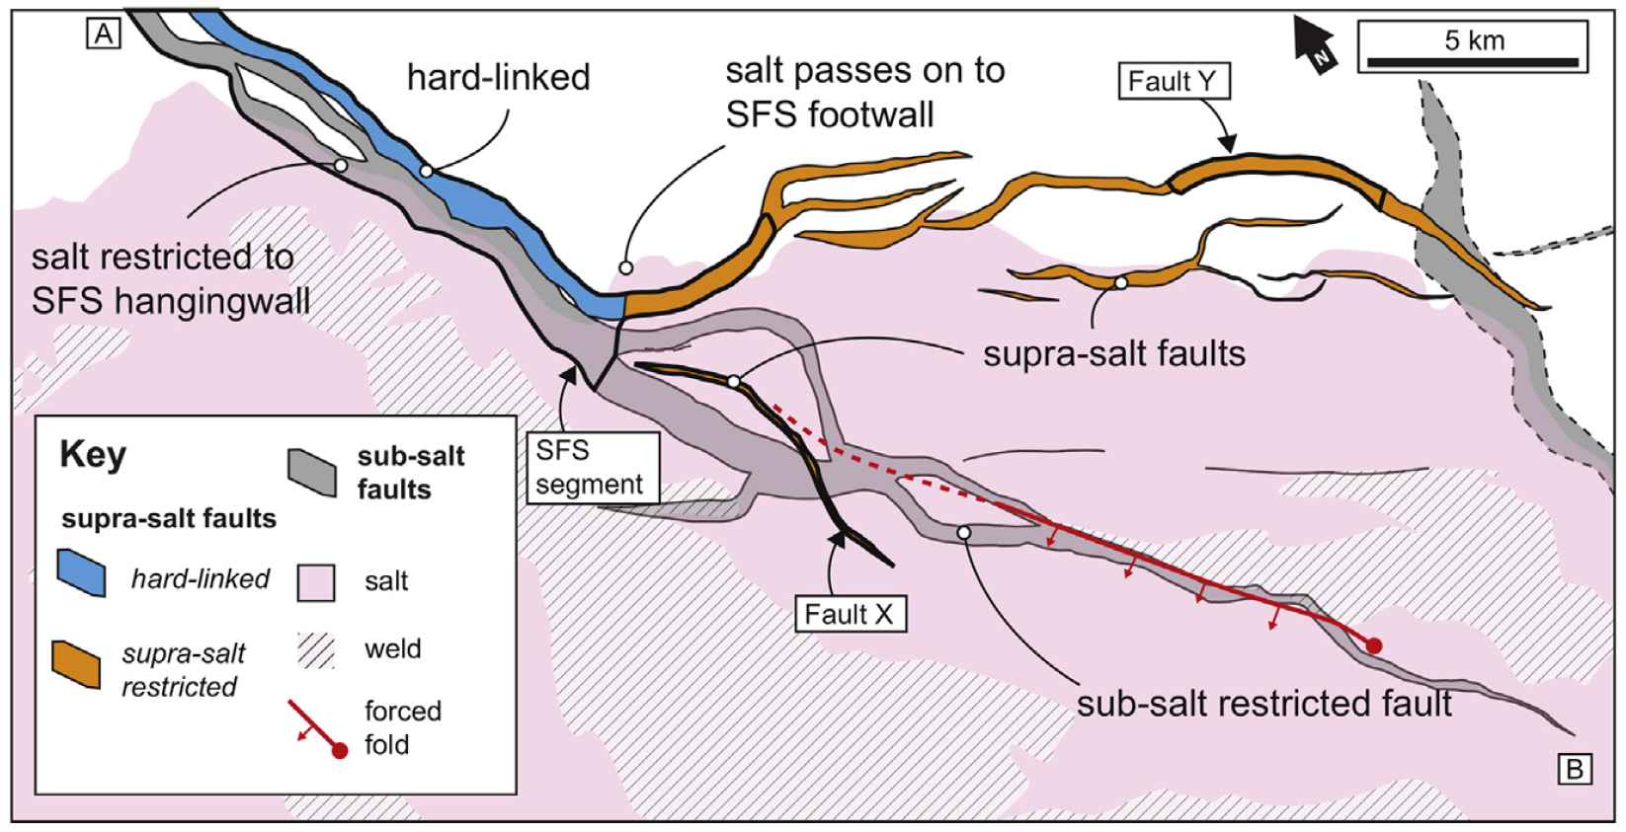
Basin structure
base salt
salt thickness
SFS defined by two fault segments and a relay ramp at basement depths
Salt restricted to hangingwall in NW; extends into footwall in the SE
Salt distribution directly impacts structural style of of basin-bounding fault system; single, thick-skinned system in the NW (blue) passing into a coupled thick-/thin-skinned system in the SE (orange)
base synrift

Slide 7
Basin structure
no salt in footwall
salt in footwall
Single, thick-skinned system in the NW (left)
Coupled thick-/thin-skinned system in the SE (right) with basement strain transferred into cover along salt
Along-strike change in structural style controls along-strike variations in syn-rift stratigraphic architecture

Slide 8
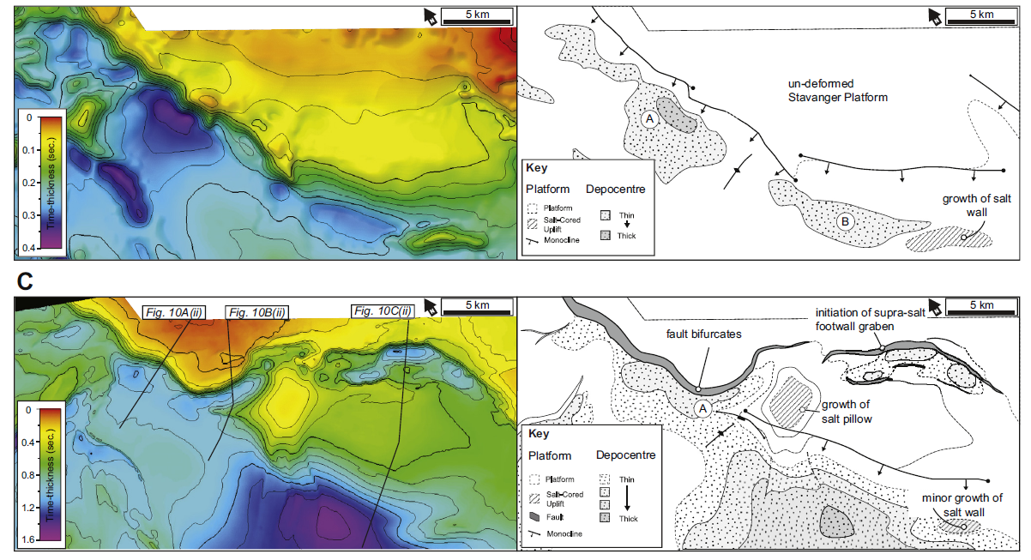
Basin evolution
lower synrift (Baj.-Kimm.)
upper synrift (Tith.-Alb.)
Early rifting: surface-breaching fault passes along strike into fault-tip monocline (growth fold); no footwall deformation
Late rifting: similar to early rifting, with formation of the thin-skinned footwall graben

Slide 9
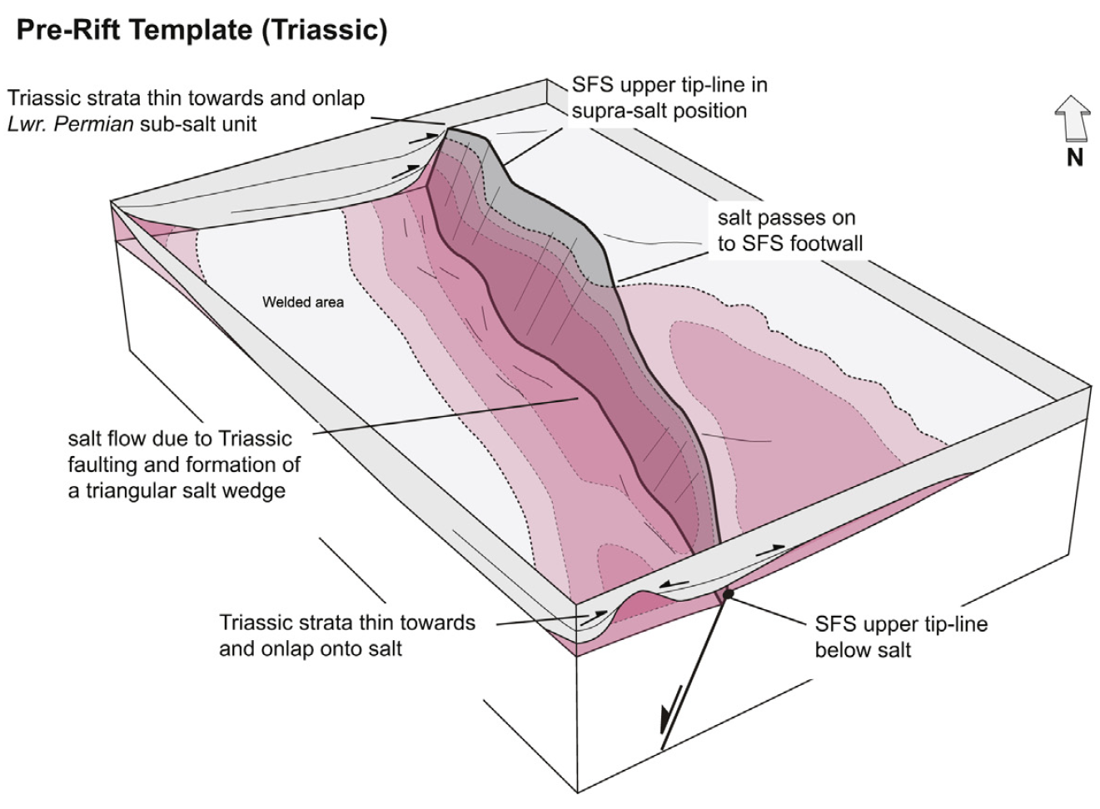
Structural evolution I

Slide 10
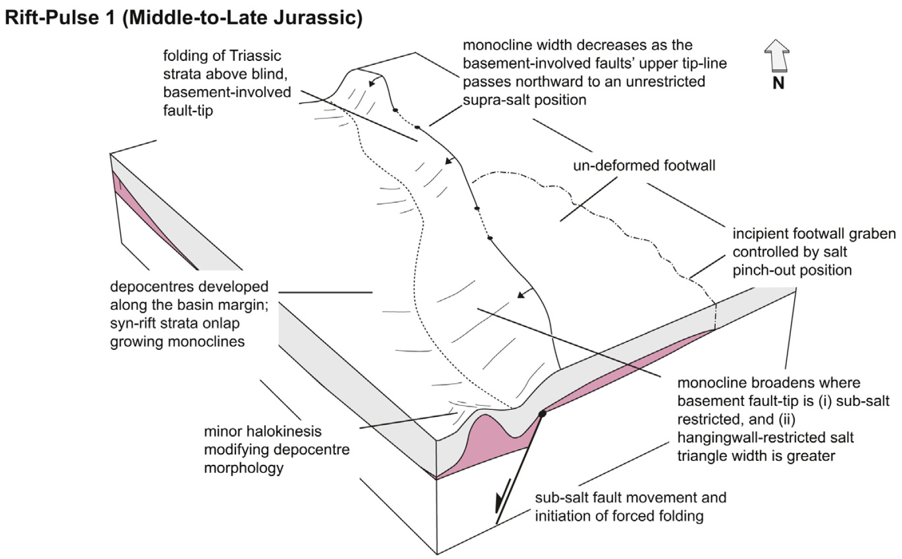
Structural evolution II

Slide 11
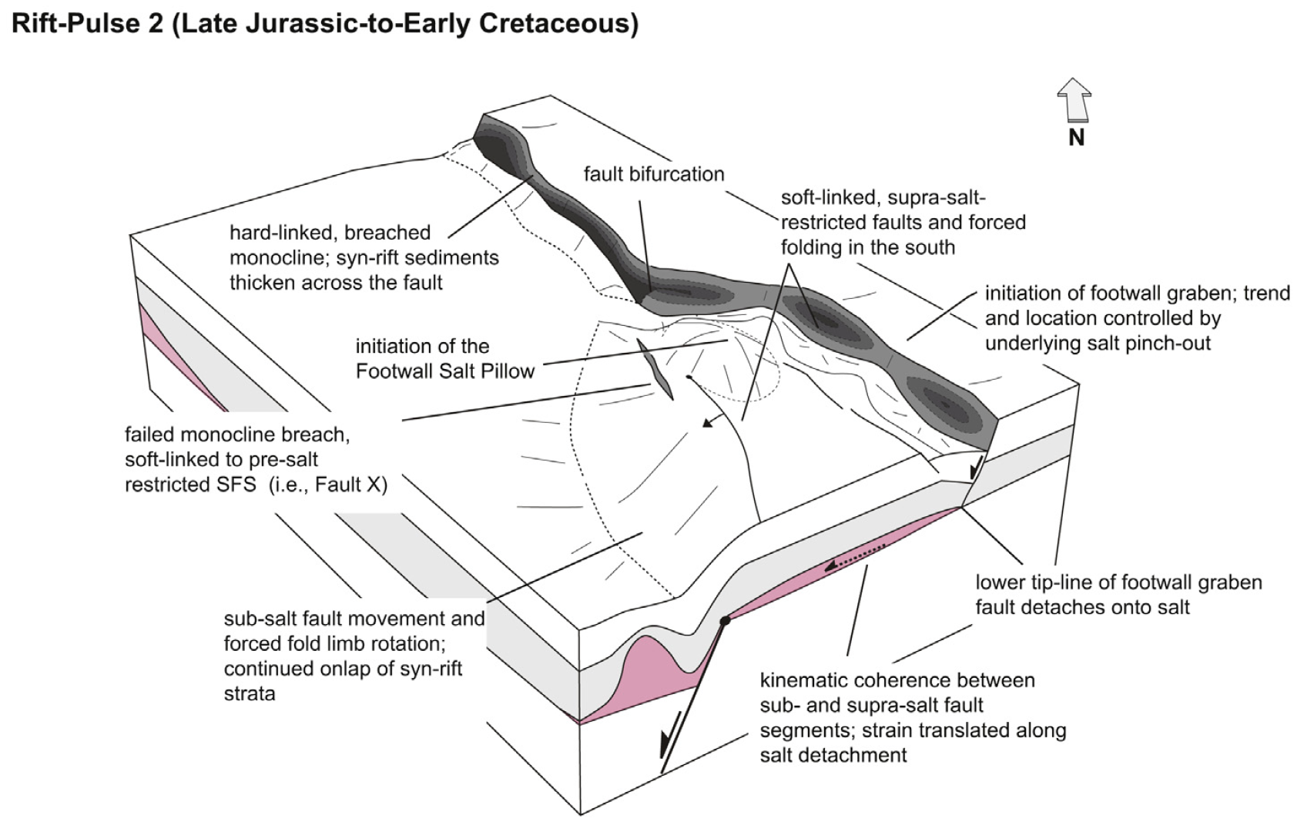
Structural evolution III

Slide 12
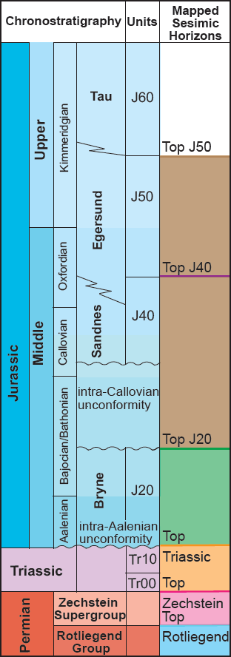
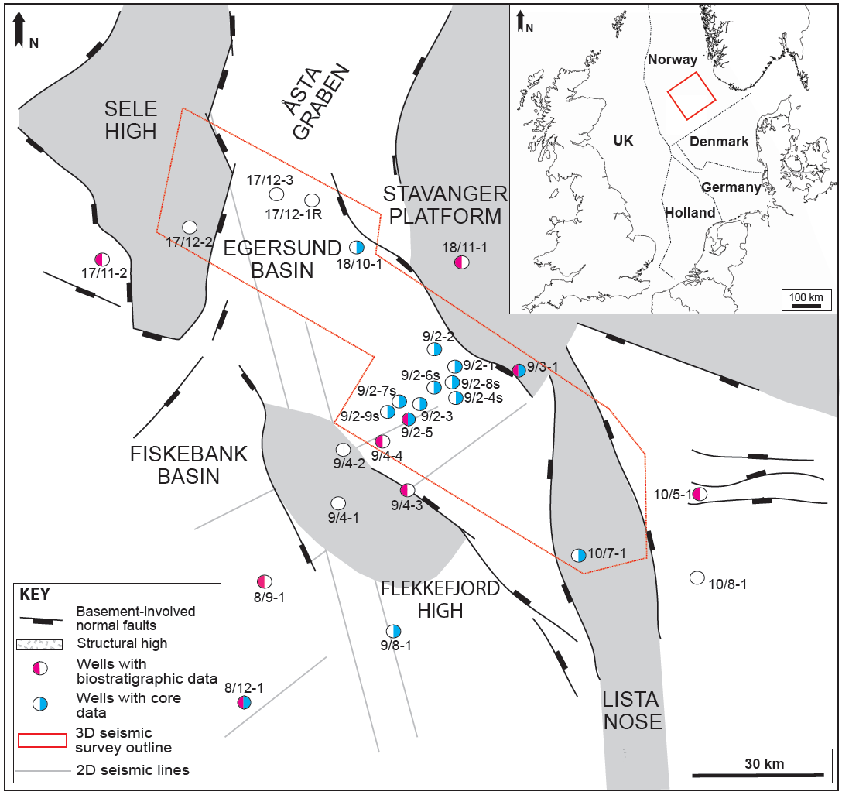
Syn-rift stratigraphic response
Study focused on the Bryne and Sandnes fms (Lower-Middle Jurassic)
Coupled seismic-borehole study; borehole coverage best in centre of study area
Offset borehole data used to constrain facies framework
interval of interest

Slide 13
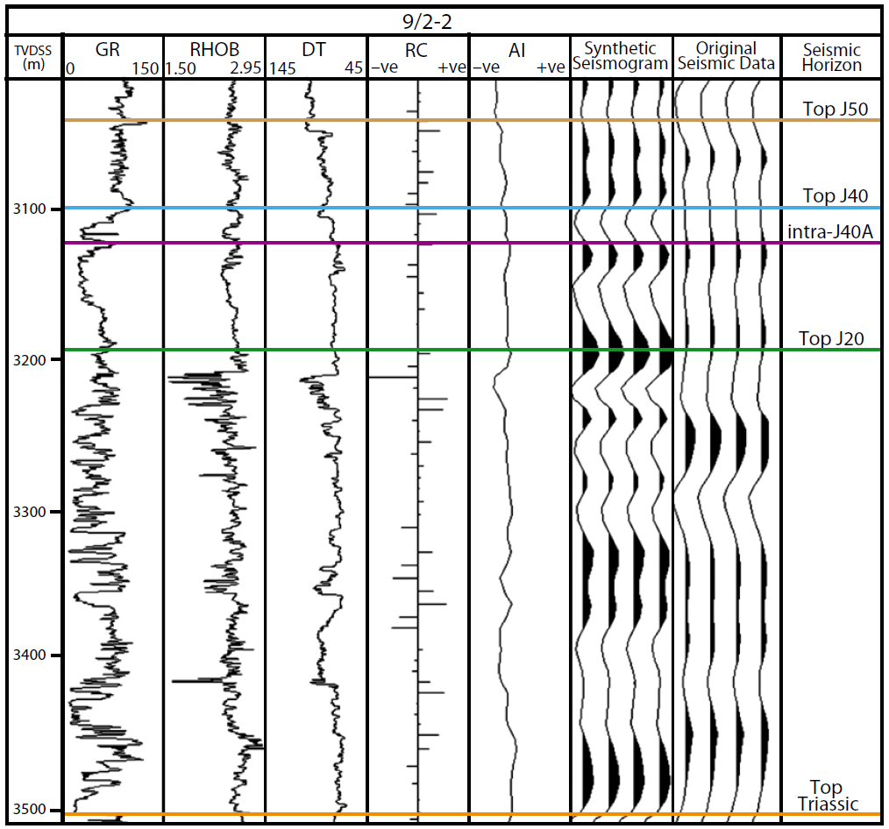
Seismic-stratigraphic framework
Top and base of the Bryne and Sandnes fms (top Triassic-J20 and J20-J40, respectively) tied to seismic data using synthetic seismograms (e.g. 9/2-2)
Intra-Sandnes Fm reflection locally mapped where Sandnes Fm sufficiently thick (>80 m)
Note overall log motif; heterolithic (coastal-plain) Bryne Fm overlain by more sandstone-dominated Sandnes Fm (shallow marine)

Slide 14
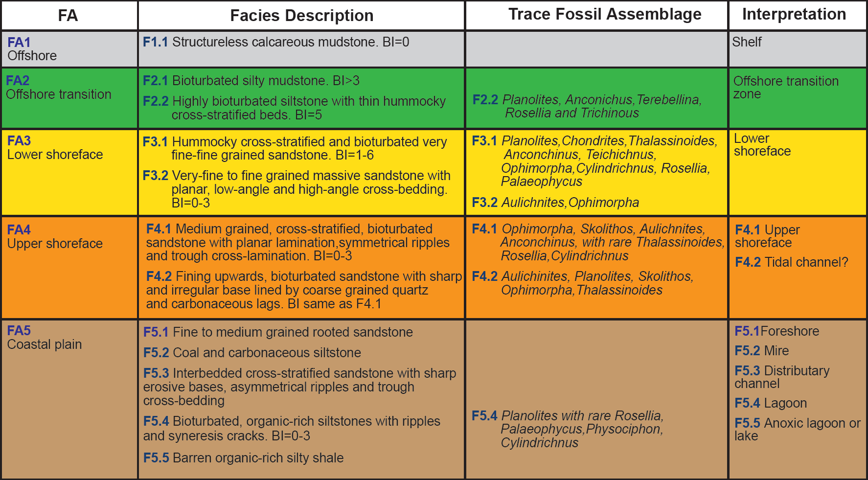
Sedimentary facies

Slide 15
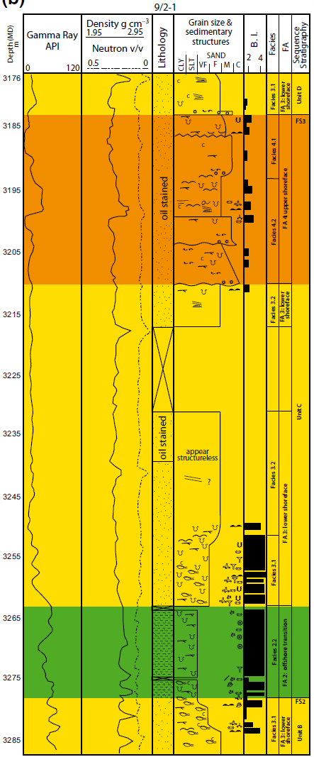
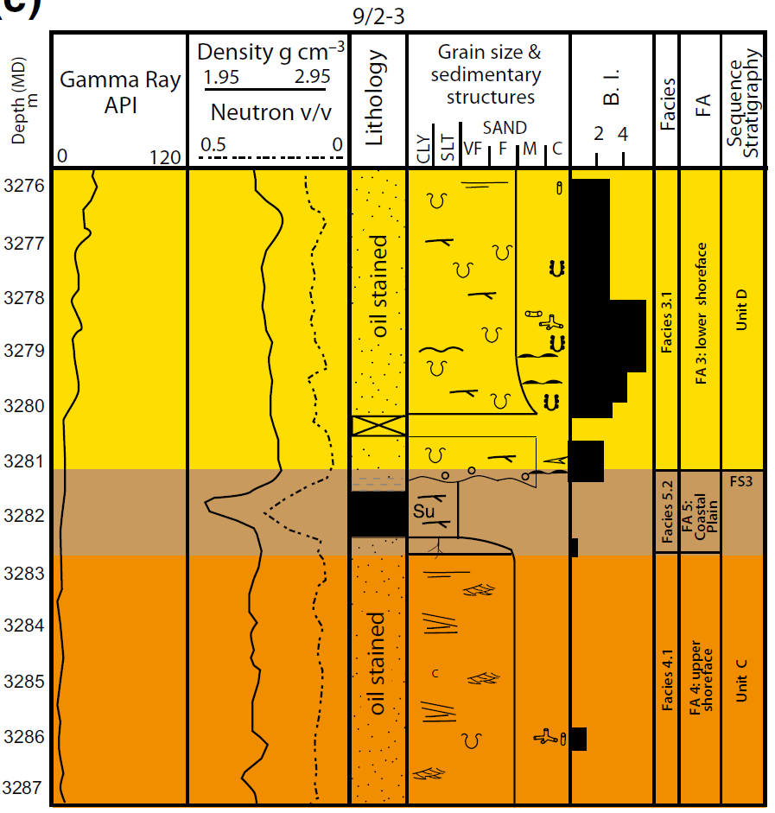
Sequence stratigraphy
Left: c. 100 m-thick, upward-coarsening parasequence in Sandnes Fm documents progradation of a wave-dominated shoreface (FA2-FA4); underlain and capped by flooding surfaces (blue lines), with coastal-plain deposits (FA5) absent
Right: Upper shoreface deposits (FA4) in Sandnes Fm capped by coastal-plain deposits (FA5); latter overlain by lower shoreface deposits (FA3) across a flooding surface (blue line)
FS
FS
FS

Slide 16
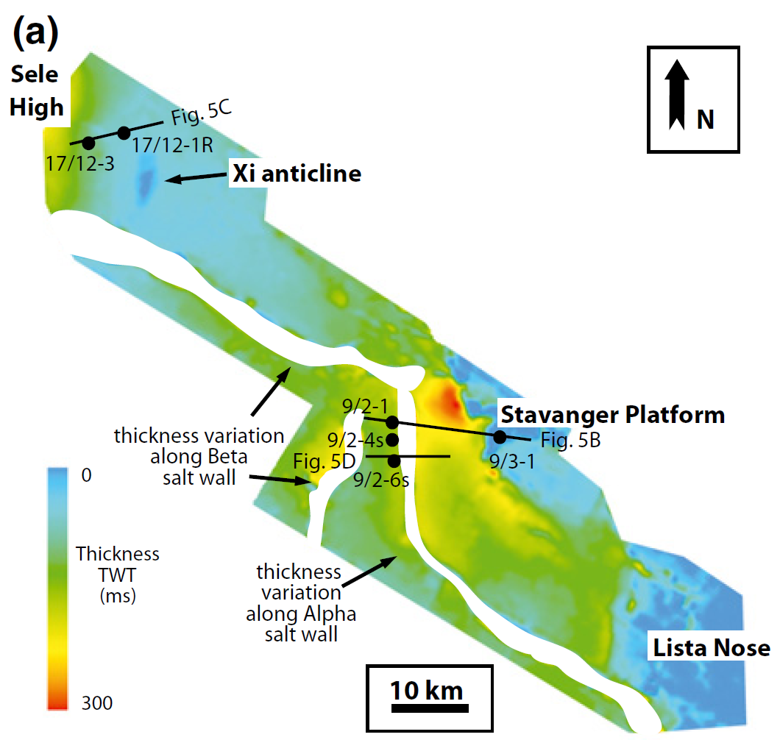
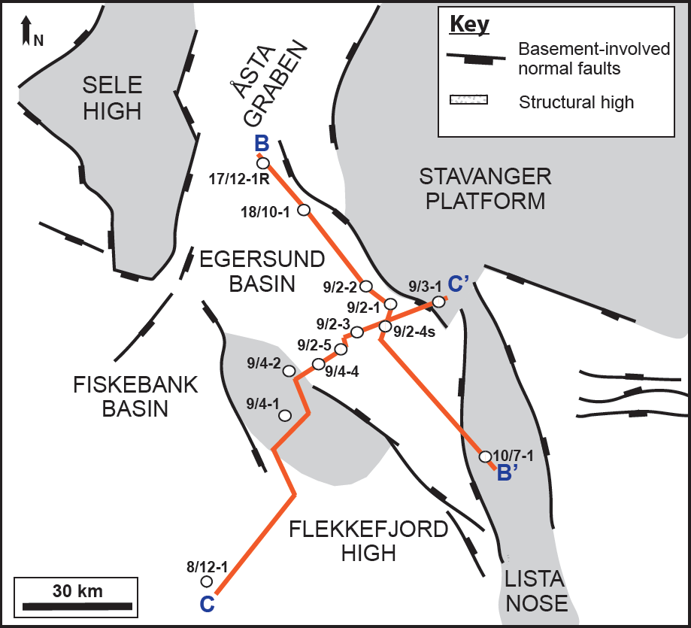
Regional stratigraphic architecture
Regional isopach of J20-J40 interval showing thickness changes in main part of Sandnes Fm
Note thickness changes related to both thick-skinned, basin bounding fault systems (e.g. Sele High, Stavanger, Lista Nose) and salt structures (e.g. Beta and Alpha salt walls)

Slide 17
Regional stratigraphic architecture
Depositional-dip section
Sandnes Fm up to 100 m thick and divided into three parasequences defining a net-transgressive stratigraphic architecture
Strongly aggradation with shoreface/reservoir stacking in the central and south-eastern parts of the basin
Shallow-marine sandstone/reservoir deposits thin and pinch-out towards the NW

Slide 18
Regional stratigraphic architecture
Depositional-strike section across central part of basin
Sandnes Fm continuous across strike, but thins onto basement-cored structural highs at basin margins (e.g. Stavanger Platform and Flekkefjord High)
Local preservation of offshore transition deposits in basin centre; otherwise removed by wave-ravinement during transgression at basin margins?

Slide 19
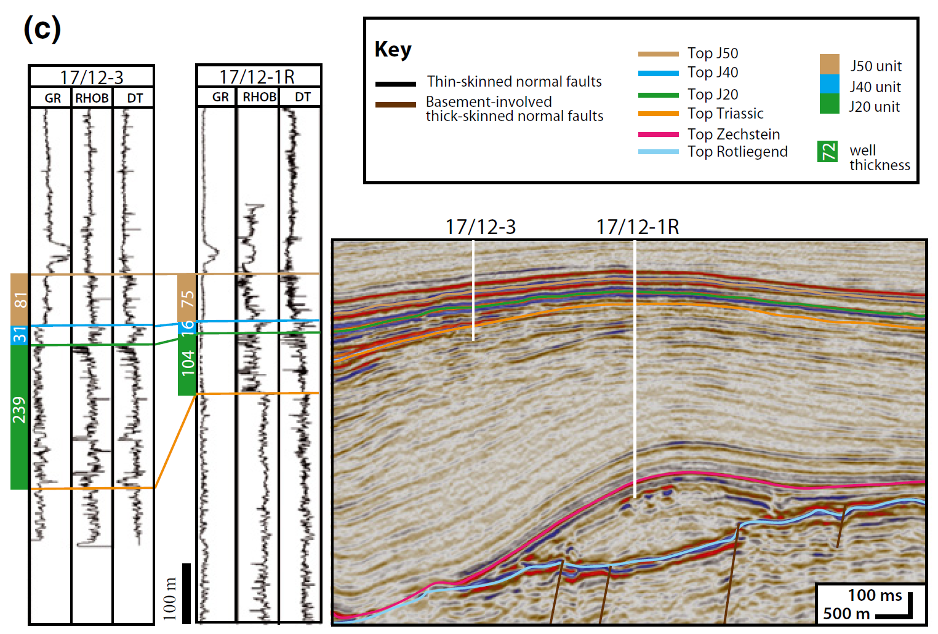
Local stratigraphic architecture
Pronounced thinning of the Bryne Fm (J20; green) onto the Xi salt anticline; thinning more subtle in Sandnes (blue; J40) and Egersund fms (brown; J50)
Main period of salt anticline growth during the earliest Middle Jurassic (Aalenian-Bajocian); post-Bajocian growth more limited

Slide 20
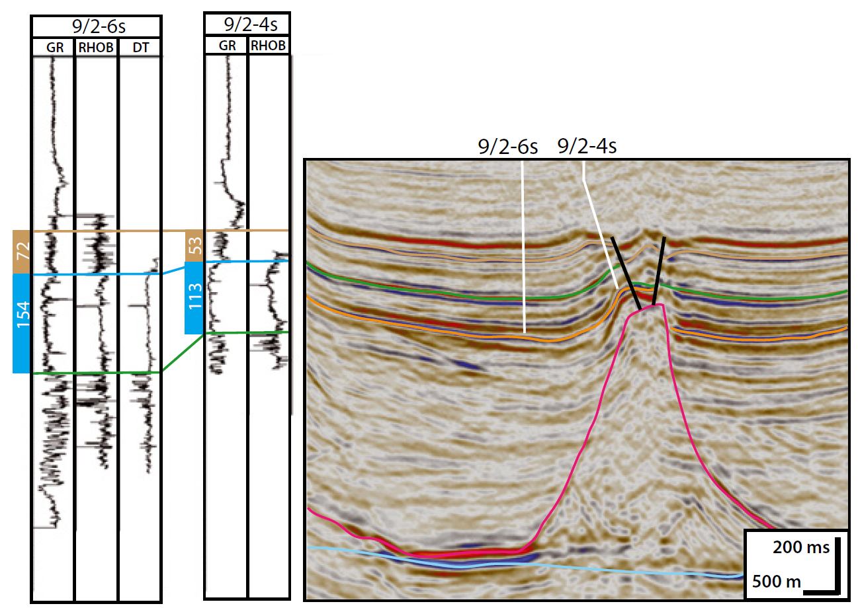
Local stratigraphic architecture
Pronounced thinning of Sandnes Fm (J40; blue) onto upturned flank (halokinetic fold) of a diapir that was actively rising during the Middle Jurassic
Amalgamation of shallow marine sandstones towards diapir; associated with loss of offshore transition deposits due to transgressive wave-ravinement?

Slide 21
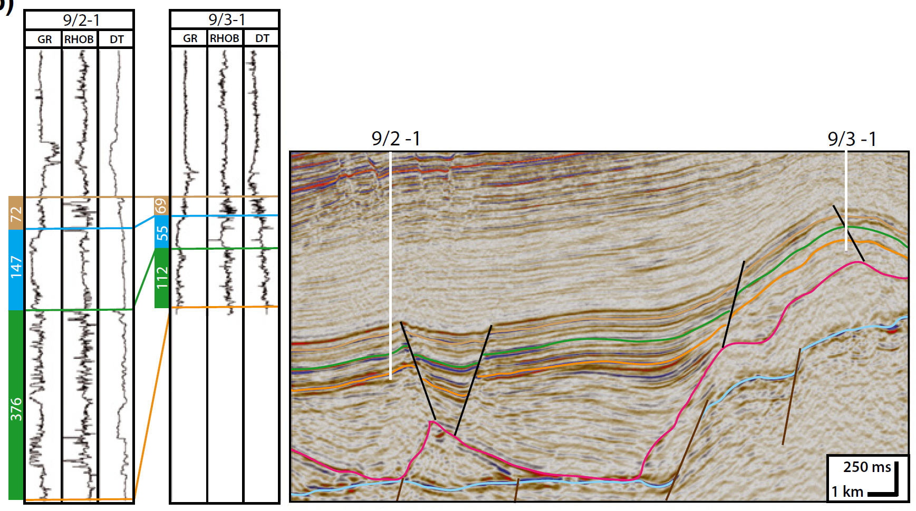
Local stratigraphic architecture
Pronounced thinning of Bryne (J20; green) and Sandnes fms (J40; blue) onto salt pillow-enhanced, fault-tip fold formed due to growth of the Stavanger Fault System

Slide 22
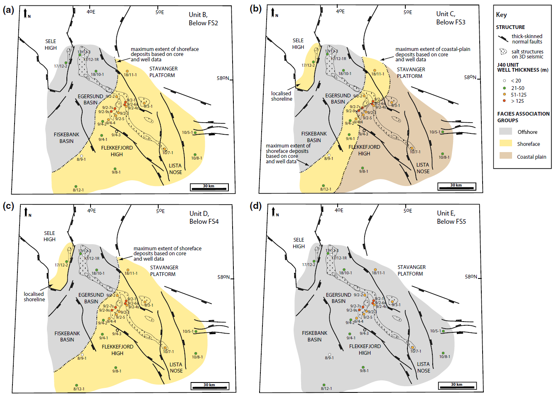
Regional depositional setting
These maps show the distribution of the main facies associations (offshore, shallow marine, and coastal-plain) below the main intra-Sandnes Fm flooding surfaces
These are NOT paleogeographic maps; i.e. Sandnes Fm shorefaces were never up to 60 km wide!
Shorefaces more likely a few kilometres wide at any one point in time; progradation and accretion of these shorefaces led to deposition of much broader belts
Coeval coastal-plain deposits likely removed during transgressive wave-ravinement between periods of shoreline progradation
Unit 1
Unit 2
Unit 3
Unit 4

Slide 23
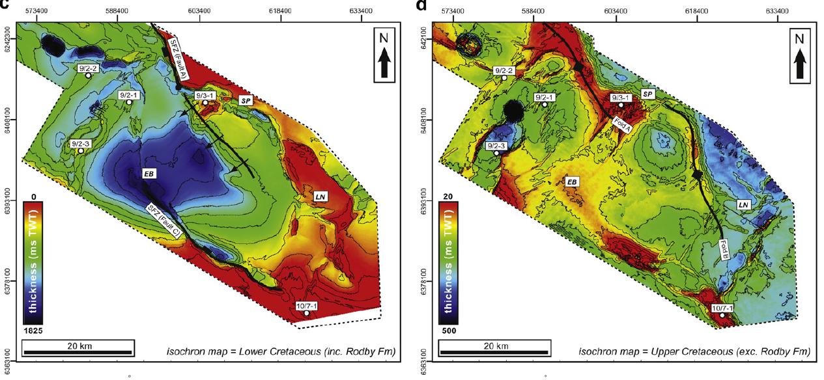
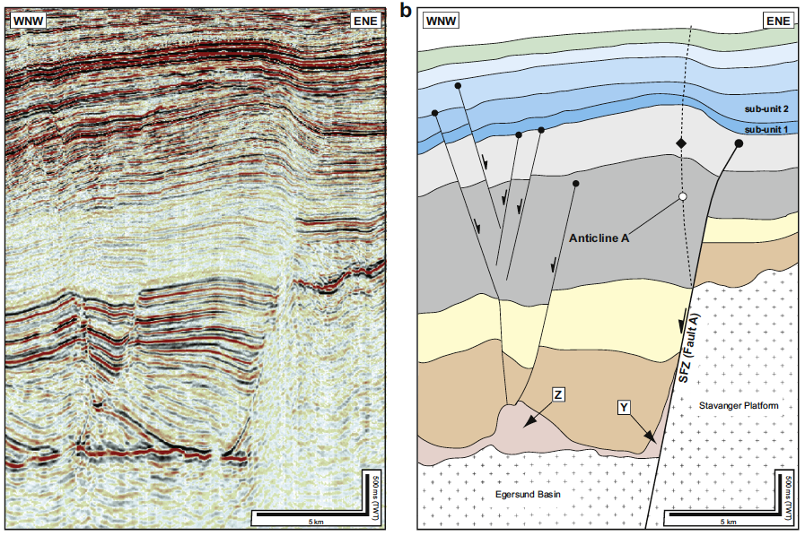
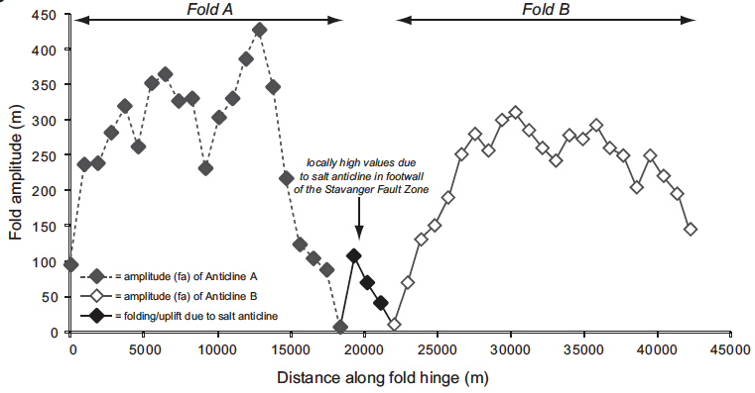
Other research - basin inversion
Diachronous inversion-related fold growth initiated in the Turonian-Coniacian (c. 89 Ma) and Santonian (c. 83 Ma)
Inversion event lasted c. 20 Myr and ceased in the Maastrichtian
Segmented inversion structures reflect segmented rift structures
Jackson et al. (2013)

Slide 24
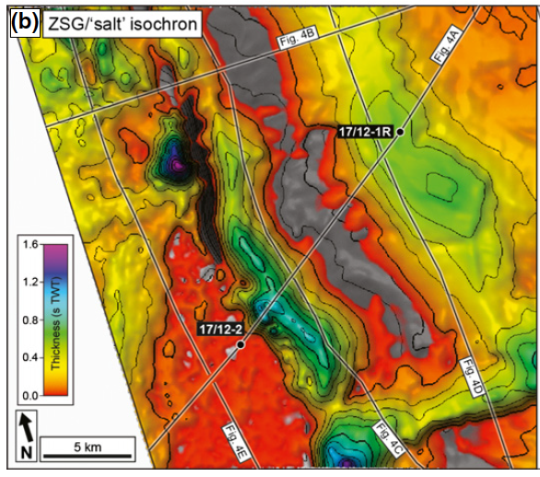
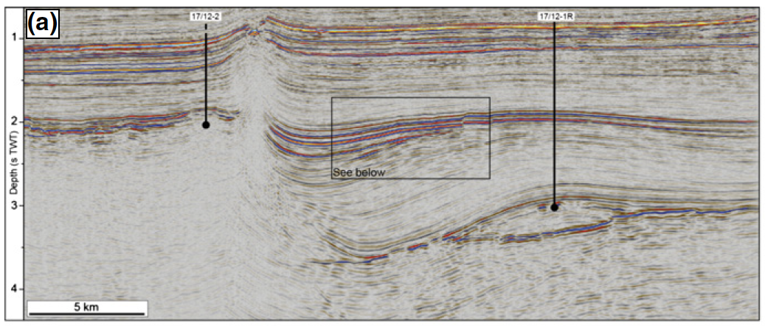
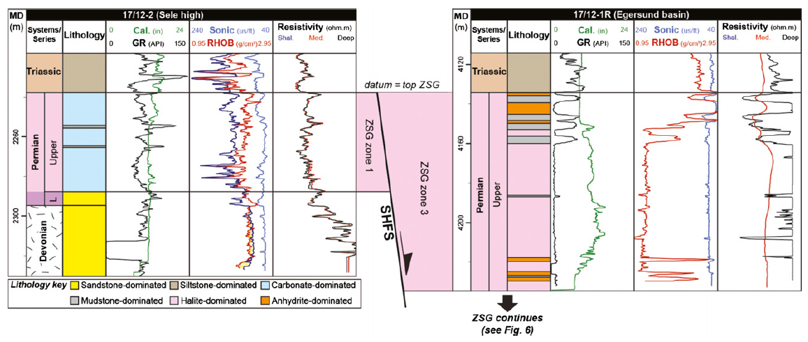
Other research – salt composition
Jackson & Lewis (2014)
Tectonics, salt deposition (thickness and composition), and the style of overburden deformation (thin- vs. thick-skinned) coupled for >180 Myr
Tectono-stratigraphic models based on fully brittle crust do not appropriately describe the range of structural styles occurring in salt-influenced rifts

Slide 25
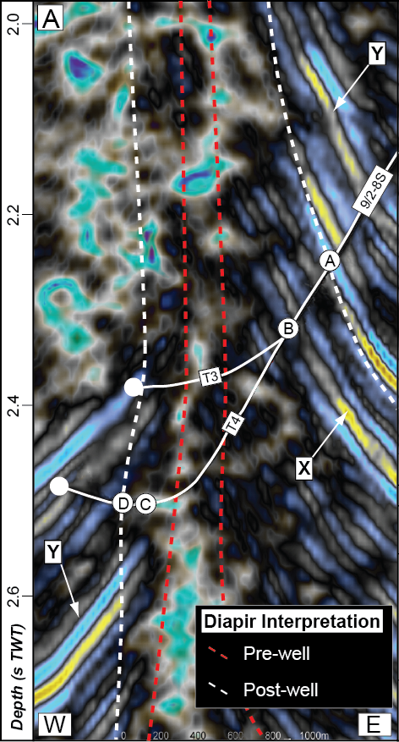
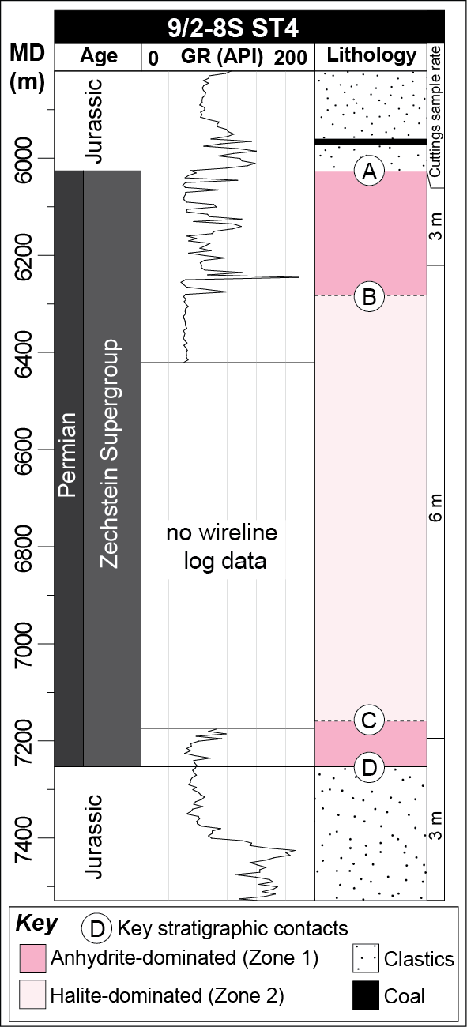
Other research – salt composition
Epsilon Diapir consists of an inner, c. 1500 m thick, halite-dominated zone, and an outer, c. 250 m thick, anhydrite-dominated ‘sheath’
Origin of the anhydrite sheath is unknown
The margins of steep-sided salt structures may be misidentified by several hundred metres
Jackson & Lewis (2012)

Slide 26
Summary
The Egersund Basin records the tectono-stratigraphic development of a polyphase, salt-influenced rift basin subject to mild, late-stage inversion
Rift structural style controlled by the distribution, thickness, and composition of Zechstein Supergroup salt
The Sandnes Fm defines a net-transgressive, retrogradationally-to-aggradationally stacked, shallow marine succession, deposited in a NE-trending, NW-prograding, wave-dominated shoreface
Deposition of the Sandnes Fm reservoir (and potentially the secondary Bryne Fm reservoir) controlled by salt tectonics and slip on thick- and thin-skinned normal faults

Slide 27
Bibliography
Jackson, C.A-L., Elliott, G.M., Royce-Rogers, E., Gawthorpe, R.L., & Aas, T.E., (2019) Salt thickness and composition influence rift structural style, northern North Sea, offshore Norway. BASIN RESEARCH.
Jackson, C.A-L., & Stewart., S.A., (2017) Composition, Tectonics, and Hydrocarbon Significance of Zechstein Supergroup Salt on the United Kingdom and Norwegian Continental Shelves: A Review. Permo-Triassic Salt Provinces of Europe, North Africa and the Atlantic Margins. Elsevier.
Tvedt, A.B.M., Rotevatn, A., & Jackson, C.A-L. (2016). Supra-salt normal fault growth during the rise and fall of a diapir: Perspectives from 3D seismic reflection data, Norwegian North Sea. JOURNAL OF STRUCTURAL GEOLOGY, 91, 1-26.
Mannie, A.S., Jackson, C.A-L., Hampson, G.J., & Fraser, A.J. (2016). Tectonic controls on the spatial distribution and stratigraphic architecture of a net-transgressive shallow-marine synrift succession in a salt-influenced rift basin: Middle to Upper Jurassic, Norwegian Central North Sea. JOURNAL OF THE GEOLOGICAL SOCIETY, 173, 901-915.
Jackson, C.A-L., & Lewis, M.M. (2016). Structural style and evolution of a salt-influenced rift basin margin; the impact of variations in salt composition and the role of polyphase extension. BASIN RESEARCH, 28, 81-102.
Tvedt, A.B.M., Rotevatn, A., Jackson, C.A-L., Fossen, H., & Gawthorpe, R.L. (2013). Growth of normal faults in multilayer sequences: a 3D seismic case study from the Egersund Basin, Norwegian North Sea. JOURNAL OF STRUCTURAL GEOLOGY, 55, 1-20.
Jackson, C.A-L., & Lewis, M.M. (2013). Physiography of the North Permian Basin margin: new insights from 3D seismic reflection data. Journal of the Geological Society, 170, 857-860.
Mannie, A.S., Jackson, C.A-L., & Hampson, G.J. (2014). Structural controls on the stratigraphic architecture of net-transgressive shallow-marine strata in a salt-influenced rift basin: Middle-to-Upper Jurassic Egersund Basin, Norwegian North Sea. BASIN RESEARCH, 26, 675-700.
Lewis, M.M., Jackson, C.A-L., & Gawthorpe, R.L. (2013). Salt-influenced normal fault growth and forced folding: The Stavanger Fault System, North Sea. JOURNAL OF STRUCTURAL GEOLOGY, 54, 156-173.
Jackson, C.A-L., Chua, S.-T., Bell, R.E., & Magee, C. (2013). Structural style and early stage growth of inversion structures: 3D seismic insights from the Egersund Basin, offshore Norway. JOURNAL OF STRUCTURAL GEOLOGY, 46, 167-185.
Jackson, C.A-L., & Lewis, M.M. (2012). Origin of an anhydrite sheath encircling a salt diapir and implications for the seismic imaging of steep-sided salt structures, Egersund Basin, Northern North Sea. JOURNAL OF THE GEOLOGICAL SOCIETY, 169, 593-599.

