Slide 1





Petrophysical characterisation and structural styles of salt welds in the Southern North Sea
Gabriela Salomao Martins*
Christopher A-L Jackson
Basins Research Group (BRG)
Dept. of Earth Science &Engineering, Imperial College London
*email: g.salomao-martins18@imperial.ac.uk
*Twitter: @gsalomaomartins
Seismic data:
Software:
Borehole
data:
Funding:

Slide 2
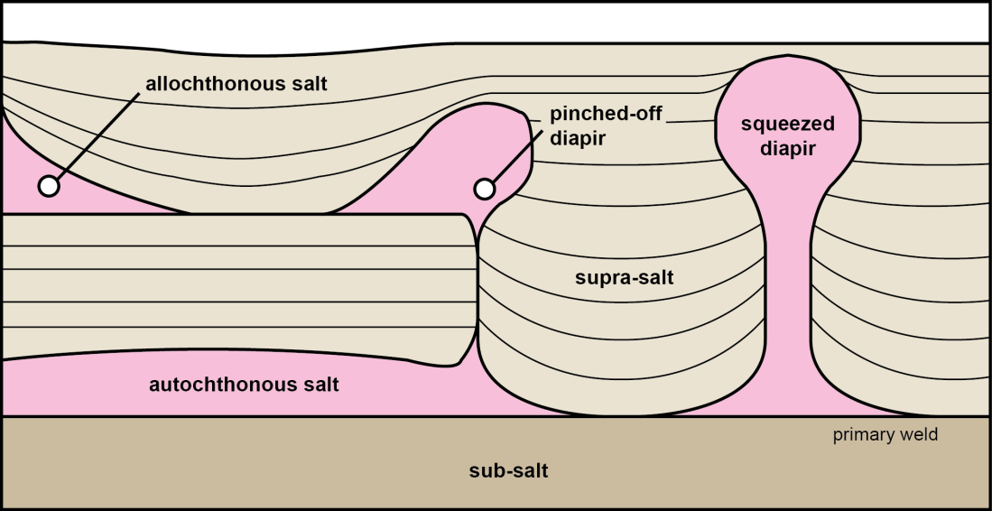
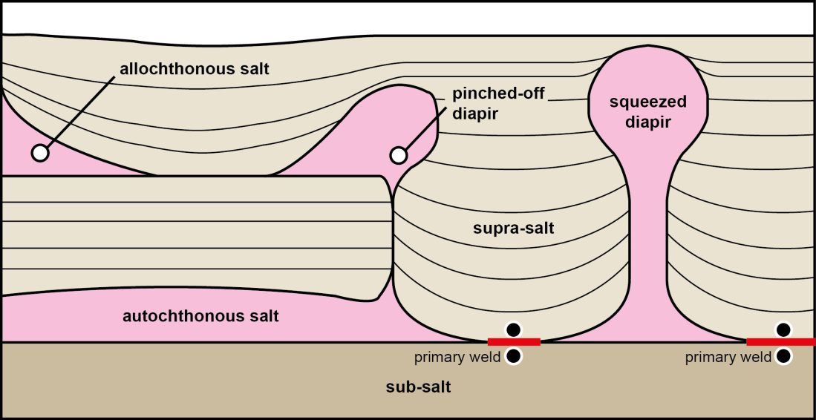
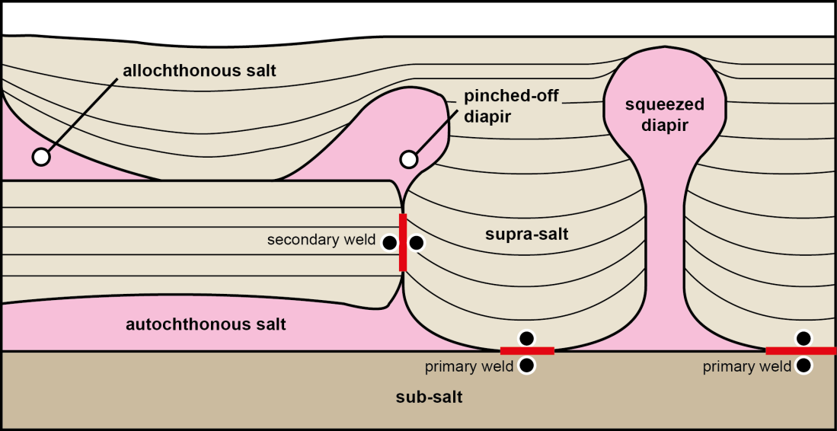
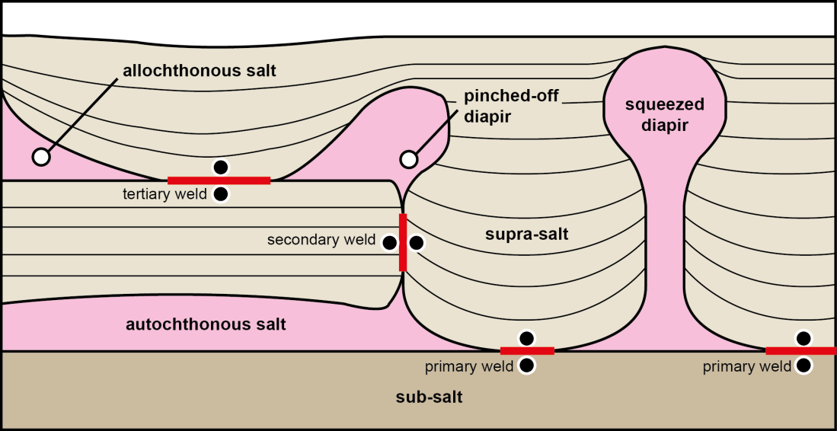
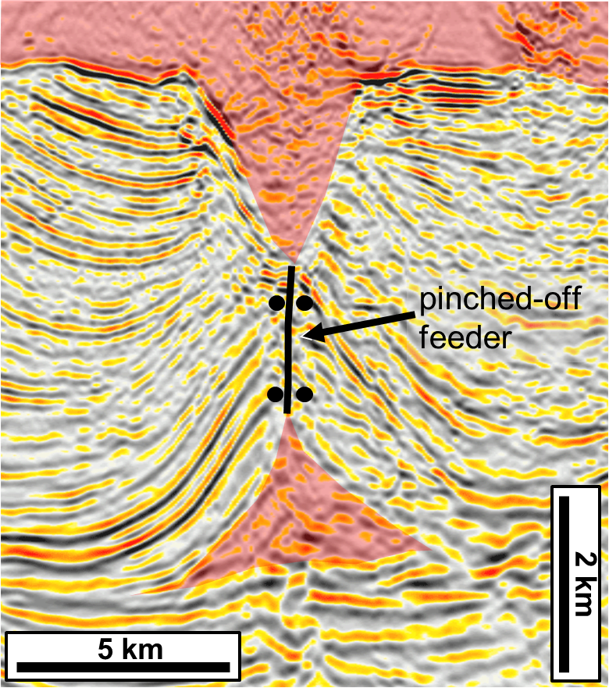
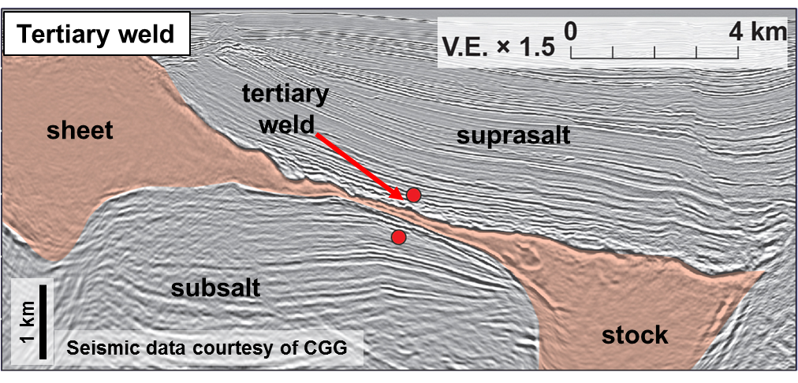
What is salt weld?
salt
“…the structure joining two rock bodies formerly separated by salt…” (Jackson and Cramez, 1989).
no scale implied
from Jackson et al. (2014)
salt
salt
salt
Seismic data courtesy of CGG
primary - joins strata originally above and below autochthonous salt
secondary – joins minibasins originally situated either side of diapirs
tertiary – joins strata originally above and below allochthonous salt

Slide 3

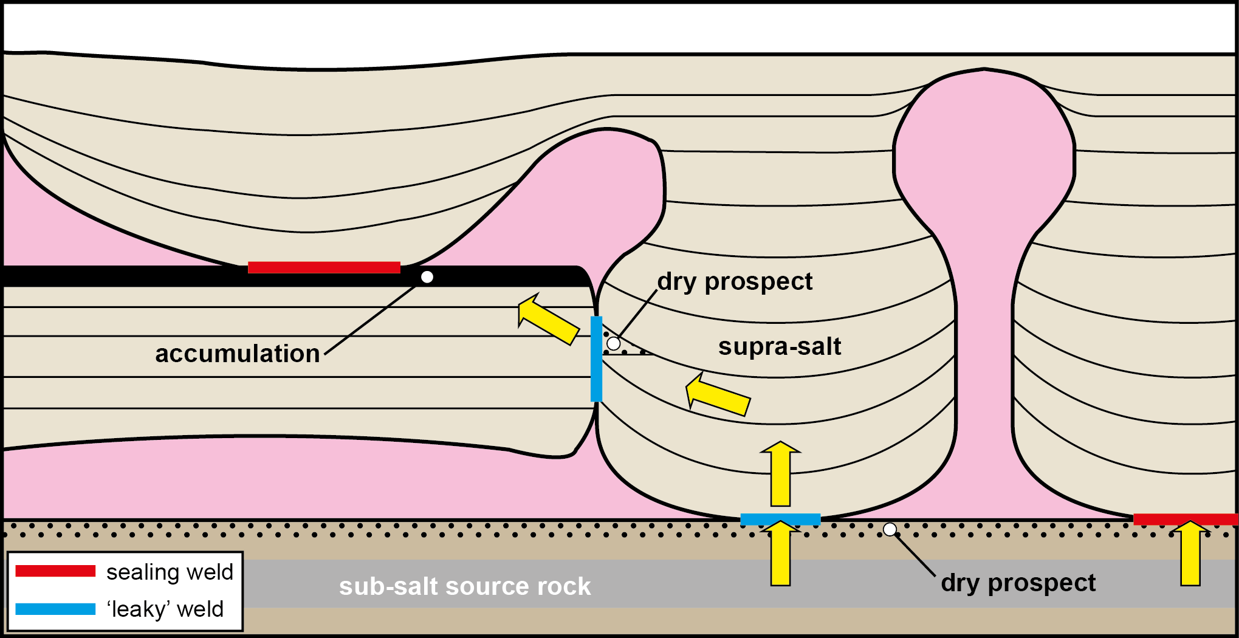
Why are salt welds important?
from Jackson et al. (2014)
Rheology of remnant lithologies in welds has an impact on prospectivity.
Reconstruct the geological evolution of salt-bearing sedimentary basins.
Capacity of these features to control the flow of hazardous nuclear waste, which is locally stored in related diapirs.
Welds may also play a role in the ability of salt-tectonic systems to act as CO2 repositories.

Slide 4
What do we want to know?
Variability of thickness and composition of salt welds, and how this relates to bulk thickness and composition of the original salt layer.
Factors controlling the capacity of salt welds to transmit or seal fluids.
Effects of welding on seismic velocity, density and porosity of adjacent rocks, and how could it impact seismic imaging, reservoir quality and trap definition.
Subsurface case study from the Southern North Sea, UKCS
Notes:
Key questions to be answered in this talk

Slide 5
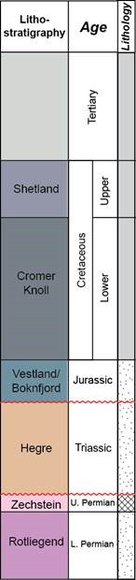
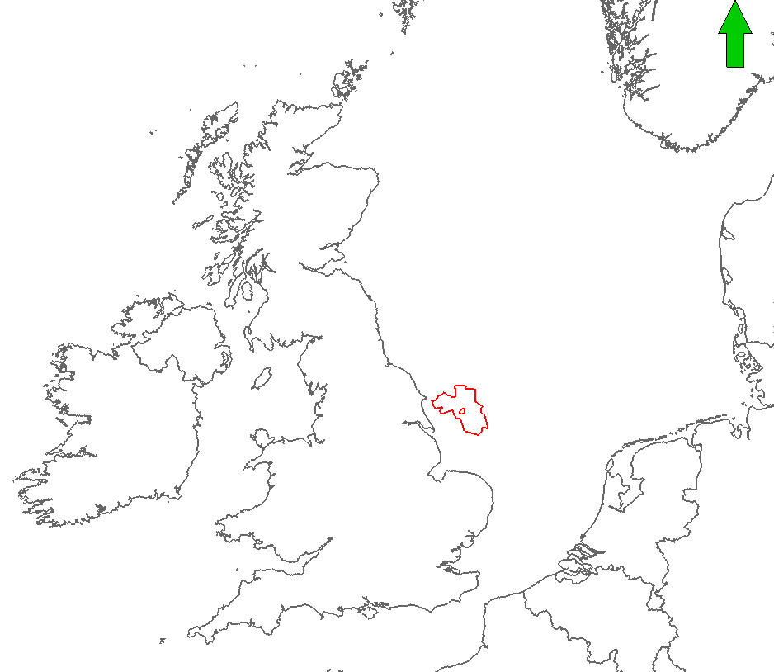
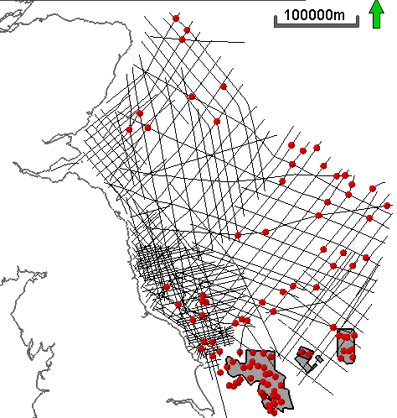
Study area and dataset
Well
2D seismic
3D seismic

Slide 6
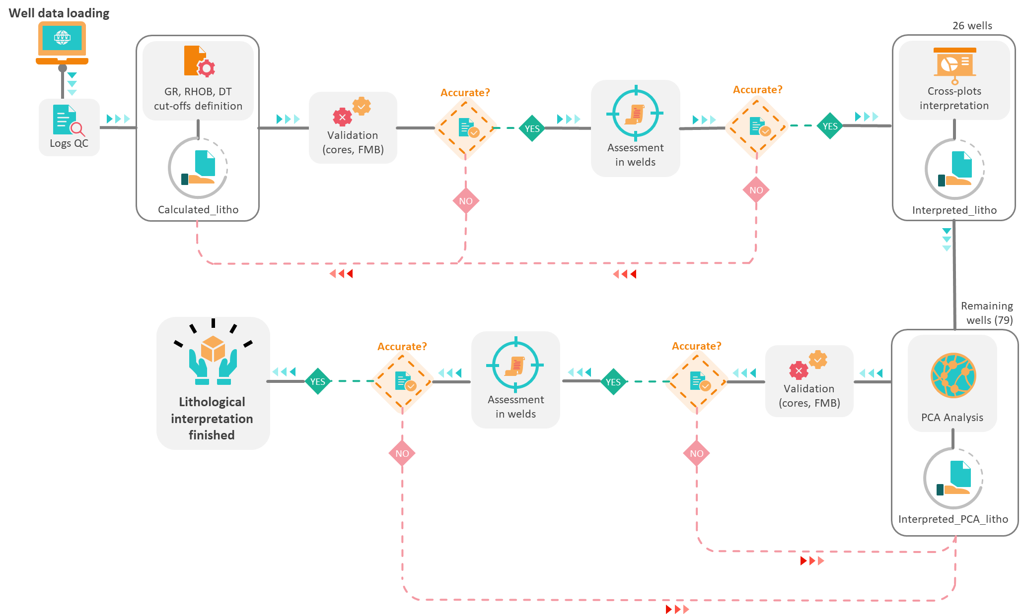
Zechstein Super Group (ZSG) petrophysical characterisation

Slide 7
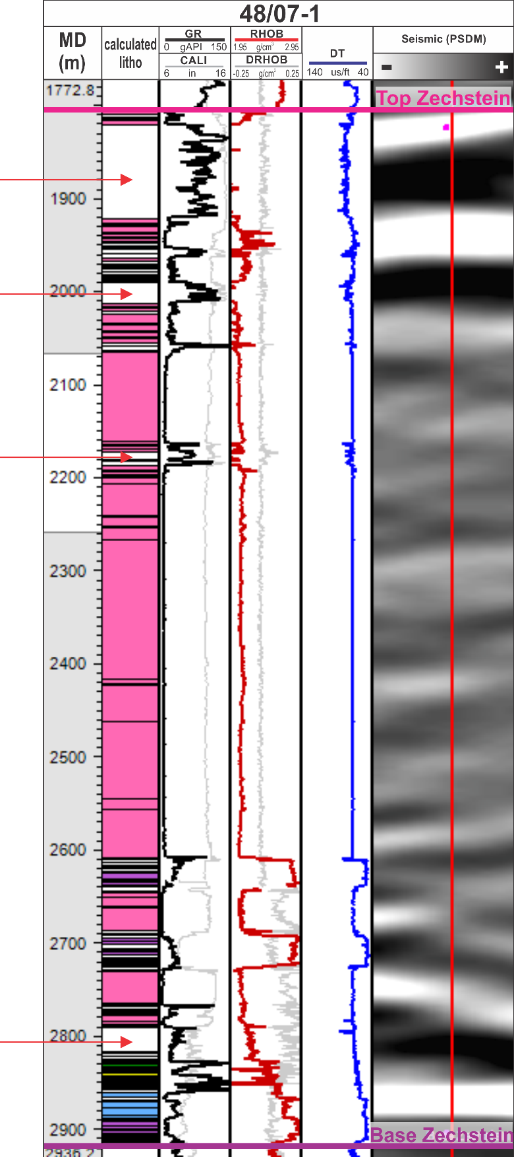
ZSG petrophysical characterisation
GR, RHOB, DT cut-offs definition
Lithology | Gamma-ray (GR) (API) | Density (RHOB) (g/m3) | Sonic (DT) (µs/ft)
Shale | 65 - 180 | 2.2 - 2.65 | 70 - 150
Sandstone | 30 - 65 | 2.3 - 2.35 | 60 - 70
Carbonate | 25 - 65 | 2.4- 2.9 | 40 - 70
Anhydrite | 0 - 25 | 2.8 - 3.1 | 48 - 52
Gypsum | 0 - 35 | 2.25 - 2.35 | 51 - 54
Halite | 0 - 30 | 1.9 - 2.2 | 64 - 72
Polyhalite | 100 - 200 | 2.7 - 2.95 | 55 - 60
Sylvite | > 450 | 1.4 - 1.8 | 72 - 84
Carnalite | 80 - 250 | 1.4 - 1.9 | 72 - 84
Tachydrite | 0 - 35 | 1.6 - 1.8 | 85 - 95
Calculated_litho
All wells (103)
Ranges of typical log values based on (Rodriguez, 2017; Jackson et al., 2018; Warren, 2018).
Cut-offs consist of a restricted search window, centred on the typical log response for each of the intra-ZSG lithologies.

Slide 8
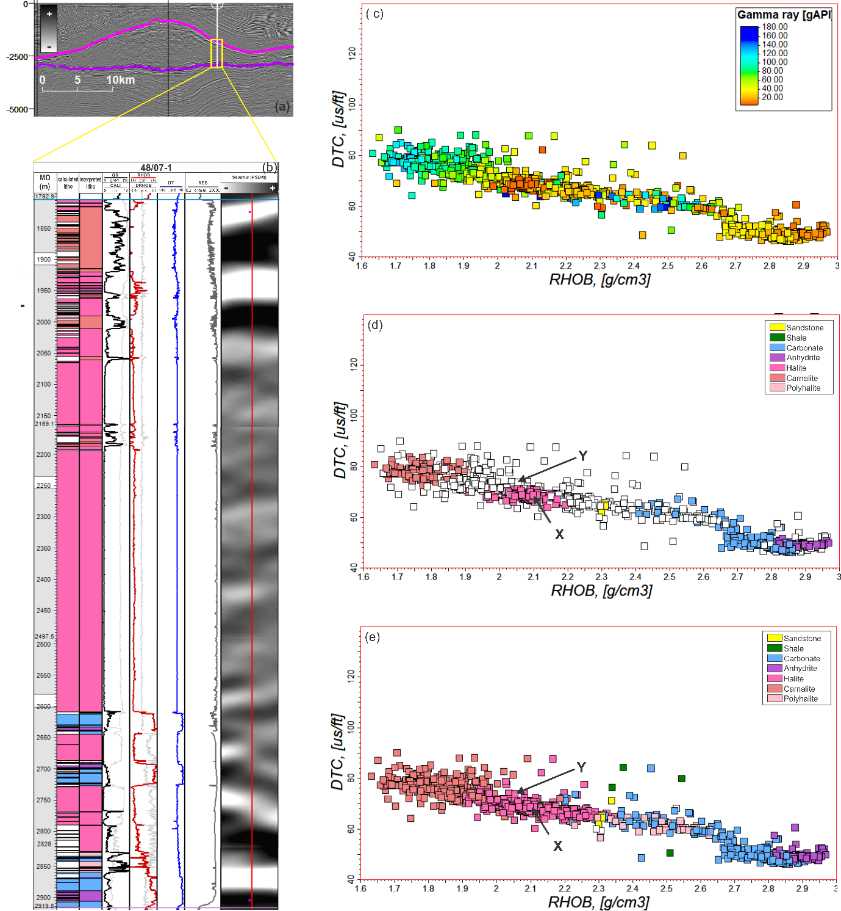
ZSG petrophysical characterisation
Cross-plots interpretation
Interpreted_litho
26/103 wells
Detailed cross-plot based interpretation.
Human/geological judgement driven.
Each of the 26 wells interpreted individually.

Slide 9
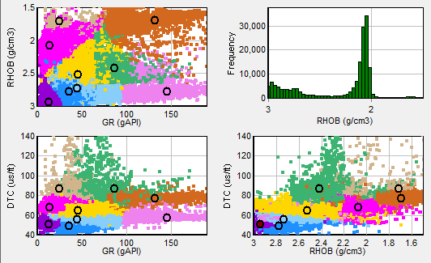
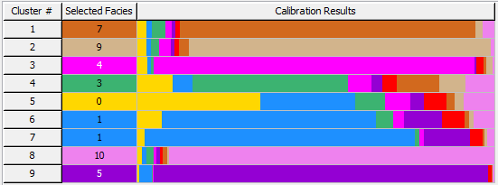
ZSG petrophysical characterisation
PCA Analysis
Interpreted_PCA_litho
77/103 wells
26 fully interpreted wells were used to calibrate statistical clustering (principal component analysis).
1 = Carnalite (82.72%)
2 = Tachydrite (84.56%)
3 = Halite (89.86%)
4 = Shale (43.53%)
5 = Sandstone (34.44%)
6 = Carbonates (59.81%)
7 = Carbonates (75.60%)
8 = Polyhalite (91.09%)
9 = Anhydrite (93.57%)
Points within each cluster were assigned with the lithology with the highest correlation to the calibration wells.

Slide 10
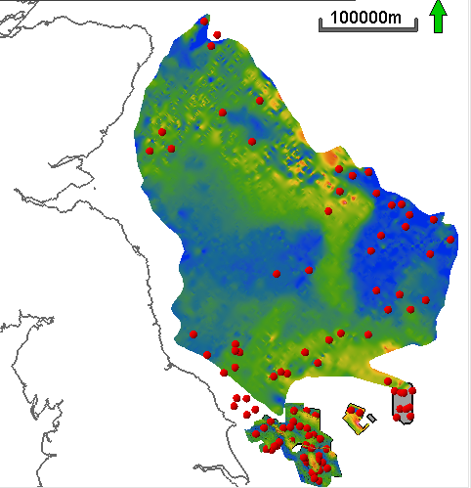

ZSG Salt structural domains
100 km
ZSG thickness
Thin salt domain (blue)
  Welds/ thin deposition in structural highs
Thick salt domain (red)
  Pillows, diapirs, walls
N
thick
Area 1
thin
Area 4
Area 3
Area 2

Slide 11
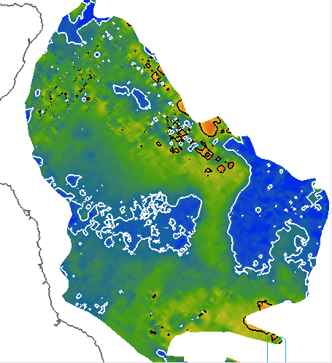
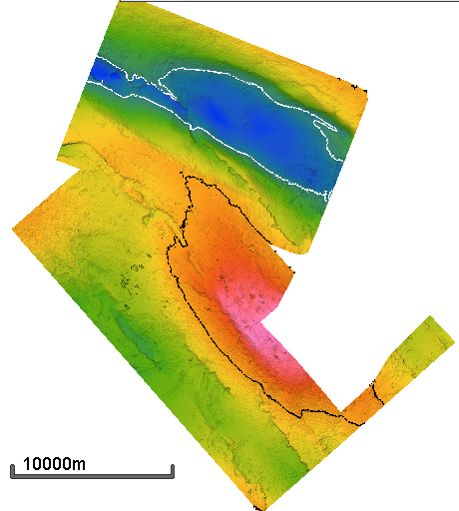
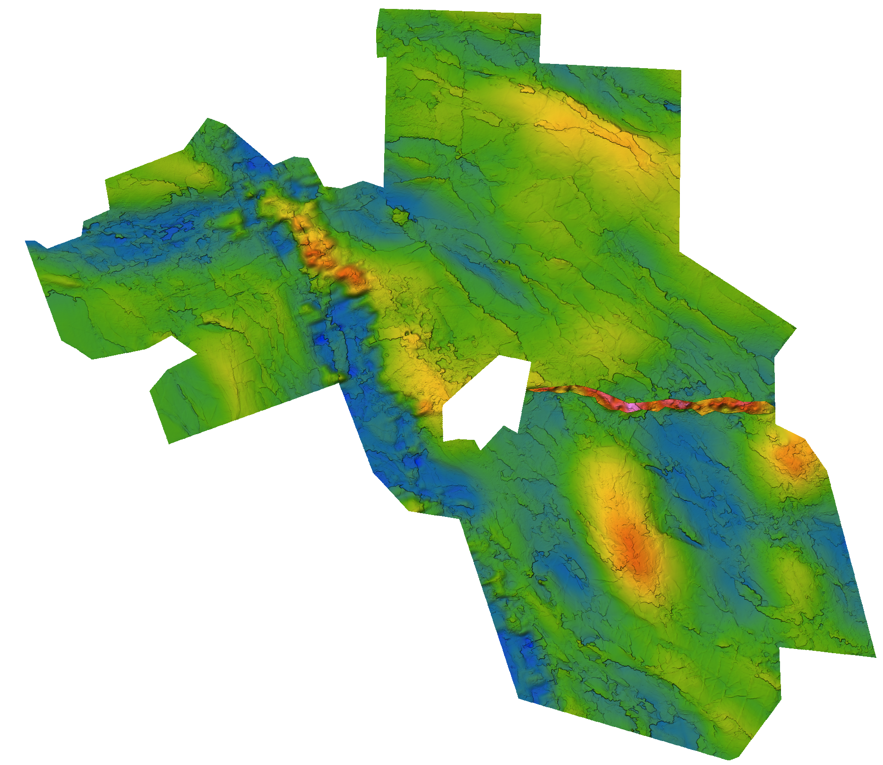
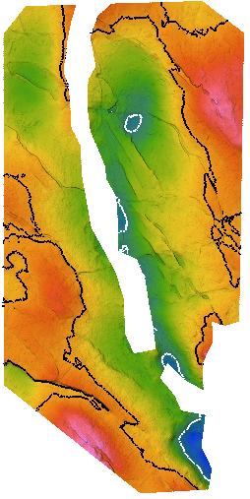
ZSG Salt structural domains
Area 1
N
N
N
Area 2
Area 3
thick
N
Thick salt domain (pillows, diapirs)
Thin salt domain (welds, structural highs)
Area 4
thin

Slide 12
ZSG Salt structural domains – Area 2
N
Thickness Zechstein (m)
3250
1625
0
Thick salt domain (pillows, diapirs)
Thin salt domain (welds, structural highs)
25 km

Slide 13
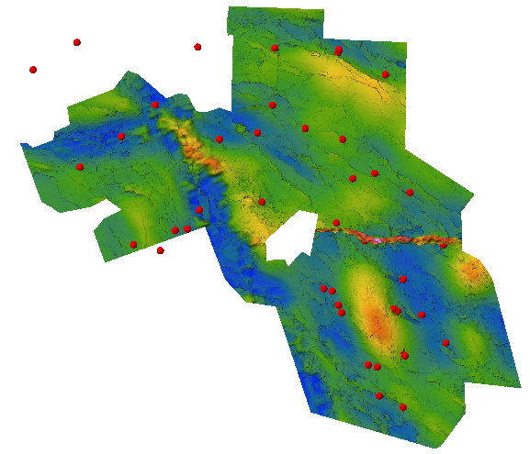
ZSG salt structural domains – Area 2
N
Thickness Zechstein (m)
3250
B
1625
0
Thick salt domain (pillows, diapirs)
Thin salt domain (welds, structural highs)
25 km

Slide 14
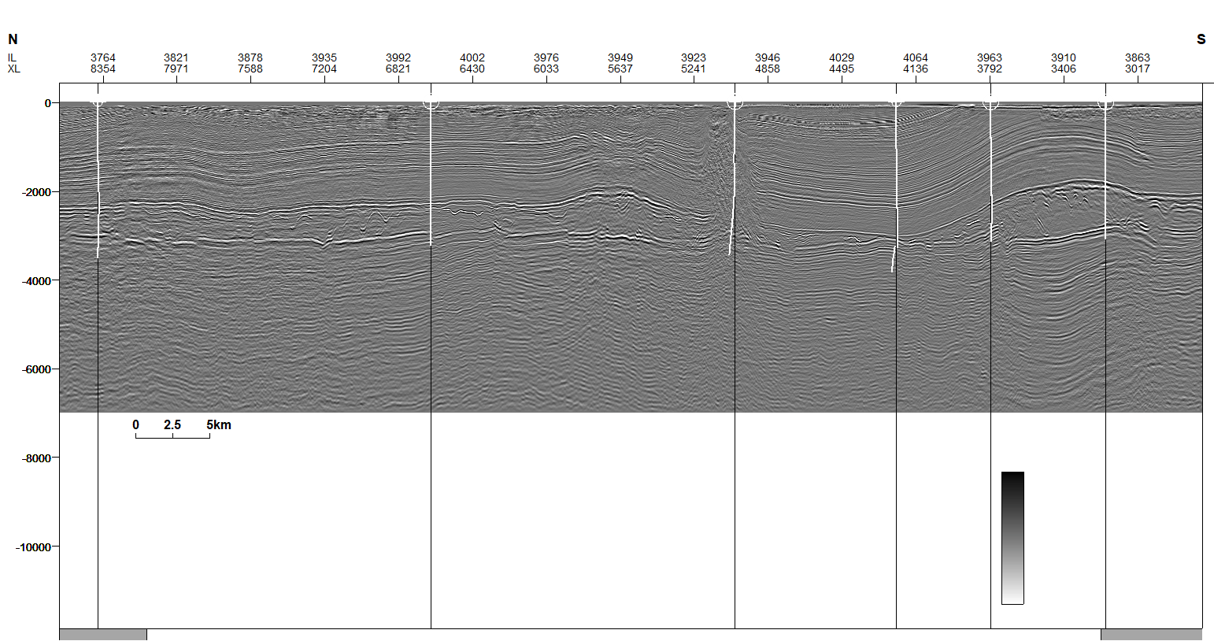

Area 2 – structural style and ZSG compositional variability
48/01-2A
48/02-1
48/07b-3
48/07-1
+
-
V.E. 3x
5 km
Salt weld
Top Zechstein
Base Zechstein
Welding under compressional regime
  buckle folds
  squeezed diapirs
B

Slide 15
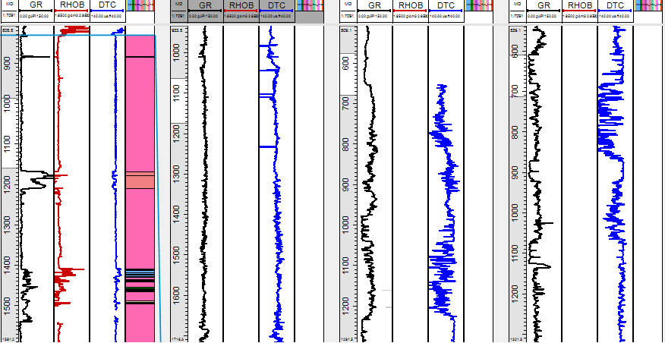
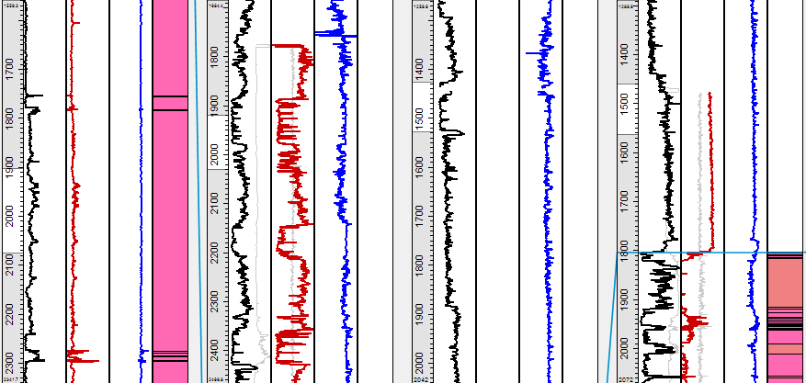
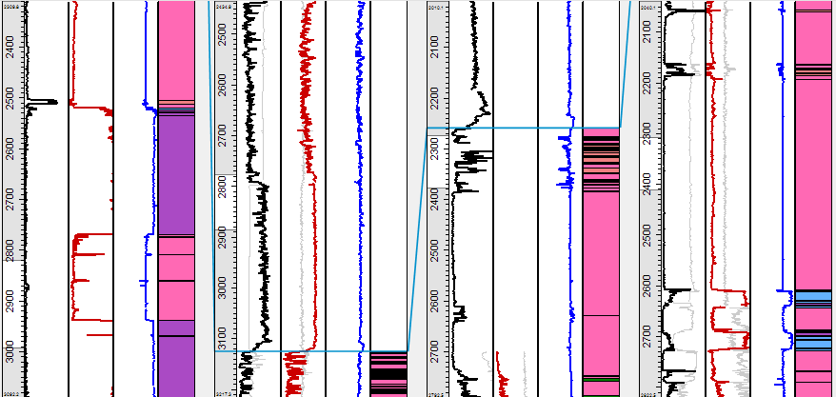
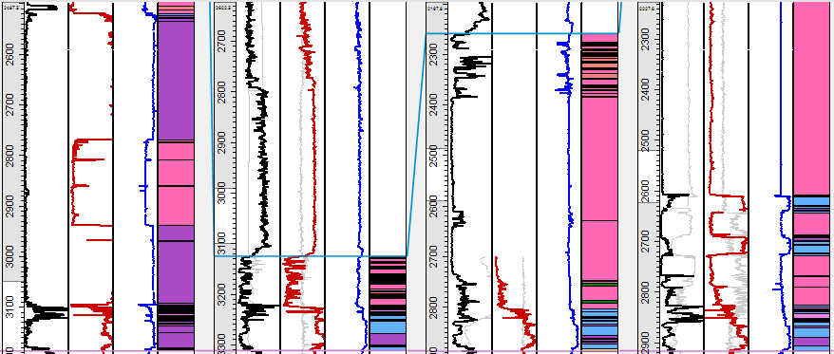
Area 2 – structural style and ZSG compositional variability
48/01-2A
48/02-1
48/07b-3
48/07-1
B
Top Zechstein
Mobile salts (halite) rich section.
Thickness variable in relation to ZSG gross thickness.
Thinner in welds, thicker in diapirs.
Mobile salts
Tachydryte
Carnalite
Halite
Anhydrite
Polyhalite
Carbonate
Shale
Base Zechstein
Clastics

Slide 16
Area 2 – structural style and ZSG compositional variability
48/01-2A
48/02-1
48/07b-3
48/07-1
Basal section with mechanically strong layers.
Constant thickness across salt structures

Slide 17
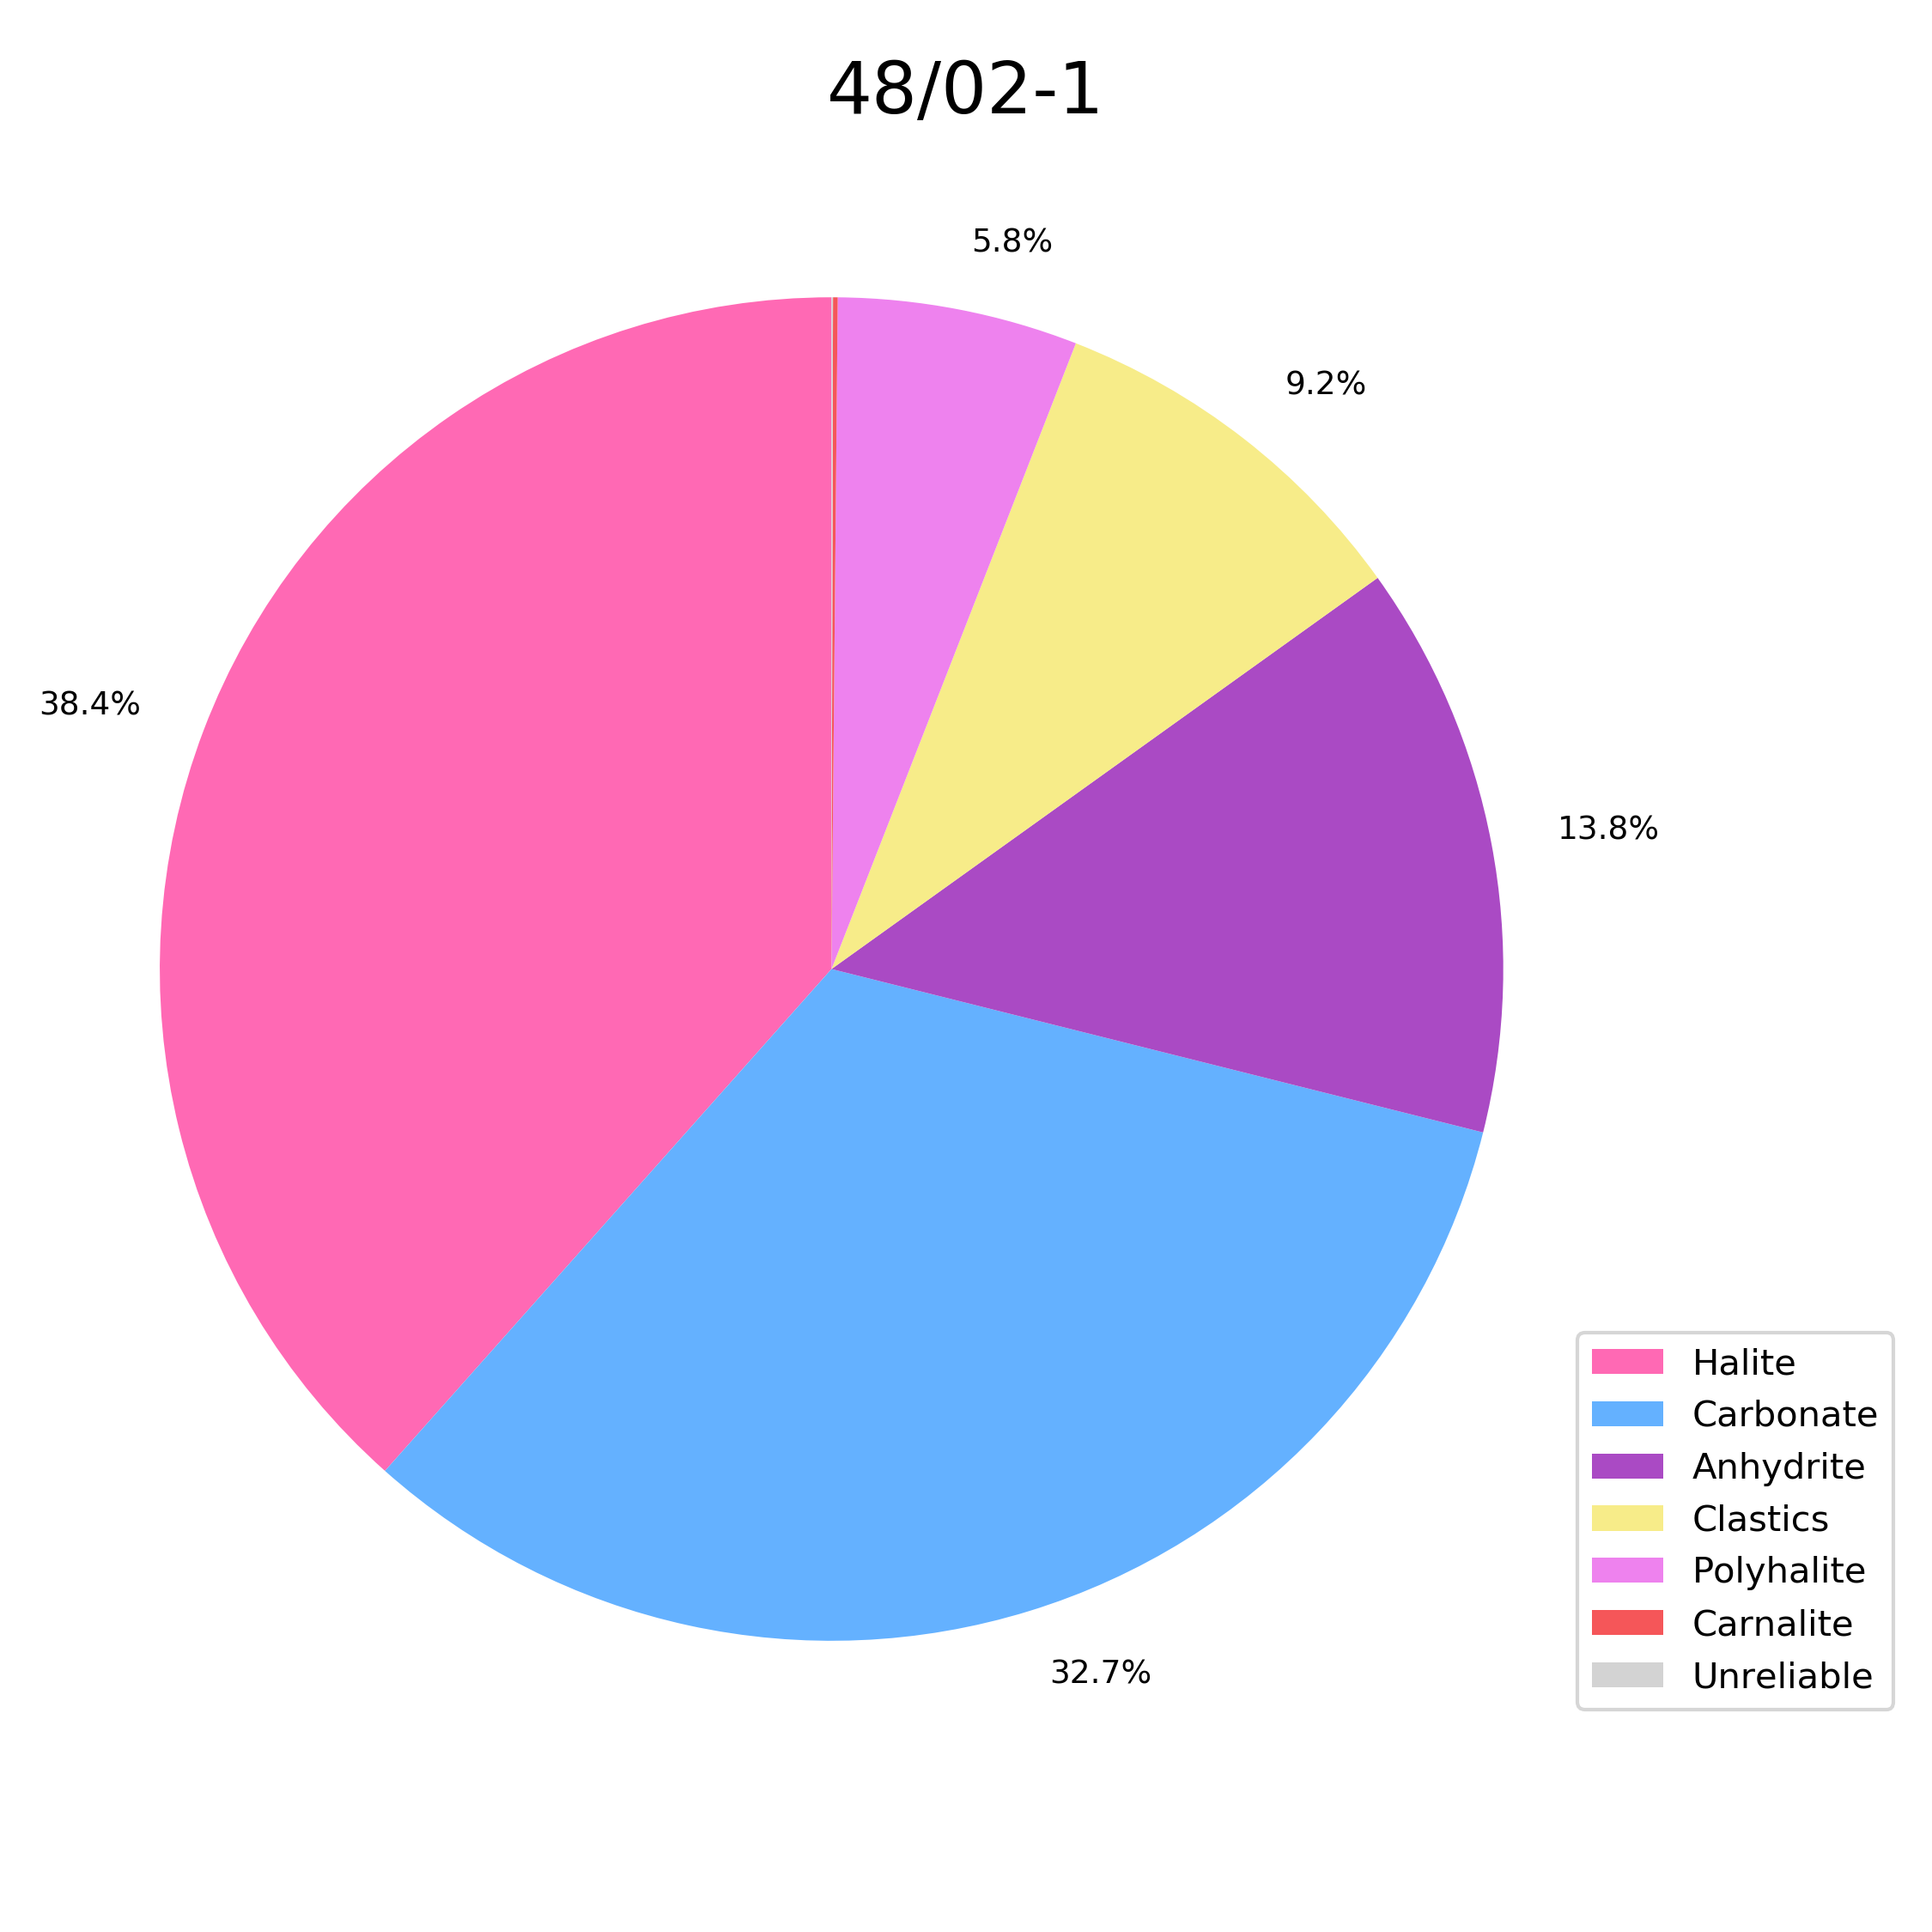
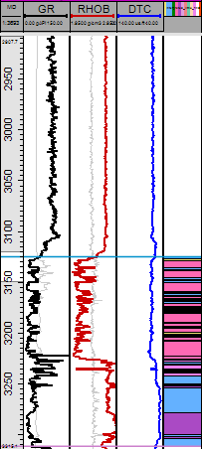
Area 2 – structural style and ZSG compositional variability
48/01-2A
48/02-1
48/07b-3
48/07-1
5.8%
38.4%
9.2%
13.8%
B
32.7%
Top Zechstein
Mobile salts
Tachydryte
Carnalite
Halite
Anhydrite
Polyhalite
Carbonate
Shale
Base Zechstein
Clastics

Slide 18
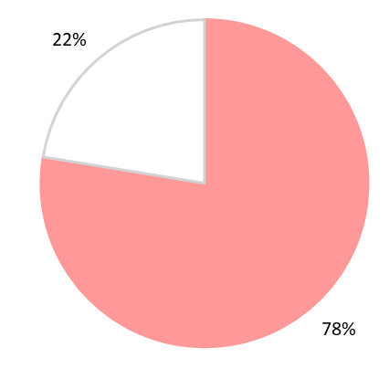
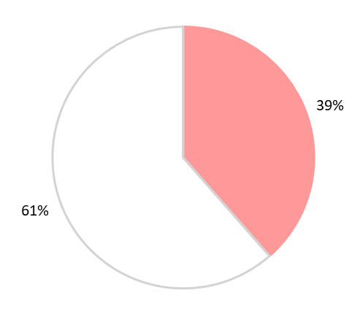
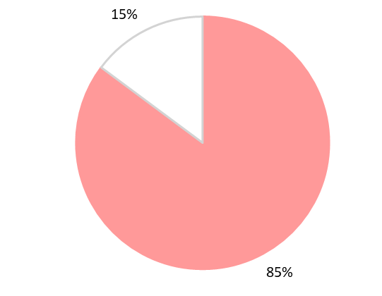

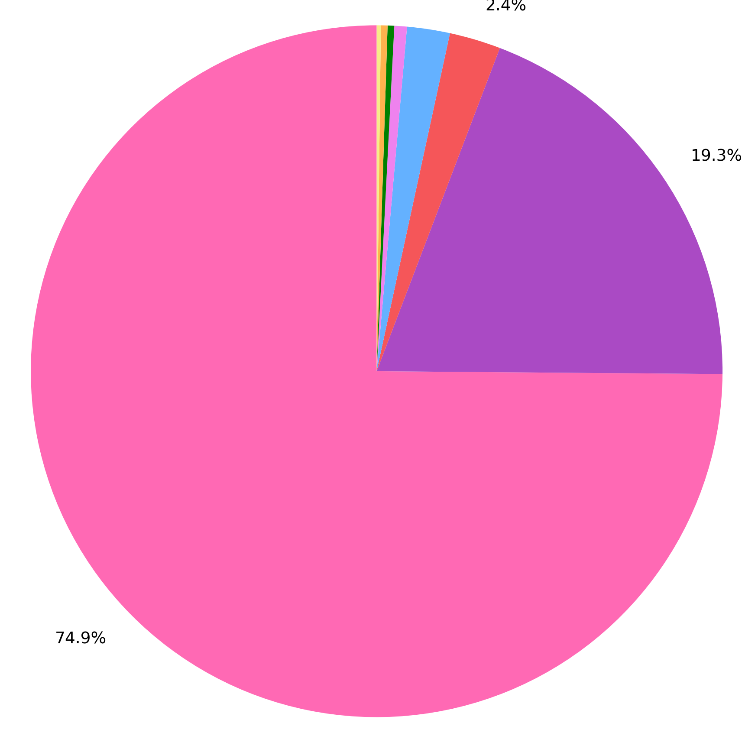
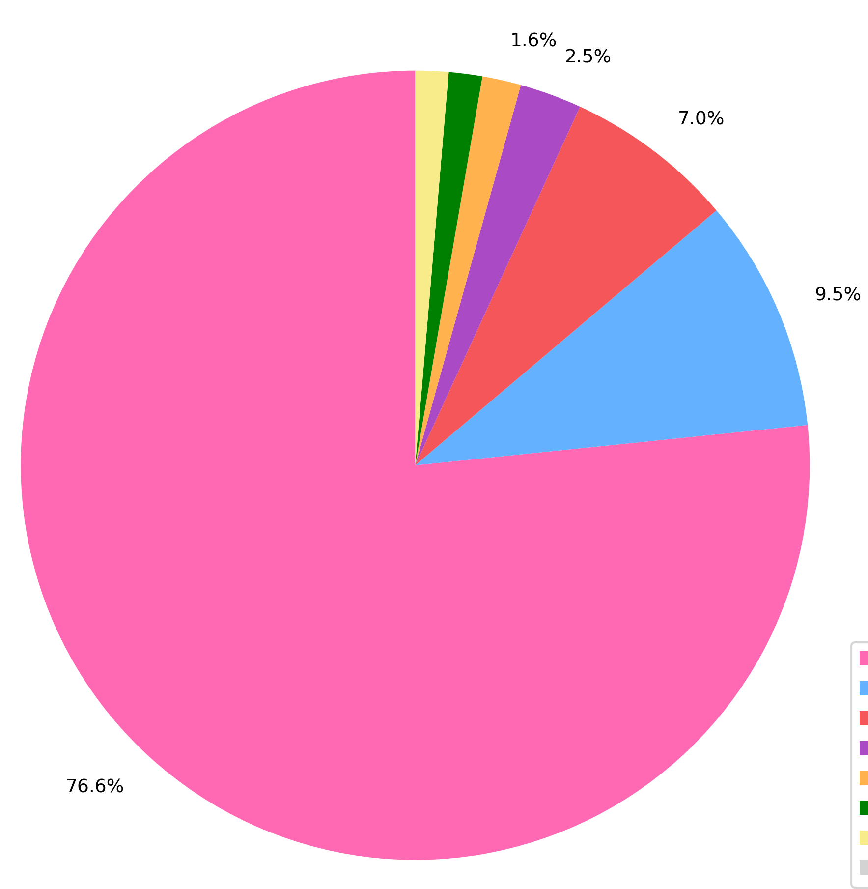
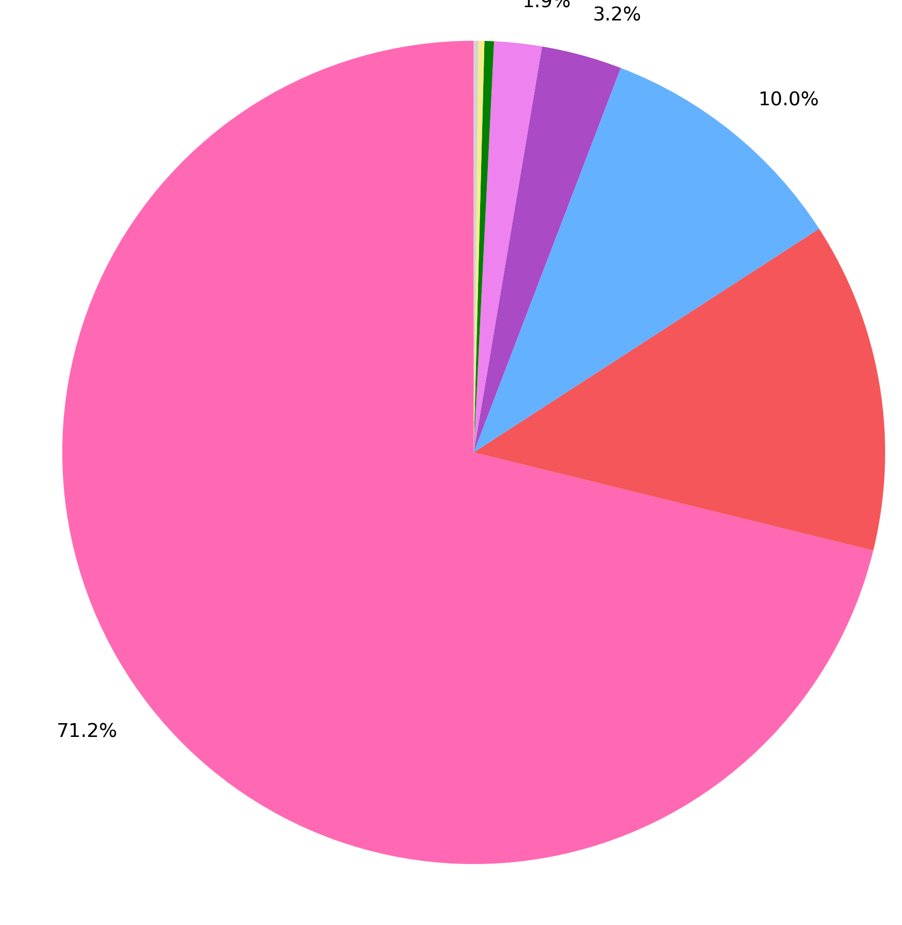
Area 2 – structural style and ZSG compositional variability
48/01-2A
48/02-1
48/07b-3
48/07-1
2%
2.4%
1.6%
2.5%
1.9%
3.2%
5.8%
9.2%
7%
10%
19.3%
38.4%
9.5%
13%
13.8%
74.9%
32.7%
76.6%
71.2%
Mobile salts
Tachydryte
Carnalite
Halite
Anhydrite
Polyhalite
Carbonate
Shale
Clastics

Slide 19
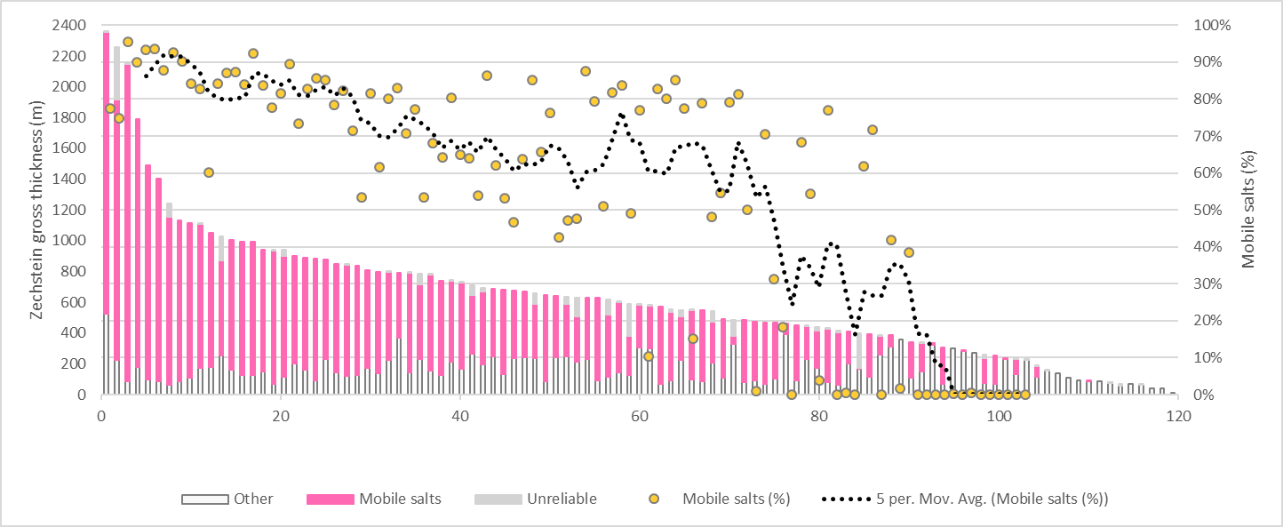
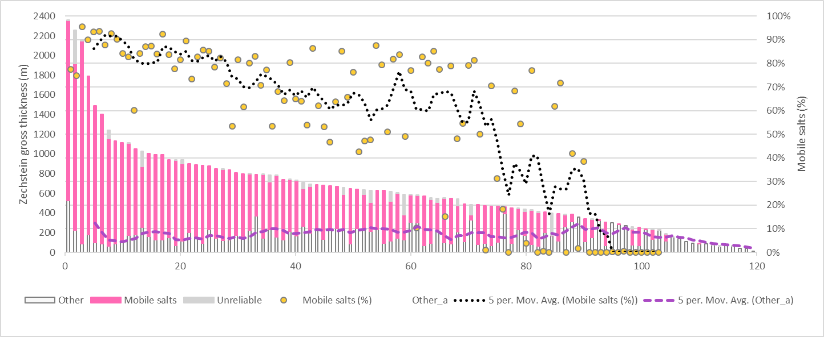
ZSG compositional variability x gross thickness
General increase trend of mobile salts as ZSG gross thickness increases (salt diapirs enriched in mobile salts).
Absence of mobile salts up to ~150m of ZSG gross thickness (related to original deposition in structural highs).
Thickness of the mechanically strong lithologies from the ZSG basal section presents subtle variations around an average of ~180 m.

Slide 20
Conclusions
Across the different salt structural domains, the base of the ZSG is dominated by mechanically strong layers such as anhydrite (minor polyhalite), carbonates and clastics.
This mechanically strong basal section presents subtle thickness variation across different salt structures (e.g. welds and diapirs), indicating a depositional (in situ) character.
The mechanical behaviour of this section suggests that these rigid layers were not involved in the salt deformation and were not removed by salt flow. Reasons: increased boundary drag effect (slower flow velocity on the borders of the section) and coupling with underlying rocks (Rotgliends Gr.) due to similar mechanical behaviour.

Slide 21
Conclusions
Salts welds in the Southern North Sea are not enriched in mechanically strong layers because they seems to be autochthonous but are depleted in mobile salts that flow into nearby diapirs.
(i-iii) Salt inflation
Imobile lithologies
(i) Primary
salt layer
Mobile salts
thinning
(ii) Salt
thinning
thinning
(ii) Salt
welding

Slide 22
Conclusions
The enrichment of thick salt domains in mobile salts is indicated by the increasing percentage of them as the ZSG gross thickness increases – Differential purification by movement (sensu Kupfer, 1968).

Slide 23
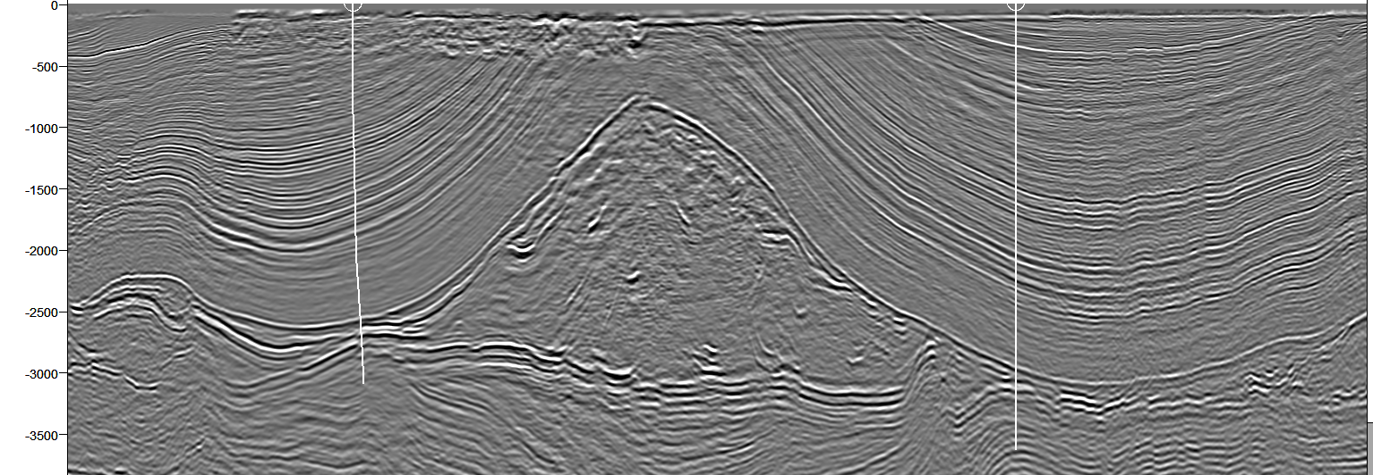
Conclusions
Primary welds composed predominantly of mechanically strong / brittle, immobile lithologies (e.g. carbonates, anhydrite, clastics). These lithologies may be more permeable and allow the existence of migration pathways between the sub- and supra-salt rocks and also influence how the deformation generated by the welding process is absorbed by the adjacent rocks.
Rheology and original evaporitic deposition are key to determine salt welds composition and thickness.
48/06-10
48/07b-4
+
-
V.E. 3x
2 km
D
D’
Top Zechstein
Base Zechstein

Slide 24
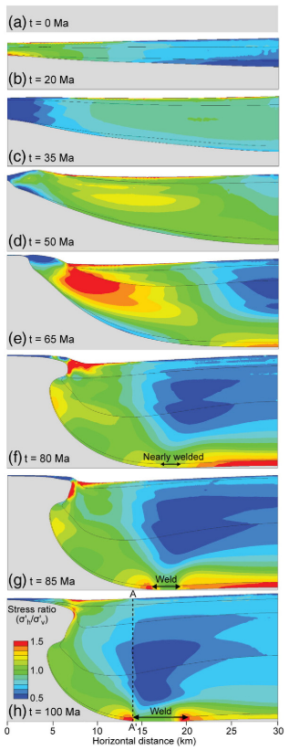
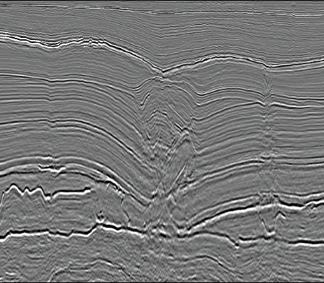
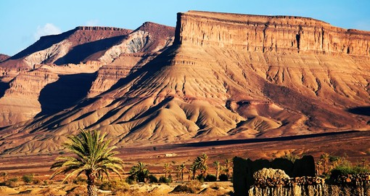
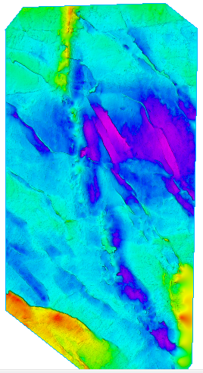
What’s next ?
Salt welds in different tectonic settings
Capacity to transmit or seal fluids
Effects of welding in sub- and supra-salt rocks
Additional seismic interpretation
Field work – Atlas, Morocco
Heidari et al. 2016
Geomechanical modelling

