Slide 1
Renaissance of North Sea Salt Tectonics: Late Permian and Triassic Salt Tectonics of the Central North Sea
Oliver Duffy*
Christopher Jackson
Hector Barnett
Tim Dooley
Gabriela Salomão-Martins
Amir Joffe
Naiara Fernandez
Gillian Apps
Frank Peel
Maria Nikolinakou
Mike Hudec
*Contains information provided by the Oil and Gas Authority and/or other third parties
*OGL Crown Copyright. Contains public sector information licensed under the Open Government Licence v3.0
a
Data:
Software:

Slide 2
Why Study the Central North Sea? Hydrocarbons and Gas Storage Potential
Jackson and Stewart (2017) – see also Jackson and Hudec; Salt Tectonics: Principles and Practice
The Triassic interval is poorly-understood and under-explored in terms of play potential – new salt tectonic understanding needed to develop Triassic plays
Recent studies have shown new hydrocarbon discoveries and plays within the Upper Permian Zechstein:
intra-Zechstein clinoform foresets (sulphate-carbonate platform) shown to be attractive exploration target (Patruno et al., 2017)
Deeper understanding of Late Permian salt tectonics likely to drive new intra-Zechstein exploration
Also important in terms of storage potential for captured CO₂

Slide 3
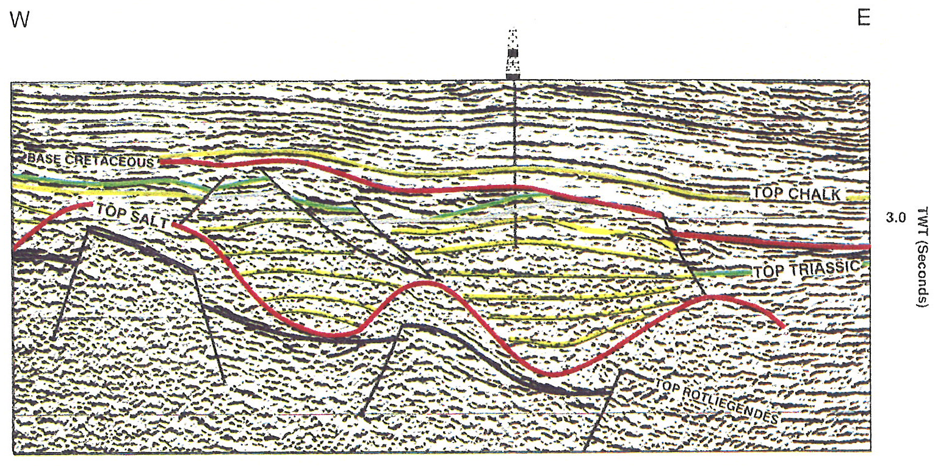
Why Study the Central North Sea Now? New Data and Concepts
Hodgson et al., (1993)
DISKOS NPD Map - 3D seismic data availability
Data Wealth and Quality:
DISKOS (Norway) and OGA (UK) have provided access to a vast library of seismic and well data with minimal confidentiality constraints
Data quality has improved significantly since 90’s when key concepts constrained
New Salt Tectonic Concepts:
Although a widely studied basin over the last 50+ years, many of the salt tectonic concepts in use today were developed in the 90’s
Since then, there have been developments in salt tectonic concepts (e.g. minibasin behaviour, intrasalt layering, minibasin translation, role of base-salt relief)
Mueller et al., (2019) - PGS

Slide 4
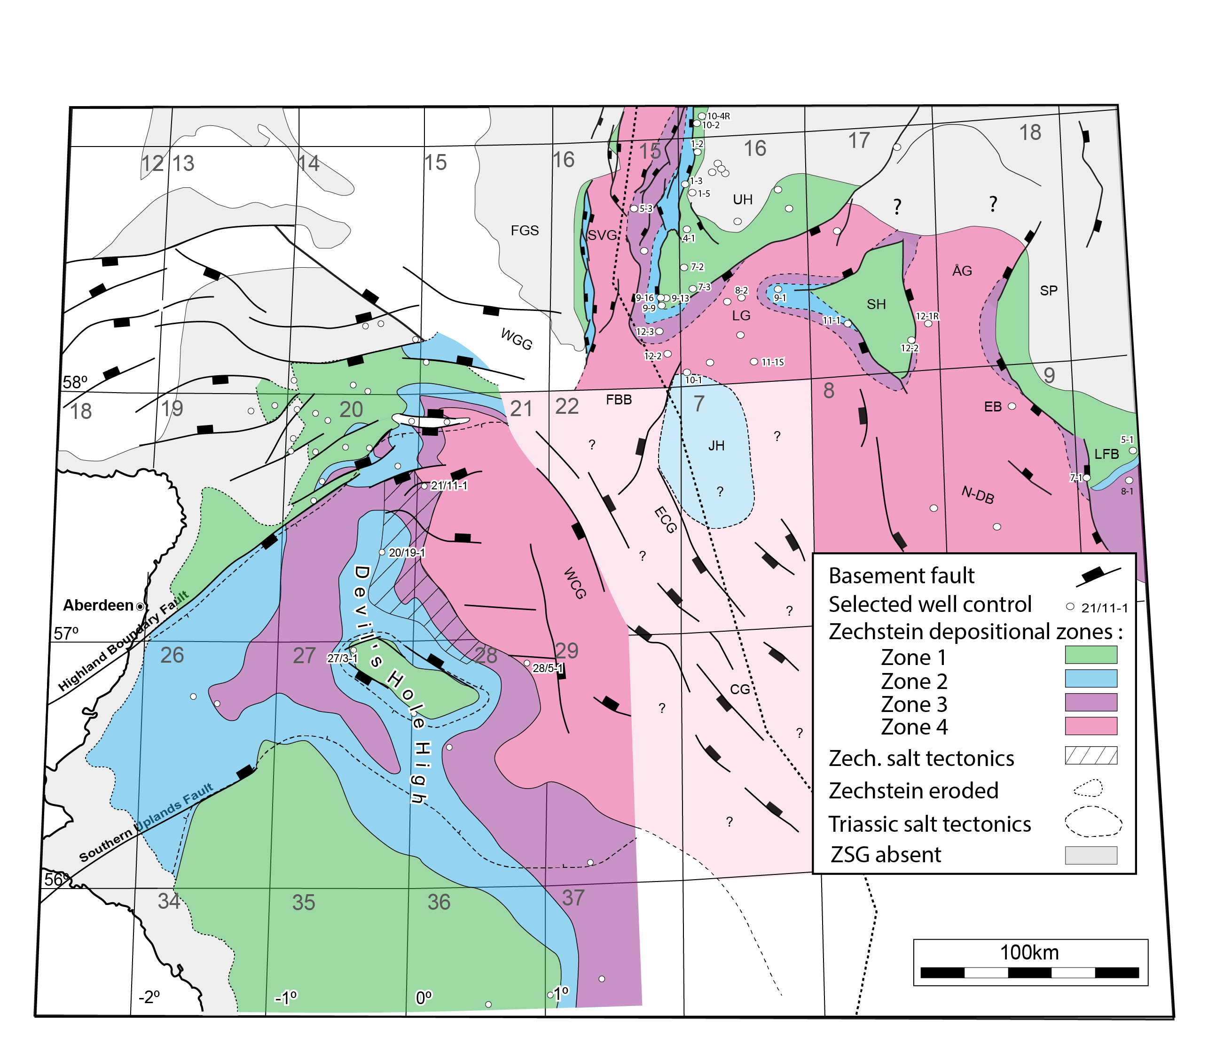
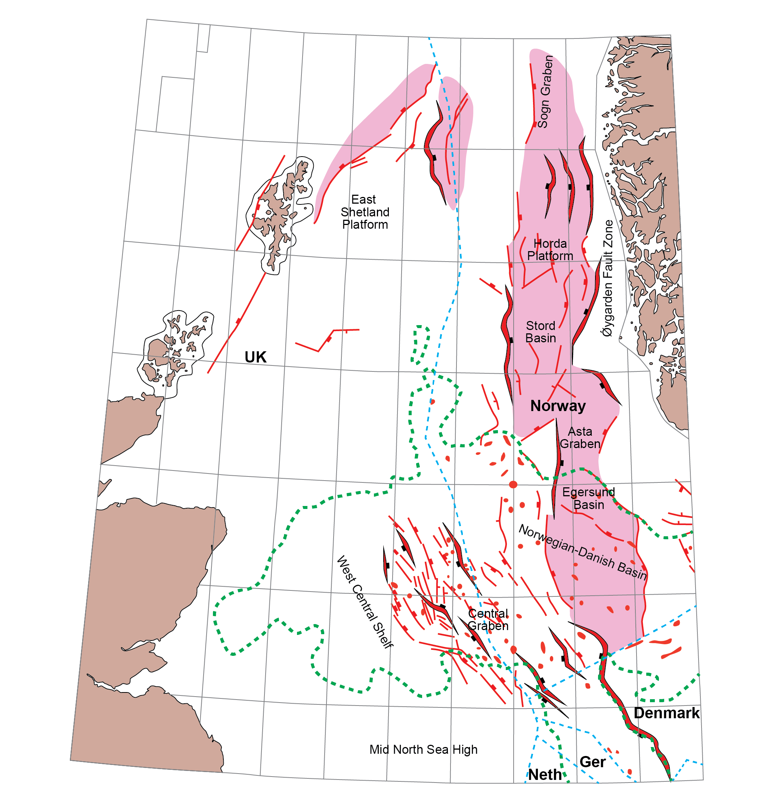
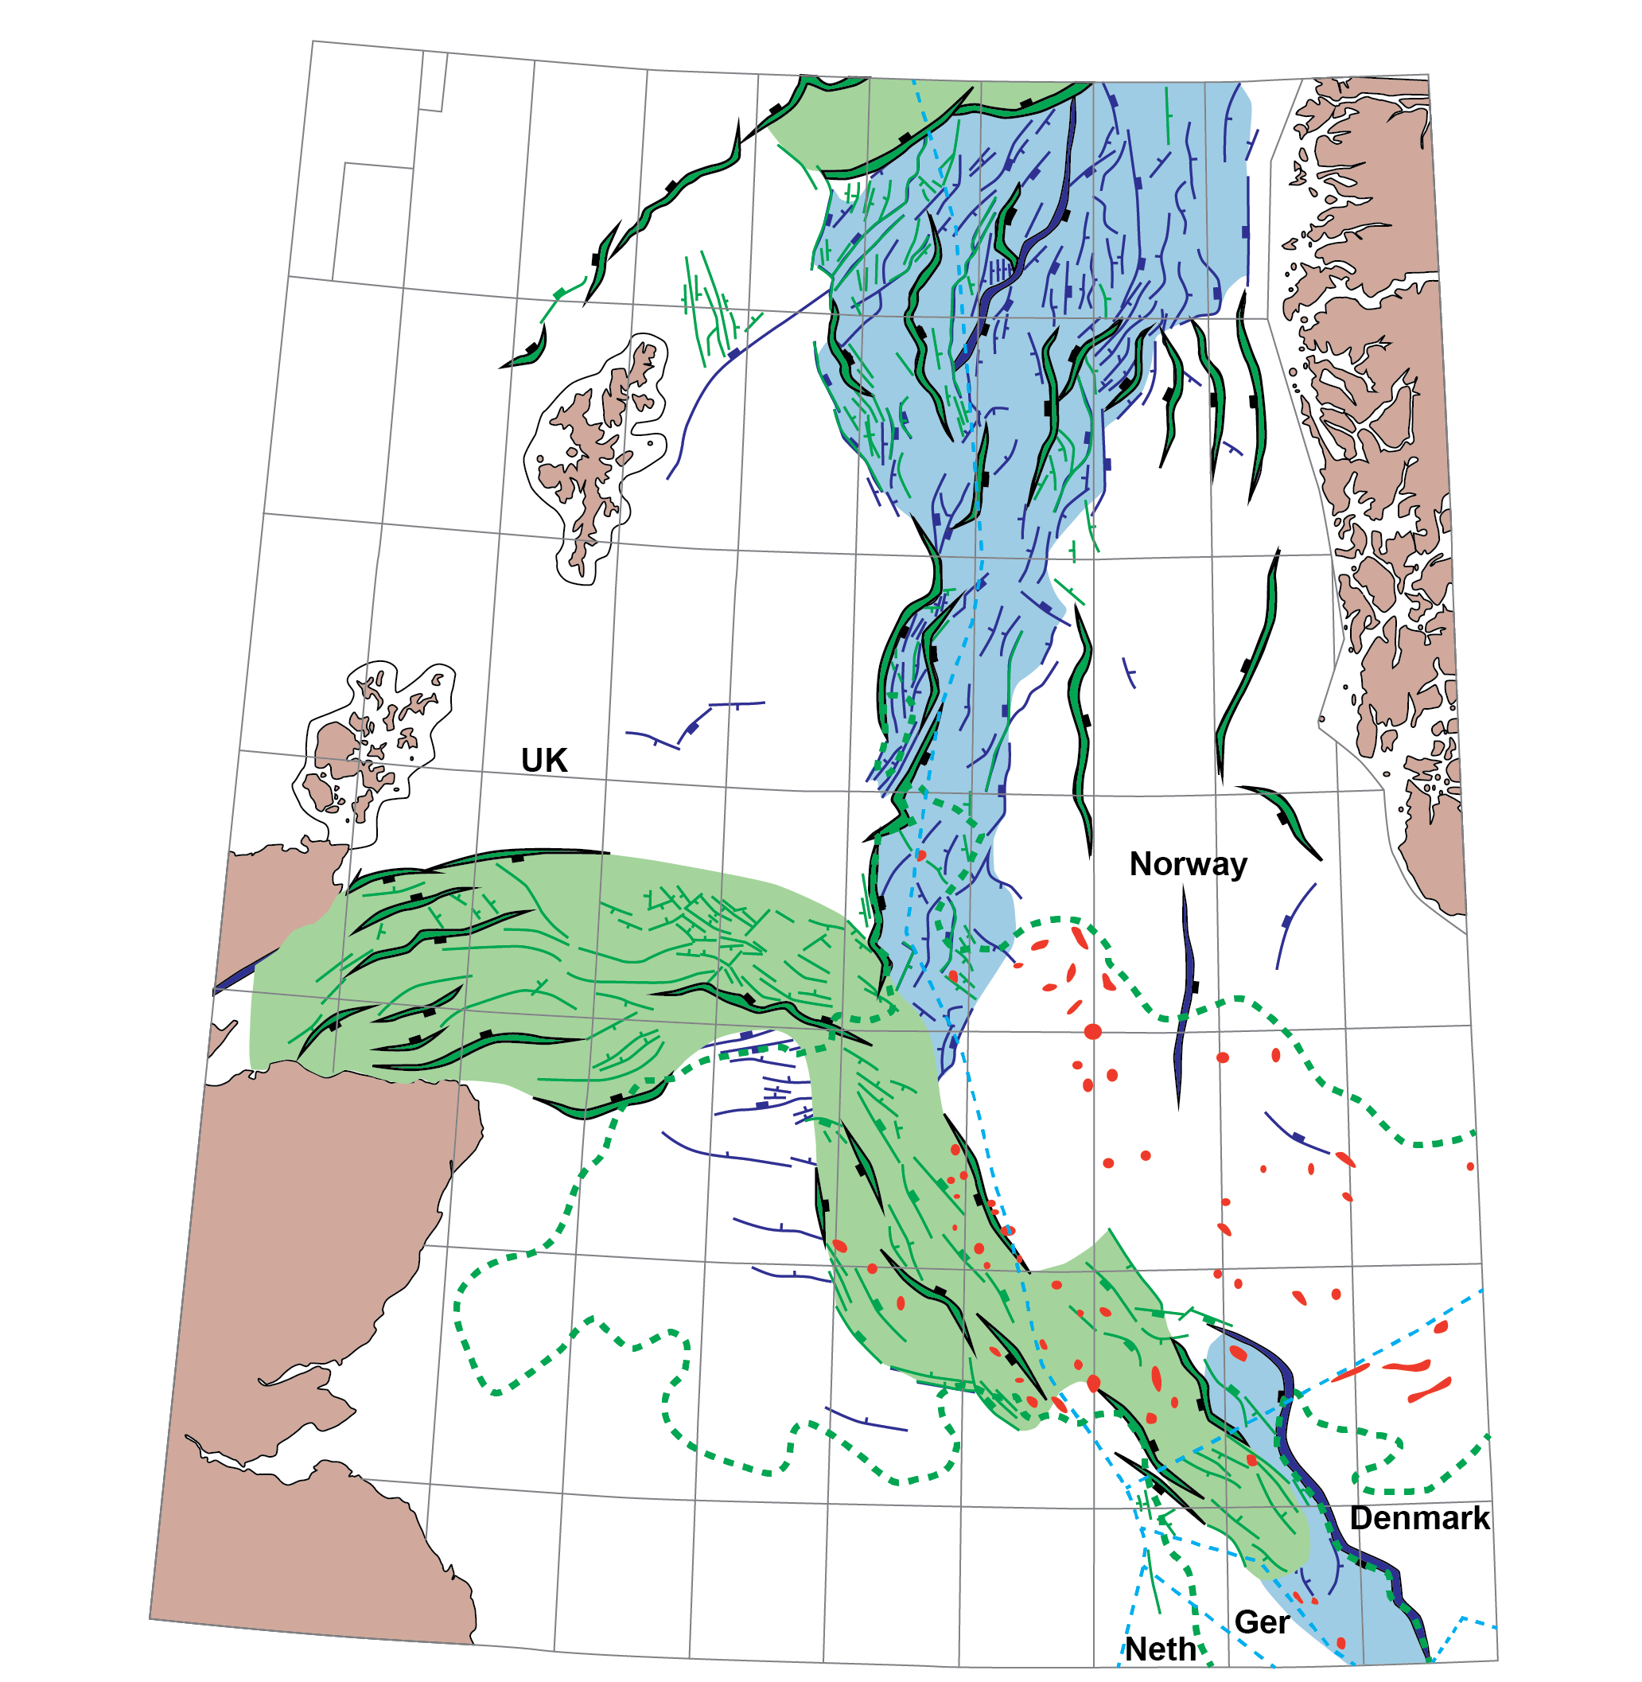
Geological Overview
Redrawn from Millennium Atlas
Redrawn from Millennium Atlas
Clark et al. (1998) and
Jackson et al. (2019)
Notes:
Zechstein Supergroup is a layered evaporite sequence containing 5 evaporite sequences (Z1-Z5)
Zechstein Supergroup deposited over a pre/syn depositional rift topography
Carbonate-dominated on rift highs and around basin margin; halite-dominated in lows and basin centre
Marked variations in salt tectonic style between different depositional zones due to variations in mobility of the Zechstein Supergroup
Influence on diapir and minibasin behavior, regional salt tectonic systems etc yet to be fully explored

Slide 5
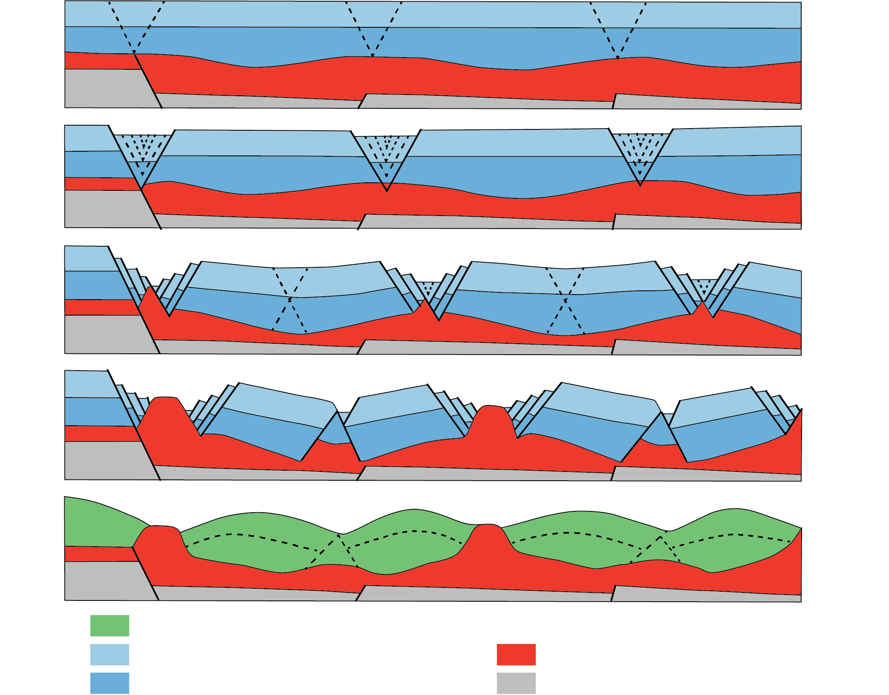
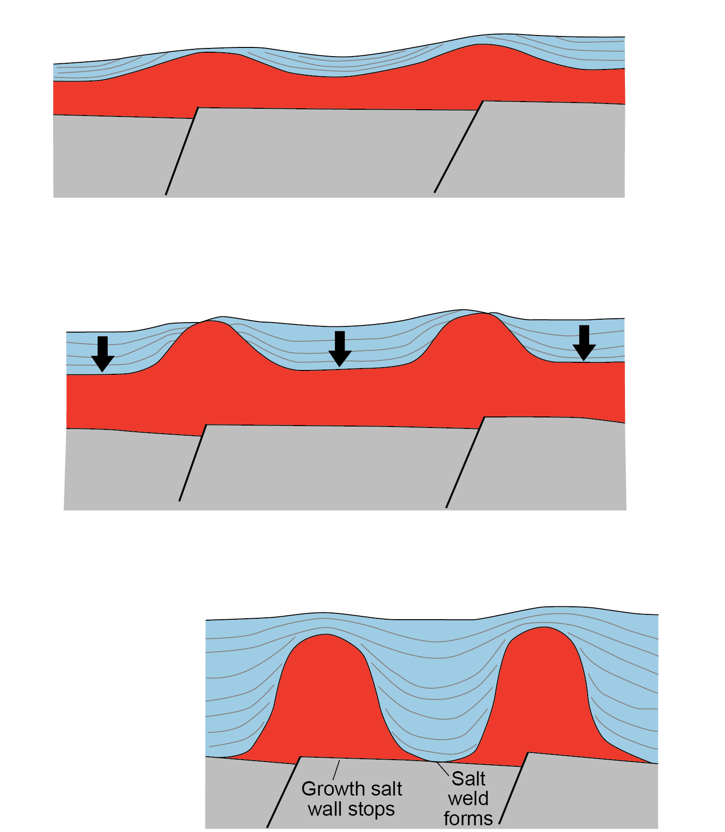
Theme 1: How Were Diapirs Triggered?
Stewart et al. (1999) suggest that no one trigger mechanism influences the entire basin; it is spatially-variable between platforms and grabens
Attempted to map out areas with different triggers, but large areas of no data, and restricted imaging offshore Norway
We will re-examine this in light of new data and concepts
What other mechanisms could come into play? Differential loading? Thin-skinned shortening? Thin-skinned extension?
Rift-raft model (Penge et al.,1993)
Pod model (Hodgson et al.,1993)
Effectively reactive diapirism
Occurs in Jurassic
Effectively passive diapirism
Occurs in Triassic
Notes:
Two theories for diapir and minibasin triggers in the CNS and NNS – rift-raft model and ‘pod’ model

Slide 6
Theme 2: Structural Style and Evolution of Salt Walls
Salt walls vary in length, height, orientation, connectivity and 3D geometry across the basin
Wealth of data and tightly-constrained tectonics provides an exceptional opportunity to examine salt walls in regional context
What is controlling the 3D geometry, composition and evolution of these salt walls?
10 km
20 km
50 km

Slide 7
Theme 2: Structural Style and Evolution of Salt Walls
Understanding the 3D geometry, composition and evolution of salt walls is crucial for:
i) constraining velocity models and improving seismic imaging of walls
ii) understanding drilling risks when drilling close to, or through salt
iii) identifying new potential reservoirs and traps near salt walls
We will integrate observations from seismic data with physical and numerical models to understand:
What are the main salt wall geometrical styles?
Why do salt walls and flanking minibasins show marked along and across-strike variations in structural style?
How do salt walls grow?
How, why, and where do some walls transition into shallow stocks?
Are there spatial and temporal patterns in salt wall growth across basins? If so, why?
How does salt flow in walls?
How do the following influence salt wall growth and geometry:
LES
Trigger mechanism
Basement faults
Source and direction of sediment input
26 km
Physical model of a salt
wall (courtesy of Tim Dooley, AGL)
Central North Sea salt wall
Numerical model of extensional diapir (courtesy of Maria Nikolinakou et al AGL)

Slide 8
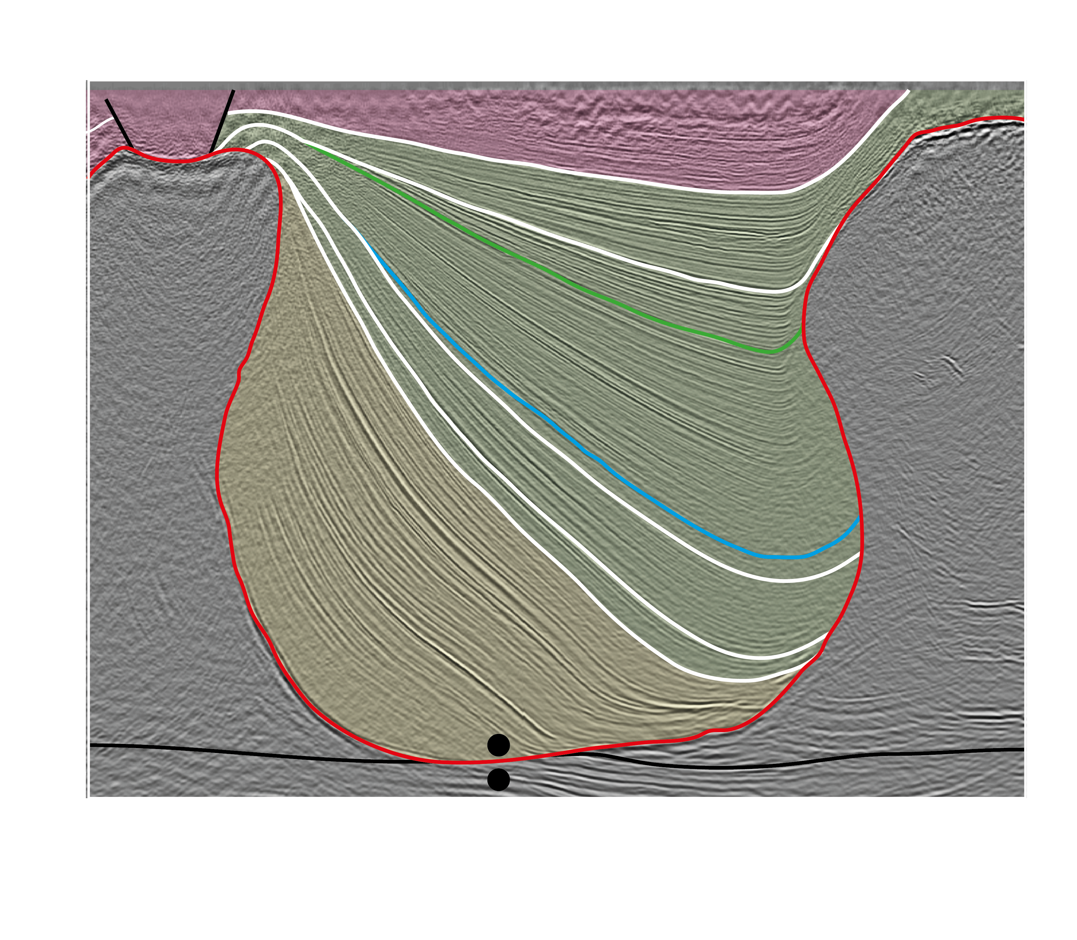
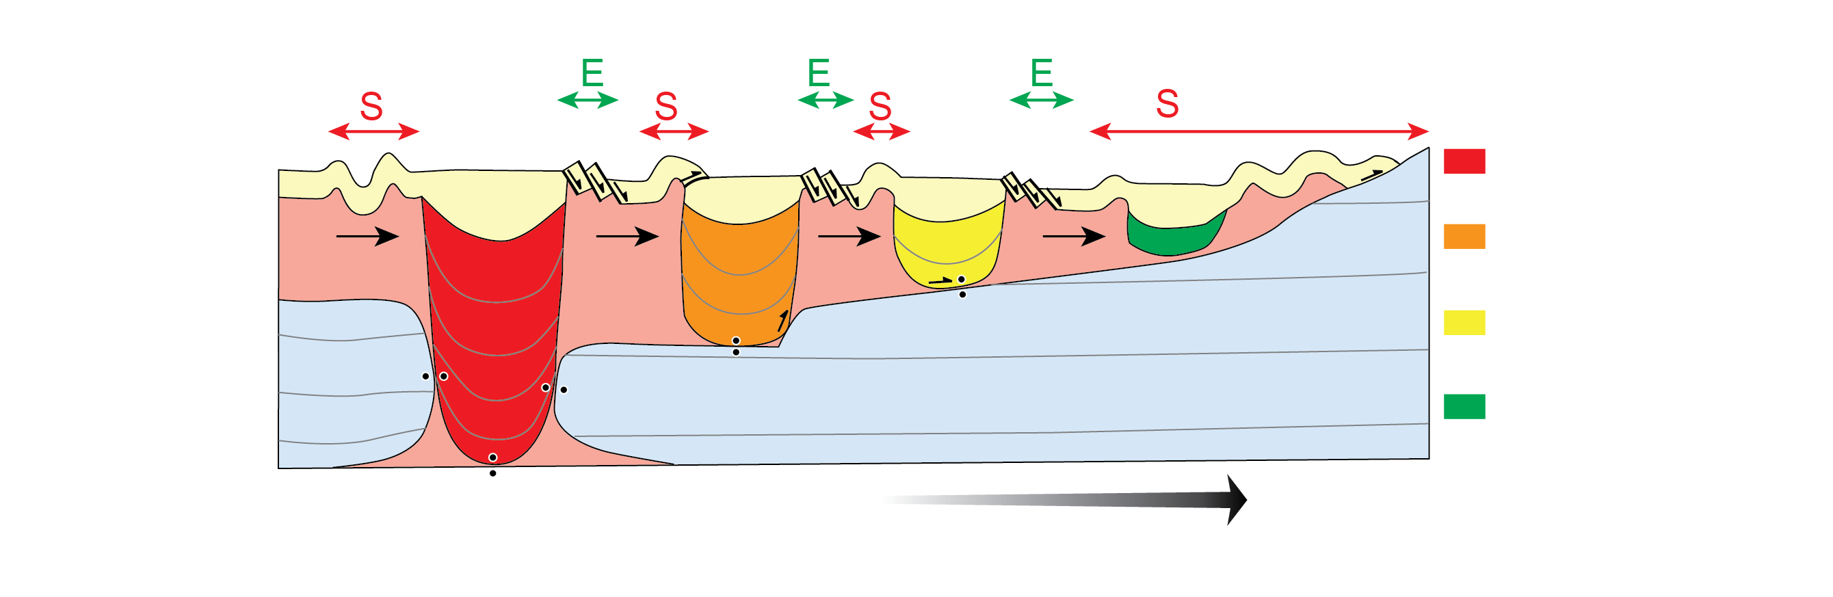
Theme 3: How do Minibasins Subside and Translate?
Recent AGL projects on the Precaspian Basin and the northern Gulf of Mexico have addressed how minibasins subside, interact, and translate, as well as how depositional systems respond to these processes
Such studies can help constrain:
The location and distribution of supra-salt reservoirs and traps
Local minibasin kinematics and thus influence structural restorations and stress/strain/borehole stability analyses
Subsalt relief in areas of poor seismic imaging
Timing of minibasin welding and timing of hydraulic connectivity between sub- and supra-salt
We seek to apply a similar approach to examine the minibasins in the Central North Sea. Why?
Controls on 3D Subsidence History of Minibasins
salt
salt
wedges
bowls
Jackson et al. (2020) Basin Research
Minibasin Interaction During Subsidence
Minibasin Translation and Obstruction on Salt-Detached Slopes
Fernandez et al. (2020) Petroleum Geoscience
Duffy et al. (2019) Basin Research

Slide 9
Theme 3: How do Minibasins Subside and Translate?
Well-imaged minibasins showing variable tilts and interactions with rift-related faults
~10 km
Courtesy of DISKOS (NPD)
ms TWT
Tr
Tr
Isolated minibasins surrounded by polygonal network of salt walls
50 km
ms TWT
What is novel about Central North Sea minibasins?
How did minibasins subside, interact and translate through layered evaporites?
Did minibasins interact with rift-related base-salt topography? Have minibasins translated laterally through time?
Why did minibasins subside when the overburden was relatively thin?
10 km
Courtesy of OGA
Minibasins with variable geometries and subsidence histories; likely influenced by variations in the proportion of non-halite lithologies in the Zechstein

Slide 10
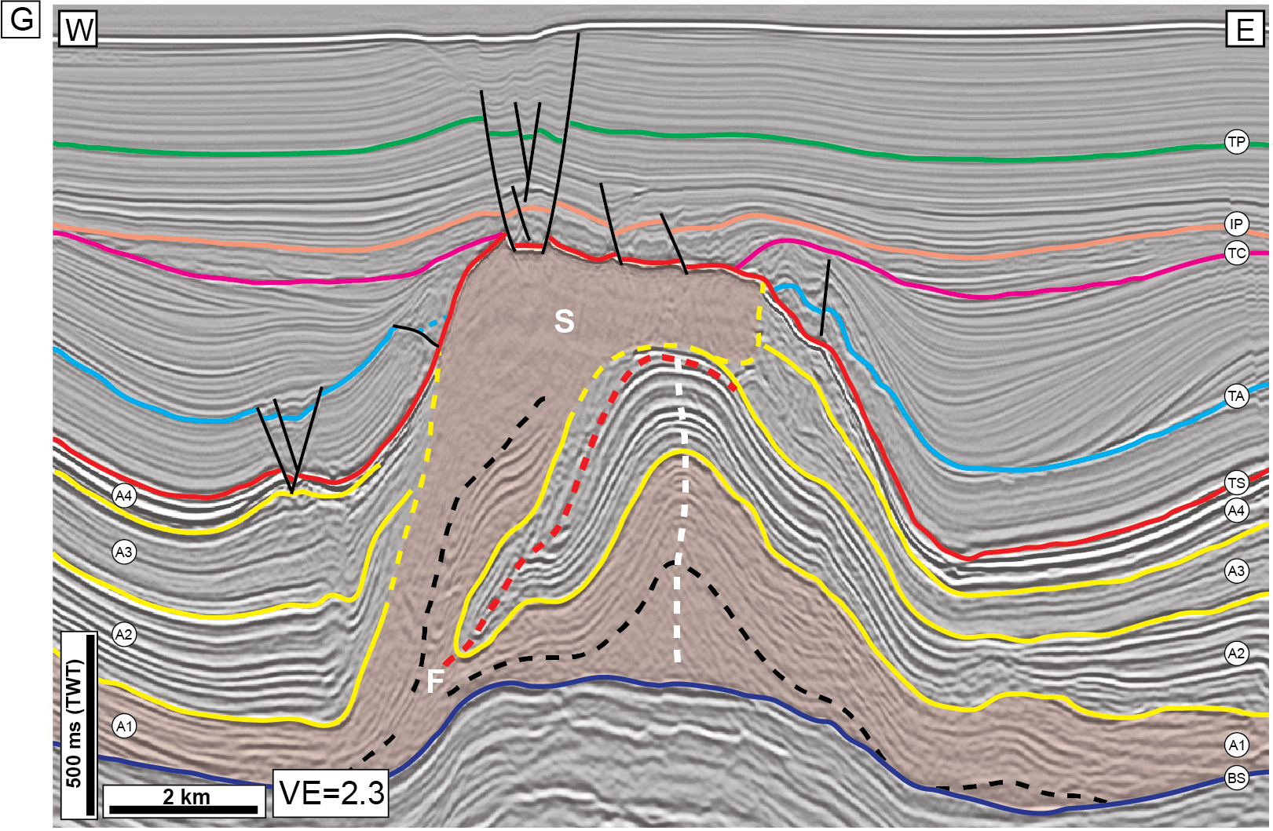
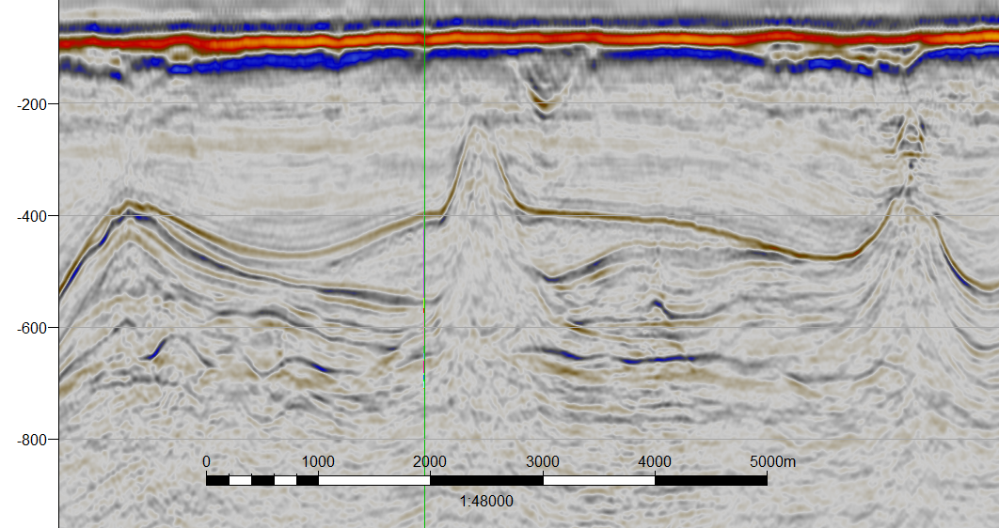
Theme 4: Intra-Zechstein Salt Tectonics
Jackson et al. (2015)
Courtesy of OGA
Layered evaporite sequences (LES) are common in salt basins around the world (e.g. offshore Brazil, Levant Margin, North Sea)
Recent work (Dooley et al., 2015; Jackson et al., 2015) show how density stratification and inversion within LES can drive intense salt tectonics within the LES
Zechstein Supergroup is a layered evaporite sequence containing 5 evaporite sequences (Z1-Z5) – could similar processes be ongoing in the Central North Sea
Forth Approaches Basin of interest….
Dooley et al. (2015)

Slide 11
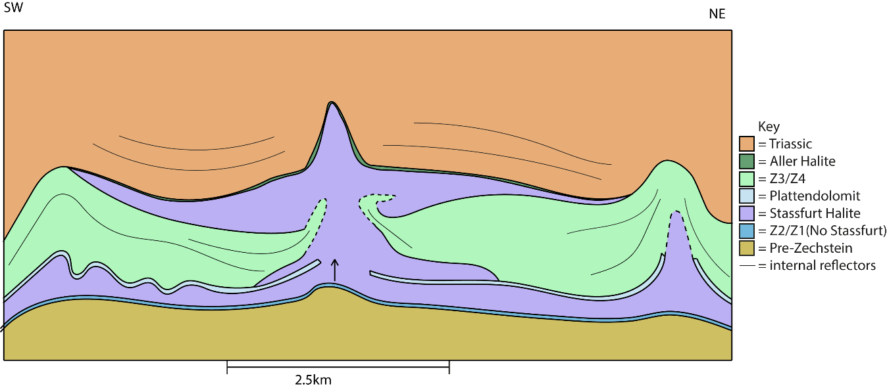
Theme 4: Intra-Zechstein Salt Tectonics
Hector Barnett MSc Pet Geo Thesis (2020) – Imperial College London
Seismic and petrophysics study in the Forth Approaches Basin (Hector Barnett MSc project) indicates potential for density inversion tectonics within the Zechstein Supergroup
Density stratigraphy (present-day densities) - Plattendolmit (Bottom Z3) sits directly above the Stassfurt Halite (top z2) and is higher density. Driven density inversion?
Zechstein Supergroup is layered elsewhere in the Central North Sea – could processes related to density overturn be widespread?
Such processes could have major implications for drilling hazards, velocity models, and identifying intra-Zechstein
reservoir/trap potential
Table of all wells present within the Forth Approaches Basin, with applied density units, average density, and thickness (yellow boxes indicate incomplete RHOB logs so density partially interpreted)

Slide 12
Theme 5: Influence of Zechstein Facies and Mobility on Structural Style
Courtesy of DISKOS (NPD)
5 km
ms TWT
Tr
Tr
Tr
Tr
Zone 1:
carbonate-dominated,
simple structure
Increasing thickness and proportion of halite
Increasing mobility of Zechstein
Zone 4: halite-dominated,
diapirs and minibasins
Compositional variations in the Zechstein Supergroup shown to influence first order structural style e.g. presence vs absence of diapirs (Clark et al. (1998) and Jackson et al., (2019))
However, scope to expand on and quantify how compositional variations in the Zechstein influence:
Trigger mechanisms and styles of diapirism across the basin
Timing of salt tectonic activity
The 3D geometries of salt structures that develop
The style and extent of gravity-driven systems
Study of direct value given recent discoveries within the Zechstein Supergroup
Jackson et al. (2019) (UK portion
from Clark et al. (1998))

Slide 13
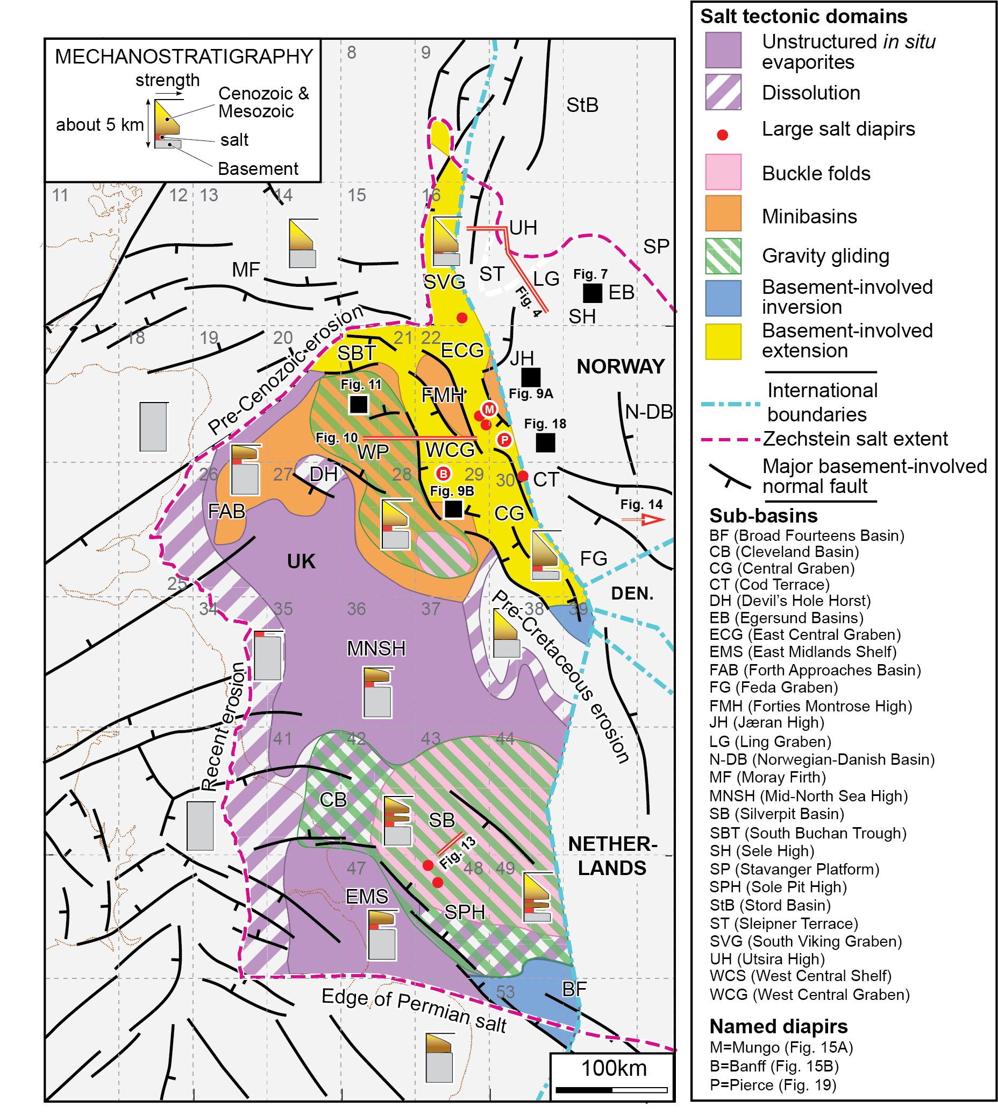
Theme 6: Triassic Regional Synthesis
Undertake a regional-scale synthesis of Late Permian and Triassic salt tectonics
Aim to test the Karlo et al. (2014) model of Triassic salt tectonics in the Central North Sea
Controversially proposes basin margin shortening and basin centre uplift during Triassic
If correct, major implications for sediment routing, salt tectonics, geodynamics, structural restorations, and play concepts etc.
We will integrate fidings from other themes and:
Develop a relative seismic-stratigraphic age framework for the Triassic interval
Analyse the 3D geometry and kinematics of salt structures across the basin
Examine spatial and temporal patterns of salt tectonics and depocentres
Initial results indicate generalized salt tectonic domains of Karlo et al. (2014) may be oversimplified
Stewart (2007) GSL Spec. Pub
Karlo et al (2014) Interpretation

Slide 14
Conclusions
Central North Sea is ready for a sustained research effort on salt tectonics in light of abundant new data and new salt tectonic concepts
Reconnaissance work has constrained key research themes that tie to, and build on recent research strengths:
Diapir trigger mechanisms
Salt wall geometry and growth
Minibasin subsidence and translation
Influence of variable salt composition and mobility on structural style
Findings from each theme to be integrated to develop a regional synthesis of Late Permian and Triassic salt tectonics
This synthesis will test the novel yet controversial model for Triassic salt tectonics in the Central North Sea presented by Karlo et al. (2014)
50 km
26 km

Slide 15
Research Proposal – Please Get In Touch
The Central North Sea is ready for a sustained research effort on salt tectonics in light of new data and concepts
AGL collaborating with University of Manchester (Prof. Chris Jackson), and the University of Bergen (Prof. Rob Gawthorpe and Prof. Atle Rotevatn) on RCN research proposal (due Feb 2021)
Proposal funding would help hire PhD students and Post-docs (number determined by industry interest)
We seek two or more industrial partners interested in CNS exploration to share 20% of total funding we request from RCN
We are happy to shape our preliminary proposal to suit industry interests
Please get in touch if interested
Thank you!
Please contact oliver.duffy@beg.utexas.edu and c.jackson@imperial.ac.uk for expressions of interest and for further details

Slide 16
References
DOOLEY, T.P., JACKSON, M.P.A., JACKSON, C.A.L., HUDEC, M.R. & RODRIGUEZ, C.R. (2015) Enigmatic Structures within Salt Walls of the Santos Basin-Part 2: Mechanical Explanation from Physical Modelling. Journal of Structural Geology, 75, 163-187.
DUFFY, O.B., FERNANDEZ, N., PEEL, F.J., HUDEC, M.R., DOOLEY, T.P. & JACKSON, C.A.L. (2019) Obstructed Minibasins on a Salt-Detached Slope: An Example from above the Sigsbee Canopy, Northern Gulf of Mexico. Basin Research.
EVANS, D. (2003) The Millennium Atlas: Petroleum Geology of the Central and Northern North Sea;[a Project of the Geological Society of London, the Geological Survey of Denmark and Greenland and the Norwegian Petroleum Society].
FERNANDEZ, N., HUDEC, M.R., JACKSON, C.A.-L., DOOLEY, T.P. & DUFFY, O.B. (2020) The Competition for Salt and Kinematic Interactions between Minibasins During Density-Driven Subsidence: Observations from Numerical Models. Petroleum Geoscience, 26, 3-15.
HODGSON, N.A., FARNSWORTH, J. & FRASER, A.J. (1992) Salt-Related Tectonics, Sedimentation and Hydrocarbon Plays in the Central Graben, North Sea, Ukcs. Geological Society London Special Publications, 67, 31.
JACKSON, C.A.-L., JACKSON, M.P., HUDEC, M.R. & RODRIGUEZ, C.R. (2015) Enigmatic Structures within Salt Walls of the Santos Basin—Part 1: Geometry and Kinematics from 3d Seismic Reflection and Well Data. Journal of Structural Geology, 75, 135-162.
JACKSON, C.-L. & STEWART, S. (2017) Composition, Tectonics, and Hydrocarbon Significance of Zechstein Supergroup Salt on the United Kingdom and Norwegian Continental Shelves: A Review. In: Permo-Triassic Salt Provinces of Europe, North Africa and the Atlantic Margins (Ed. by, 175-201. Elsevier.
JACKSON, C.A.L., DUFFY, O.B., FERNANDEZ, N., DOOLEY, T.P., HUDEC, M.R., JACKSON, M.P. & BURG, G. (2019) The Stratigraphic Record of Minibasin Subsidence, Precaspian Basin, Kazakhstan. Basin Research.
JACKSON, C.A.L., ELLIOTT, G.M., ROYCE‐ROGERS, E., GAWTHORPE, R.L. & AAS, T.E. (2019) Salt Thickness and Composition Influence Rift Structural Style, Northern North Sea, Offshore Norway. Basin Research, 31, 514-538.
KARLO, J.F., VAN BUCHEM, F.S., MOEN, J. & MILROY, K. (2014) Triassic-Age Salt Tectonics of the Central North Sea. Interpretation, 2, SM19-SM28.
PENGE, J., MUNNS, J.W., TAYLOR, B. & WINDLE, T.M.F. (1999). Rift-Raft Tectonics: Examples of Gravitational Tectonics from the Zechstein Basins of Northwest Europe, Geological Society Pub House.
STEWART, S. (2007) Salt Tectonics in the North Sea Basin: A Structural Style Template for Seismic Interpreters. Geological Society, London, Special Publications, 272, 361-396.
STEWART, S. & CLARK, J. (1999). Impact of Salt on the Structure of the Central North Sea Hydrocarbon Fairways. Geological Society, London, Petroleum Geology Conference series, Geological Society of London.

Slide 17
Central North Sea: A Natural Laboratory for Salt Tectonics
AGL is a research consortium University of Texas at Austin has been conducting innovative and multi-disciplinary salt tectonic research for over 30 years
Concepts and terminology pioneered by AGL have had a profound influence and are widely disseminated through the oil industry
started a multi-year study of Late Permian and Triassic salt tectonics of the Central North Sea
Wealth of seismic and well data available permits study of 100+ salt structures in the basin
Aim to build on recent AGL research themes (minibasin behaviour, salt wall evolution, LES etc) to develop:
concepts applicable to salt basins worldwide
deeper understanding of the Central North Sea region
Why is it time to take a fresh look at Central North Sea salt tectonics?

Slide 18
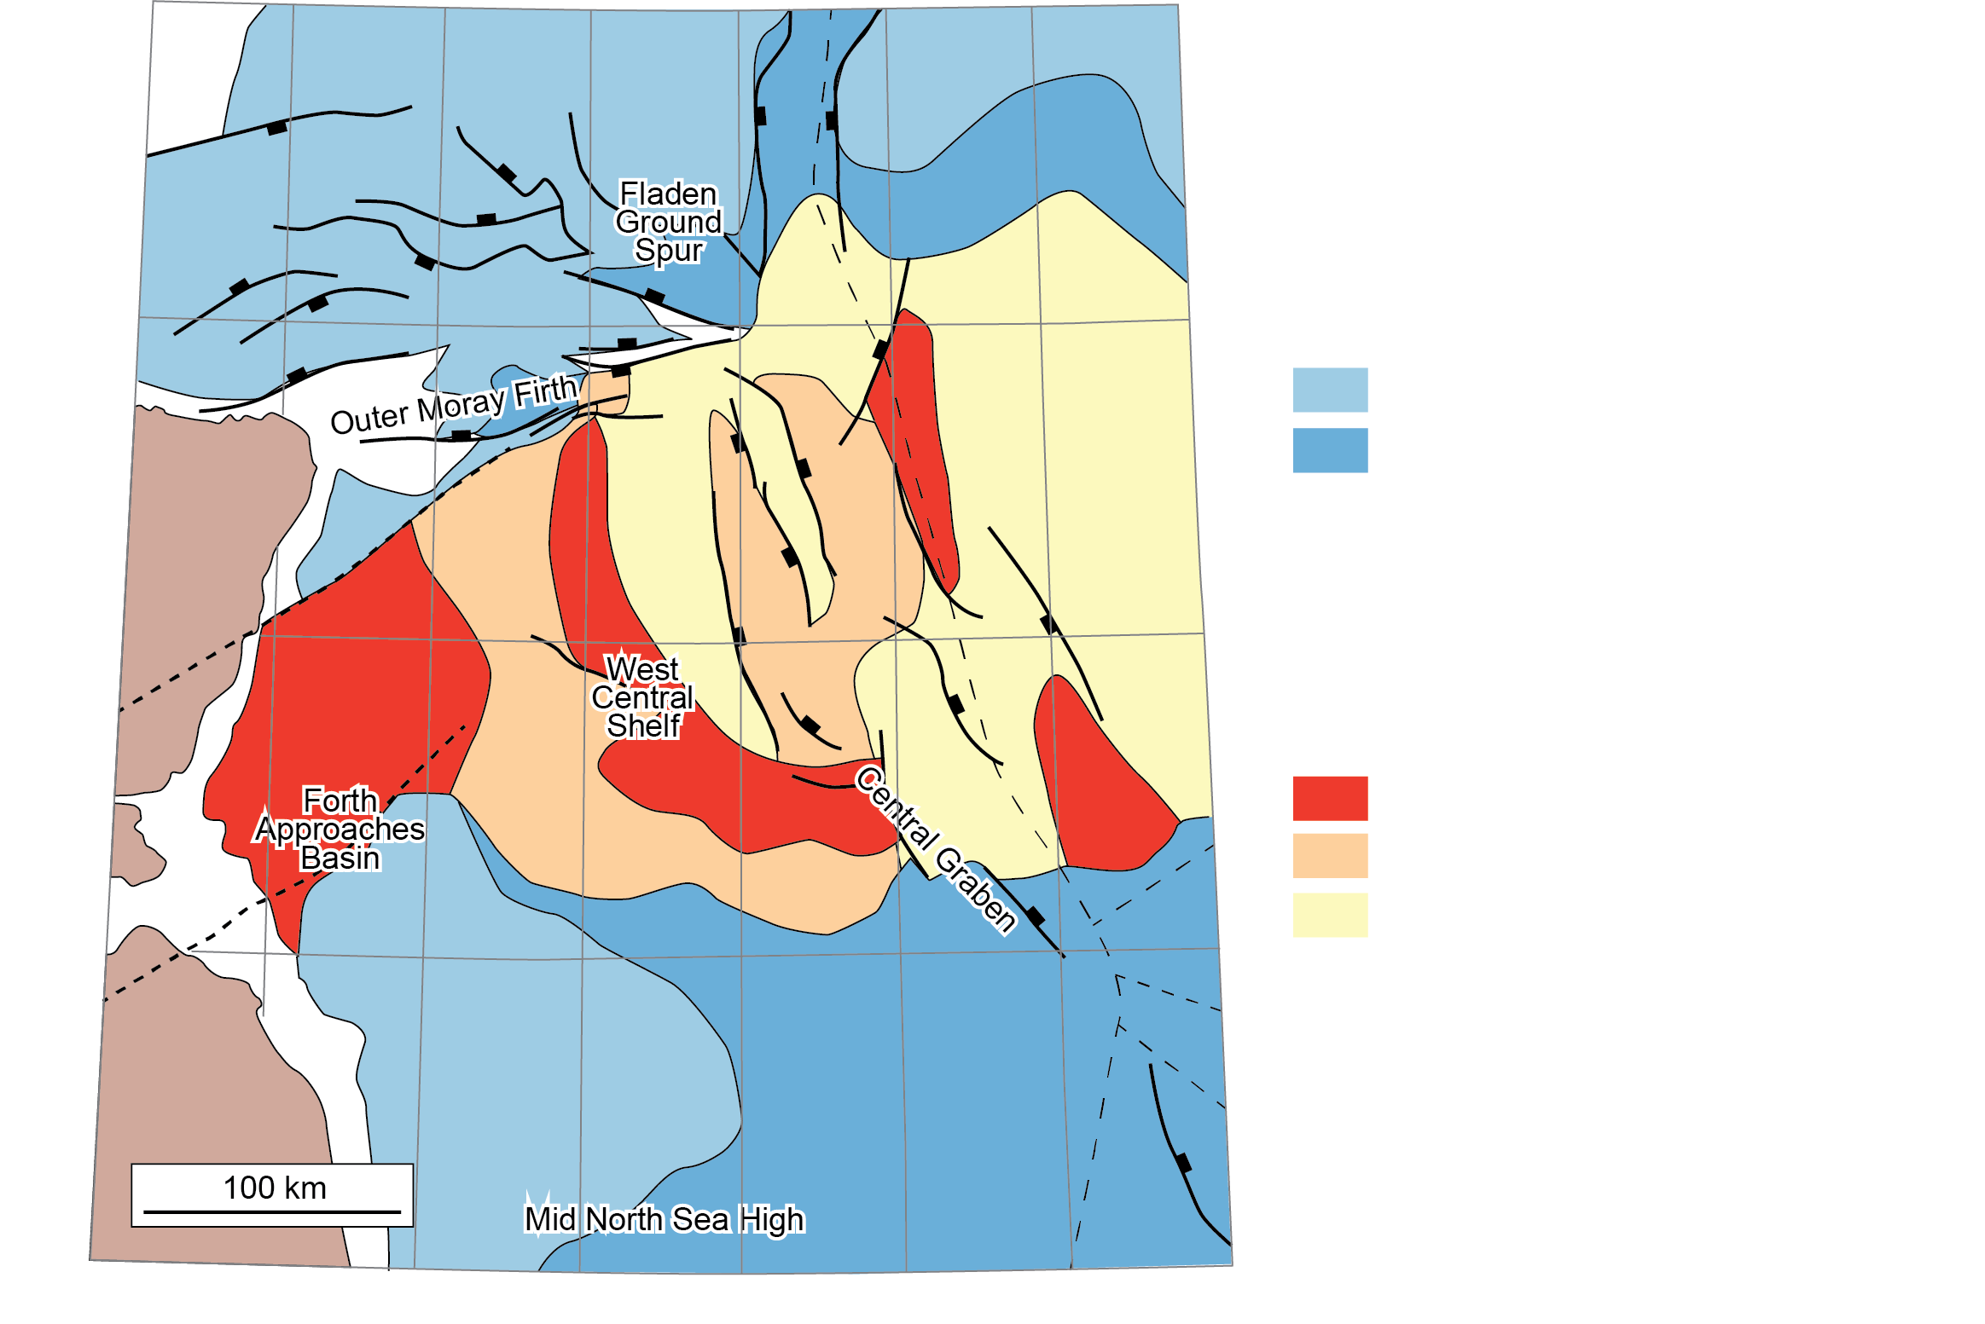
Theme 1: How Were Diapirs Triggered?
Stewart et al. (1999) suggest that no one trigger mechanism influences the entire basin; it is spatially-variable between platforms and grabens
Attempted to map out areas with different triggers, but large areas of no data, and restricted imaging offshore Norway
We will re-examine this in light of new data and concepts
What other mechanisms could come into play? Differential loading? Thin-skinned shortening? Thin-skinned extension?
Do the same concepts apply offshore Norway?
Stewart et al. (1999)
Geol. Soc. London

